Slide 1

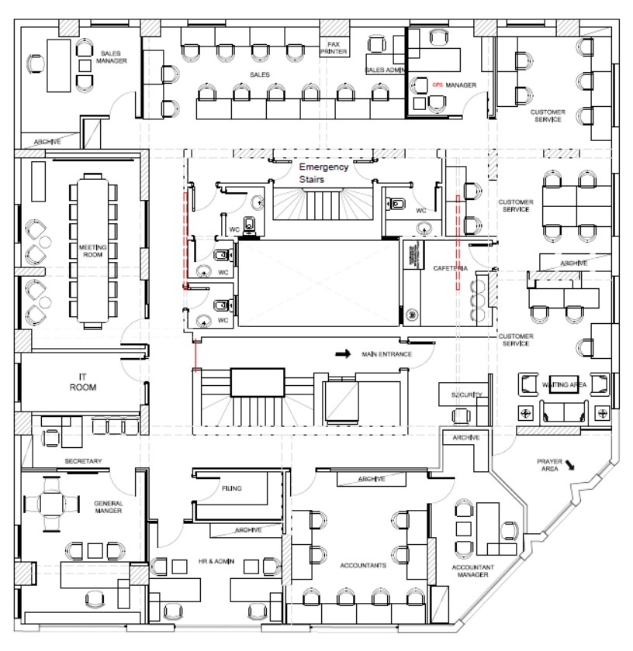














Country Office
Cairo, Egypt
You are here
Legend: Fire Extinguisher Fire Alarm First Aid Box Exit Point You

Slide 2
Country Office
Cairo, Egypt
You are here
Legend: Fire Extinguisher Fire Alarm First Aid Box Exit Point You

Slide 3

Country Office
Cairo, Egypt
You are here
Legend: Fire Extinguisher Fire Alarm First Aid Box Exit Point You

Slide 4
Country Office
Cairo, Egypt
You are here
Legend: Fire Extinguisher Fire Alarm First Aid Box Exit Point You

