Slide 1
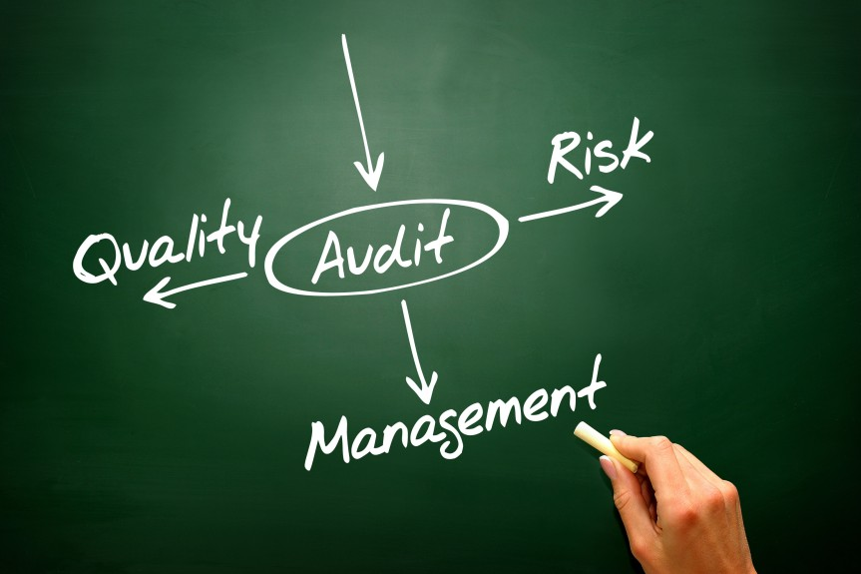


QRM
Part 1

Slide 2



Slide 3


The 9 Building Blocks of the Strategy Pyramid
AND
8.
CORPORATE
STRATEGY
9. RISK
7. BUSINESS STRATEGY
OPPORTUNITY
COMPETITIVENESS
5. CURRENT
6. TARGET
3. MARKET
DEMAND
4. INDUSTRY
SUPPLY
1. OUR BUSINESS
2. OUR AIMS

Slide 4

The 9 Building Blocks Explanation
CURRENT
COMPETITIVENESS
RISK & OPPORTUNITY
OUR BUSINESS
MARKET DEMAND
BUSINESS STRATEGY
What advantage do we have over the competition, Capabilities i.e. market share, cost factor, product capabilities, network,
Customer service, competitive position
Bridging the capabilities of each business, Optimizing the business portfolio, Leveraging resources. Should we invest? Should we hold? Should we exit?
Business segments of SMSA
Which segment delivers most profit
What is our market share
What is the demand anticipated in our industry.
Due diligence
Identify risk
Identify opportunity
01
02
03
04
05
06
07
08
09
OUR AIMS
INDUSTRY SUPPLY
COMPETITIVENESS -
TARGET
CORPORATE STRATEGY
How many players in the market
Does supplier exceed demands
Under supplier - Pricing can be set
Where we want SMSA to be in 3 years
Which parameter do we measure success
Identified gaps in the market
Product/ segment we need to compete-in
Do we need to diversify, enter areas not covered
Buy businesses

Slide 5





















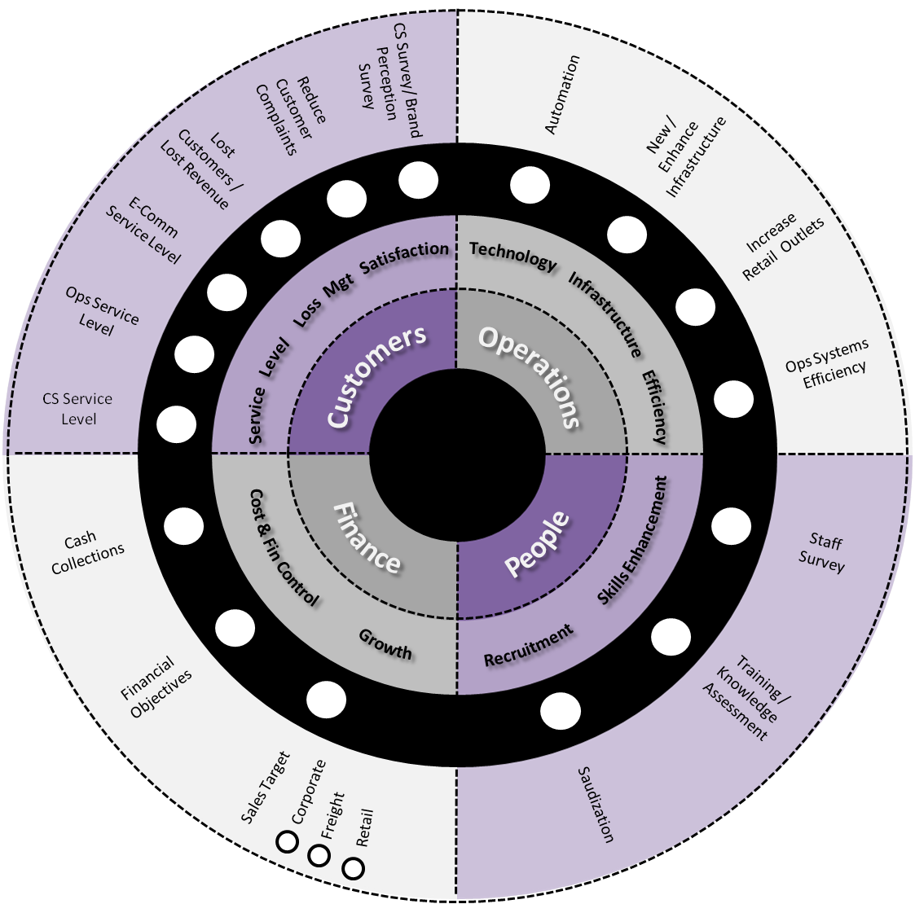



360° Strategy Planning
Clauses 6.2.1 & 6.2.2
MISSION
& VISION
CORE
VALUES
QUALITY
POLICIES
Stakeholders
Employees Opinions
Kaizen
Previous Results
Lessons Learnt
Risks
Opportunities
SWOT
Internal
Factors
Customer Survey
Brand & Market Survey
Mystery Shopping
Social Media Feedback
Vision 2030
Interaction Feedback
External
Factors
MS
Facebook
Instagram
Twitter
Emails
Chats
Strategy Committee
Consultant
Resources
Business Objectives
SMSA Wheel
Monetization
Actions
Sustainability

Slide 6

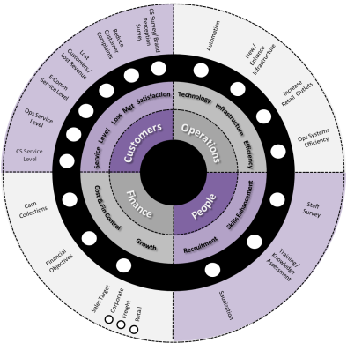
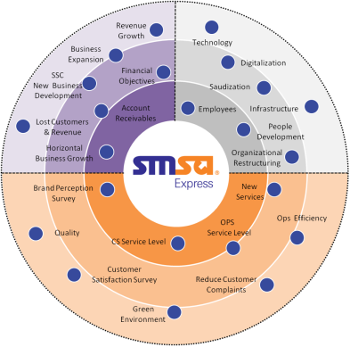











Strategy Formation
Actions transferred
& monitored
Country & Business Unit Wheel
Approved Strategy Radar
EACH COUNTRY HAS ITS OWN INDIVIDUAL STEERING WHEEL
KSA
USA
OMN
UAE
JOR
ZAF
KWT
EGY
BAH
QAT
HKG

Slide 7





Previous Strategy Logos
2023
5
2020
4
2016
3
Strategy
2013
2
2010
1

Slide 8




Strategy Journey Milestones
“SMSA Vision 2020”
New Vision/ Mission
Disaster Recovery test
Cold Chain Service
E-Learning introduced
Retail COD
New Riyadh Hub/ Station
SDC services in GCC (Bahrain)
Branding guidelines completed
Developed Fulfillment section
New SMSA customer website/portal
IATA certified trainers at Cat6 DG
Southern region Army initiative
Route optimization in all Stations
“Into the Future”
Introduction of the QMS (GUIDE)
ISO 9001:2008 Certification Awarded
Best Saudi Company Award 9th Place & 3rd Place
CORE Operation system
First employee video
Success story CISCO, HP & Microsoft
Industrial engineers hired
“Shift the Gear”
“SMSA Strategy 2023”
New certifications – TAPA & Bahrain - ISO9001:2015
Implementation of Professional Services
ISO Certification for Professional Services
Expansion of station facilities
LMX restructure
STAX implementation and Go Live
"Best Quality Service Contribution" Award from Huawei
Started NEOM city project
Service Centers are now paperless
Lockers (self check-in)
SMSA Service Center on wheels (Riyadh & Jeddah)
Introduced drop box in Banks
Established SMSA Support Services KSA & Bahrain
Develop new integration solution for new partners and customers
BCDR & Investigation systems
Acquired business in Kuwait & South Africa
Great Place to Work (GPTW) Certified organization
Cold Chain system for Pharma Customers
Dark Store
Outsourced Management System
Customer Feedback and Queuing System
MOH Projects & Blood Samples
EHS & TICSI Certification
New Incentive programs created
ERP
New Dammam Hub
Separate from FedEx
Freight department formed
New major contracts won in MRM
Re-engineer process of Mailroom
Expansion of DG business
New service – fresh/ bio-express
Smart ship
New IVR system for CSD
Female Call Center
POS in all Retail
New 3PL system
FIATA/ IATA Membership
GSA Agreements
Automated COD payments
VAT implementation
Staff award scheme introduced
Freelance application
New Logistics Warehouse
WHO-GDP, TAPA, ISO 10015, ISO 10002
Direct Services introduction (HKG, BAH, EGY, )
Standardization of SSC / Ops facilities (Cat ABC)
“Driving Excellence”
Introduction of electronic apps
New facility: Buraydah, Hafer Albaten, KFIA
Introduction of e-Commerce service
Healthcare Logistics
Nitaqat Program (Platinum)
SSHR System
E-Learning
Introduction of Finger Print Kingdom-wide
Social Media launch
Direct Service introduction Dubai , USA

Slide 9
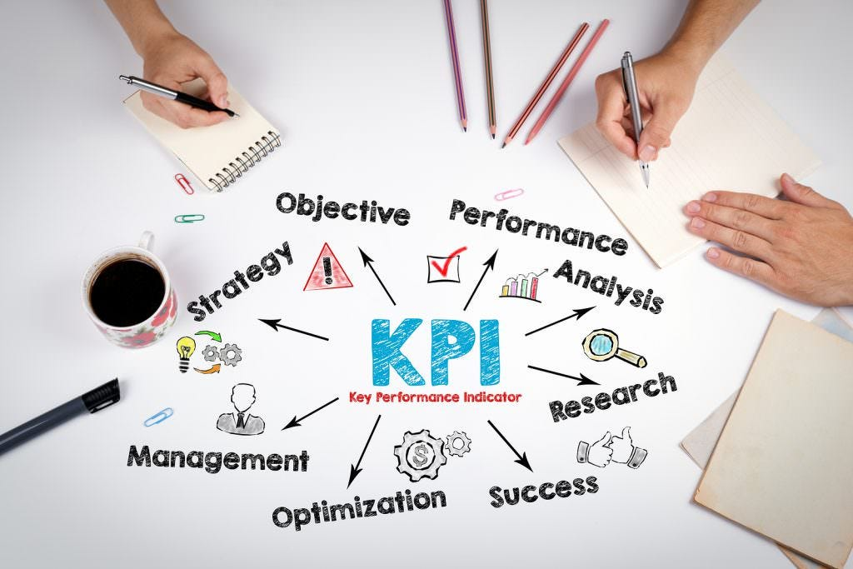


Slide 10
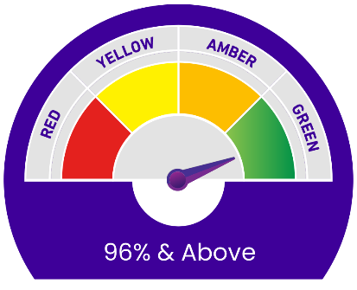
Levels of KPIs
01. Corporate
Corporate steering wheel
Analytical Dashboard for Performance Metrics
Goals Disseminated to business unit / country tiers
Accomplishments Reported Upward
02. Country / Business Unit
01
Business Unit / country steering wheel
Analytical Dashboard for Performance Metrics
Objective Distribution to Departmental Levels
Evaluation of Performance (Performance review)
Upward Reporting of Achievements
02
03
03. Departments
Department-Specific Objectives and Key Performance Indicators
Performance Monitoring Dashboard
Distribution of Objectives to Employees
Evaluation of Performance (Performance review)
Reporting Achievements to Higher Management
04
04. Individual
Goal settings
Evaluation of Performance (Performance review)
Upward Communication of Achievements

Slide 11
Aligning KPIs with Strategy
Supporting Metrics
What are the detailed monthly/ quarterly/ yearly results that support and augment the KPIs?
Key Performance Indicators
What measures of success are tied to the drivers?
5
Key Business Drivers
What are the important execution steps to meet the goals & objectives?
4
Goals, Objectives
What are the short and long term
objectives to achieve the strategy?
3
Over-all Business Strategy
What is the business trying to accomplish?
2
1

Slide 12

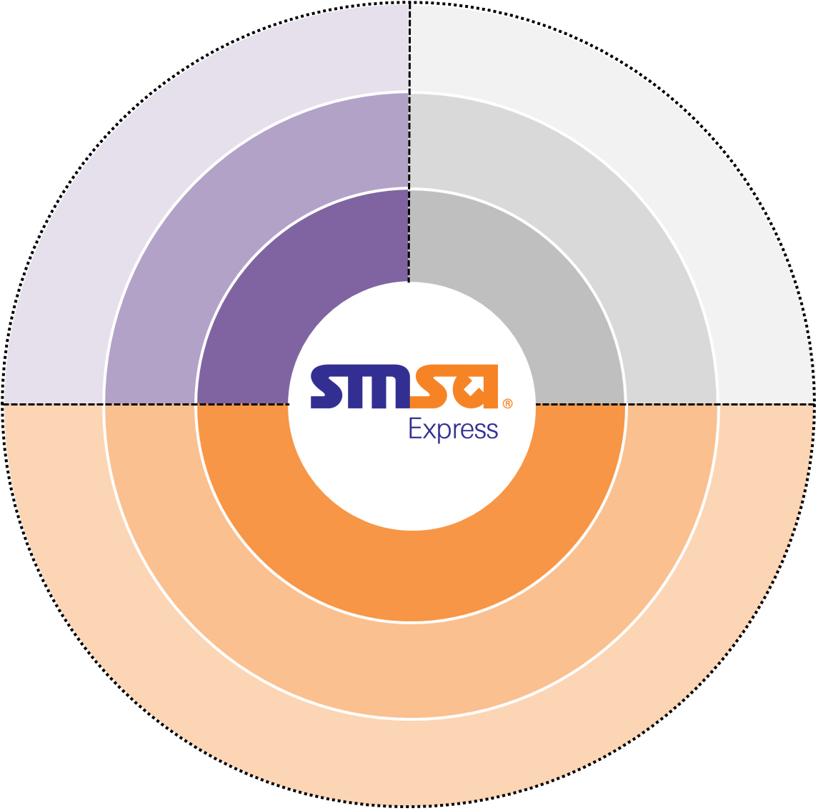





Strategy Radar
Revenue
Growth
Business
Expansion
Technology
Financial
Objectives
Digitalization
SSC
New Business
Development
Localization
Receivable collections
Employees
Infrastructure
Lost Customers
& Revenue
People Development
Horizontal
Business Growth
Organizational
Restructuring
Resource
Optimization
Brand Perception
New
Services
Quality
OPS
Service Level
Ops Efficiency
Weight 92.36%
Actual 95.68%
Corporate Social
Responsibility
CS Service Level
Segments
Customer Satisfaction
Reduce Customer
Complaints
RESOURCES
Green
Environment
SUSTAINABILITY
MONETIZATION

Slide 13
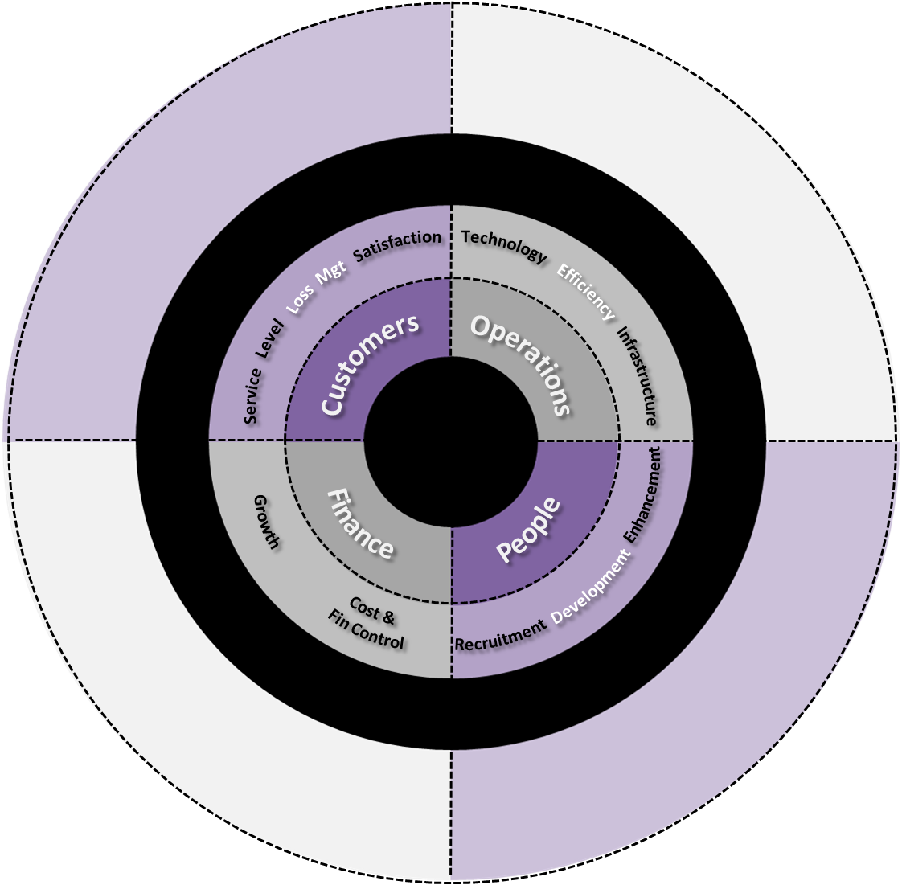
SMSA Steering Wheel
Customer Satisfaction
Brand Perception
Digitalization
Technology
Reduce
Customer
Complaints
Lost Customers
& Revenue
Ops Efficiency
Resource
Optimization
New
Services
Quality
OPS
Service Level
Business
Expansion
CS
Service Level
98%
Infrastructure
SSC
New Business
Development
Organizational
Restructuring
Horizontal
Business
Growth
Revenue
Growth
Training
CORP
SFD
Employees
SSC
Financial
Objectives
Account
Receivables
Localization
Achieved Weight : 100%
Achieved Percentage : 100%

Slide 14
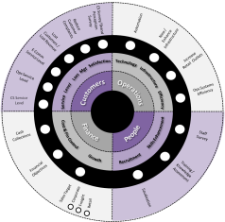
KPI Performance Color Coding
Red
85% and below
Yellow
86% to 90%
1
2
White
Not yet started
6
3
Amber
91% to 95%
5
4
Blue
On Hold
Green
96% and above

Slide 15

KPI Dashboard
Area | KPI No. | Description |  | Measurement Criteria | Value out of 100% | Value out of Overall Wt % | Yearly Target
O P E R A T I O N S | KPI-1 | Automation (New / Enhancement) | New Automation Automation of PAS (TRNG) 100% SMSA Chat Bot ( CSD) 100% Electronic Achieving (MRM) 0% ( plan to start from May and plan will be given) Oracle Fusion (FIN) 100% IT Data protection for new countries (IT) 100% E-Signature ( MKT) 100% Digital Sales Service ( RTL) 0% ( will be given in Sept LOG Automated (LOG) 100% | As per Plan | 30% | 9.00% | 100.00%
 |  |  | Enhance Automation Mobile App Ph5 DAT Center upgrade SMSA Auto Tool - SAM Heavy/ SAM Light Ph3 Enhance CRM SECOM & SDC Enhancement Ph3 SDC App – SDM System Whatsapp phase 2 Website enhancement | As per Plan **IT Dept | 30% | 9.00% | 100.00%
 | KPI-2 | OPS System Efficiency | Control Room Fleet 100% Automation sorting machine 0% | As per Plan ** OPS | 15% | 4.50% | 100.00%
 | KPI-3 | Infrastructure ( New / OLD) | As per plan | As per Plan ** Sami | 10% | 3.00% | 100.00%
 | KPI-4 | Increase Retail Outlets | 24 New Retails | As per Plan ** Bader | 15% | 4.50% | 100.00%
 | Total |  |  |  | 100% | 30.00%
 | OVERALL WEIGHT |  |  |  | 30%

Slide 16
KPI Dashboard
Area | KPI No. | Description |  | Measurement Criteria | Value out of 100% | Value out of Overall Wt % | Yearly Target
P E O P L E | KPI-1 | Staff Survey | As per plan | 87% Target ** Masoom | 25% | 2.50% | 100.00%
 | KPI-3 | Training / Knowledge Assessments | As per plan | 78% pass mark - 80% of untrained frontline attend training. ** Masoom | 40% | 4.00% | 100.00%
 | KPI-4 | Saudization | As per plan | To be maintained at 28%, As per HR Report ( 1st Q 25% , 2nd Q 26% , 3rd Q 27% ,4th Q 28%) ** Hassan | 35% | 3.50% | 100.00%
 | Total |  |  |  | 100% | 10.00%
 | OVERALL WEIGHT |  |  |  | 10%
Area | KPI No. | Description |  | Measurement Criteria | Value out of 100% | Value out of Overall Wt % | Yearly Target
F I N A N C E | KPI-1 | Financial Objectives | Quarterly measurement | As per Finance Report | 35% | 14.00% | 100.00%
 | KPI-2 | SMSA Revenue Target | Include (RTL , CORP , SFD) & International Business Development ( IBD) - As per target | As per Finance Report | 50% | 20.00% | 100.00%
 | KPI-3 | Cash Collection | As per target | To be achieved 94%, As per Finance Report | 15% | 6.00% | 100.00%
 | Total |  |  |  | 100% | 40.00%
 | OVERALL WEIGHT |  |  |  | 40%

Slide 17
KPI Dashboard
Area | KPI No. | Description |  | Measurement Criteria | Value out of 100% | Value out of Overall Wt % | Yearly Target
C U S T O M E R S | KPI-1 | CS Service Level | TSF % , Complaint Handling Survey Results , Social Media , Trace Handling , Inbound / Outbound calls survey % | To be maintained as per SLA Target 90% | 20% | 4.00% | 100.00%
 | KPI-2 | OPS Service Level | Dlvy Commitment : SFO , SFS , SSD , SPO - Int'l IB , Destination failure | To be maintained at 95% , As per CORE Report | 20% | 4.00% | 100.00%
 | KPI-3 | E-Com Service Level | Delivery commitments 85% from received packages to be delivered with in 3 days. | As per CORE report | 30% | 6.00% | 100.00%
 | KPI-4 | Reduce Customer Complaints | As per CS report | Number of complaints will not exceed 0.25 % of the total volume | 10% | 2.00% | 100.00%
 | KPI-5 | Customer Satisfaction Survey / Mystery Shopping & Brand Perception Survey | Corporate , Retails , S2D , MRM , HC , Log , ECOM , Complaints , SDC | To achieve 96% satisfaction from CSS. To carry out Brand Perception Survey - KSA. | 5% | 1.00% | 100.00%
 | KPI-6 | Lost Customers / Lost Revenue | As per FIN Report | Standard of lost customers should be 20% from last year .Standard of lost revenue not more than 1% from last year | 15% | 3.00% | 100.00%
 | Total |  |  |  | 100% | 20.00%
 | OVERALL WEIGHT |  |  |  | 20%

Slide 18
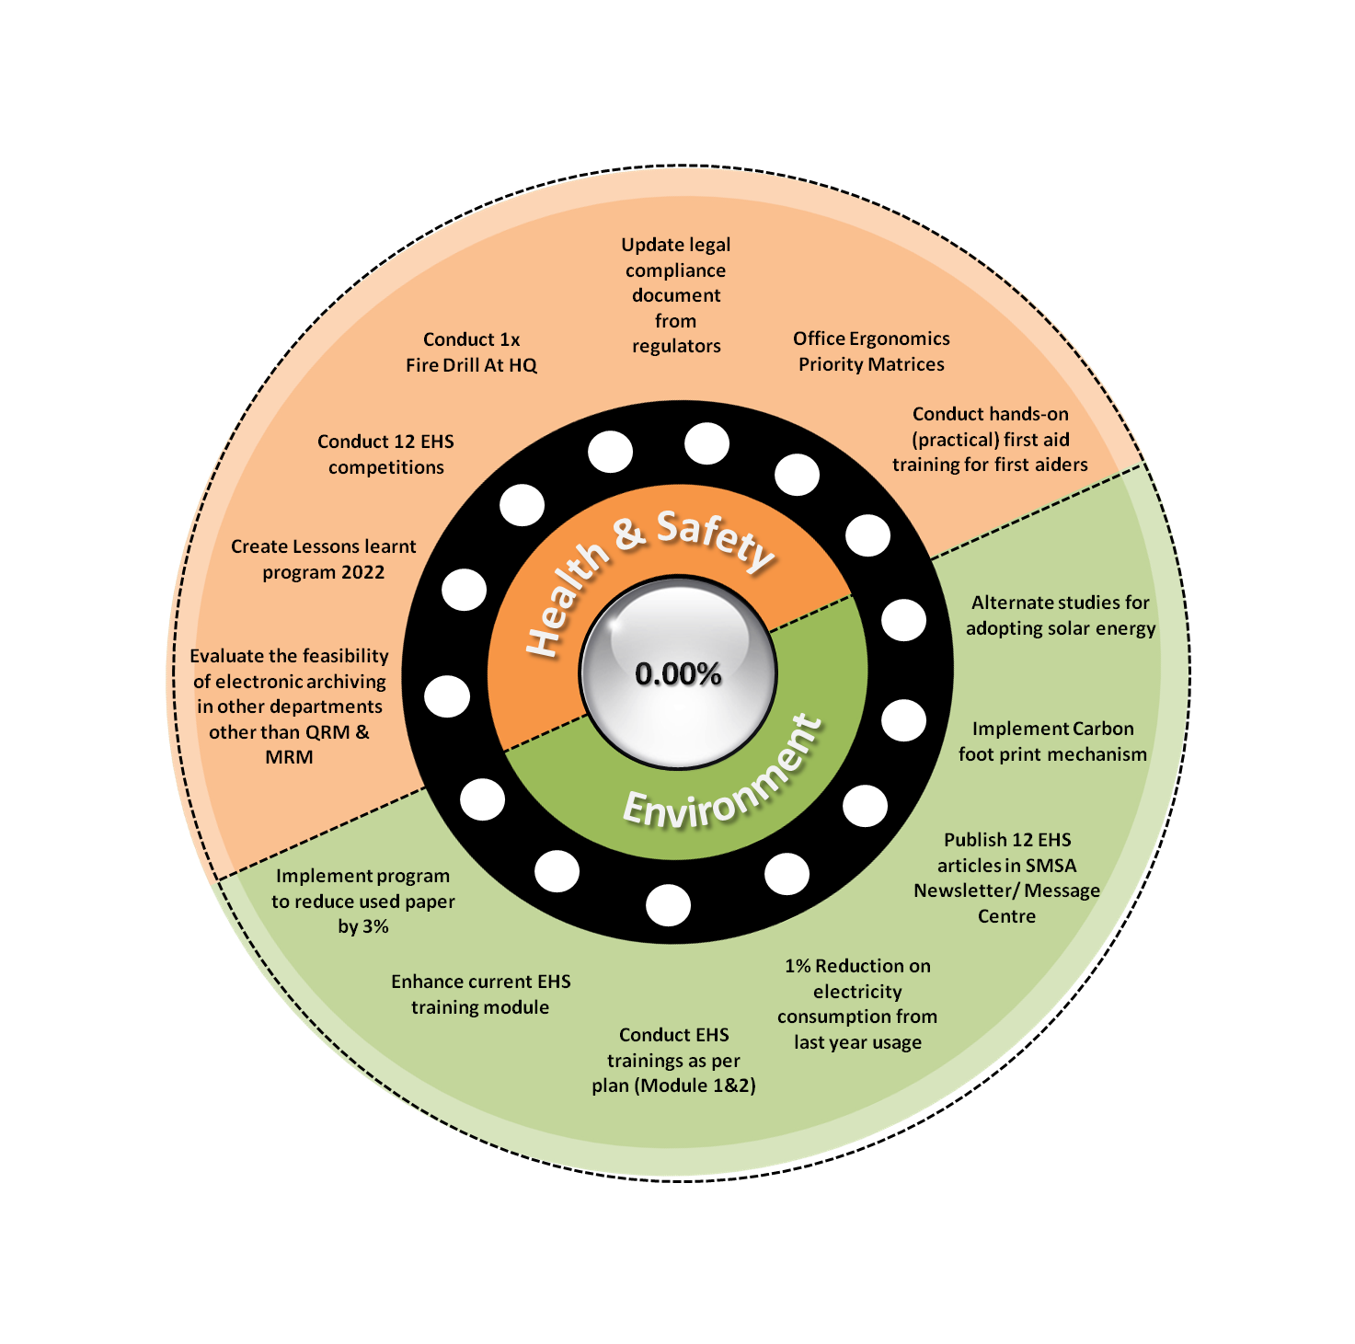
EHS Steering Wheel 2022
Achieved Weight : 100%
Achieved Percentage : 100%

Slide 19
EHS KPI Dashboard
Area | KPI No. | Description | Measurement Criteria | Value out of 100% | Value out of Overall Wt % | Yearly Target
ENVIRONMENT | KPI-1 | Implement program to reduce used paper by 5% | Amount of paper purchased in 2019 vs amount of paper purchased in 2020 | 10% | 5.00% | 100.00%
 | KPI-2 | Enhance current coaching forms to cover EHS elements | Amended Coaching forms uploads | 20% | 10.00% | 100.00%
 | KPI-3 | 2% Electricity consumption reduction from last year usage | Last years consumption (KW) vs current years consumption | 10% | 5.00% | 100.00%
 | KPI-4 | Publish 12 articles in SMSA newsletter/message center | One article each month | 30% | 15.00% | 100.00%
 | KPI-5 | 85% of the newly purchased electronic items to be energy efficient | 85% electronic items to be energy efficient from the list of purchases | 10% | 5.00% | 100.00%
 | KPI-6 | Monitor & maintain temperature monitoring & control program | As per plan - weekly log sheets | 20% | 10.00% | 100.00%
 | Total |  |  | 100% | 50.00%
 | OVERALL WEIGHT |  |  | 50%

Slide 20
EHS KPI Dashboard
Area | KPI No. | Description | Measurement Criteria | Value out of 100% | Value out of Overall Wt % | Yearly Target
HEALTH & SAFETY | KPI-1 | Conduct emergency response / fire drills x1 in 2020 | As per plan | 20% | 10.00% | 100.00%
 | KPI-2 | Create electronic internal archiving for HRD and other departments | As per HRD plan | 10% | 5.00% | 100.00%
 | KPI-3 | Create and implement lessons learnt program | Incidents lessons learnt analysis | 20% | 10.00% | 100.00%
 | KPI-4 | Conduct x1 EHS training | As per plan | 20% | 10.00% | 100.00%
 | KPI-5 | Conduct 12 EHS competitions and create appreciation program | As per plan | 10% | 5.00% | 100.00%
 | KPI-6 | Conduct first aid - hands on (practical training) for first aiders | As per plan | 20% | 10.00% | 100.00%
 | Total |  |  | 100% | 50.00%
 | OVERALL WEIGHT |  |  | 50%

Slide 21
Any
Questi ns

Slide 22

Thank You!
QRM Contact Numbers
Security & Risk
Abdullah Al Enazi: +966 50 444 1348
Quality Reports
Marwan Siddiq: +966 53 761 1405
GUIDE and Mapping
Mohamed Nifraz : +966 59 736 1857
Nouf Al Rammah : +966 53 847 5329
EHS
Mohamed Al Dawsari : +966 55 977 5558
TAPA
Imad Elddin: +966 54 398 5888
BCMS
Altamush Khan: +966 56 731 2568
Edwin Ramos: +966 53 825 6619
ISO 9001:2015
Ahmed Khan: +966 54 229 5610
QRM Email Addresses
quality.qrm@smsaexpress.com
security.qrm@smsaexpress.com
tellus@smsaexpress.com

