Slide 1





Quality & Risk Management

Slide 2




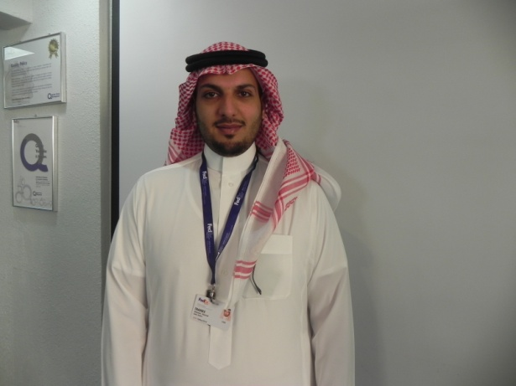







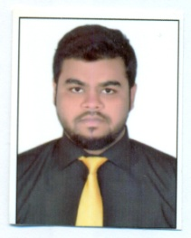










QRM Structure
Mohammad
Bhaiyat
Total: 135 Staff
Director, QRM
Abdullah
Al Enazi
Marwan
Siddiq
Abdulaziz
Alesmail
Mohammad
Altamush Khan
Edwin
Ramos
22301 BCMS
IBU
Nat’l Safety & Security
Manager
Quality Improvement Specialist
Compliance Specialist
Quality Specialist
Quality Specialist
Islam
Shamseldin
Dafallah
Shaima
Al Jasas
Imad
El Khidir
Mohammed
Ahmed Khan
Musaad
Al Jawhari
Wael
Al Harbi
Nouf Thamer Al Rammah
WHO-GDP
Spl. Svcs, TAPA
10002
10015
Site Auditor - NR
Safety & Security Manager
Technician -
Security Systems
Quality Coordinator
Quality Management
Specialist
Quality Auditor
– SR & NR
Quality Auditor
– CR
Bushra Mahmoud
Abdalmomen
Sultan Mohd
Al Jarrah
Ismail Mahmood
Mastora
Al Juhani
Hassan Ali Akram
TBA
Mohamed
Nifraz
9001
Site Auditor - SR
Projects Specialist
Technician -
Security Systems
Quality Coordinator
BC/DR Specialist
Quality Auditor
- CR
TBA
Quality Auditor
Anwar
Abdullah
Alenazi
Hamza Osman
Alfatih Mamun Ali Ahmad
Mohammed
Almubarak
Zeeshan
Asif Ali
14001 & 45001
22301 BCMS
Site Auditor - CR
Site Auditor - ER
Technician -
Security Systems
Quality Auditor
– WR
Quality Auditor
Mohammed
Mazrui
115 Security staff (08 Specialized Services locations for Guns & Ammunitions - KSA)
09 Auditors – 02 Analysts - 03 System Specialists (Covering KSA & IBU)
05 Site Inspectors (Specialized Projects – Bank Inspections - KSA) 03 Security Technicians
Site Auditor - WR

Slide 3
QRM Core Functions and Strategic Initiatives
QUALITY & RISK
Maintain & Implement Quality Certifications
Regulatory & Standards Compliance
Conduct QA Measurement and Performance Analysis
Quality & Risk Audits
Process Management
Maintain QMS System
Document and Record Control Management
Bus. Continuity/ Disaster Recovery
Strategy Planning & Monitoring
Manage Objective & Targets – KPI
Ensure Accurate and Updated Maintenance of SMSA Quality Databases
Facilitate Management Reviews and Strategy Review
CURRENT SPECIALIZED PROJECTS
Site Inspections
Guns and Ammunition Security Management Project
SAFETY & SECURITY
Risk Assessment & Analysis
Manage Security Personnel and Guarding Services
Investigations
Incident Management
Health, Safety & Security
Physical Asset Protection and Disposal Management
Loss Management / Prevention
Liaise with Gov’t. Authorities
Maintenance and Installation of Security Equipment, including CCTV, Alarms & X-Ray Systems
SPECIALIZED TRAINING
ISO 9001:2015 Awareness and Compliance Training & other standards
Environment Health & Safety
WHO-GDP Awareness
GUIDE (QMS) System Training
CAPA
TAPA Awareness
Fire Safety Awareness
Investigation System Training
Security Officer Training
X-ray Operations and Suspicious Package Detection Training

Slide 4
Operational High Level Process
Context of the Organization
Control of Documents
Control of Records
Quality Internal Audits
Management Review
Corrective & Preventive Actions
Control of Non-conformities
CORE PROCESSES
Mailroom
Warehouse & Fulfillment
Customer Services
Services
Pick-up
Route
Delivery
Special Delivery Channel
OPERATIONS
Gateway
SMSA Service Center
HRD
ADM
ITD
LEG
MKT
PUR
FIN
QRM

Slide 5
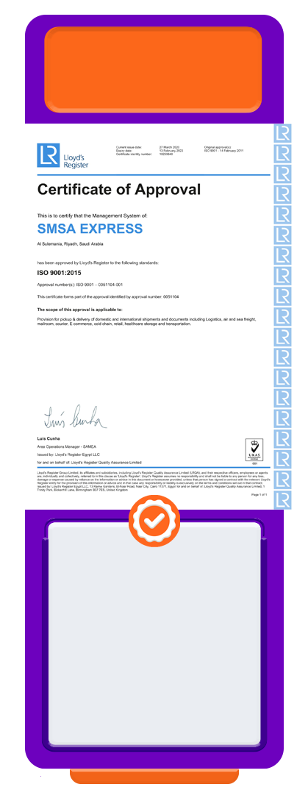
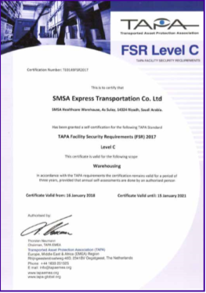

Quality Certifications
ISO
9001:2015
ISO
10015:2019
ISO
14001:2015
ISO
45001:2018
TAPA - FSR
ISO
10002:2018
Quality
Management
System
incorporating
WHO-GDP
Standards
Guidelines for
Competence
Management
and People
Development
Occupational
Health
and Safety
Management
System
Transported
Asset
Protection
Association
Facility Security
Requirements
Environment
Management
System
Complaints
Handling
Guidelines
SMSA Specialized Services has a separate ISO 9001:2015 Certification
Certifications under process – ISO 27001 IT Security, ISO 22301 BCDR, ISO13485 Medical Devices

Slide 6










Specialized Services
Consultancy
Food Safety
MRM
Contact
Centre
Auditing
Inspections
CCTV
Management
Investigations
Loss
Prevention
SSC
Agent Banking

Slide 7
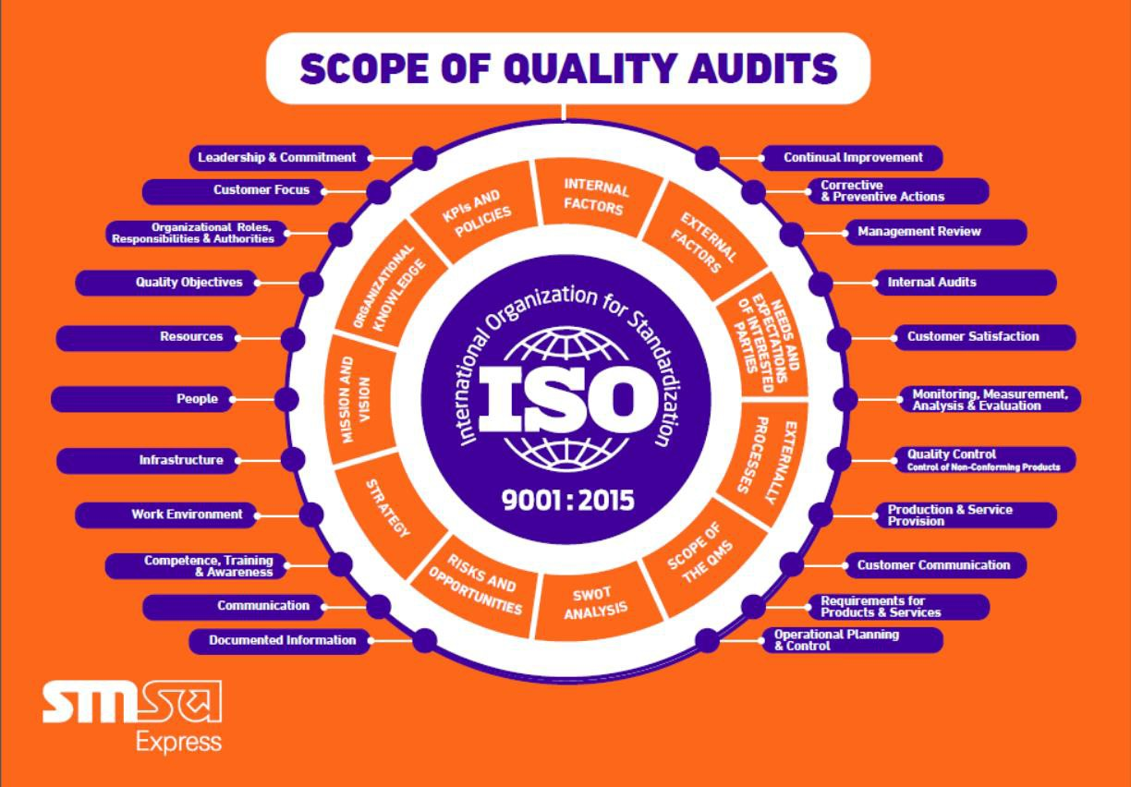
Scope of the Quality Management System
Legal
Technological
Social
Cultural
Market
Competition
Ergonomics
Internal Factors
External Factors
Performance
Values
Culture
Knowledge
“Copyrights: All rights are reserved, no part of this presentation can be reproduced or copied by any means except with written permission from SMSA“

Slide 8








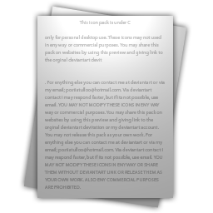




Quality Management System
Statement Sets
Security Access
Document No. &
Version Control
Policies,
Work Instructions
& Forms
Change
Management
Mapped
Processes
Annual
Review
Org
Structure
Auto Email Notification
History Log

Slide 9
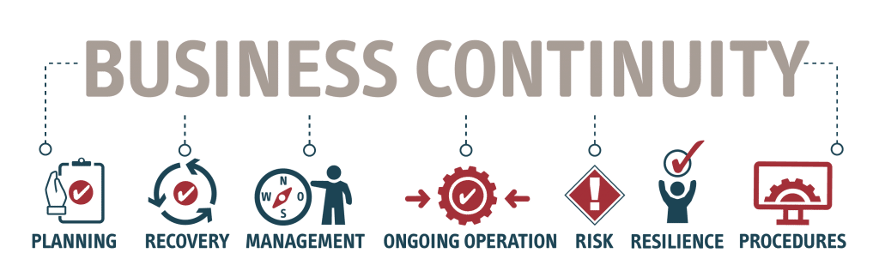

ISO 22301:2019 (BCMS)
Business Continuity Management Systems - Requirements
*SMSA has a Business Continuity/ Disaster Recovery System

Slide 10

The Nine Building Blocks
Note:
Reviewed with the MD and the Strategy Committee
CURRENT
COMPETITIVENESS
OUR BUSINESS
MARKET DEMAND
BUSINESS STRATEGY
RISK & OPPORTUNITY
Business segments of SMSA
Which segment delivers most profit
What is our market share
What is the demand anticipated in our industry.
What advantage do we have over the competition, Capabilities i.e. market share, cost factor, product capabilities, network, customer service, competitive position
Bridging the capabilities of each business, Optimizing the business portfolio, Leveraging resources. Should we invest? Should we hold? Should we exit?
Due diligence
Identify risk
Identify opportunity
01
02
03
04
05
06
07
08
09
OUR AIMS
INDUSTRY SUPPLY
COMPETITIVENESS -
TARGET
CORPORATE STRATEGY
AND
Where we want SMSA to be in 3 years
Which parameter do we measure success
How many players in the market
Does supplier exceed demands
Under supplier - Pricing can be set
Identified gaps in the market
Product/segment we need to compete-in
Do we need to diversify, enter areas not covered
Buy businesses
8.
CORPORATE
STRATEGY
9. RISK
OPPORTUNITY
7. BUSINESS STRATEGY
COMPETITIVENESS
5. CURRENT
6. TARGET
3. MARKET
DEMAND
4. INDUSTRY
SUPPLY
1. OUR BUSINESS
2. OUR AIMS
“Copyrights: All rights are reserved, no part of this presentation can be reproduced or copied by any means except with written permission from SMSA“

Slide 11







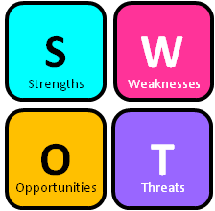










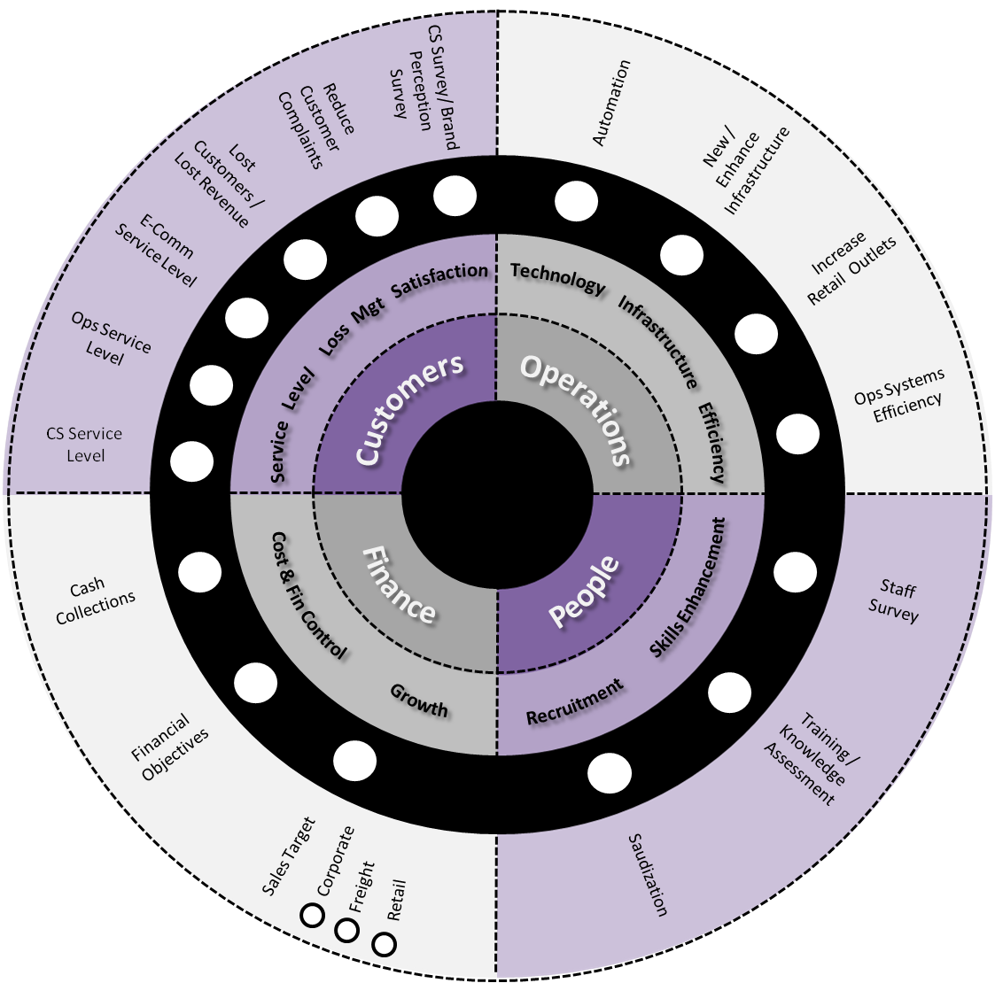



360° Strategy Planning
MISSION
& VISION
CORE
VALUES
QUALITY
POLICIES
Stakeholders
Employees Opinions
Kaizen
Previous Results
Lessons Learnt
Risks
Opportunities
SWOT
Internal
Factors
Customer Survey
Brand & Market Survey
Mystery Shopping
Social Media Feedback
Vision 2030
Interaction Feedback
External
Factors
MS
Facebook
Instagram
Twitter
Emails
Chats
Strategy Committee
Consultant
Resources
Business Objectives
SMSA Wheel
Monetization
Actions
Sustainability
Note:
Reviewed with the MD and the Strategy Committee
“Copyrights: All rights are reserved, no part of this presentation can be reproduced or copied by any means except with written permission from SMSA“

Slide 12
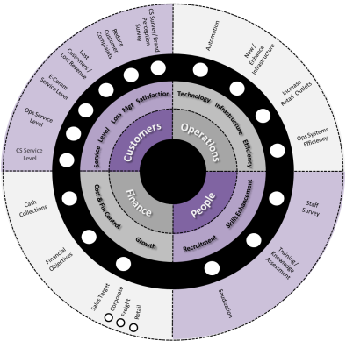
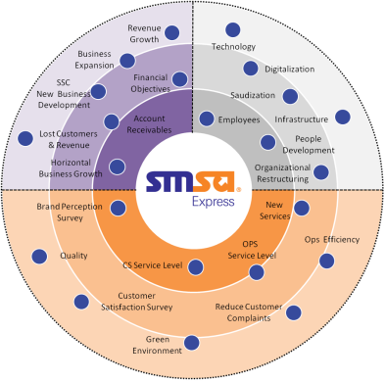











Strategy Formation
Actions Transferred
& Monitored
Country & Business Unit Wheel
Approved Strategy Wheel
EACH COUNTRY HAS ITS OWN INDIVIDUAL STEERING WHEEL
KSA
USA
OMN
UAE
JOR
ZAF
KWT
EGY
BAH
QAT
HKG
Note:
Reviewed with the MD and the Strategy Committee
“Copyrights: All rights are reserved, no part of this presentation can be reproduced or copied by any means except with written permission from SMSA“

Slide 13

Summary of the Strategy Planning
2024-2026
1. Objectives
2. Strategy
All the essential information received and analysed, formed the foundational pillars of the strategy.
The strategy was crafted based on defined objectives.
Objectives
Strategy
4. Executive Summary
3. Business Goals
Executive
Summary
Business
Goals
Defining the key performance indicators using the balance score card (Corporate, Bus Units & Country wheels created)
Summary carefully aligned with all key elements and a strategic blueprint created
Note:
The MD will make the final decision on the final key strategic points.
People
Operations
Customer
Finance
Organizational Structure Authority Delegation and Governance Investing in Our People Compensation and Benefits Localization | SMSA Systems Quality Optimizing Operations Business Model Infrastructure Operational Efficiency | Strategic Partnerships SMSA's Services Marketing Transformation & Expansion Customer Retention and Mitigating Loss | Budget Management Cost Management Growth and Revenue Market Expansion
Approval & Execution
2024-2026 working on the strategy initiatives tracking results & audits.
“Copyrights: All rights are reserved, no part of this presentation can be reproduced or copied by any means except with written permission from SMSA“

Slide 14



We decided to use the BCG matrix to help us better understand our current business units
High
Question Mark
Description: High growth but neutral or negative cash flow (expensive growth)
Strategy: See if ROI can be improved
Star
Description: Growing earnings, positive or neutral cash flow
Strategy: Invest in growth
Note:
Services reviewed by OPS and FIN based on the Matrix
Growth
rate
Dog
Description: Small market share in low growth market, requires much capital to continue
Strategy: Divest or close
Cash Cow
Description: Stable earnings and solid cash flow, low growth business
Strategy: Milk for remaining value
Low
Low
Market share
High
No Investment
More investment
*BCG: Boston Consulting Group Matrix
Caption:
“Copyrights: All rights are reserved, no part of this presentation can be reproduced or copied by any means except with written permission from SMSA“

Slide 15
Business Growth 2024-2026
Revenue Type | BCG Matrix
Freight
All Services | Star
Cross-Border Trucking | Cow
DG | Cow
Express
B2B Express - Intl | Star
B2B Express - Dom | Star
Retail Express - Intl | Star
Retail Express - Dom | Star
Road Freight (SFS) | Cow
B2C - E-Commerce
Cross Border OB | Star
Cross Border IB | Cow
Domestic | Cow
Returns | Cow
B2C - Other Services
SDC | Star
MRM | Star
Revenue Type | BCG Matrix
Revenue Type | BCG Matrix
Revenue Type | BCG Matrix
Digital Express
Store2Door | Cow
Smart Ship | Question
E-Lockers | Cow
Healthcare
Healthcare | Star
Cold Chain (B2B) | Cow
Cold Chain (Retail) | Cow
Pharma (Private) | Cow
Logistics
2PL Projects | Star
3PL - Standard | Star
3PL - Temp Controlled | Star
Fulfilment | Star
South Africa | Star
DG | Cow
Bonded Facility | Cow
Vertical Growth
Audit Services | Star
Ammo Ex (Falcon Club) | Cow+
ISO Certification | Star
Marketing Survey | Star
Hajj Project | Cow+
BagEx | Cow+
VP Services | Cow+
Archiving | Cow
NEOM/Red Sea | Cow
Inorganic
Acquisitions | Cow
“Copyrights: All rights are reserved, no part of this presentation can be reproduced or copied by any means except with written permission from SMSA“

Slide 16

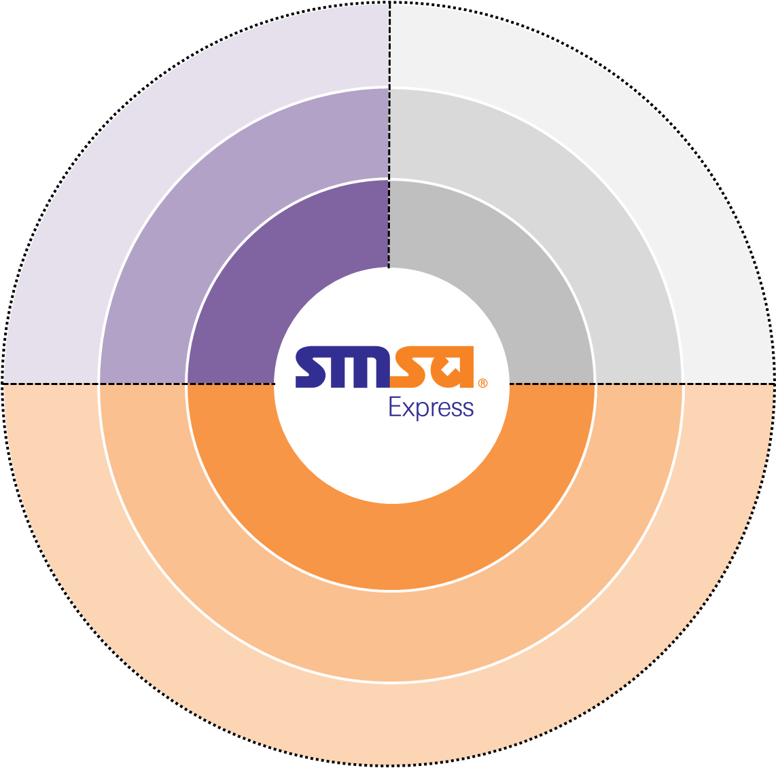




Strategy Wheel (Jan 2024 to Dec 2026)
Segments
Service Levels
Organization
*As of Sept 2024
RESOURCES
Weight: 30% - 21.49%
Governance
Business
Model
Marketing
Note:
Reviewed monthly with the MD and the Strategy Committee
FIN, OPS, SLS and QRM Directors
SUSTAINABILITY
Weight: 20% - 13.23%
Localization
People
Development
Quality
MONETIZATION
Weight: 50% - 26.31%
SMSA System
RESOURCES
Operational
Efficiency
SUSTAINABILITY
Automation
Compensation
& Benefits
Percentage | Color
Greater than or equal to 95.5%
Between 90.5% to 95.4%
Between 85.5% to 90.4%
Less than 85.4%
New / Expand
Business Development
Infrastructure
90.24%
Financial
Performance
MONETIZATION
Growth &
Revenue
Colour coding: Grey
- Financial reporting will be conducted, although it will not be included in the wheel calculation.
- Bad debts are calculated as a component of other financial elements. Weight has been offset
Cost Management
R
Weight 81.39%
Financial
Reporting & Analysis
Collection
R
Actual 81.62%
“Copyrights: All rights are reserved, no part of this presentation can be reproduced or copied by any means except with written permission from SMSA“

Slide 17
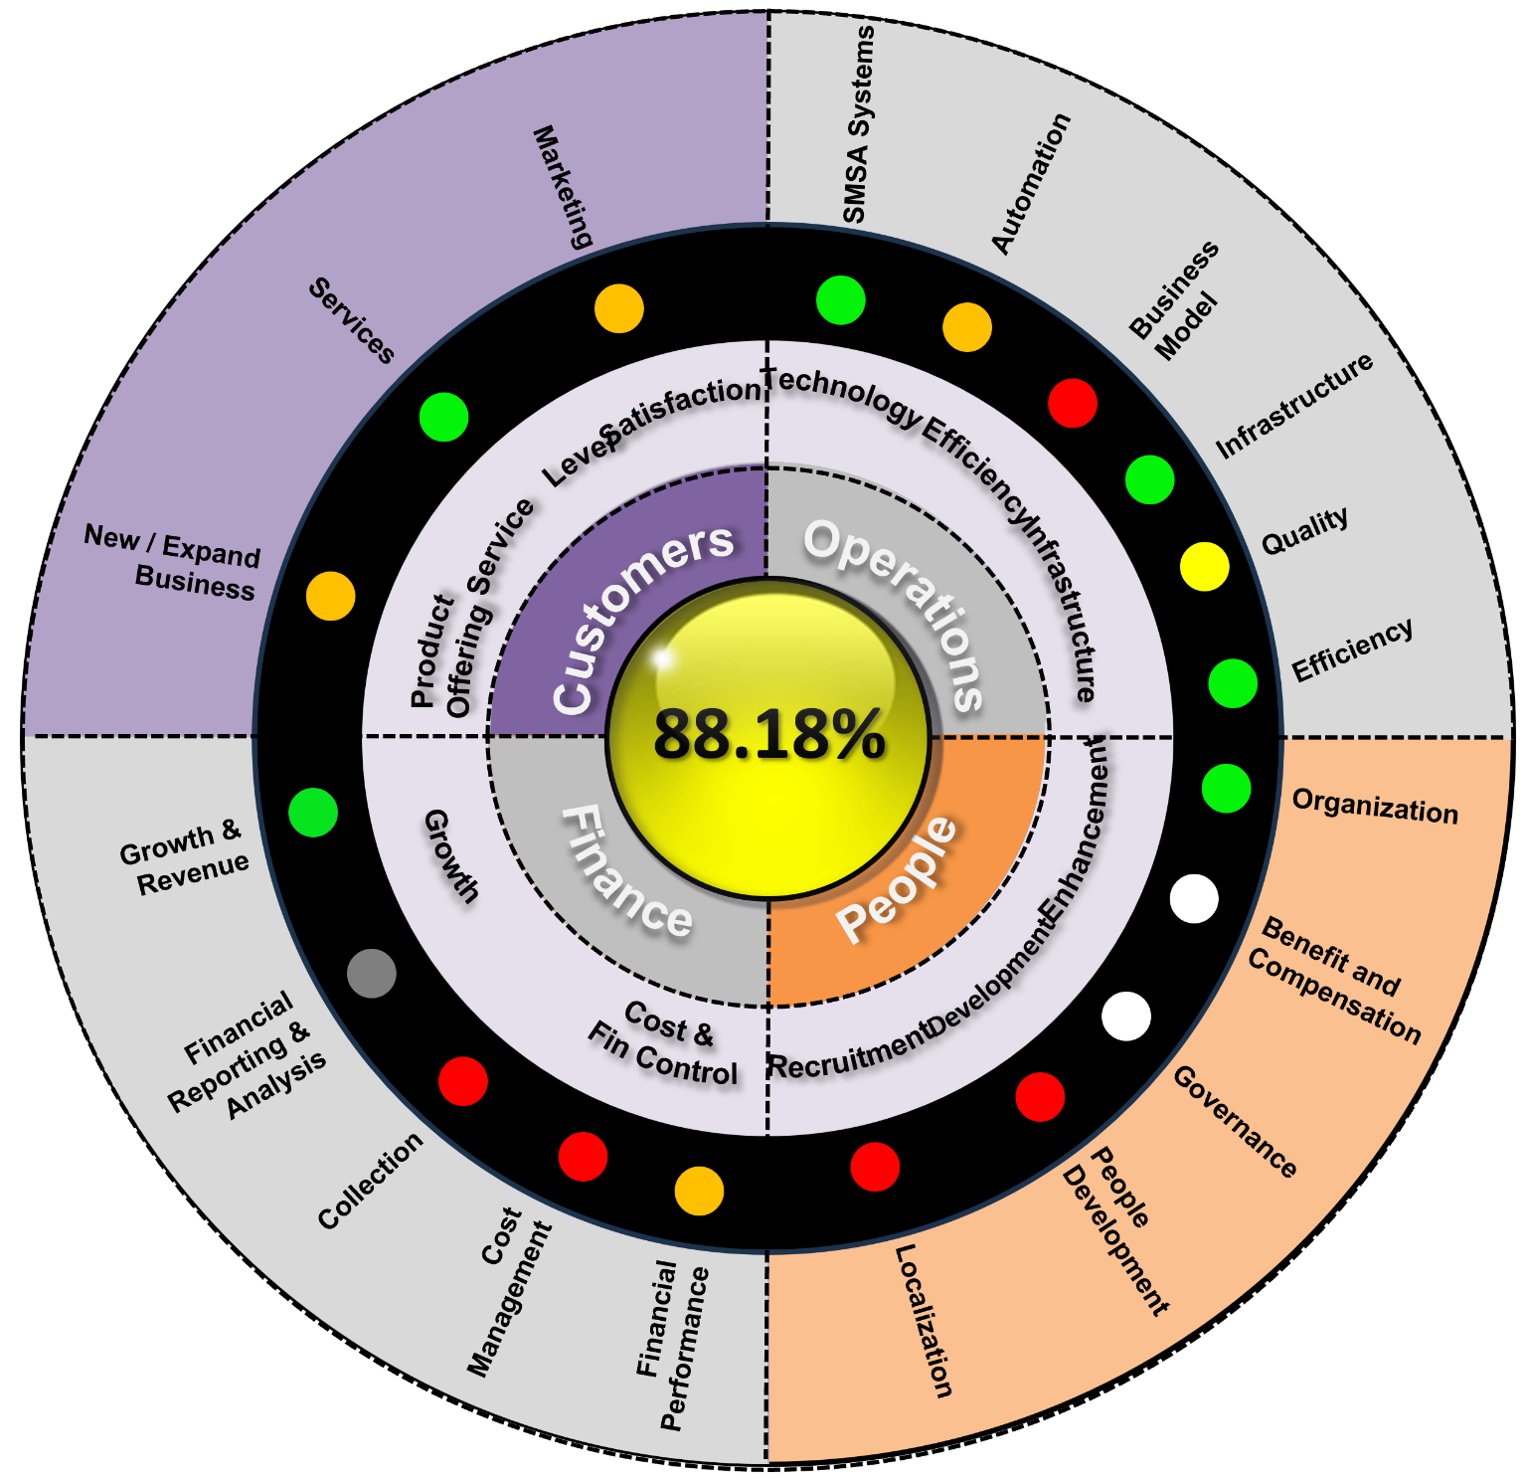
Country Wheel (Balance Score Card)
Example KSA WHEEL
Sep 2024
Note:
Reviewed monthly with the MD.
KSA - Senior Managers
IBU’s – Country Managers
Percentage | Color
Greater than or equal to 95.5%
Between 90.5% to 95.4%
Between 85.5% to 90.4%
Less than 85.4%
Achieved Weight: 82.98%
Achieved Percentage: 88.18%

Slide 18
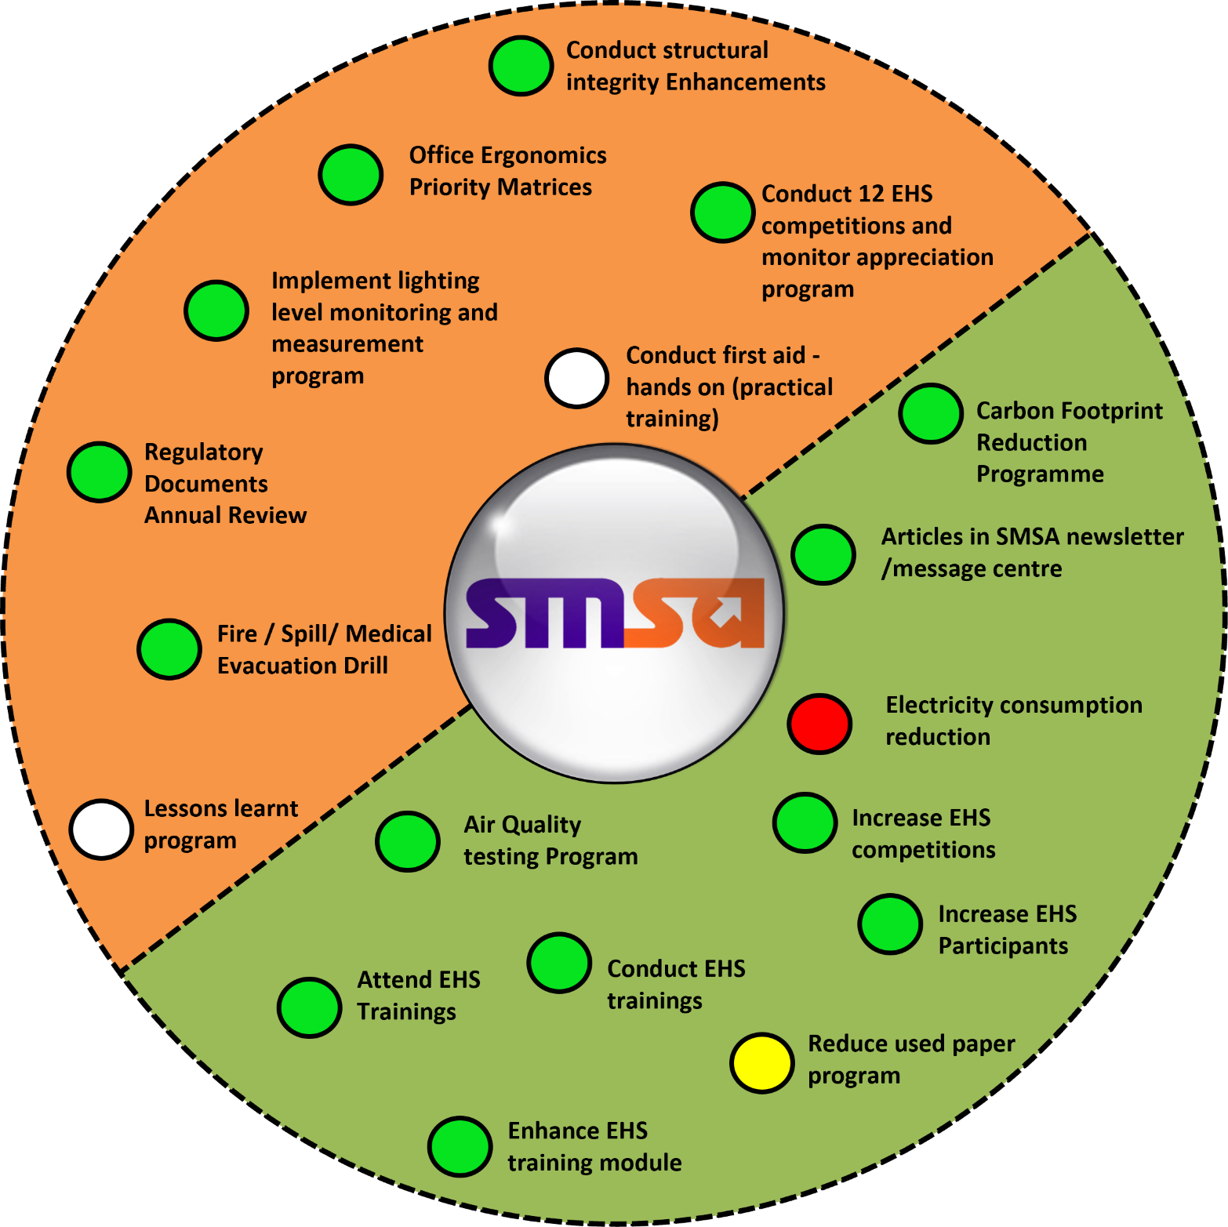
EHS Wheel Example
EHS – SMSA
As of Sep 2024
Note:
Reviewed monthly with the MD.
KSA - Senior Managers
Environment
Health & Safety
Percentage | Color
Greater than or equal to 95.5%
Between 90.5% to 95.4%
Between 85.5% to 90.4%
Less than 85.4%
A
Weight 92.74%
Actual 93.44%
A

Slide 19
Database Example
Dpt | Elements | Year 2018 |  | Year 2019 |  | Year 2020 |  | Year 2021 |  | Year 2022 |  | Year 2023 |  | Results of the customer value analysis is based on the sales revenue.
 |  | Target | Achieved | Target | Achieved | Target | Achieved | Target | Achieved | Target | Achived | Target | Achieved
Finance | Cash Collection | 93% | 87% | 93% | 90% | 93% | 88% | 93% | 90% | 93% | 89% | 93% | 94% | Cash collection improvement observed from 2020 to 2021 and dropped in 2022. Showing improvement in 2023
 | Invoice delivery on time | 97% | 98% | 97% | 97% | 97% | 98% | 97% | 98% | 98% | 98% | 98% | 98% | Consistent performance
 | Bad Debts | 0% | 18% | 0% | 9% | 0% | 10% | 0% | 5% | 0% | 5% | 0% | 6% | Bad debt gone up by 1% from 2022
 | Customer Email Update | 98% | 90% | 98% | 96% | 98% | 96% | 98% | 96% | 98% | 95% | 98% | 94% | Down by 4%
 | Data Transfer dependency | 95% | 83% | 95% | 93% | 95% | 91% | 95% | 92% | 95% | 92% | 95% | 91% | CORE to Fusion data transfer down by 4%
 | Automation of AWB | 70% | 50% | 70% | 62% | 70% | 72% | 70% | 76% | 70% | 82% | 70% | 87% | Up by 17% 2023
 | Volume per customer (Shipments) | NA | 48 | NA | 48 | NA | 52 | NA | 107 | NA | 62 | NA | 48 | Value of customer shipments has gone down from an average of 63.4 to 48 down by 24%
 | Revenue per customer (SAR) | NA | 2950 | NA | 2810 | NA | 3058 | NA | 6258 | NA | 3618 | NA | 1922 | Revenue per customer has gone down from an average of 3739 to 1922 down by 48.5%
 | Net profit per customer (SAR) | NA | 148 | NA | 141 | NA | 153 | NA | 313 | NA | 181 | NA | 96 | Net profit per customer has gone down from an average of 187 to 96 down by 48.6%
 | Cost of Customers (SAR) | NA | 11970 | NA | 9680 | NA | 10321 | NA | 26837 | NA | 22666 | NA | 19497 | Cost of Customers has gone up from an average of 16295 to 19497 up by 19%
 | Cost of Lost Customers (SAR) | NA | 2950 | NA | 2810 | NA | 3058 | NA | 6258 | NA | 3618 | NA | 1922 | Cost of Lost Customers has gone down from an average of 3739 to 1922 down by 48.5%
 | Cost of Dissatisfaction (SAR) | NA | 2950 | NA | 2810 | NA | 3058 | NA | 6258 | NA | 3618 | NA | 1922 | Cost of Dissatisfaction 3739 to 1922 down by 48.5%
 | Customer traffic per delivery channel | NA | 255 | NA | 260 | NA | 262 | NA | 516 | NA | 215 | NA | 192 | Customer traffic per delivery channel has gone down from an average of 301 to 192 down by 36.2%
 | Customer retention - Lost ratio | NA | 96% | NA | 94% | NA | 93% | NA | 96% | NA | 95% | NA | 95% | No Change

Slide 20
Database Example
Department | Elements | Year 2018 |  | Year 2019 |  | Year 2020 |  | Year 2021 |  | Year 2022 |  | Year 2023 |  | Remarks
 |  | Target | Achieved | Target | Achieved | Target | Achieved | Target | Achieved | Target | Achieved | Target | Achieved
Sales | Corporate Sales | 100% | 82% | 100% | 98% | 100% | 100% | 100% | 118% | 100% | 81% | 100% | 82% | Corporate sales includes SSC not achieving targets in 2022 & 2023 down by 18% in 2023.
 | Freight Sales | 100% | 94% | 100% | 97% | 100% | 78% | 100% | 104% | 100% | 87% | 100% | 62% | Freight sales not achieving targets in 2020, 2022 & 2023 down by 38% in 2023.
 | Lost Revenue (Overall) | NA | 316507 | NA | 66498 | NA | 631076 | NA | 403425 | NA | 3745584 | NA | 2992431 | Overall Lost of revenue has gone up from an average of 1032618 to 2992431 up by 189%
 | Lost Revenue - CR | NA | 262226 | NA | 50887 | NA | 389596 | NA | 90717 | NA | 665345 | NA | 645086
 | Lost Revenue - ER | NA | 16603 | NA | 0 | NA | 205656 | NA | 217962 | NA | 0 | NA | 0
 | Lost Revenue - WR | NA | 31042 | NA | 15611 | NA | 35824 | NA | 94746 | NA | 102494 | NA | 1021239
 | Lost Revenue - RR | NA | 6636 | NA | 0 | NA | 0 | NA | 0 | NA | 814346 | NA | 1088102
 | Lost Customers (Overall) | NA | 53 | NA | 25 | NA | 53 | NA | 36 | NA | 150 | NA | 110 | Overall Lost Customers has gone up from an average of 63 to 110 up by 74%
 | Lost Customers - CR | NA | 18 | NA | 16 | NA | 32 | NA | 22 | NA | 19 | NA | 35
 | Lost Customers - ER | NA | 8 | NA | 2 | NA | 15 | NA | 5 | NA | 0 | NA | 0
 | Lost Customers - WR | NA | 5 | NA | 7 | NA | 6 | NA | 8 | NA | 6 | NA | 8
 | Lost Customers - RR | NA | 22 | NA | 0 | NA | 0 | NA | 0 | NA | 15 | NA | 55
 | Lost Customers due to Services Failure | NA | 11 | NA | 11 | NA | 25 | NA | 11 | NA | 28 | NA | 8 | Service failure is the main factor for Lost of major customers
 | Lost Customers due to Lost Shipment | NA | 3 | NA | 2 | NA | 2 | NA | 1 | NA | 0 | NA | 0
 | Lost Customers due to Price | NA | 14 | NA | 5 | NA | 11 | NA | 7 | NA | 32 | NA | 0
 | Lost Customers due to Damage | NA | 4 | NA | 0 | NA | 1 | NA | 0 | NA | 4 | NA | 0
 | Lost Customers due to Other factors | NA | 21 | NA | 6 | NA | 14 | NA | 17 | NA | 76 | NA | 101
 | At Risk Revenue (Overall) | NA | 4848373 | NA | 1304394 | NA | 2128127 | NA | 2447091 | NA | 6880845 | NA | 5758369 | Overall Lost Revenue has gone up from an average of 3521766 to 5758369 up by 63.5% Western Region is main contributor causing 37% in Lost Customers.
 | At Risk Revenue - CR | NA | 1842455 | NA | 264786 | NA | 37172 | NA | 1363637 | NA | 361559 | NA | 1646047
 | At Risk Revenue - ER | NA | 2388724 | NA | 929551 | NA | 1877503 | NA | 229376 | NA | 628751 | NA | 216672
 | At Risk Revenue - WR | NA | 451689 | NA | 110057 | NA | 213452 | NA | 854078 | NA | 2322879 | NA | 2178515
 | At Risk Revenue - RR | NA | 165505 | NA | 0 | NA | 0 | NA | 0 | NA | 2975760 | NA | 773745
 | At Risk Customers (Overall) | NA | 196 | NA | 163 | NA | 85 | NA | 99 | NA | 166 | NA | 119 | Overall At Risk Customers has gone down from an average of 141 to 119 down by 15% Remote Regions are the main contributor of at risk customers
 | At Risk Customers - CR | NA | 64 | NA | 62 | NA | 6 | NA | 35 | NA | 9 | NA | 41
 | At Risk Customers - ER | NA | 64 | NA | 62 | NA | 55 | NA | 32 | NA | 26 | NA | 5
 | At Risk Customers - WR | NA | 44 | NA | 38 | NA | 24 | NA | 32 | NA | 21 | NA | 14
 | At Risk Customers - RR | NA | 24 | NA | 1 | NA | 0 | NA | 1 | NA | 95 | NA | 48

Slide 21
Example
Strategic Revenue Objective
Jan to Sep 2024
Performance report shows mixed results:
Strong Performers: Logistics and Vertical Growth exceeded targets consistently, indicating effective strategies.
Underperformers: Freight, Express, and Healthcare sectors are well below targets, showing significant gaps.
Action Needed: Urgent strategic adjustments are required for underperforming sectors, while successful approaches in logistics and vertical growth can be leveraged across other areas to drive improvement.
**March figures includes January & February

Slide 22
Achievements 2024
Quality & Risk Management
Achievements Based On The Strategy Segments
Quality
Technology / Automation
Maintained Key ISO Certifications KSA & IBU
9001,14001, 45001, 10015, 10002, WHO GDP & TAPA
Progress On ISO 27001 Cybersecurity
95% Completion Of ISO 22301 BCDR For Healthcare
Prepared South Africa & KFIA For ISO Certification
New E-Audit System For Quality Audits
New Investigation System
Automated Security Checks Through System
Growth & Revenue
Financial Performance
Localization
Revenue Retention
Saudization In QRM
Successful Investigation Efforts
Revenue Growth From Specialized Services
Cost Savings
BT & Salaries

Slide 23
Plans 2025
Quality & Risk Management
Quality
Technology
Growth & Revenue
Revenue Retention
New Certifications JOR, KWT & EHS EGY
Maintain ISO Certifications
BCDR Gateway
ISO 27001 Cybersecurity
ISO 13485 Certification For Medical Devices
WHO GDP UAE
New Major Customer For Specialized Services SAB Bank, General Entertainment Authority
New GUIDE System
Phase 2 Of Investigation System
Investigation To Retain Revenue

Slide 24

Thank You

