Slide 1


SMSA Services
presentation

Slide 2





We are market leaders in Express, Logistics, Mailroom, Warehousing, Cold chain, Healthcare, E-Commerce,
Freight, Consultancy and Specialized Services

Slide 3

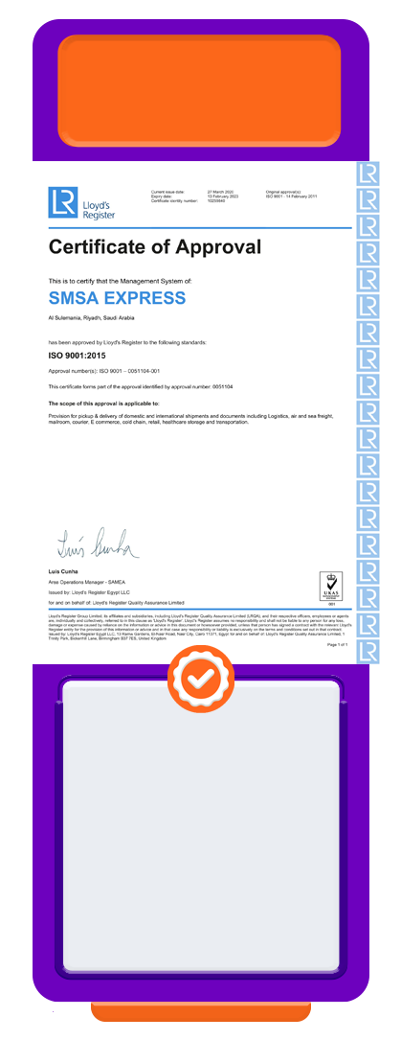
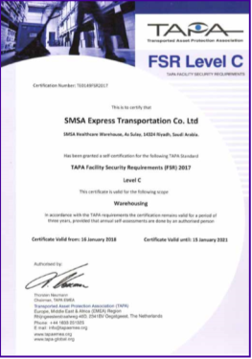

Quality Certifications:
ISO
9001:2015
ISO
10015:2019
ISO
14001:2015
ISO
45001:2018
TAPA - FSR
ISO
10002:2018
Quality
Management
System
incorporating
WHO-GDP
Standards
Guidelines for
Competence
Management
and People
Development
Occupational
Health
and Safety
Management
System
Transported
Asset
Protection
Association
Facility Security
Requirements
Environment
Management
System
Complaints
Handling
Guidelines
SMSA Specialized Services has a separate ISO 9001:2015 Certification
*

Slide 4










Value Added Services:
Consultancy
Food Safety
MRM
Contact
Centre
Auditing
Inspections
CCTV
Management
Investigations
Loss
Prevention
SSC
Agent Banking

Slide 5






Expertise of SMSA:
Diverse Professional
Membership
Multifaceted Auditing
Standards & Ground-Up
Consultancy Skills
PROFESSIONAL
SERVICES
COMPREHENSIVE
EXPERTISE
Legal, Regulatory &
Compliance Proficiency
Ongoing Process
Improvement & Strong
Risk Management
Wide Cross- Industry Experience
& Mastery of Quality Management
Systems

Slide 6














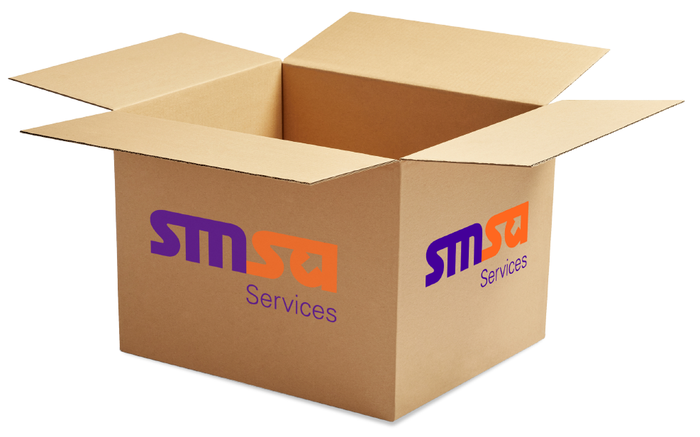





Compelling Reasons to Choose SMSA:
AUDIT EFFICIENCY AND REGULATORY EXCELLENCE:
COST-EFFECTIVE SOLUTIONS:
Ensure strict adherence to industry standards and regulations with
our streamlined audit process.
Optimize financial performance
through our budget-friendly
offerings.
CLIENT CENTRIC PARTNERSHIP:
UNPARALLEL EXPERTISE:
We prioritize your success by
working closely to understand
your vision.
Our consultants bring extensive industry knowledge & sector-specific expertise.
ONGOING ENHANCEMENT INITIATIVES:
Drive improved operations, profitability, and performance
over time through our continuous improvement efforts.
TAILORED SOLUTIONS:
Customized to precisely fit
your unique requirements.
IMAGE ENHANCEMENT:
PROVEN EXCELLENCE:
Elevate your company’s reputation and brand
presence with our services.
Consistently deliver exceptional results.
SCALABILITY:
Flexibility to adapt seamlessly to your
evolving needs.

Slide 7











Inspection Project:
Structure
Planning / SLA
Application
Inspection Process
Customer Portal
Escalation
Contingencies
Health & Safety

Slide 8











Inspection Project: Example of Project Scope
Planned Inspections
Adhoc/ New ATM Insp.
Quarter 1 & 3 - Night Inspections
Cover ATM Branches
Quarter 2 & 4 Day Inspections
Cover ATM’s only
Emergency visit to be performed
within 24 hours for main cities and
72 hours for remote cities and New
ATM handover from contractor
Project Reports
Duty Hours
Weekly, Monthly & Quarterly
reports submitted on the 5th
of the month
Night duty timing from 8 pm
to 4 am.
Day duty timing from 8 am
to 4 pm.
Updating Plans
Inspection Report
Updated locations in the Plan
and Status of inspections is
updated on Weekly basis
5 - 9 photos for each ATM / Branch
with time stamping (Date/Time)
99% inspection TBO per Quarter

Slide 9






Projects Structure
QRM DIRECTOR
Floaters
PROJECT MANAGER
Floaters
SITE AUDITOR
Central Region
SITE AUDITOR
Eastern Region
SITE AUDITOR
Western Region
SITE AUDITOR
Northern Region
SITE AUDITOR
Southern Region

Slide 10





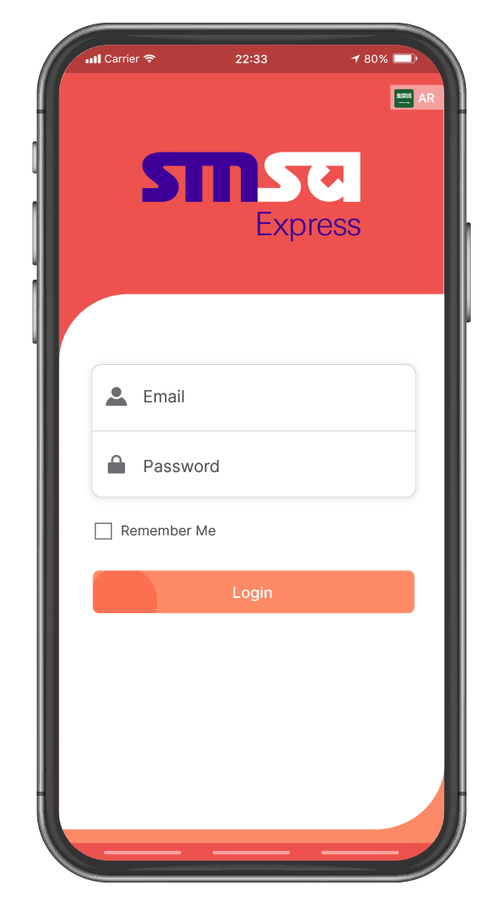
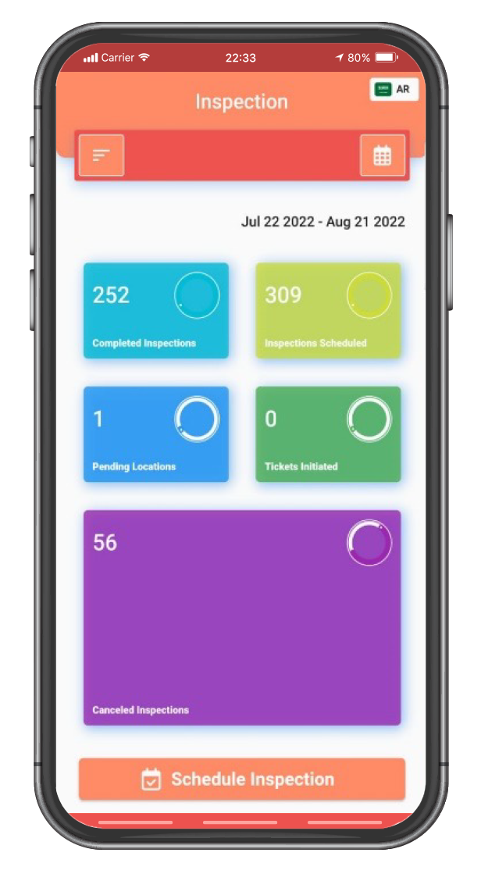
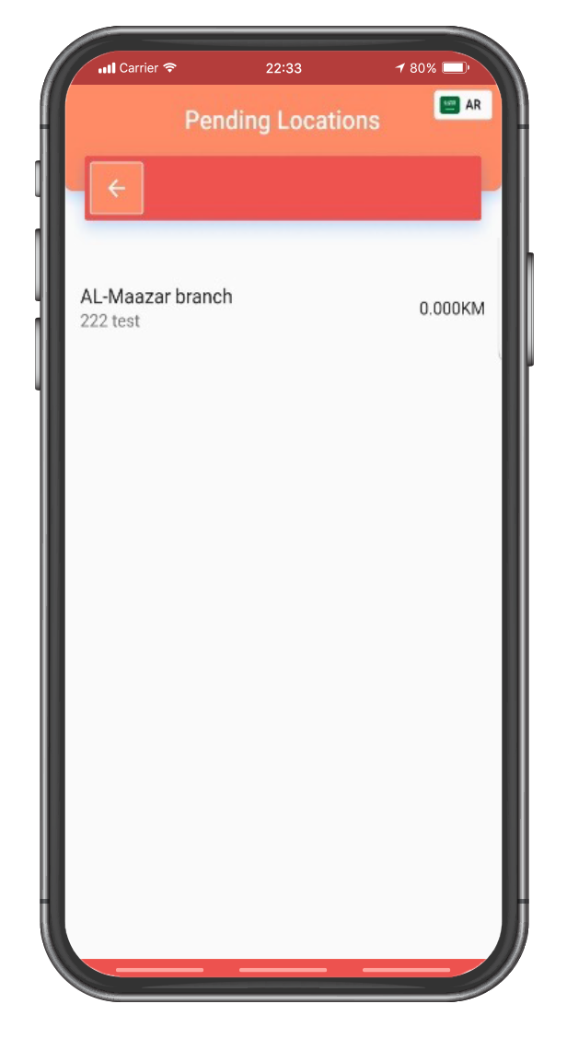
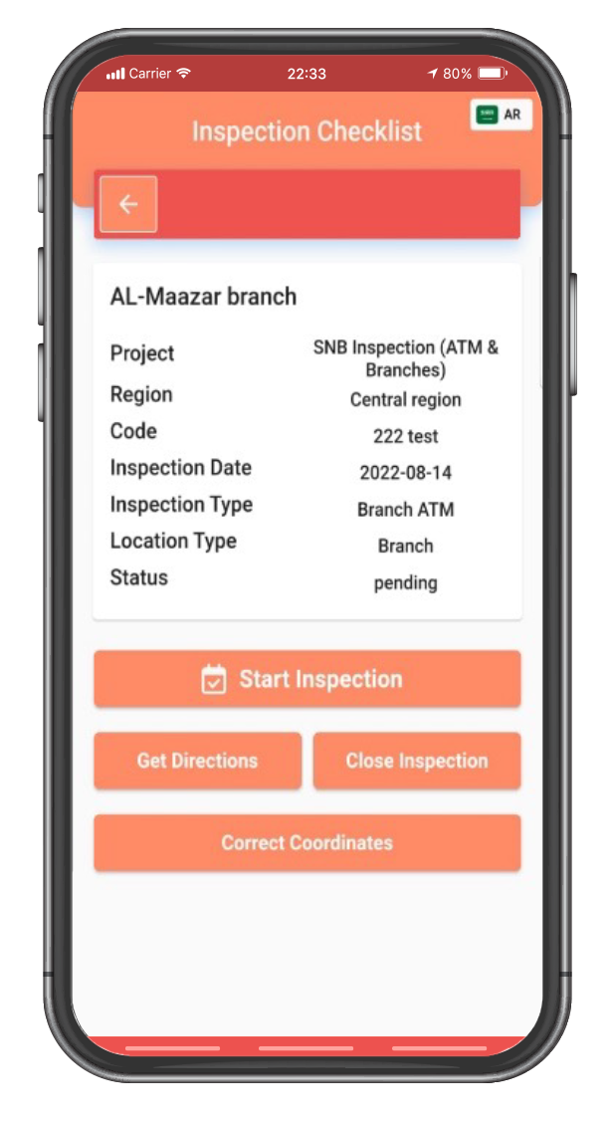
Application Functionality
Select the date
Schedule inspection
Status pending,
completed
Status schedule,
cancelled
Sign in using email
Page appears
Unique Password
Login
List of inspections
GPS direction

Slide 11




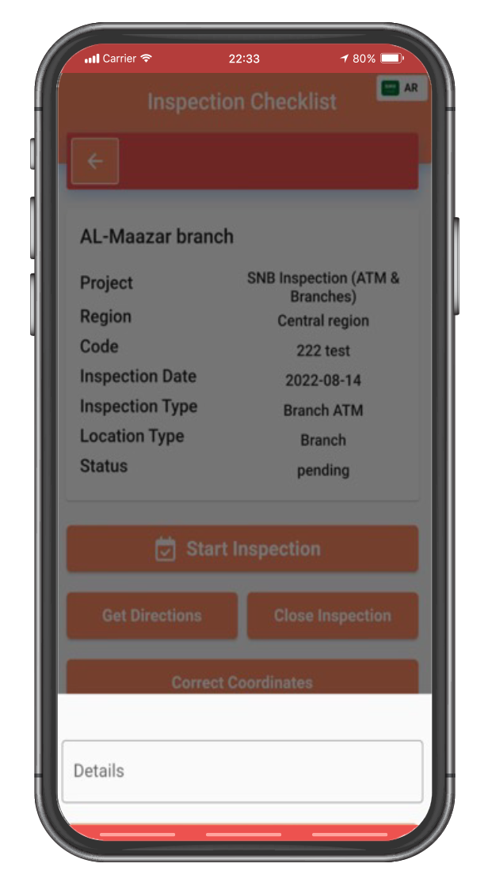
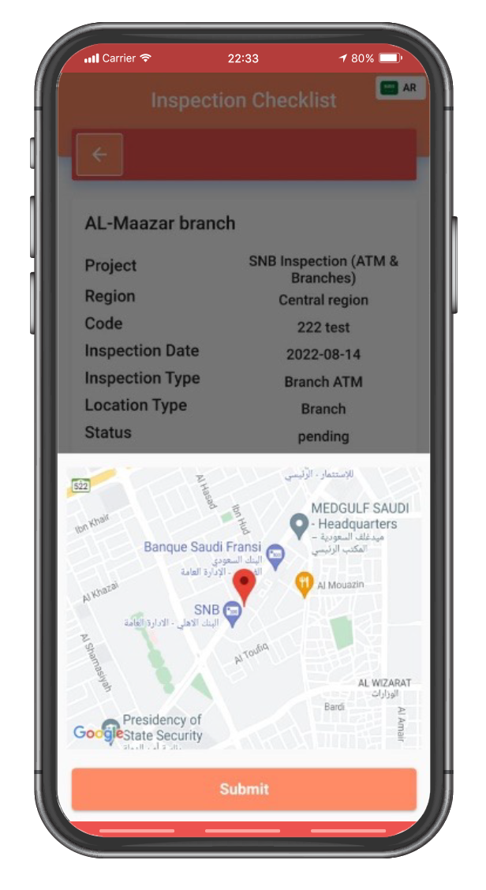
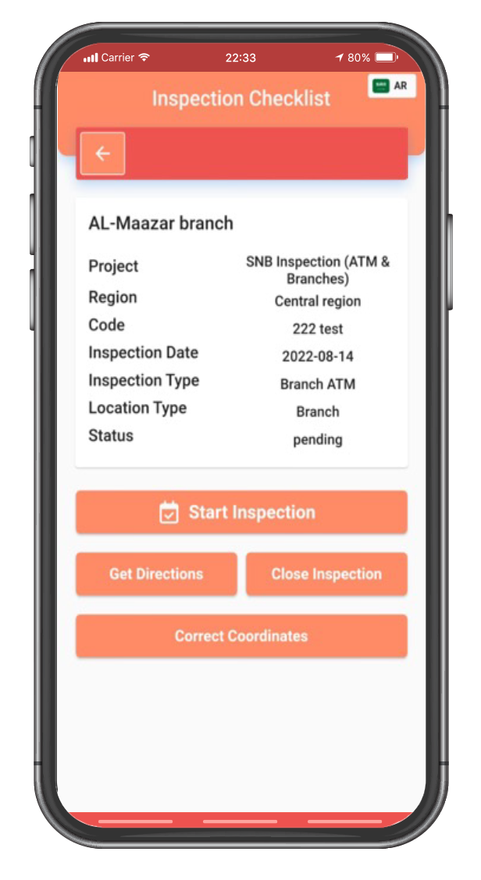
Application Functionality
Submission of
corrected coordinates
Notification process:
automated email to
admin
Admin updates
coordinates in bank
provided List
Reaching location
Close inspection due to
various reasons such as
(Location closed,
No permission to enter
the facility, ATM /
Branch not found etc )
Identified coordinate
errors
Manual correction
of locations
Updating coordinates
in the system
If no issues found on
entering the branch or
ATM, ‘ Start Inspection ’

Slide 12
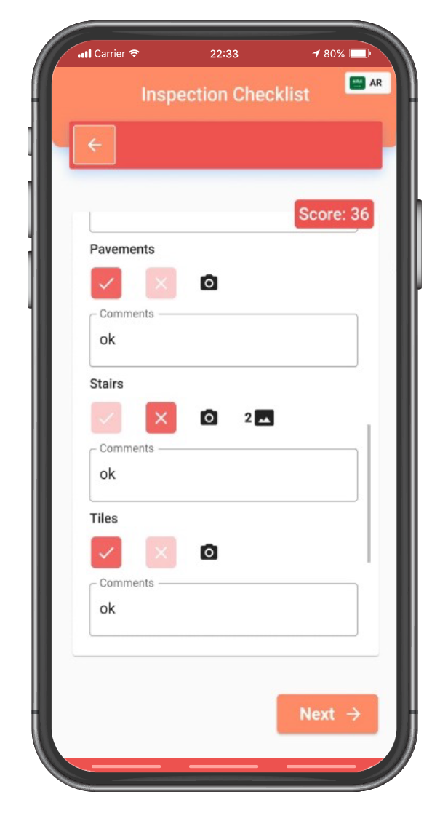
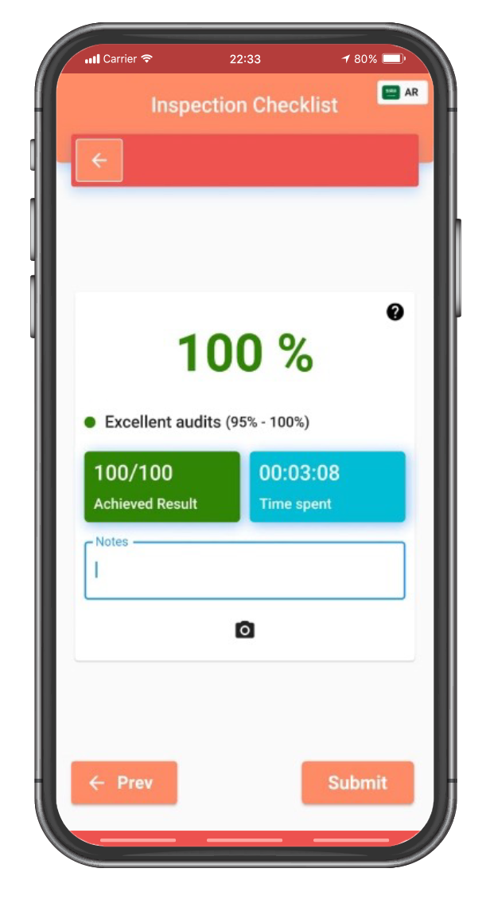


Application Functionality
Compliance with bank standards
Completion checklist:
If no issues: mark with a tick
If issues mark with a cross
Overall Audit Results and Time Spent.
Overall Comments
Documenting problem areas:
Modifications to the Checklist:
Mandatory upload of multiple
photographs for problematic areas.
Designated icon to upload
photographs.
Documentation of Compliance:
9-10 images as proof if no issues
are found in any category or
sub-category.
Completing each inspection section:
All sections are thoroughly
inspected.
Space for comments in each section.
Record discrepancies found in each section.

Slide 13

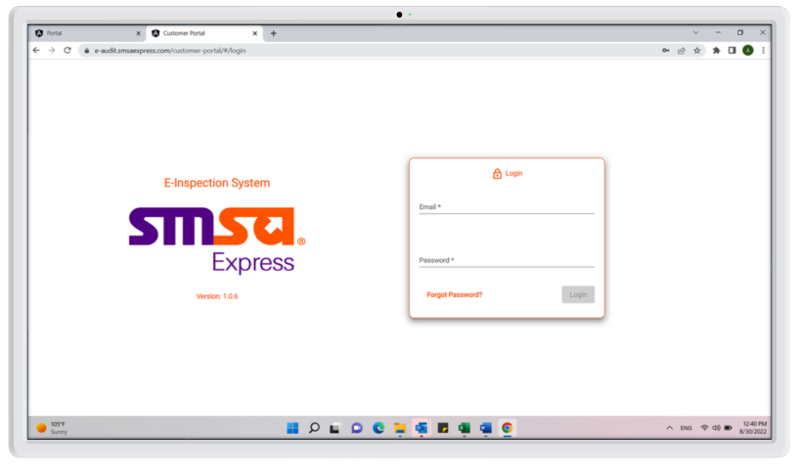
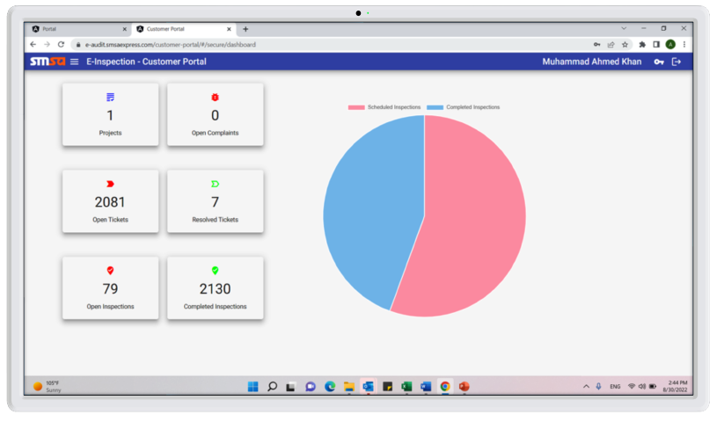
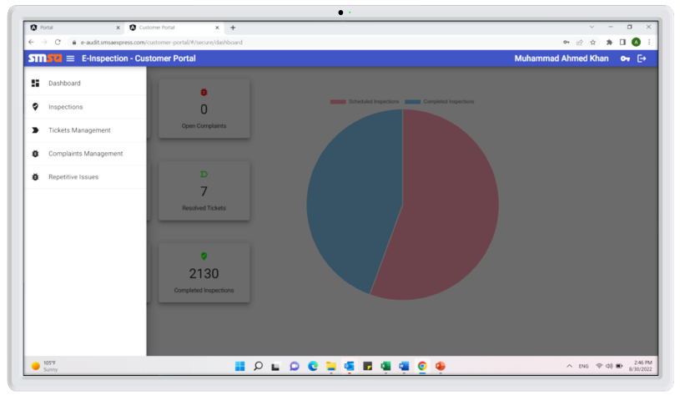
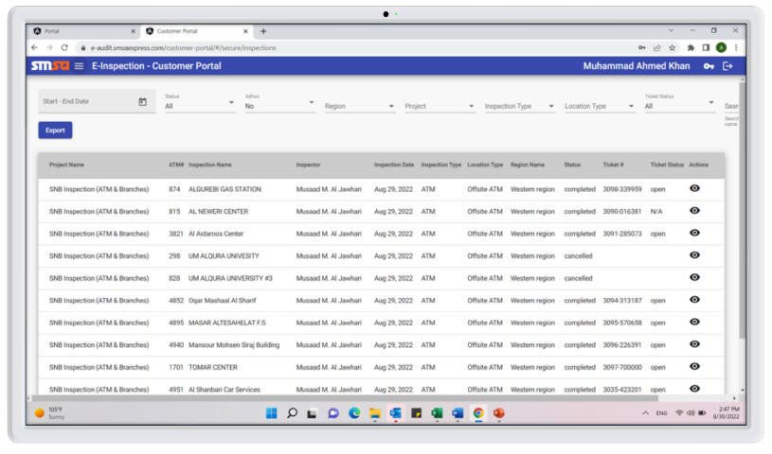
Customer Portal Functionality
1
2
Customer Portal
access login page :
Login credentials
given.
After login, the
dashboard screen
will appear to
view the inspections
summary
3
4
Click on Inspections
and the inspections
page will pop up.
All Inspections
details will appear.
Click on Actions

Slide 14
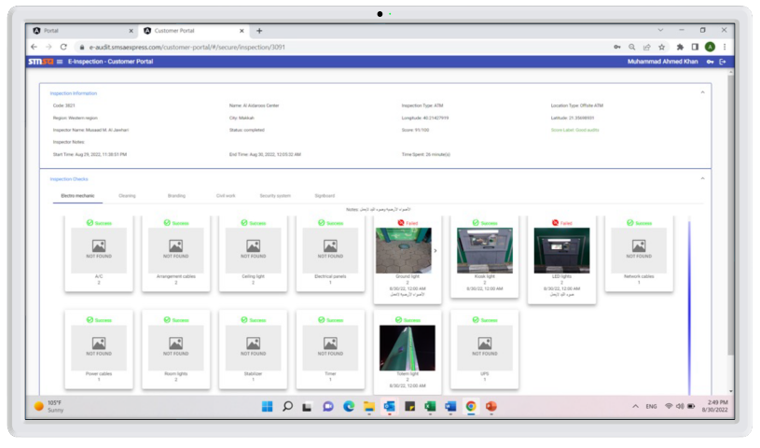
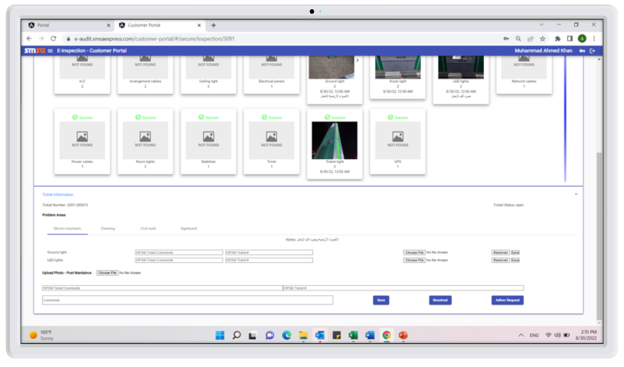
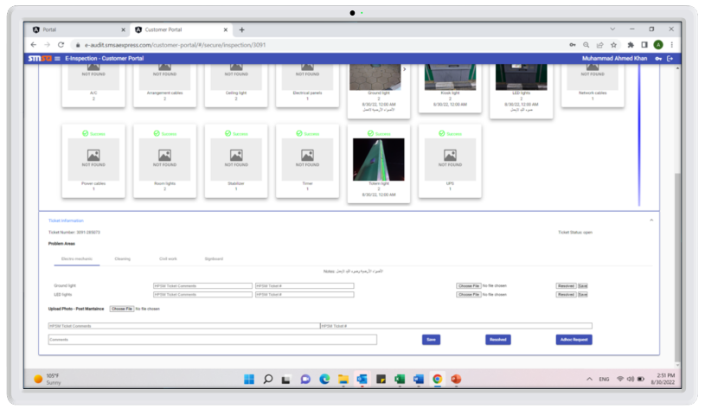
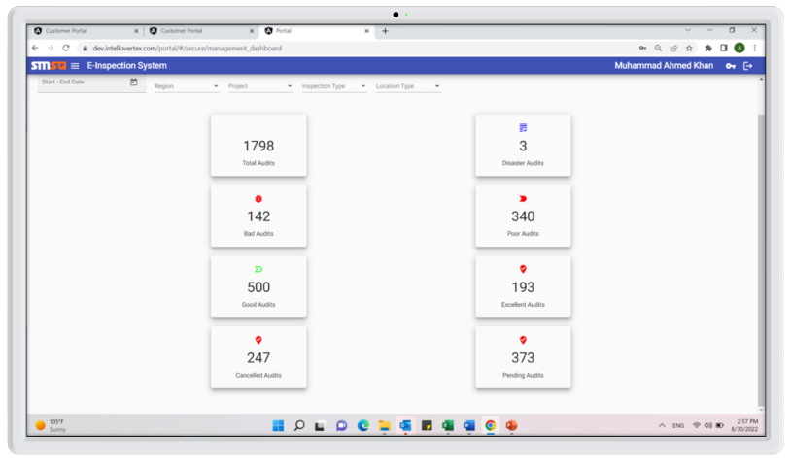
Customer Portal Functionality
5
6
Inspection report
will appear with
All inspections
details.
Continued Inspections
report shows the
ticket details which
will be initiated
in bank system and
will be recorded
in this screen.
7
8
After fixing the
issues the fixed
images will be
uploaded and
ticket will be
resolved.
Overall view
of all inspections
as a helicopter view
can be reviewed

Slide 15
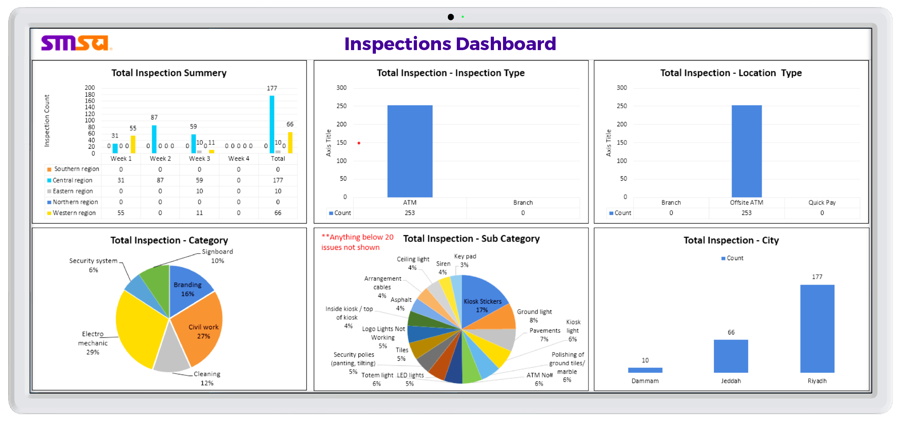
Customer Portal Functionality
Inspection Summary
Total Inspection - Inspection Type
Total Inspection - Location Type
Total Inspection - Category
Total Inspection - Sub Category
Total Inspection - City
*Above graphs are manually done in excel but populated from actual data extracted from SMSA system.
And the same interactive graphs will be implemented into system in the future.

Slide 16





Business Continuity
Network / Application Issues
Vehicle Breakdown
Vehicle Accident
Wrong Location
Sick / Absent

Slide 17

Inspection Project - Planning
KSA
UAE
BAH
EGY
QAT
1
Coordinates provided by the bank are divided into regions.
2
Routes optimized to ensure operational efficiency.
3
Closest districts first based on set travel time and total service time.
4
Spare time includes (Travel from house to location and back, parking, road closures, reroutes, follow-ups etc.).
5
Minimum 15 locations per day re adjusted considering the distance for travel and service time for each day.
6
Spare time set at min 30 min and maximum 2 hours excluding remote locations in the holy month of Ramadan.
7
Saturday is a day off during Ramadan to compensate for the extra working hours.
8
Business travel for remote locations based on SMSA Business Travel Policy.
USA
ZAF
KWT
OMN
JOR

Slide 18
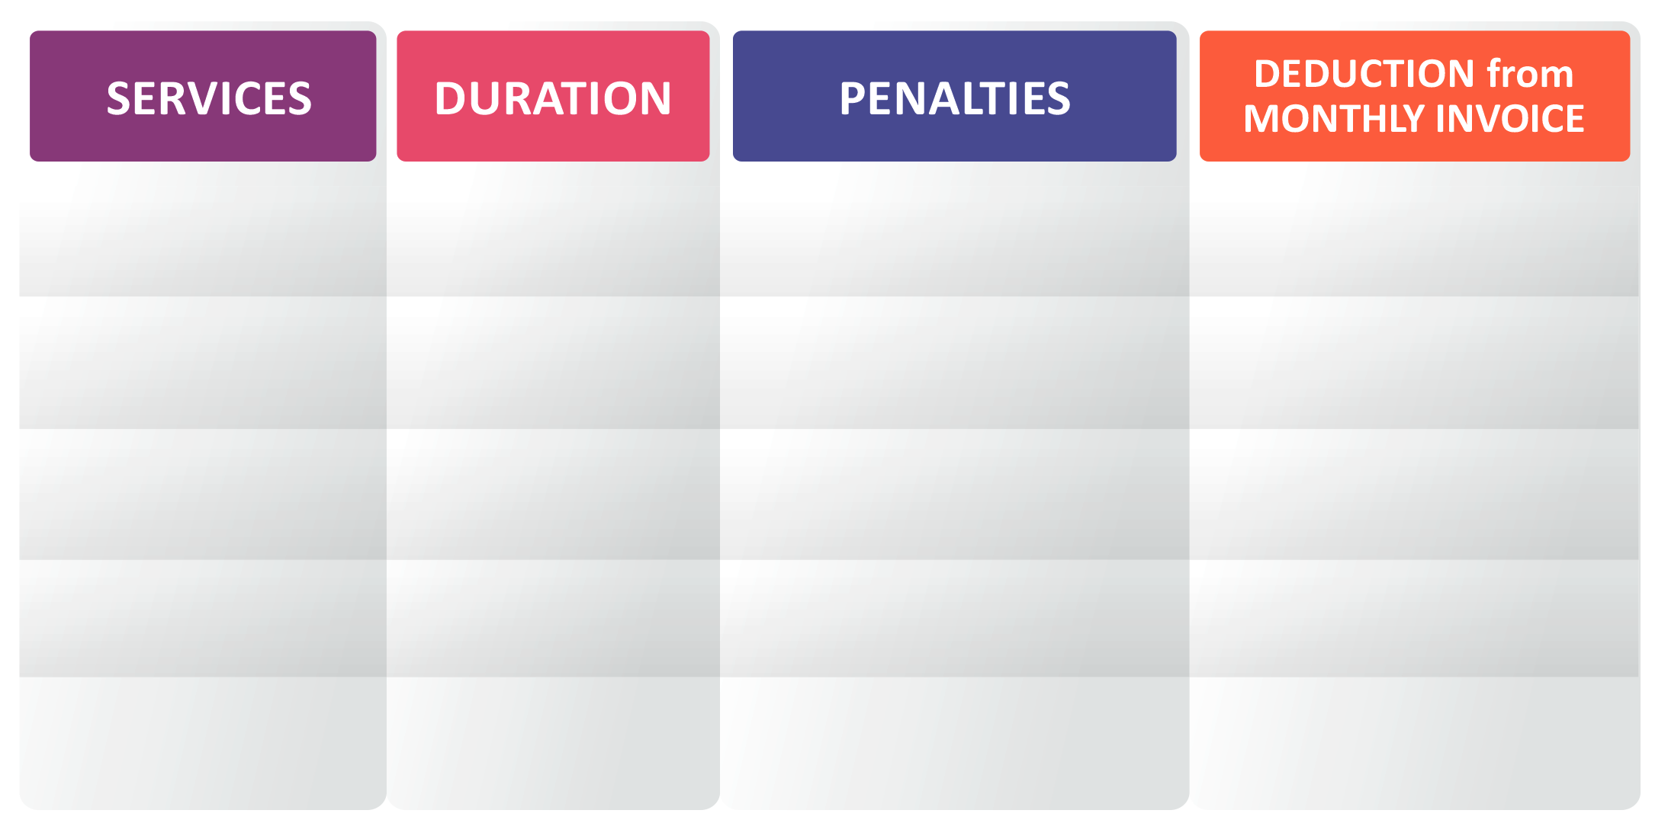
Inspection Project – Example of SLA
80 - 98% from the
monthly target
6%
60 - 79% from the
monthly target
7%
Monthly
visit
Targets Set
Monthly
40 - 59% from the
monthly target
8%
20 - 39% from the
monthly target
9%
0 - 19% from the
monthly target
10%

Slide 19














Inspection Project - Process
Bank Coordinates
Provided
Notification for
Adhoc visits
Adhoc Work - 24 hrs
main cities
72 hours remote
Photos must have
date & time stamp
SLA Signed
Inspection
Schedule
Available
Visit
Completed
Reports
Submitted
SLA
Fulfilled
Plan
Routes By
Region
Visit & Inspect
Branch / ATM
Submit
Inspection
Reports
Send STATS
To
customers
SITE AUDITOR
SITE AUDITOR
SITE AUDITOR
SITE AUDITOR

Slide 20




Inspection Project - Checks
Electro Mechanic
Electro Mechanic
Civil Works
B
R
A
N
C
H
Cleaning
Security Systems
A
T
M
Branding
Cleaning
Signboards
Branding
Signboards
Each inspection is customized to the customer requirements

Slide 21














Inspection Project - Escalations
Customer Charter
The purpose of this charter is to explain
to our customers about the level of
service they should expect from SMSA and
how they can give feedback on these services.
Managing
Director
QRM Director
Project
Manager
Our Aim
SMSA is committed to providing an excellent level of
customer service and strive to get it right from
the first time, every time. Occasionally,
things may not go according to plan and even
on these rare occasions when we had fallen short
of our very high standards, we will ensure that
we address and resolve your concerns and put things
right quickly and to your complete satisfaction.
Project
Supervisor
Project
Supervisor
Customers
Complaints

Slide 22




Inspection Project - Health & Safety
Method Statement (GUIDE doc. no.: 2873)
Working at Height
All regulatory requirements are followed
All SOPs followed
Training provided
Health & Safety equipment provided
to inspectors
All inspectors have uniforms.
Electrical Safety
General Safety

Slide 23

Google Maps Management Projects
Transforming Branch Accessibility
Through Google Maps:
A Strategic Improvement

Slide 24




Google Maps Management Project
- Strategy
IMPACT:
Facilitate easier customer access
and improve overall service experience
PURPOSE:
APPROACH:
Dramatically enhance the visibility and
operational clarity of Bank Branches
and ATMs on Google Maps
Targeted updates through a dedicated
team, ensuring high accuracy and
compliance

Slide 25

Google Maps Management Project - Example
- Scope & Objectives
Boost user Interaction
& Satisfaction
through enhanced digital
presence
Ensure each branch’s
details are
5 months
accurately reflected
on Google Maps
of Comprehensive
Coverages
To update and verify
Information for
25 branches
Updated per day,
Ensuring a steady and measurable progress
branches
across
5 major regions

Slide 26





Google Maps Management Project
- SMSA Team
Team Roles & Workflow
Utilize the expertise of SMSA staff
skilled in
DIGITAL MAPPING
& DATA HANDLING
Daily assignments
of branches
based on GEOGRAPHICAL
PLANNING
REAL-TIME
DATA CAPTURE
including photographs and operational hours
Update & verification within 24-48 hours as per
Google Maps
Secure necessary permits
from the bank

Slide 27













Google Maps Management Project
- Work Flow
If branch, Identity
Opening and closing
hours
Bank Coordinates
Provided
Maintain Database
SLA signed
Inspection
Schedule
Available
Facility
Identified
Take Photograph
and get
Location and
coordinates
Submitted
To Google
Map Admin
Upload
Complete
Plan
Routes By
Region
Identity
Branch/ ATM
Upload received
Information
To
Google Maps
SLA
Fulfilled
Submit
Reports
SITE AUDITOR
SITE AUDITOR
(s) E-Audits
SITE AUDITOR
GOOGLE MAP
ADMIN
SITE AUDITOR

Slide 28
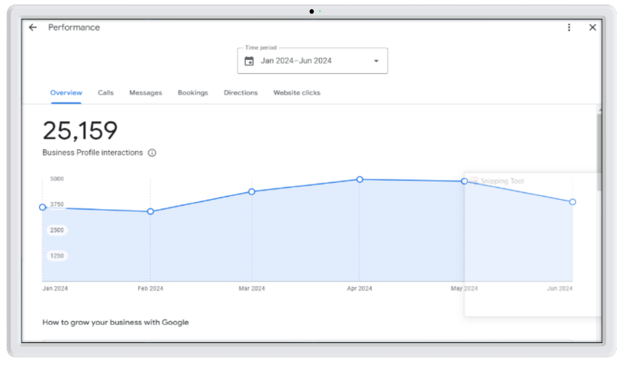
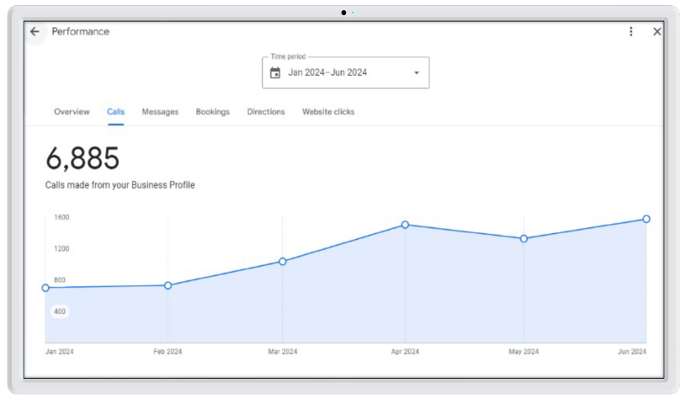
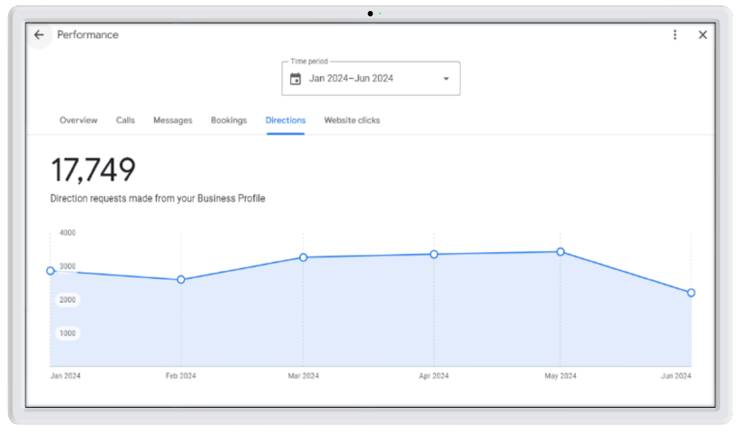
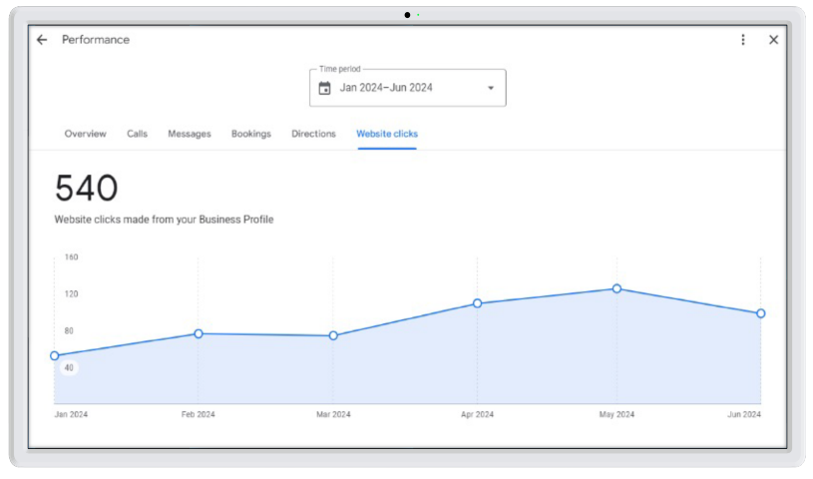
Google Maps Management Project
- Reporting
1
2
Overview Profile
Interaction
Calls Made
From the Business
Profile
3
4
Direction Requests
Made From the
Business Profile
Website Clicks
Made From the
Business Profile

Slide 29
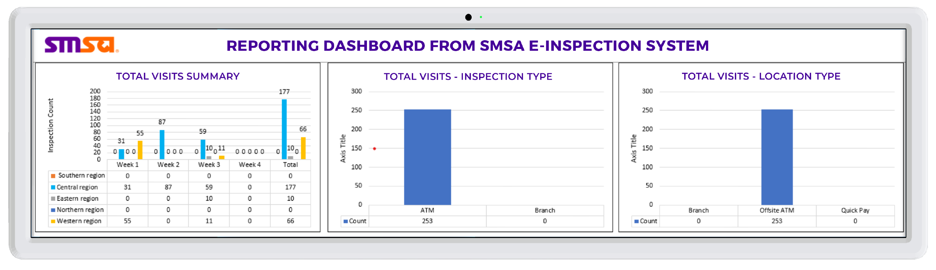
Google Maps Management Project
- Reporting
* The above graphs are manually done in Excel but populated from actual data extracted from the SMSA system.
And the same interactive graphs will be implemented into the system in the future.

Slide 30

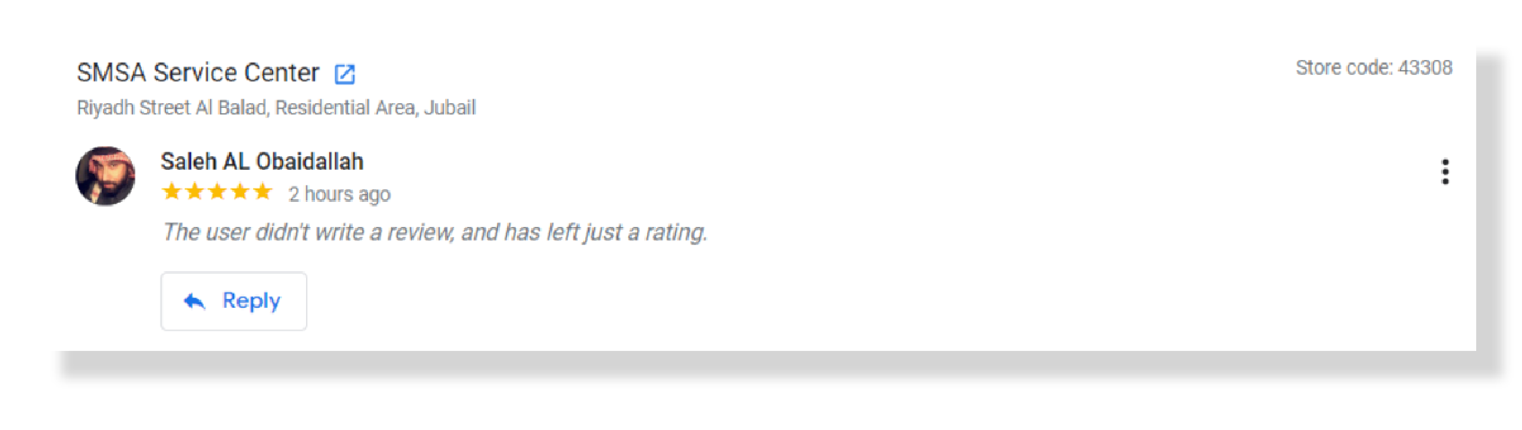
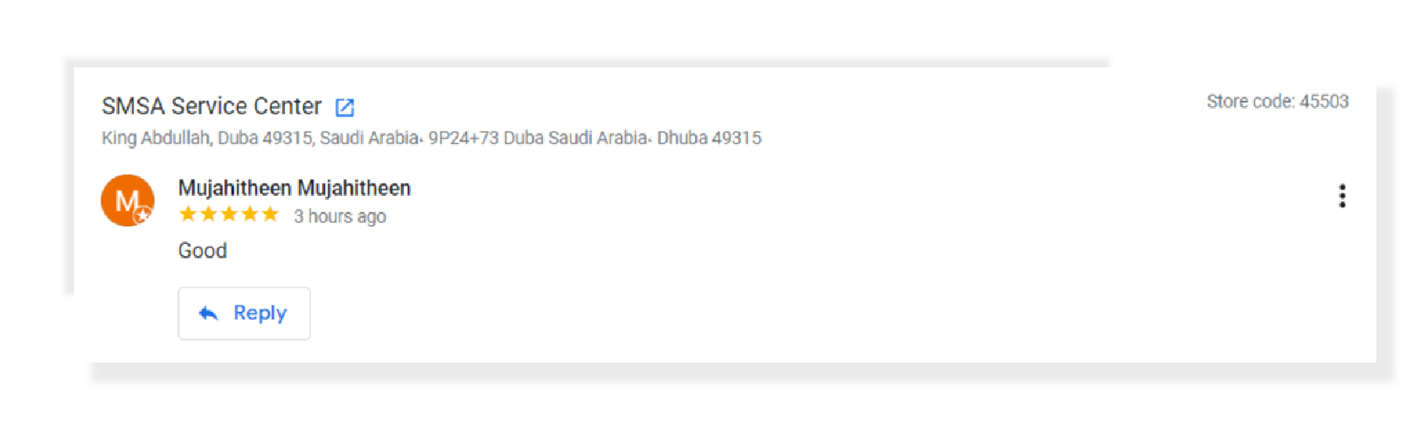
Google Maps Management Project
- Add on Services – Manage Reviews

Slide 31
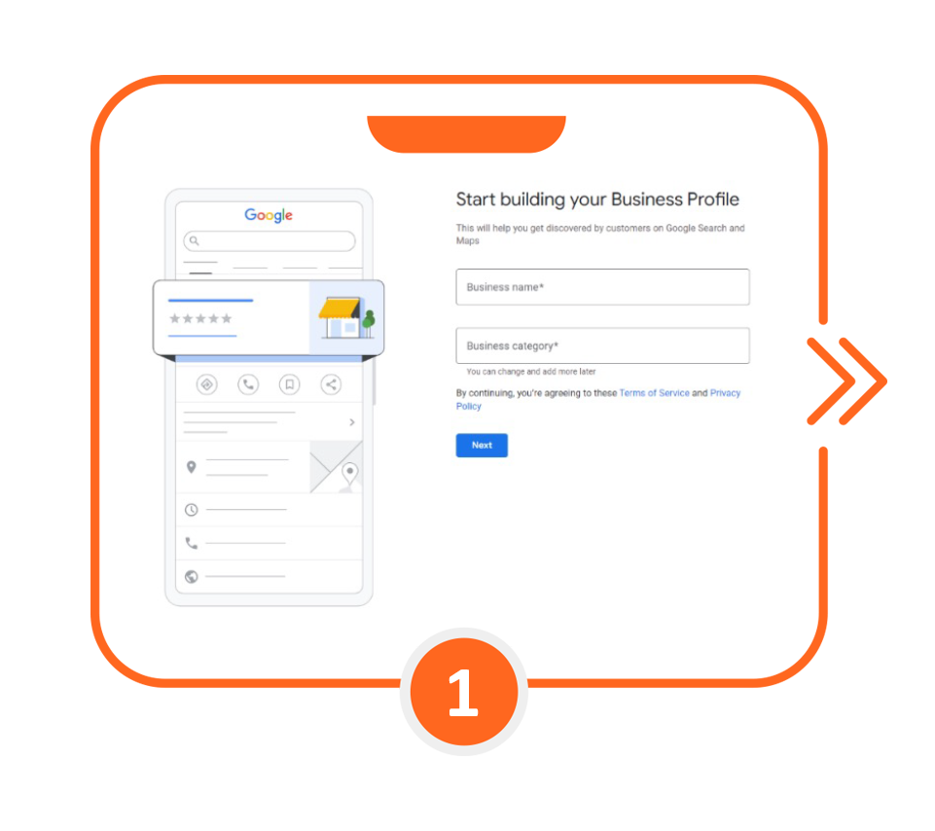
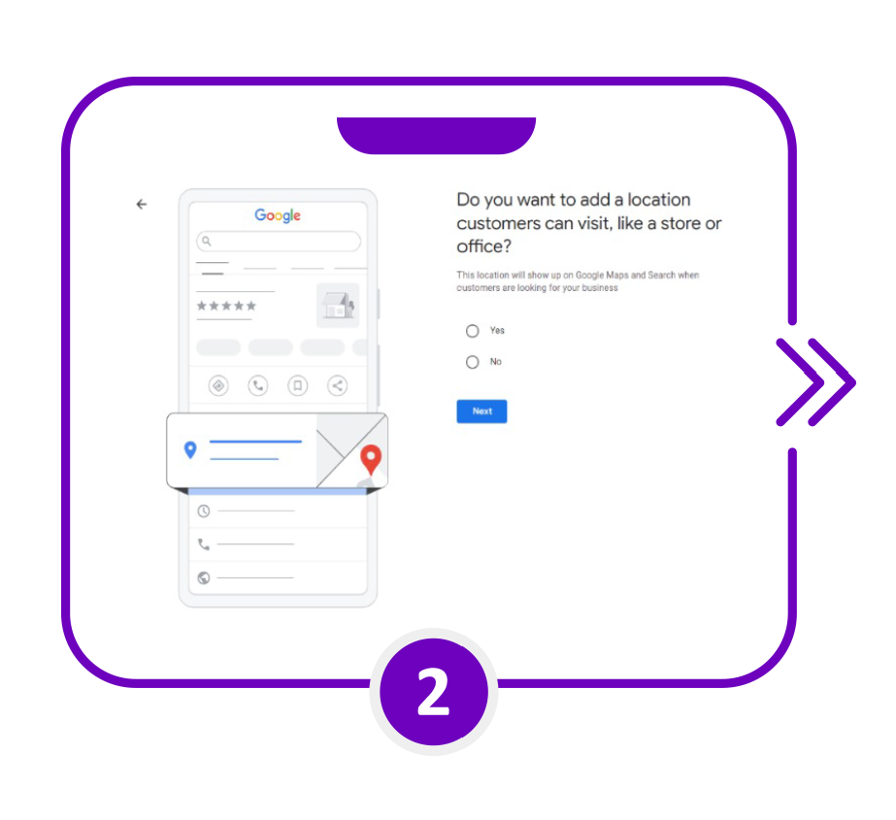
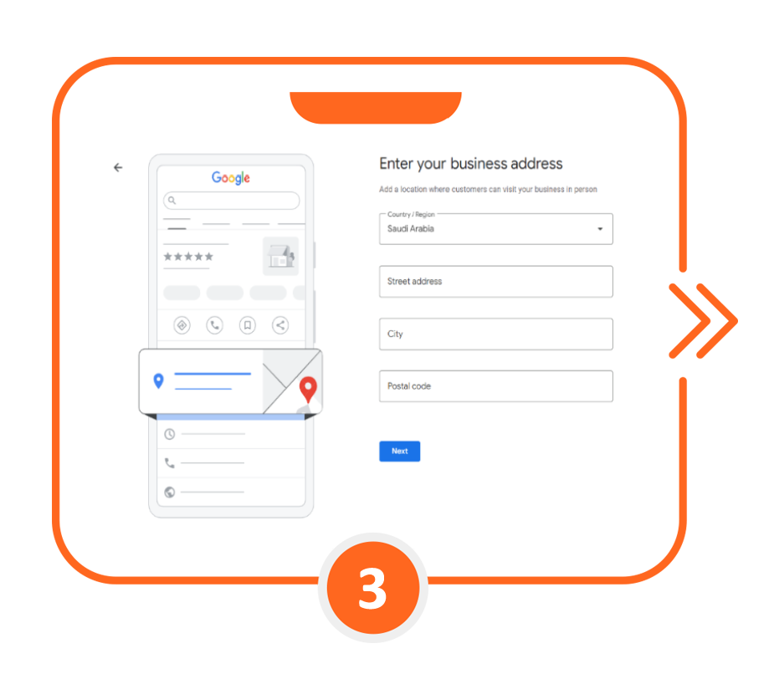
Google Maps Management Project
- Process

Slide 32
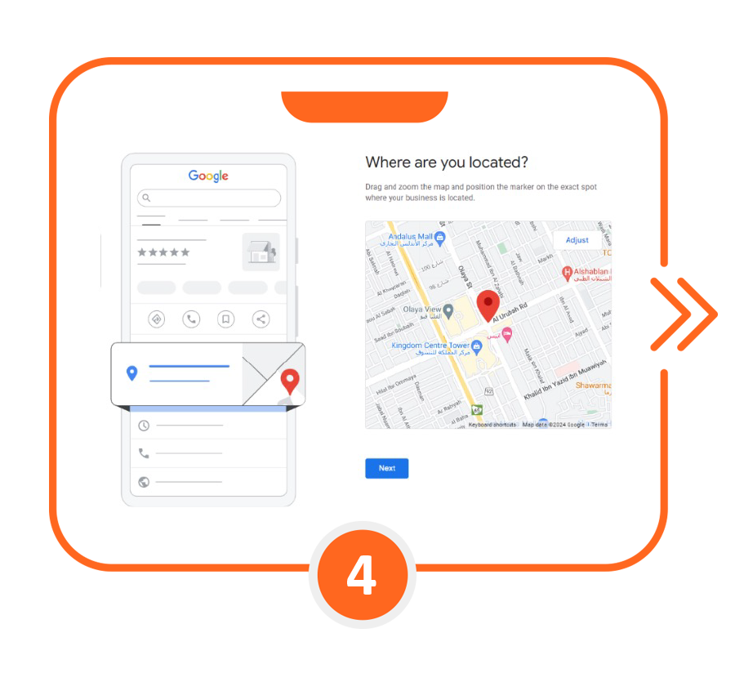
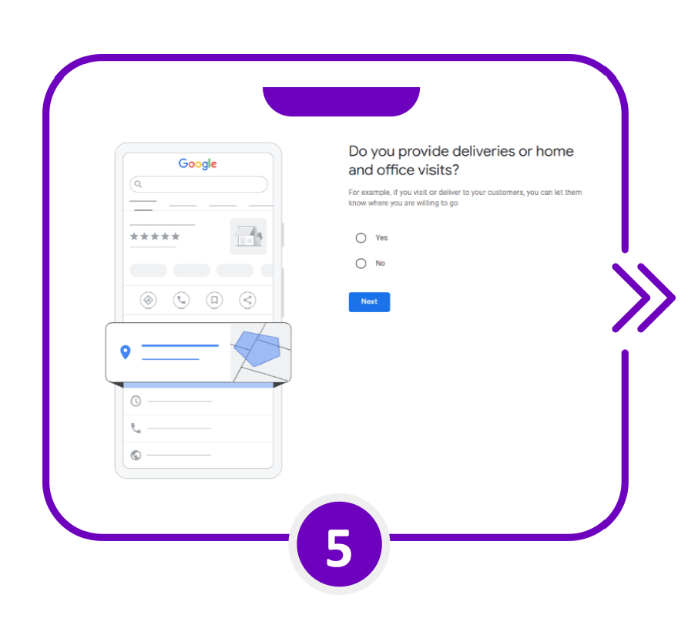
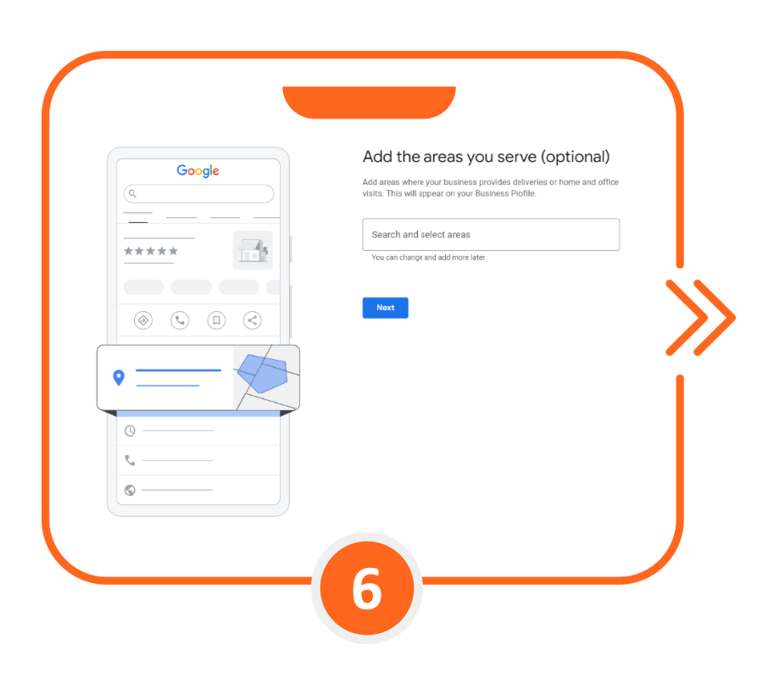
Google Maps Management Project
- Process

Slide 33
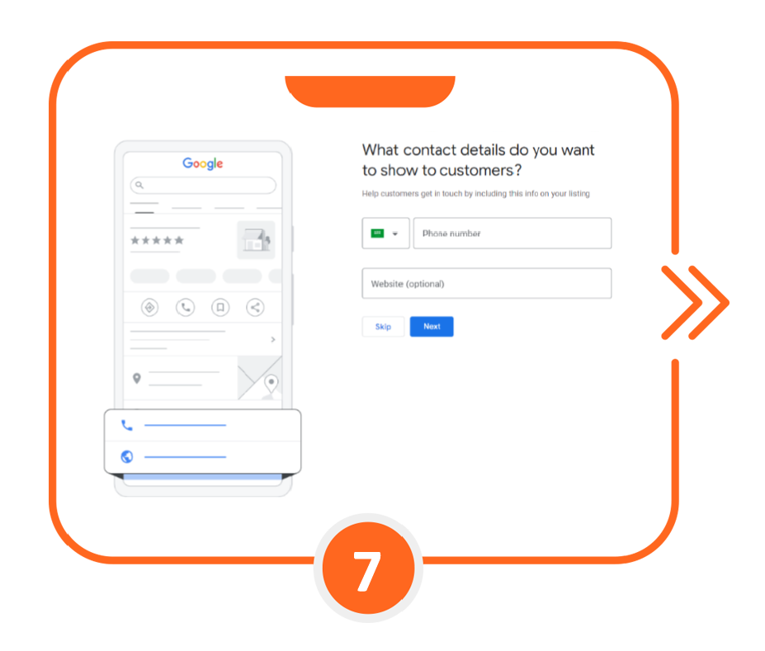
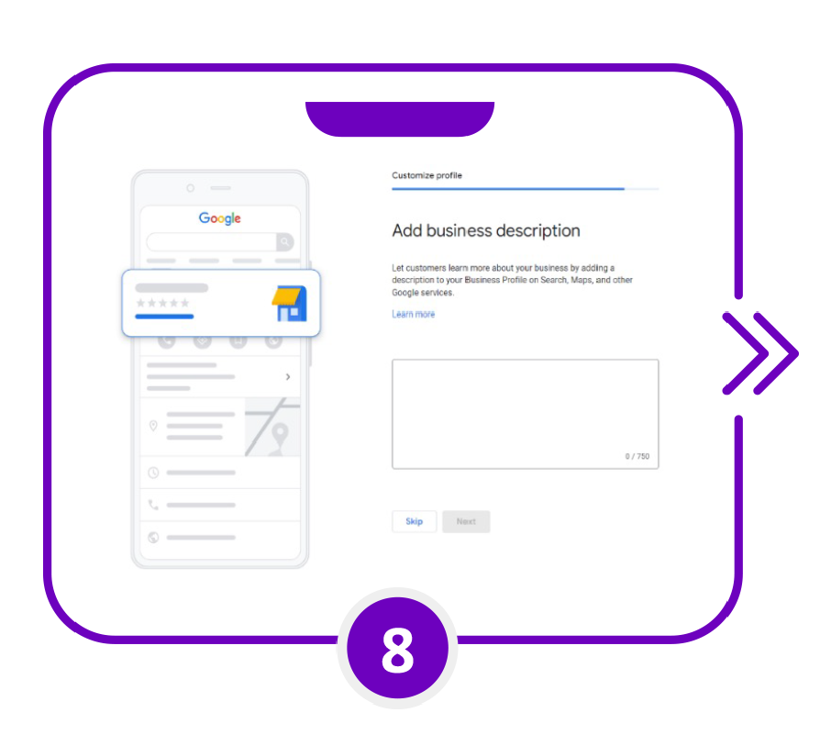
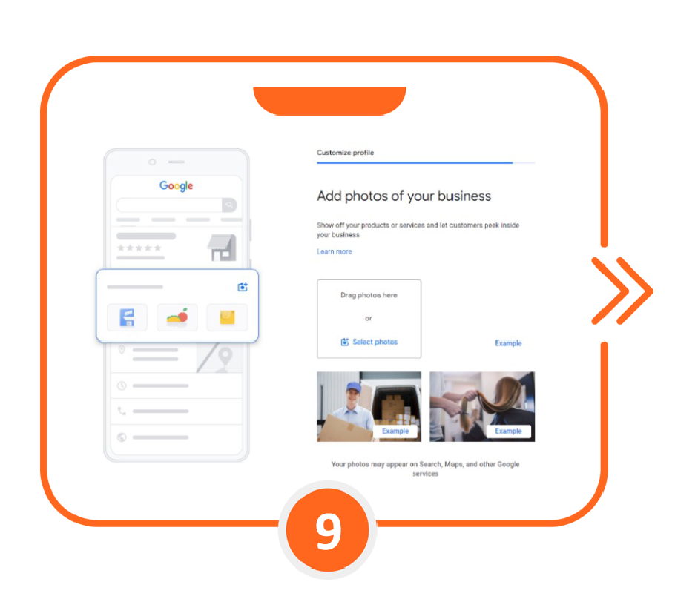
Google Maps Management Project
- Process

Slide 34
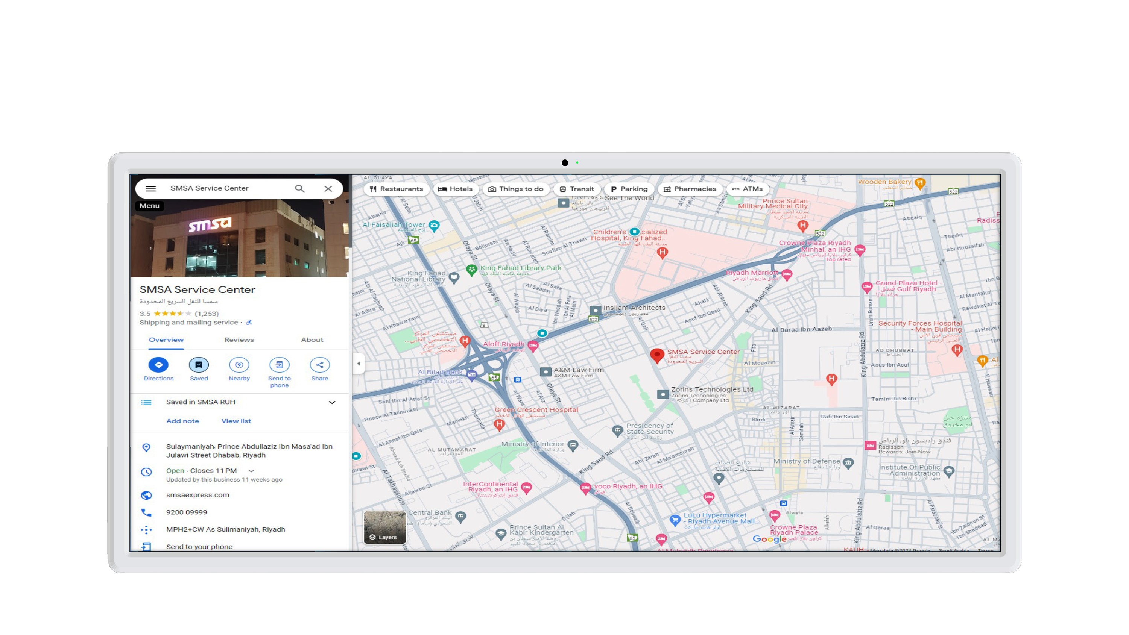
Google Maps Management Project
- Process

Slide 35




Google Maps Management Project
- Benefits to the Banks
Customer First Approach
Enhance navigational ease for customers, ensuring seamless
access to branch locations and services, ultimately boosting
satisfaction levels.
Operational Excellence
Ensure accuracy and consistency in branch information
across all platforms, optimizing customer interactions both
online and offline.
Brand Visibility
Strengthen Bank's online presence and accessibility
through Google Maps, reinforcing our commitment to
technological integration and customer-centricity

Slide 36

Our Clients and Partners

Slide 37

Our Clients and Partners

Slide 38

Our Clients and Partners

Slide 39

Our Clients and Partners

Slide 40
THANK YOU
Any Questions?

