Slide 1
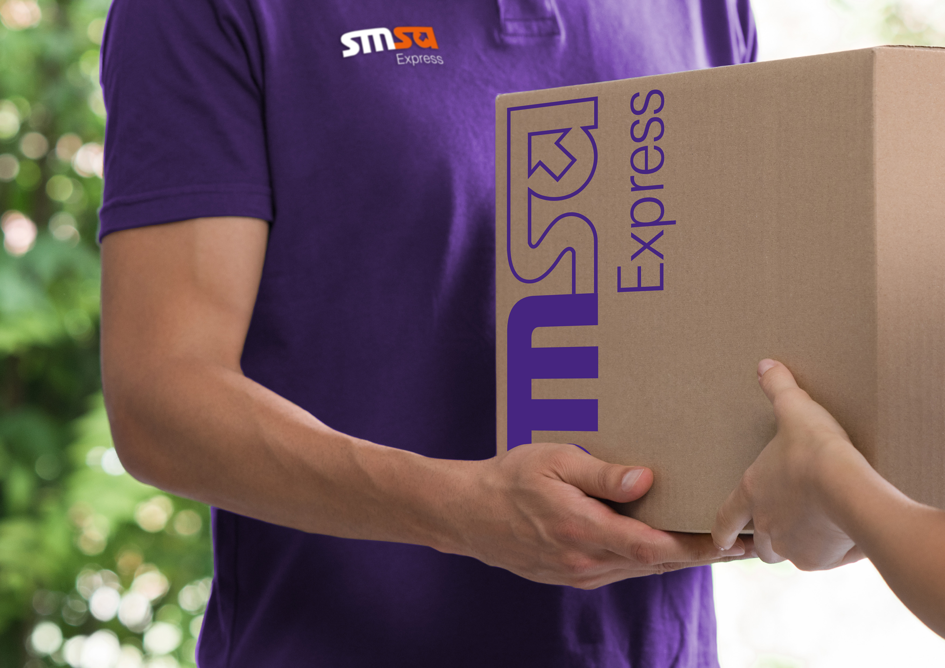

SNB Inspection Training

Slide 2


Content
Staff Responsibilities
Staff Uniform
Vehicles Maintenance
Project SLA/ Scope/Structure
Project SOP /Process
Inspections Job Aid
Health & Safety Guidelines
Routes & Plans
Contingency , Escalations & Actions
Application Guidelines
“Copyrights: All rights are reserved, no part of this presentation can be reproduced or copied by any means except with written permission from SMSA Express Transportation Co. Ltd.”

Slide 3
Course Objectives
Why are you having this training?
SMSA policy and procedures are followed
Requirement of SLA are well communicated
Understanding your role and responsibilities
SLA’s are followed and compliance ensured
Understanding method of inspections
Ensuring health & safety
Objectives achieved and avoid penalties
“Copyrights: All rights are reserved, no part of this presentation can be reproduced or copied by any means except with written permission from SMSA Express Transportation Co. Ltd.”

Slide 4
Auditor Responsibilities
Updated inspection plans maintained
Inspections carried out as per plan
Trained on inspections and specialized services applications
Operational Incident reporting
Maintaining health & safety
Policies/ Process/ SLA Compliance
“Copyrights: All rights are reserved, no part of this presentation can be reproduced or copied by any means except with written permission from SMSA Express Transportation Co. Ltd.”

Slide 5
Staff Uniform
Why is it important to wear proper uniform & ID badges?
To identify you as SMSA employee
To project a professional company Image
Important Points to Remember:
Uniforms should be used ONLY for work.
Uniforms must be clean and in good state of repair
Shoes must be worn with the uniform. No ‘flip flops’
Smart appearance will create a good impression for both you and SMSA.
*For more details please refer to SMSA Dress Code, Uniform and Appearance Policy (GUIDE doc. no. 32)
“Copyrights: All rights are reserved, no part of this presentation can be reproduced or copied by any means except with written permission from SMSA Express Transportation Co. Ltd.”

Slide 6
Vehicles Maintenance
DO’s
Keep your vehicle clean and neat. Dirty vehicles will be subject to penalties as per policy
Check the oil level, tires condition, air pressure and continuously observe the vehicle’s dash board and report any mechanical failure immediately to the fleet in charge
Drive in accordance to the traffic rules and regulations
Maintain list of emergency contacts in the vehicle
Vehicles must be taken for periodic maintenance whenever it’s due for maintenance according to the sticker
DON’T
Installation of glass shading is prohibited
Smoking inside the vehicle is not allowed
Rash driving and racing leads to termination of service.
Vehicles must not be handed over to unauthorized persons
Do not carry family or non family members during duty hours
*For more details please refer to SMSA Fleet Rules & Regulations & Co. Car Policy
“Copyrights: All rights are reserved, no part of this presentation can be reproduced or copied by any means except with written permission from SMSA Express Transportation Co. Ltd.”

Slide 7
Project Structure
QRM Director
Floaters
Safety & Security Manager
Project Coordinator x 4
Site Auditor
Central Region
Site Auditor
Eastern Region
Site Auditor
Western Region
Site Auditor
Northern Region
Site Auditor
Southern Region
“Copyrights: All rights are reserved, no part of this presentation can be reproduced or copied by any means except with written permission from SMSA Express Transportation Co. Ltd.”

Slide 8
Scope of Project
Project Reports
Duty hours
Updating plans
Weekly, Monthly & Quarterly reports to be submitted on the 5th of the month
Night duty timing from
8 pm to 4 am.
Day duty timing from
8 am to 4 pm.
Maintain updated locations in the plan and ensure status of inspection is updated on weekly basis
Planned Inspections
Adhoc inspections
Inspections Report
Quarter 1 & 3
Night Schedule
Cover ATM & Branches
Quarter 2 & 4
Day Schedule
Cover ATM’s only
Emergency visit to be performed within 24h for main cities and 72h for remote cities
Report Inspections findings through application.
5-9 photos for each ATM / Branch with time stamping (Date/Time)
99% inspection TBD per Quarter
“Copyrights: All rights are reserved, no part of this presentation can be reproduced or copied by any means except with written permission from SMSA Express Transportation Co. Ltd.”

Slide 9

Inspection Planning Criteria
Coordinates provided by the bank are divided into 5 regions
Routes optimized to ensure operational efficiency
Closest districts first based on set travel time and total service time.
Spare time includes ( Travel from house to location and back, parking, road closures, reroutes, follow-ups etc)
Minimum 15 locations per day re adjusted considering the distance for travel and service time for each day
Spare time set at min 30 min and maximum 2 hours excluding remote locations and month of Ramadan.
Saturday is day off during Ramadan to compensate for the extra working hours
Business Travel for remote locations based on SMSA Business travel policy i.e. 300 km (from base to boundary)
*For more details please refer to Inspection Plan
“Copyrights: All rights are reserved, no part of this presentation can be reproduced or copied by any means except with written permission from SMSA Express Transportation Co. Ltd.”

Slide 10


Inspection Plan
REGION | ATM’s & BRANCHES
CENTRAL | 617
WESTERN | 742
EASTERN | 332
NORTHERN | 160
SOUTHERN | 505
Q1 & 3
Night
26 %
15%
31%
7 %
21 %
Central
Eastern
Western
Northern
Southern
REGION | ATM’s ONLY
CENTRAL | 439
WESTERN | 593
EASTERN | 225
NORTHERN | 121
SOUTHERN | 412
Q2 & 4
Day
24 %
13 %
33 %
7 %
23 %
Central
Eastern
Western
Northern
Southern
“Copyrights: All rights are reserved, no part of this presentation can be reproduced or copied by any means except with written permission from SMSA Express Transportation Co. Ltd.”

Slide 11
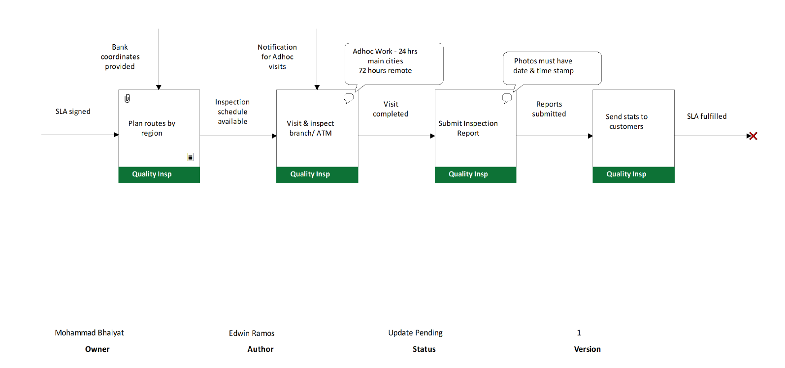
Inspection Process
“Copyrights: All rights are reserved, no part of this presentation can be reproduced or copied by any means except with written permission from SMSA Express Transportation Co. Ltd.”

Slide 12
Objectives KPI’s
ACTIONS
OBJECTIVES
Always start your duty on time. Input the coordinates on google maps as per your plan and visit and inspect the ATM/Branch
To achieve the Inspection Plan - 100%
(Measured based on Inspection Reports)
Site Auditor
Objectives
Complete the inspection checklist per atm/ branch and submit the inspection report along with the photos on the inspection application
To achieve all Adhoc Visit - 100%
(Measured based on adhoc Reports)
Ensure 99% completion of inspections and update status of inspections on weekly basis
“Copyrights: All rights are reserved, no part of this presentation can be reproduced or copied by any means except with written permission from SMSA Express Transportation Co. Ltd.”

Slide 13
Check Lists
BRANCH
ATM
Electro mechanic
Electro mechanic
Civil Works
Cleaning
Security Systems
Branding
Cleaning
Signboards
Branding
Signboards
*For more details please refer to Inspection Checklist
“Copyrights: All rights are reserved, no part of this presentation can be reproduced or copied by any means except with written permission from SMSA Express Transportation Co. Ltd.”

Slide 14
Inspections Job Aid
“Copyrights: All rights are reserved, no part of this presentation can be reproduced or copied by any means except with written permission from SMSA Express Transportation Co. Ltd.”

Slide 15

Health & Safety
Working At Height
Electrical Safety
General Safety
Notify supervisor in case of incident /accident immediately
Maintain tools and PPE’s in good state of repair.
Ensure replacement/repairs are done for all tools/ PPE’s in bad condition
Get training on health and safety
Maintain list of emergency contacts on hand /vehicle
Use rubber insulated step ladders
Ensure all four feet are in contact with the ground
Place ladder on stable ground
Place signage/barrier beside the working area
Do pre-use check every time (rungs, hand rail and foots)
Ensure locking mechanism is engaged
Maintain three points of contact at the working position (feet, hand, body)
Avoid holding heavy items while climbing (use tool belt)
Use plastic/rubber insulated tools (screw drivers, pliers etc)
Use approved electric rated safety gloves
Visually inspect the area for open frayed wiring before placing hand in the area.
Stay away from exposed electrical parts
Do not touch anything electric with wet hands
Wear safety shoes
Wear safety glasses
Leave electrical repairs to qualified personnel.
*For more details please refer to Method Statement (GUIDE doc. no. 2873)
“Copyrights: All rights are reserved, no part of this presentation can be reproduced or copied by any means except with written permission from SMSA Express Transportation Co. Ltd.”

Slide 16
SLA Penalties
Services | Duration | Penalties | Deduction from monthly invoice
Visit the monthly target | Monthly | 80-98% from the monthly target | 6%
 |  | 60-79% from the monthly target | 7%
 |  | 40-59% from the monthly target | 8%
 |  | 20-39% from the monthly target | 9%
 |  | 0-19% from the monthly target | 10%
“Copyrights: All rights are reserved, no part of this presentation can be reproduced or copied by any means except with written permission from SMSA Express Transportation Co. Ltd.”

Slide 17
Contingency
Vehicle breakdown
Vehicle Accident
Wrong Location
Sick / Absent
Network/ Application Issues
“Copyrights: All rights are reserved, no part of this presentation can be reproduced or copied by any means except with written permission from SMSA Express Transportation Co. Ltd.”

Slide 18
Contingency
What to do in case of vehicle accident ?
Turn off ignition
Turn on hazard lights
Do not admit guilt.
Call Najm / Traffic Police
Call the supervisor
Obtain accident slip
Report to regional fleet dept
Visit rental Co
Get Replacement
Assign route to floater
Locations covered in the same month
Update the inspection plan and communicate to inspector
What to do in case of vehicle breakdown ?
Move vehicle to the
side and put up
hazard sign
Call rental emergency number
Call the supervisor
Wait for mobile workshop
OR
Get venge and report to regional fleet dept
Visit rental Co
Get replacement
Inform supervisor
Provide necessary approvals and ensure staff receives vehicle on time
“Copyrights: All rights are reserved, no part of this presentation can be reproduced or copied by any means except with written permission from SMSA Express Transportation Co. Ltd.”

Slide 19
Contingency
What to do if you identify wrong physical location?
Take note of the route code and proceed to next location as per plan
Inform the supervisor
Ensure updated plans maintained
Forward details to the bank and get the updated coordinates
Update the plan and communicate to the inspector
“Copyrights: All rights are reserved, no part of this presentation can be reproduced or copied by any means except with written permission from SMSA Express Transportation Co. Ltd.”

Slide 20
Contingency
Contingency
What to do if you face network/application/ device failure?
Complete inspection on hard copies of inspection checklists
Network/App
Update the manually completed inspection data on the application and submit
Inform the supervisor
Debug
application
Device
If device functional/ replaced update manually inspected data
and submit
If not then soft copies of manual checklist and photos to be submitted to the coordinators by email
Submit device for maintenance/ replacement
“Copyrights: All rights are reserved, no part of this presentation can be reproduced or copied by any means except with written permission from SMSA Express Transportation Co. Ltd.”
“Copyrights: All rights are reserved, no part of this presentation can be reproduced or copied by any means except with written permission from SMSA Express Transportation Co. Ltd.”

Slide 21
Contingency
Case of sick / Emergency Leave
Inform the supervisor
in any scenario
If sick visit the healthcare centre and get sick leave
Obtain updated plans and proceed for inspections as per plan
Assign route to floater
Locations covered in the same month
Update the plan and communicate to the inspector
Provide necessary approvals and update SSHR
*For more details please refer to SMSA Employee Leaves Policy
“Copyrights: All rights are reserved, no part of this presentation can be reproduced or copied by any means except with written permission from SMSA Express Transportation Co. Ltd.”

Slide 22

Escalations
Director - QRM
Safety & Security Manager
All issues and concerns must be brought to the attention of the project supervisor
“Copyrights: All rights are reserved, no part of this presentation can be reproduced or copied by any means except with written permission from SMSA Express Transportation Co. Ltd.”

Slide 23
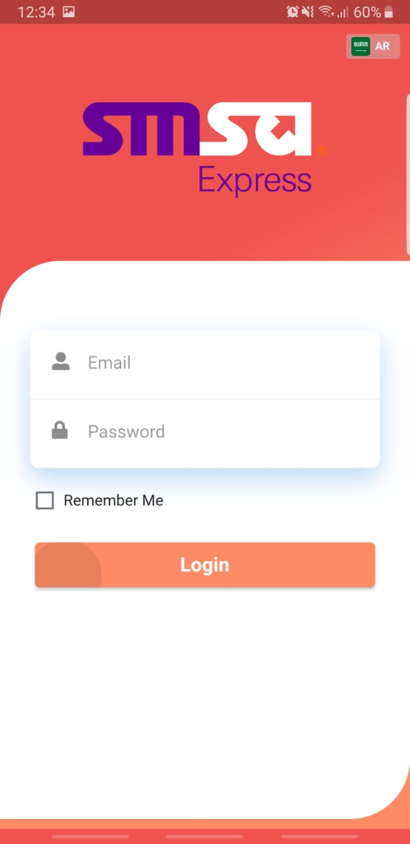

Application Guidelines
  Sign in Page will appear in your Mobile screen
  Sign in using your SMSA email
  Use the password which has been given to you (Do not share your password with anyone)
  Click on “Remember me” to save the password on your phone.
  Login
“Copyrights: All rights are reserved, no part of this presentation can be reproduced or copied by any means except with written permission from SMSA Express Transportation Co. Ltd.”

Slide 24
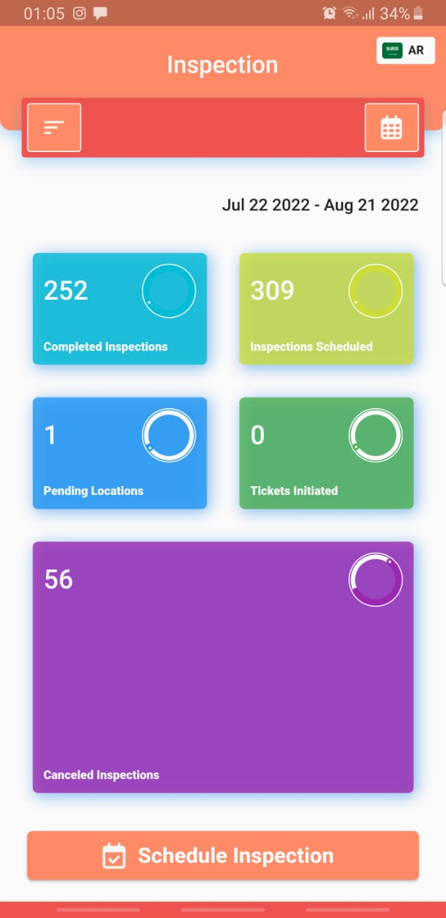
Application Guidelines
  Select the date of inspections.
  Select the date
  Select the schedule inspections
  Dash board will show your Completed, Scheduled, Cancelled and Pending inspections.
  Click on Scheduled inspections
“Copyrights: All rights are reserved, no part of this presentation can be reproduced or copied by any means except with written permission from SMSA Express Transportation Co. Ltd.”

Slide 25
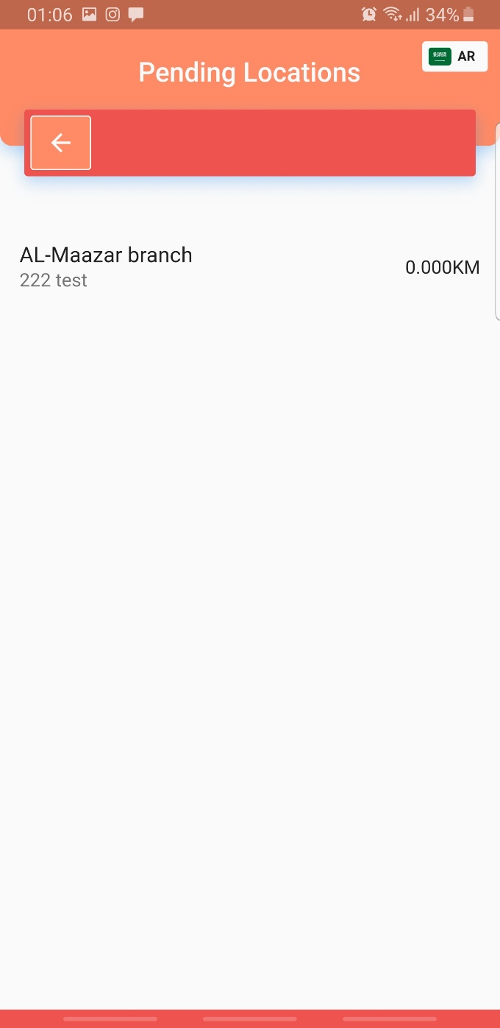
Application Guidelines
  List of scheduled inspection will appear on your screen. Select the inspection accordingly.
“Copyrights: All rights are reserved, no part of this presentation can be reproduced or copied by any means except with written permission from SMSA Express Transportation Co. Ltd.”

Slide 26
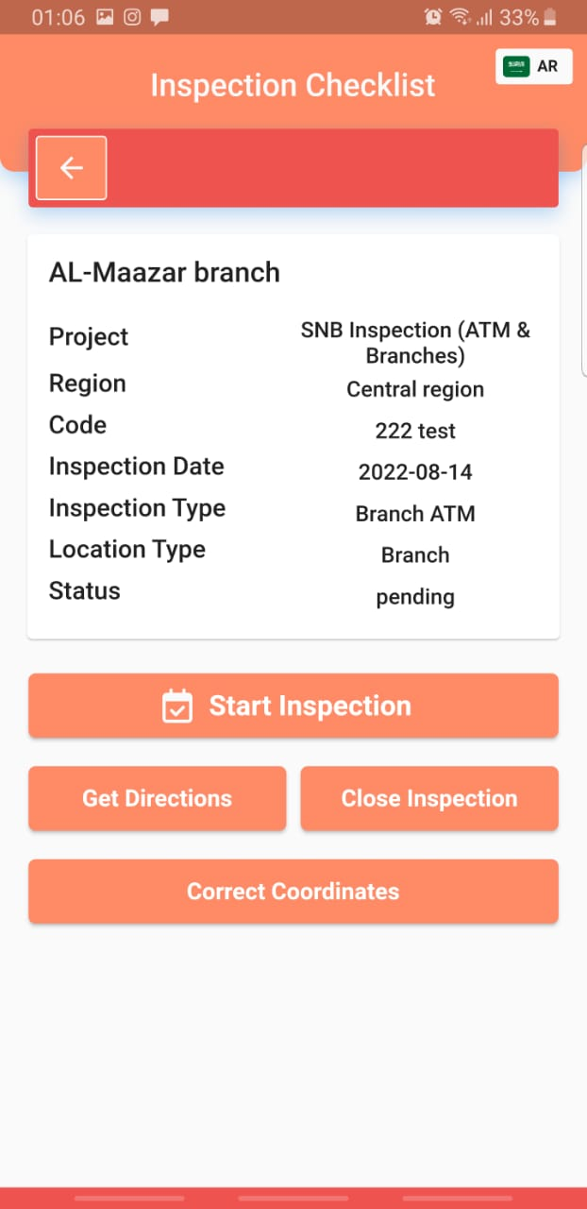
Application Guidelines
  Click on Get directions and GPS Maps will open with the directions of the location.
“Copyrights: All rights are reserved, no part of this presentation can be reproduced or copied by any means except with written permission from SMSA Express Transportation Co. Ltd.”

Slide 27
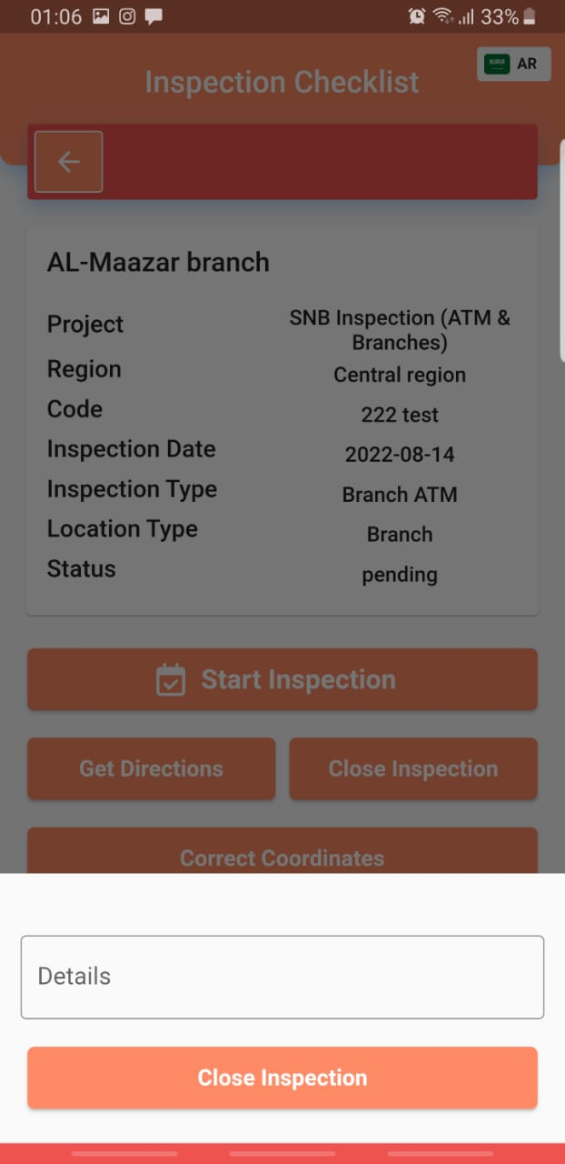
Application Guidelines
  After reaching to the location, Close the inspection due to various reasons such as (Location closed, No permission to enter the facility, ATM / Branch not found etc )
“Copyrights: All rights are reserved, no part of this presentation can be reproduced or copied by any means except with written permission from SMSA Express Transportation Co. Ltd.”

Slide 28
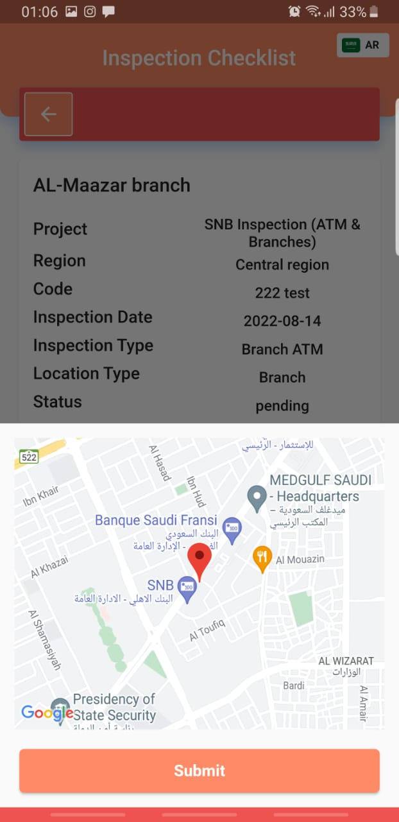
Application Guidelines
  After reaching to the location if found that the coordinates are wrong then physically reached to correct location and update the coordinates by selecting correct coordinates
  Submit the correct coordinates. Email will be sent to Admin and admin will update the coordinates in the list provided by SNB
“Copyrights: All rights are reserved, no part of this presentation can be reproduced or copied by any means except with written permission from SMSA Express Transportation Co. Ltd.”

Slide 29
Application Guidelines
  If no issues found on entering the branch or ATM, then click on ‘Start Inspection’.
“Copyrights: All rights are reserved, no part of this presentation can be reproduced or copied by any means except with written permission from SMSA Express Transportation Co. Ltd.”

Slide 30
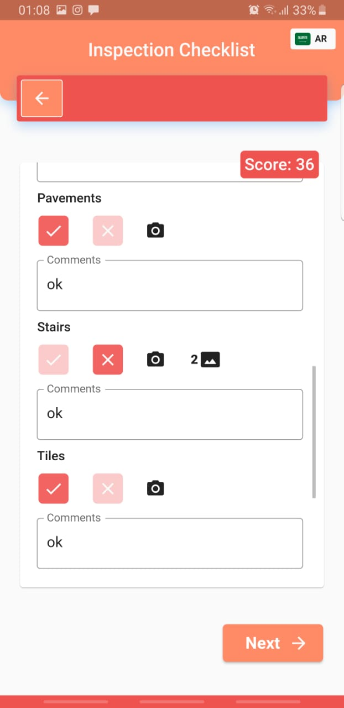
Application Guidelines
Important Note
  Ensure each section of the inspection is completed. Each section has a space for comments. Write what you found wrong in this section
  If all of the section meets the bank standards and there are no issues found then Tick  and write the comments
  Tick x the area that has a problem. And uploading the problematic multiple pictures is mandatory.
  Click on the icon and upload the pictures with problems.
“Copyrights: All rights are reserved, no part of this presentation can be reproduced or copied by any means except with written permission from SMSA Express Transportation Co. Ltd.”

Slide 31
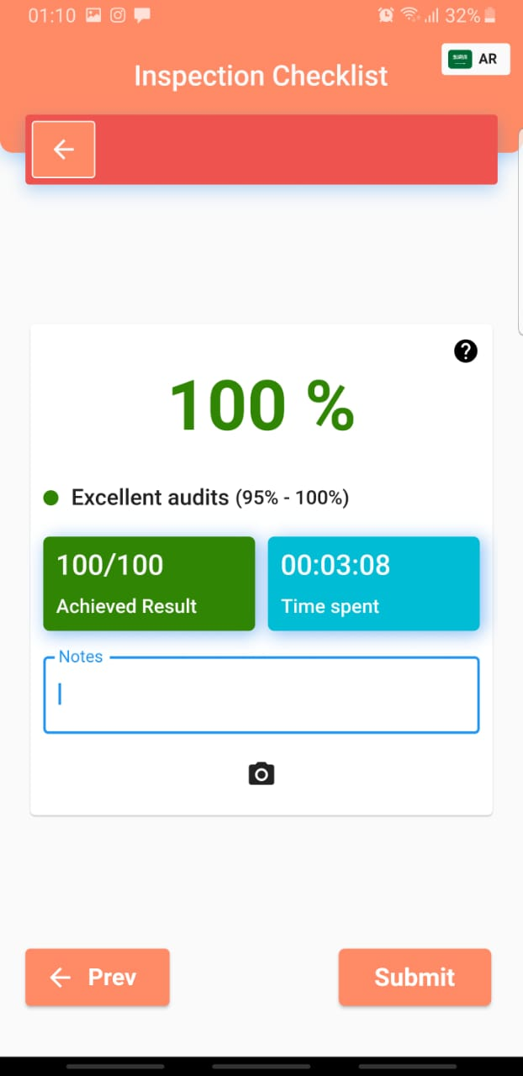
Application Guidelines
  After finishing the full checklist then Overall audit results will appear and time spent on the inspections.
  Write the overall comments of the inspections before submitting.
  Click the camera icon, If no issues found in any category or sub category, then overall 9-10 images to be uploaded.
  If any thing required to change in the checklist, then click on Previous and make changes accordingly.
“Copyrights: All rights are reserved, no part of this presentation can be reproduced or copied by any means except with written permission from SMSA Express Transportation Co. Ltd.”

Slide 32

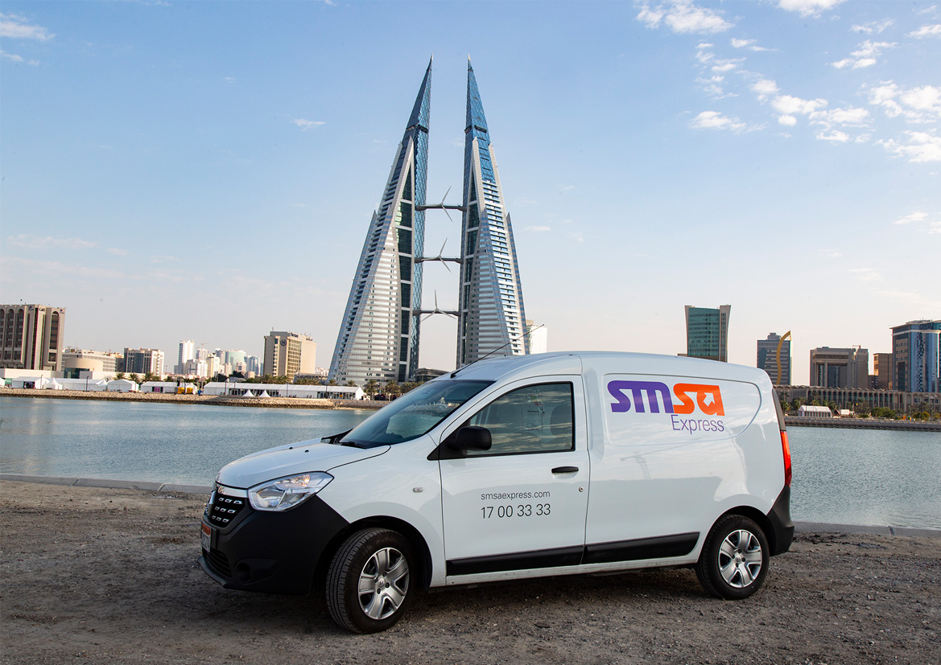
Thank You!

