Slide 1


TAPA Awareness
Training

Slide 2
Course Outline
What is TAPA
TAPA Mission
Difference between FSR & TSR
Classification levels
Certification procedure
Benefits of TAPA
TAPA requirements
Documentation

Slide 3
About TAPA Standards
TAPA Security Standards have been established to ensure secure transportation and storage of high value theft targeted cargo.
The Facility Security Requirements (FSR) represents minimum standards, specifically for secure warehousing, or in-transit storage, within a supply chain.
TAPA’s Standard, Trucking Security Requirements (TSR) is a separate Standard, focused exclusively on transporting products by truck within the supply chain.
The successful implementation of the TAPA Security Standards is dependent upon
LSP’s (Logistics Service Providers), Buyers (owner of the cargo) and TAPA authorized auditors working together.

Slide 4
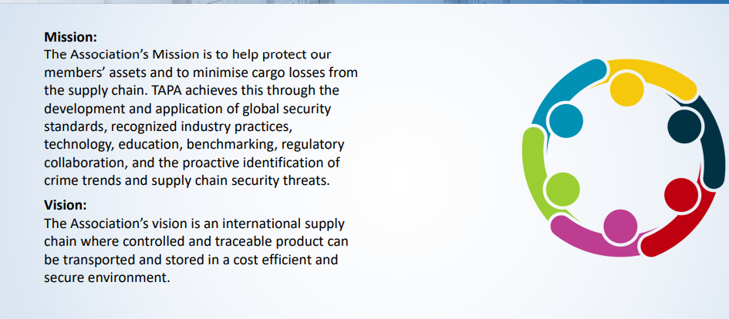
TAPA Mission

Slide 5
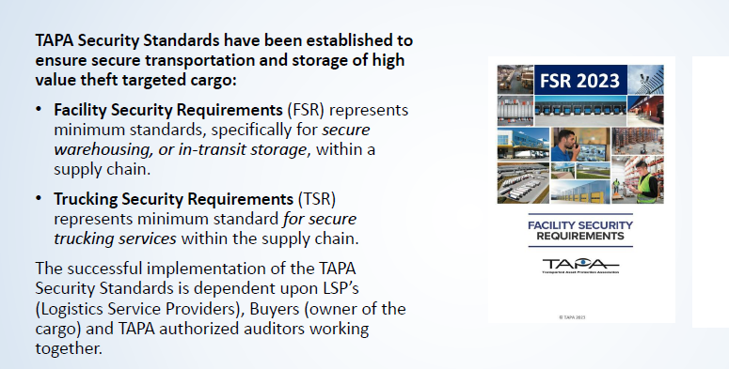
Difference Between FSR & TSR

Slide 6
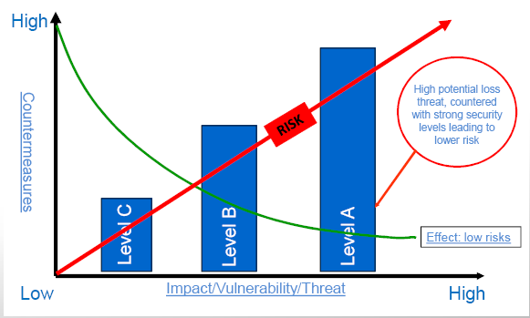
TAPA FSR Classification Levels
Facilities are classified into one of three FSR Classification Levels, based on the level of
protection needed:
• Level A = highest security protection
• Level B = mid-level security protection
• Level C = lowest security protection

Slide 7
Certification Procedure
Single site Certification by an Independent Audit Body(IAB).
Multi-site Certification by Authorized Auditors( AA) only via following the training and passing the exam.
Self- audit Certification by IAB or AA.
The Certificate will be valid for 3 years.

Slide 8
Certification Procedure
IAB Certification including Multisite (Levels A, B, or C)
The IAB will advise TAPA of the audit scope and results. If the audit is completed
successfully, the IAB issues a certificate indicating the LSP/Applicant is now TAPA FSR
certified. The level of certification (Level A, B, or C) will be specified on the certificate.
Self-Certification (Level C Only)
Level C Self-Certifications must be performed by an Authorized Auditor (AA). An AA can be an internal employee / associate, trained and authorized by TAPA as an FSR AA.
Regardless of which type of Auditor is used to conduct the Self-Certification, the completed Audit Form must be submitted to TAPA to receive the FSR Level C certification.
Waiver
A waiver is a written approval to exempt an LSP/Applicant from a specific TAPA requirement or to accept an alternative compliance solution. A waiver may be requested if an LSP/Applicant cannot meet a specific requirement in the FSR and can justify alternative measures to address the Security Standard requirement. Waivers are valid for the period of the certification.

Slide 9
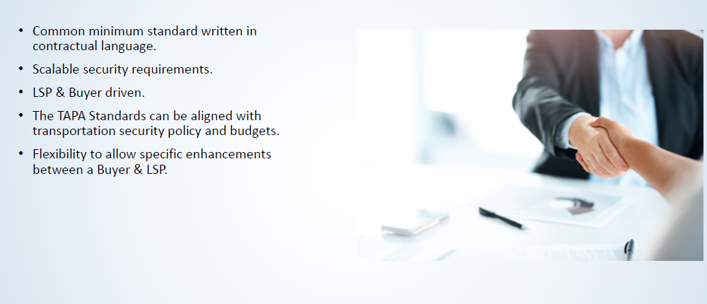
Benefits of FSR Program

Slide 10
TAPA Requirements
General Requirements
Perimeter
Outside Walls, Roof, and Doors
Office and Warehouse Entry and Exit Points
Inside Warehouse and Office
Security Systems; Design, Monitoring and Responses
Training and Procedures
Workforce Integrity

Slide 11

7. General Requirements

Slide 12
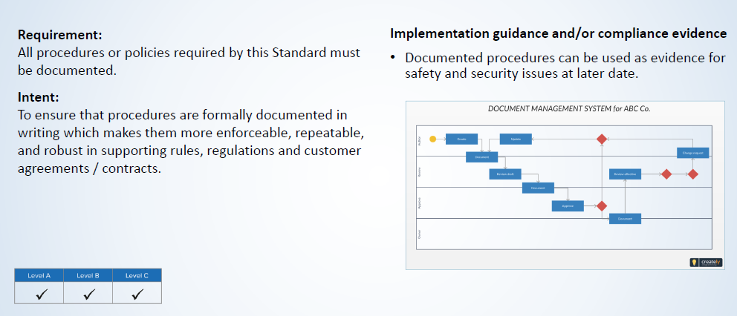
7. 0.1. Documentation

Slide 13
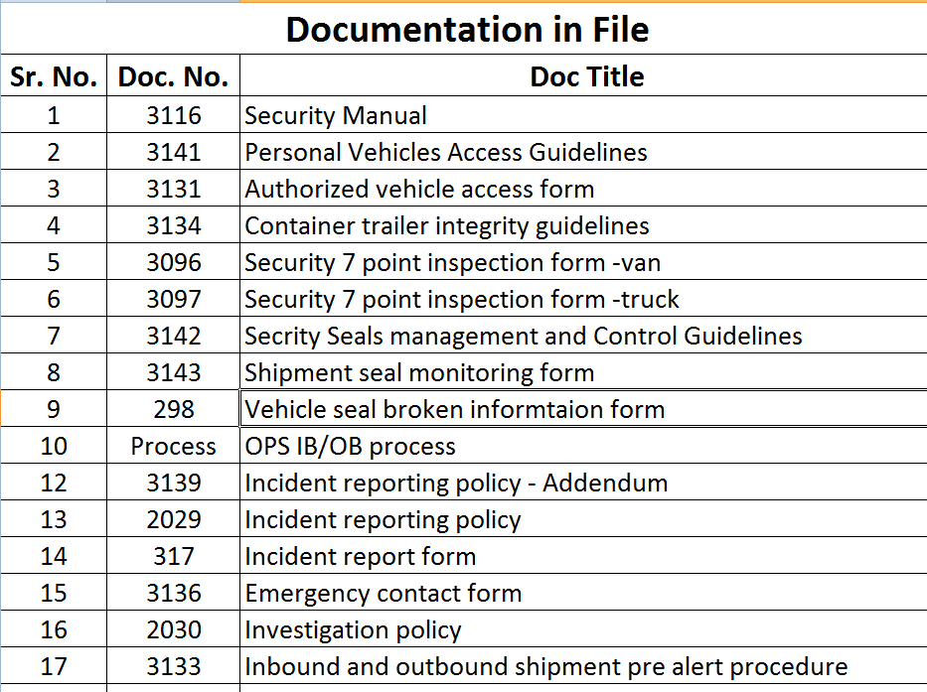
7. 0.1. Documentation

Slide 14
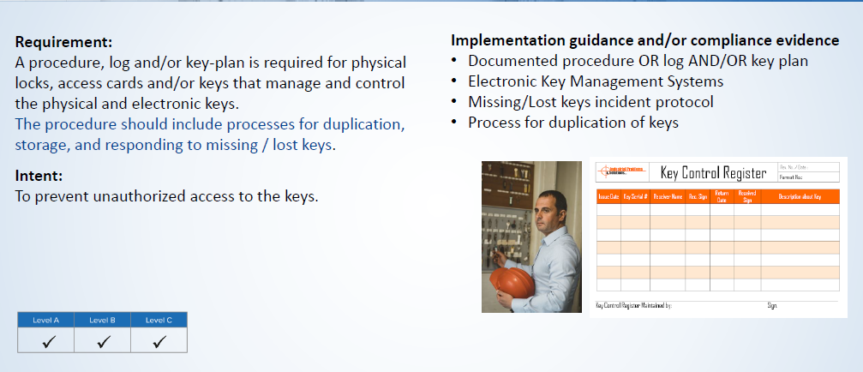

7. 0.4. General
Doc# 3402

Slide 15
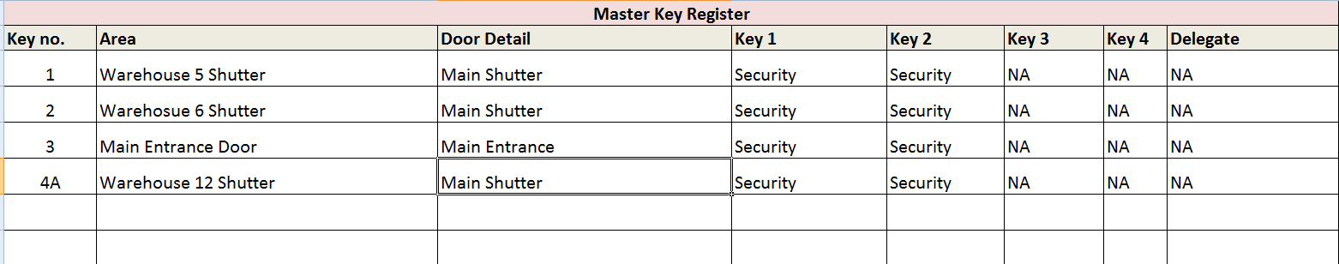
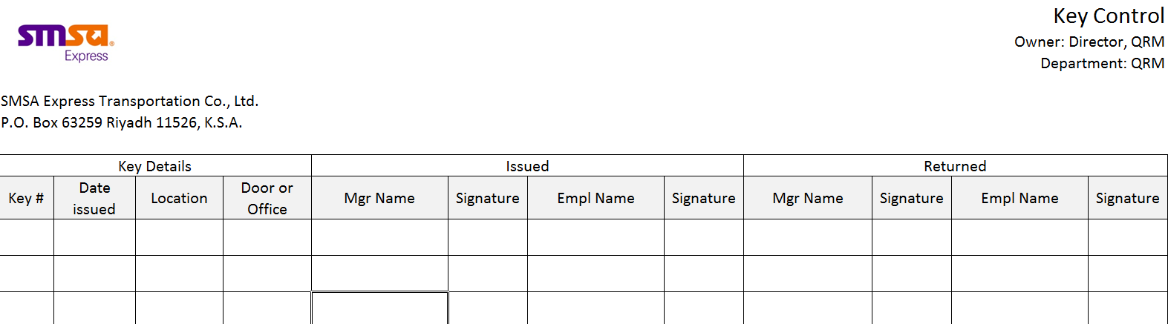
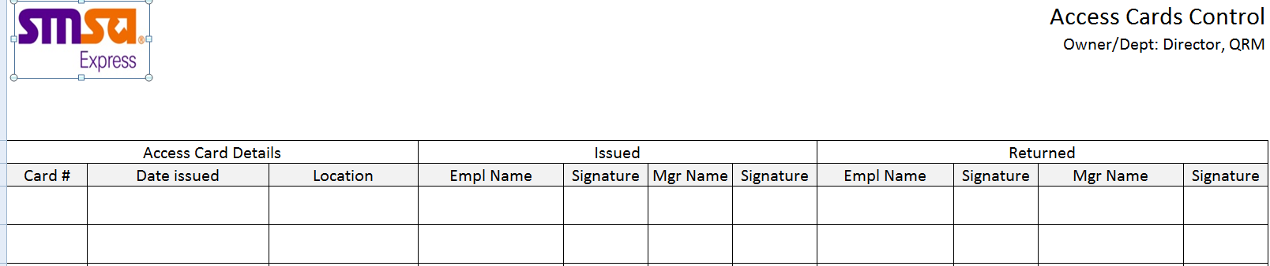
7. 0.2. General
Doc# 5487, 319 , 5483

Slide 16
7.1 Perimeter

Slide 17
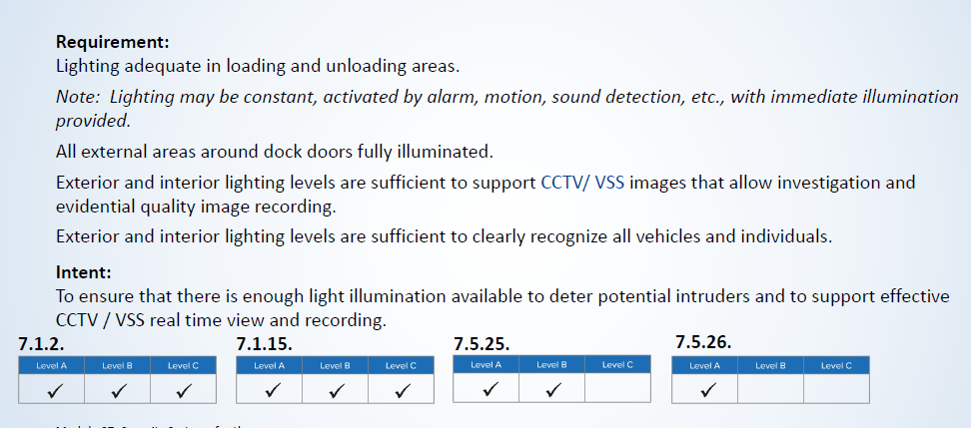
7. 1.2 Lighting

Slide 18
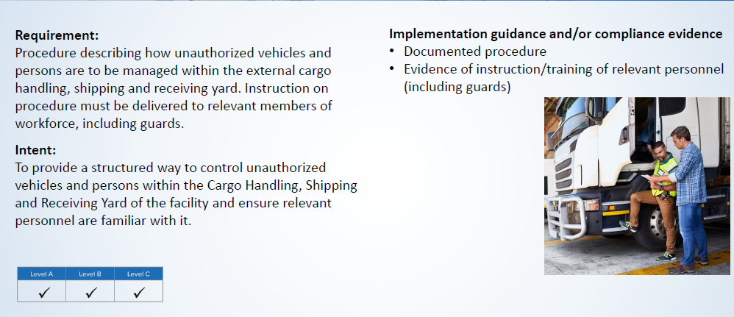
7. 1.3 Warehouse External Cargo Handling, Shipping, and Receiving Yard
Doc# 3141

Slide 19
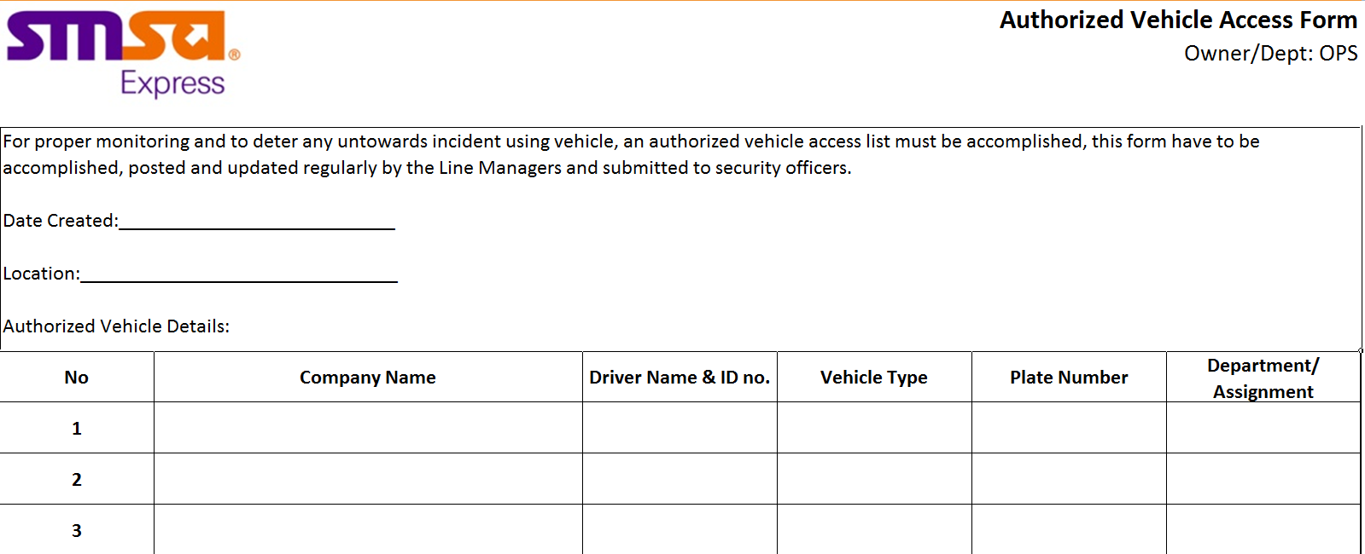
7. 1.3 Warehouse External Cargo Handling, Shipping, and Receiving Yard
Doc# 3131

Slide 20
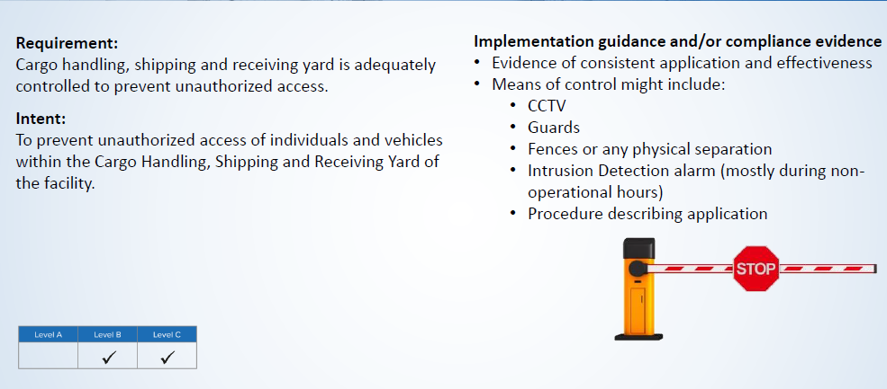
7. 1.4 Warehouse External Cargo Handling, Shipping, and Receiving Yard

Slide 21
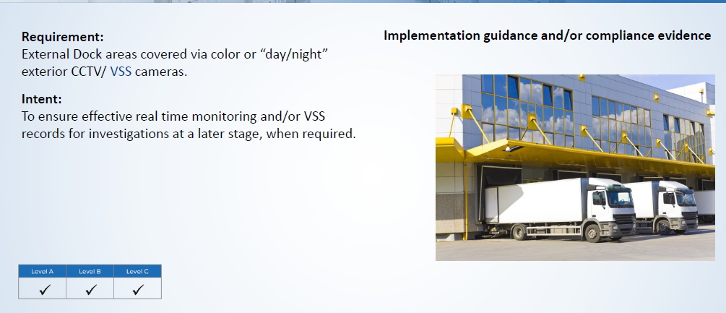
7. 1.11/7.1.15 External Dock Areas including illuminated lighting

Slide 22
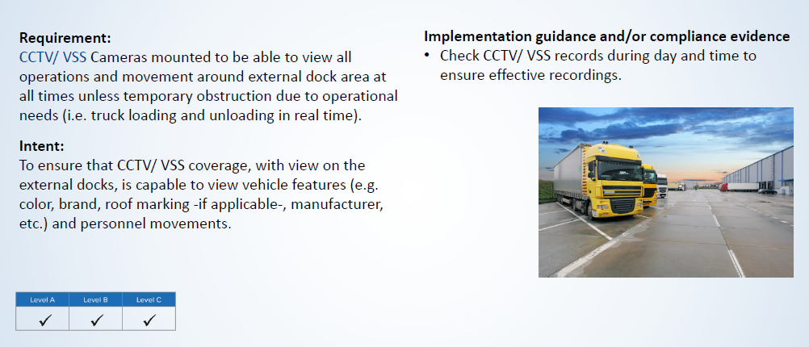
7. 1.12 External Dock Areas

Slide 23
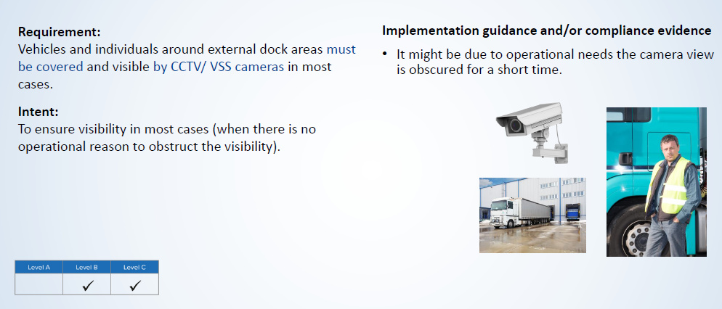
7. 1.14 External Dock Areas

Slide 24
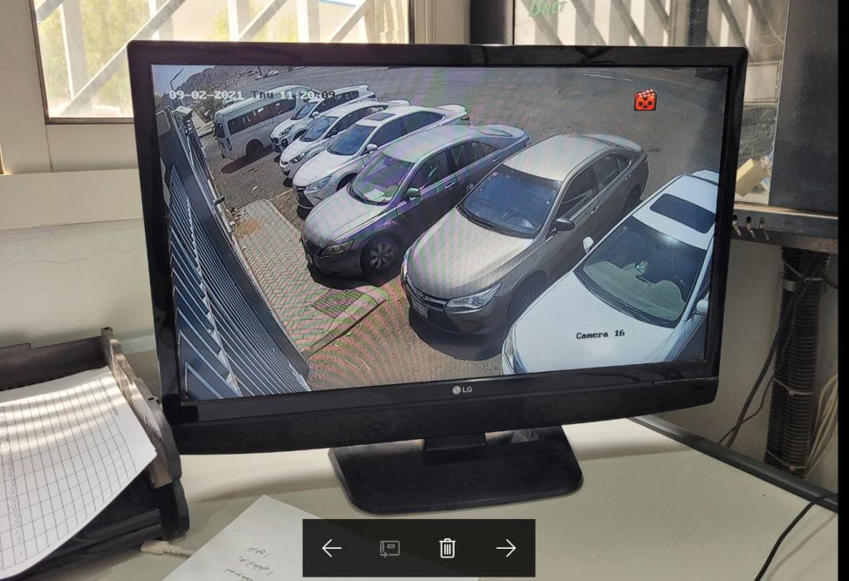
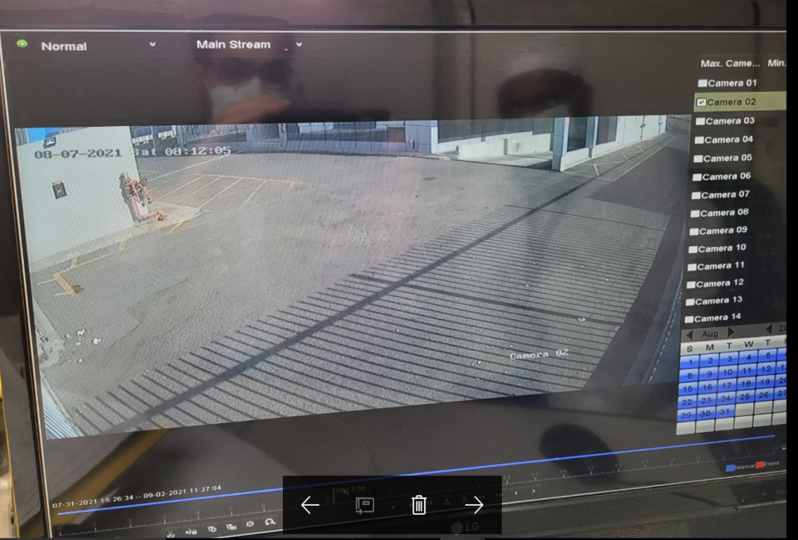
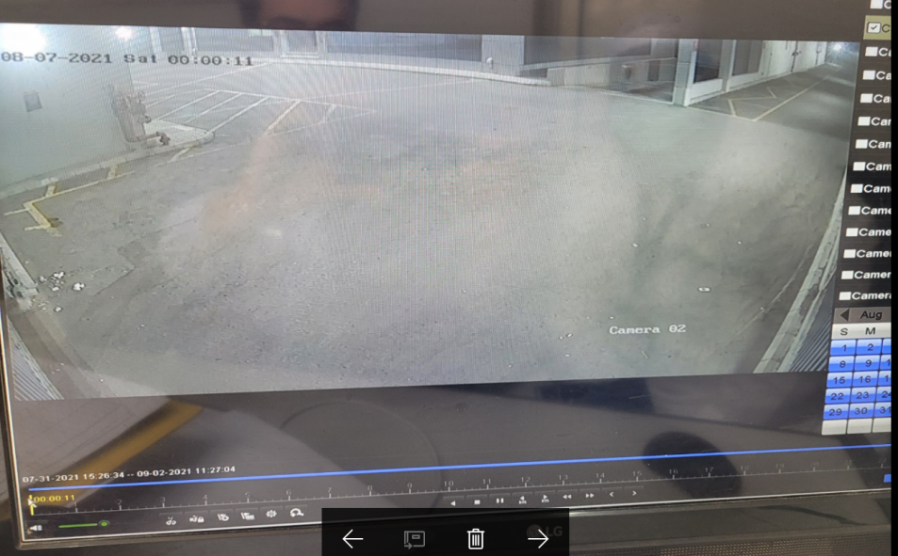
7. 1.12 External Dock Areas

Slide 25
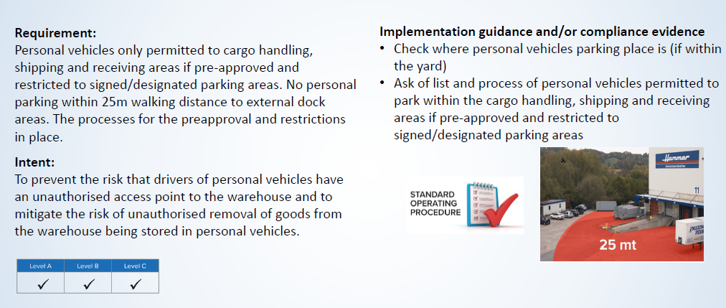
7. 1.16 Personal Vehicles Access
Doc# 3141

Slide 26
7. 1.16 Personal Vehicles Access
Doc# 3131

Slide 27
7. 2 Outside Walls, Roof, and Doors

Slide 28
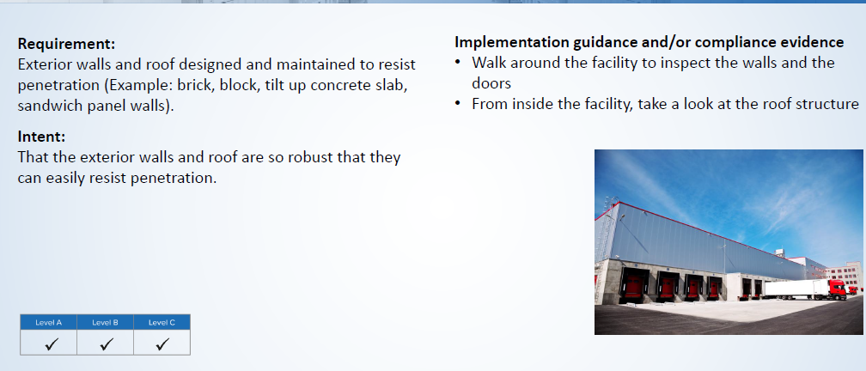
7. 2.6 Outside Walls, Roof, and Doors

Slide 29
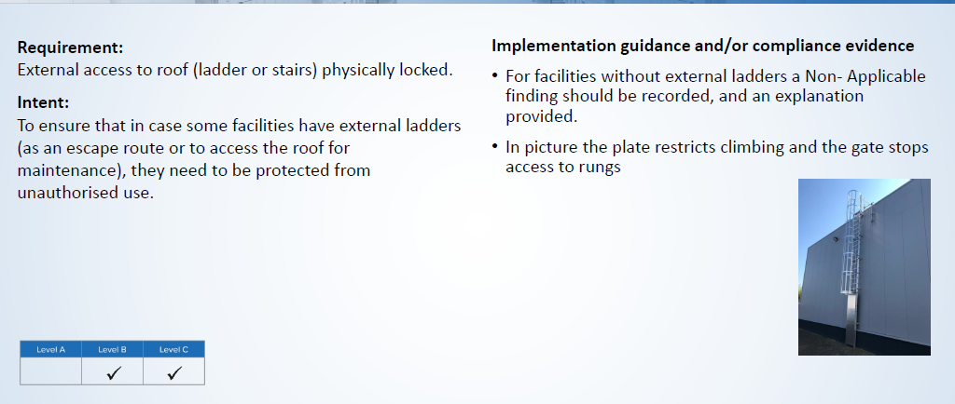
7. 2.10. Exterior Walls and Roof

Slide 30
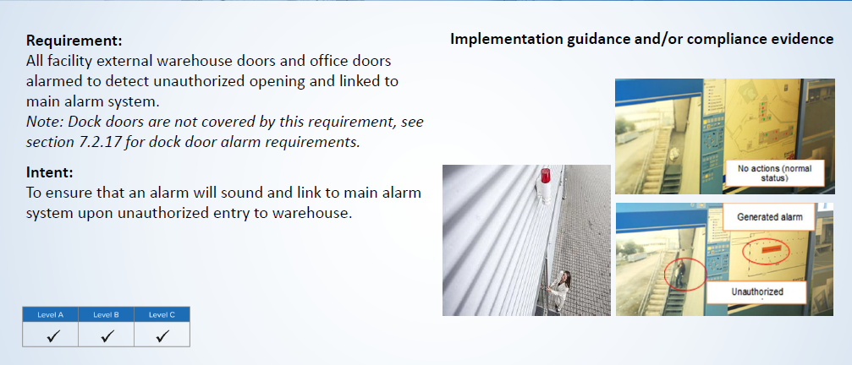
7. 2.11. Exterior Walls and Roof

Slide 31
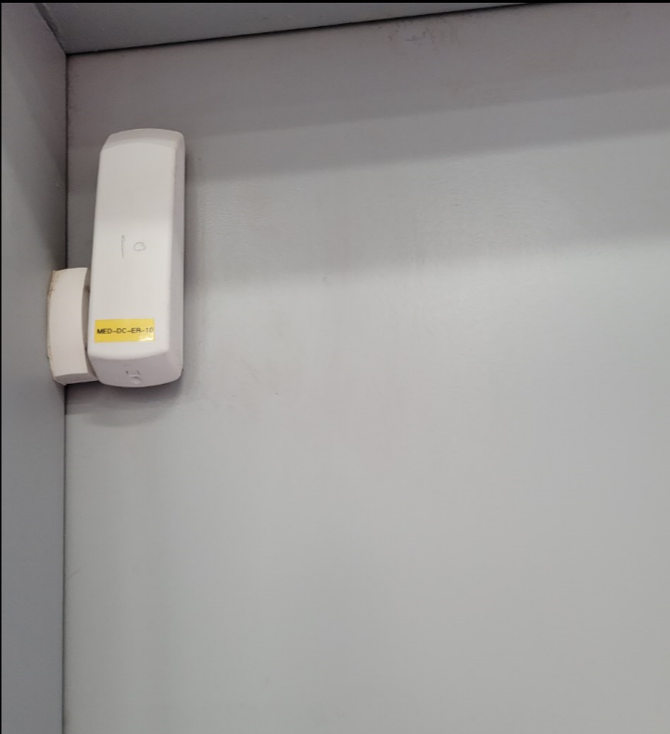
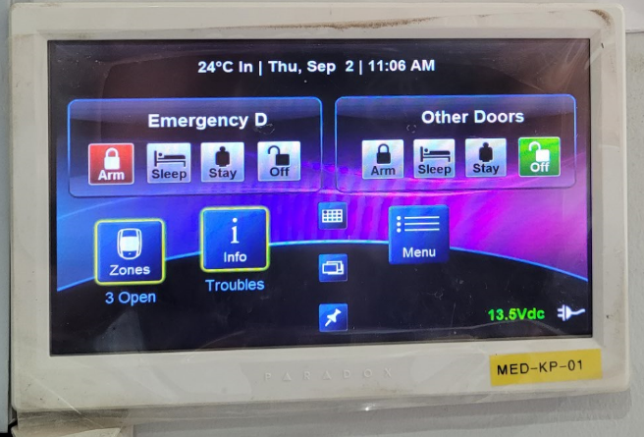
7. 2.11. Exterior Walls and Roof

Slide 32
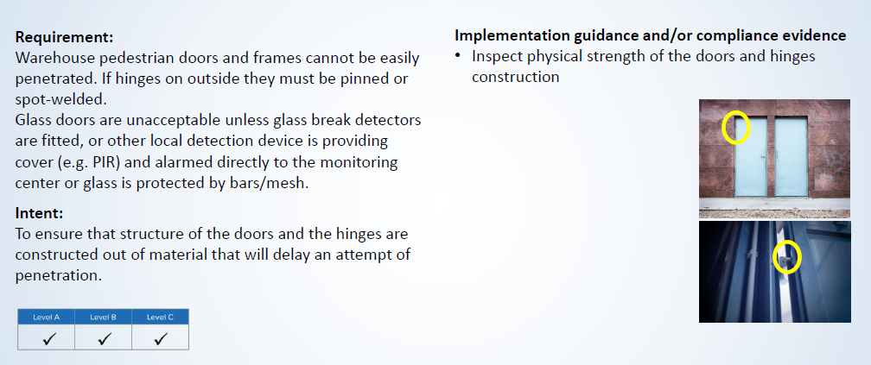
7. 2.14.Exterior Walls and Roof

Slide 33
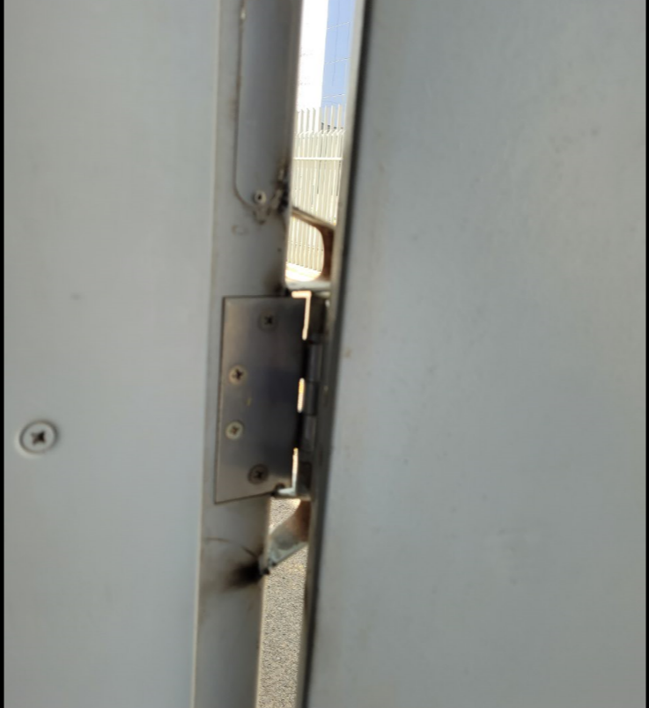
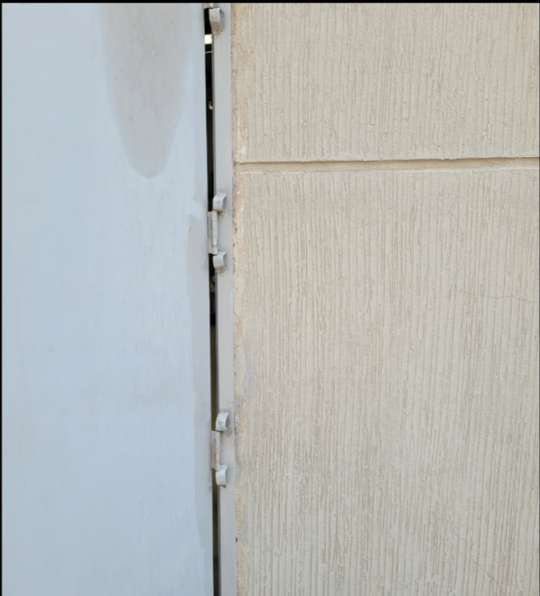
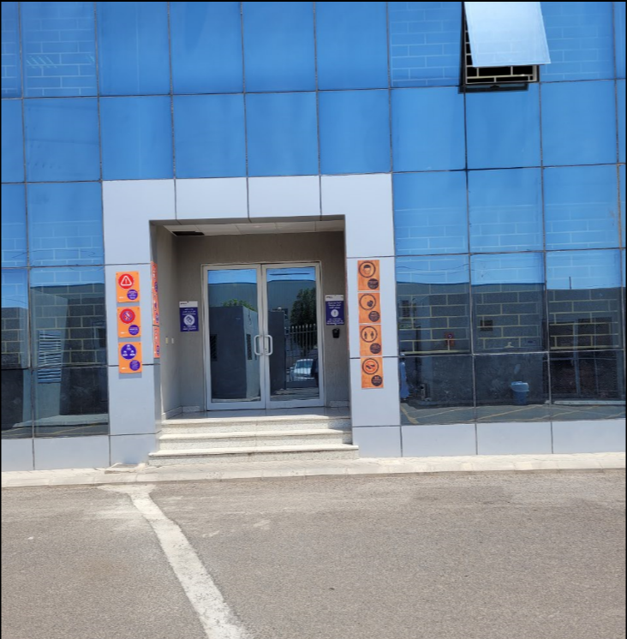
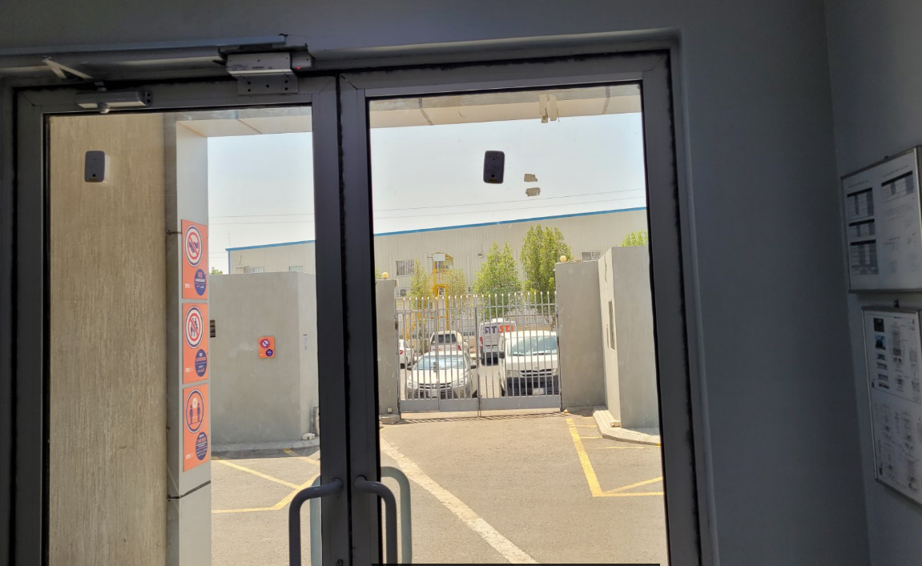
7. 2.14.Exterior Walls and Roof

Slide 34
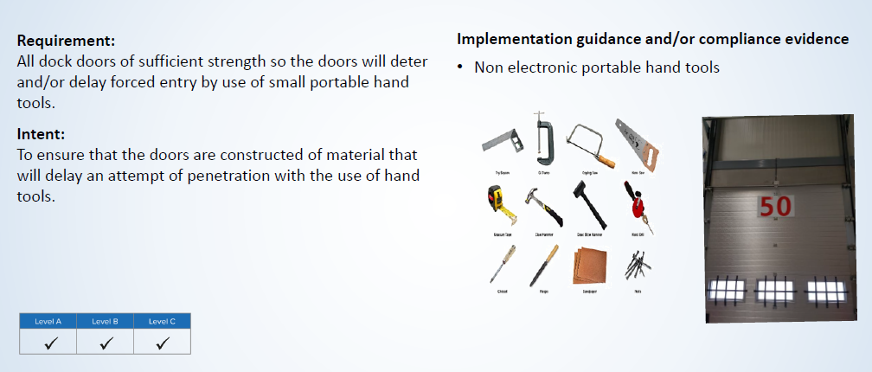
7. 2.16.Exterior Walls and Roof

Slide 35
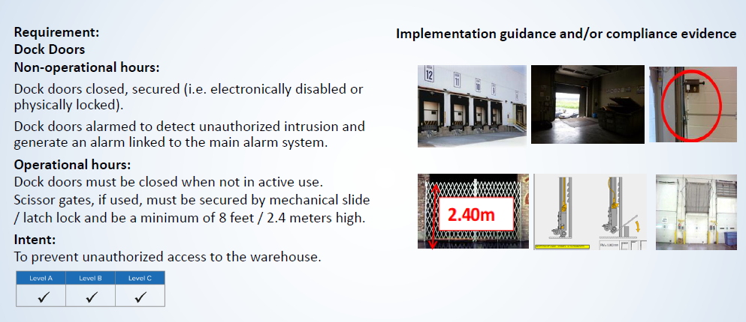
7. 2.17.Exterior Walls and Roof

Slide 36
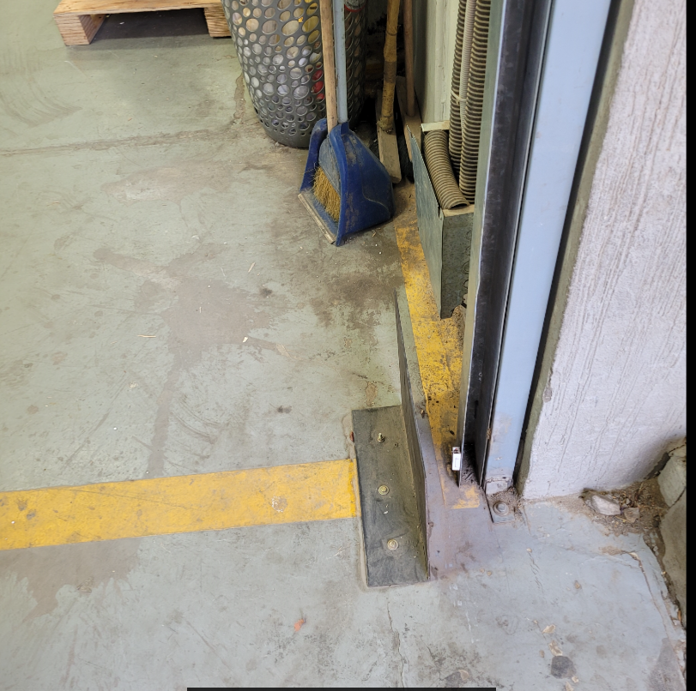
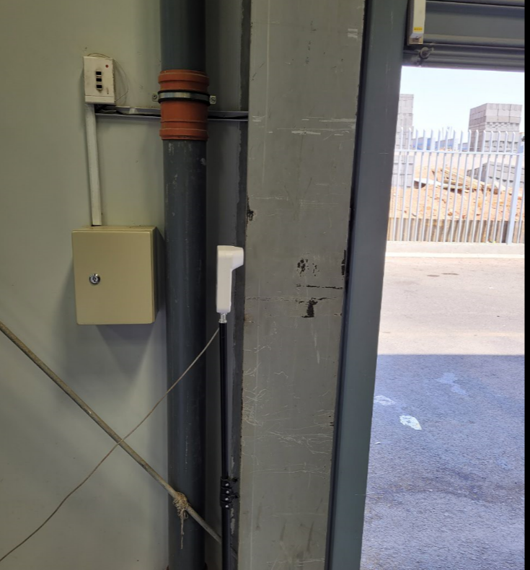
7. 2.17.Exterior Walls and Roof

Slide 37
7. 3 Office and Warehouse Entry and Exit Points

Slide 38
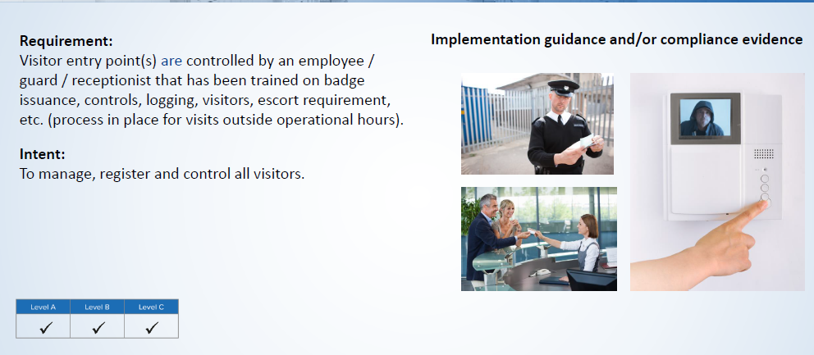
7. 3.1 Office Area Visitor Entry Points
Doc# 3116 – Security Manual

Slide 39
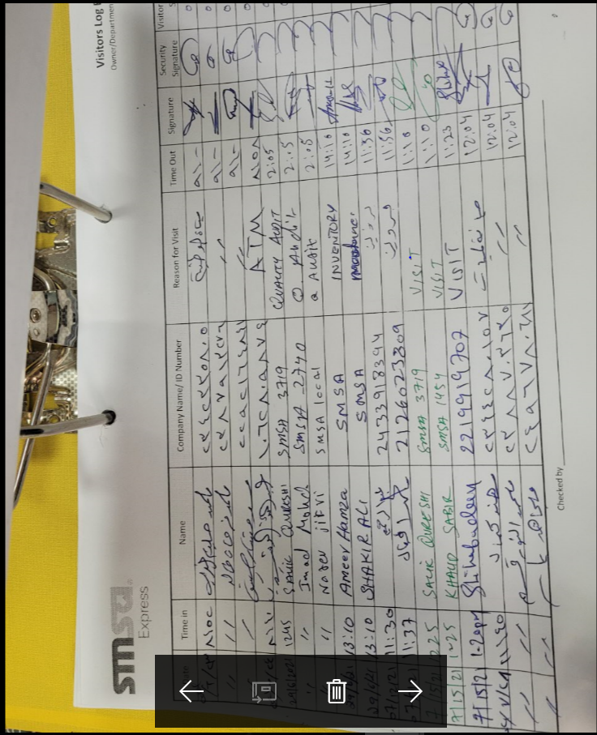
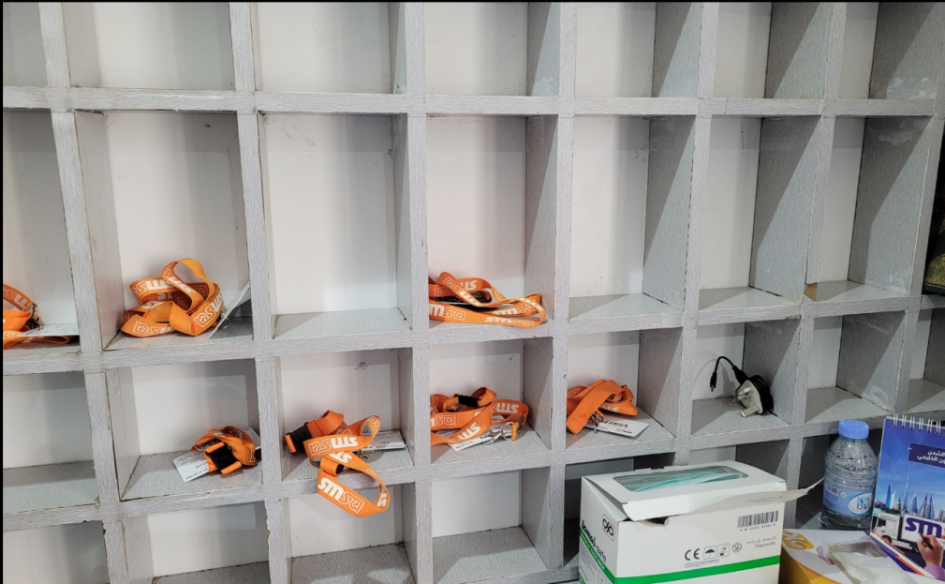
7. 3.1 Office Area Visitor Entry Points
Doc# 324 – Visitor Log

Slide 40
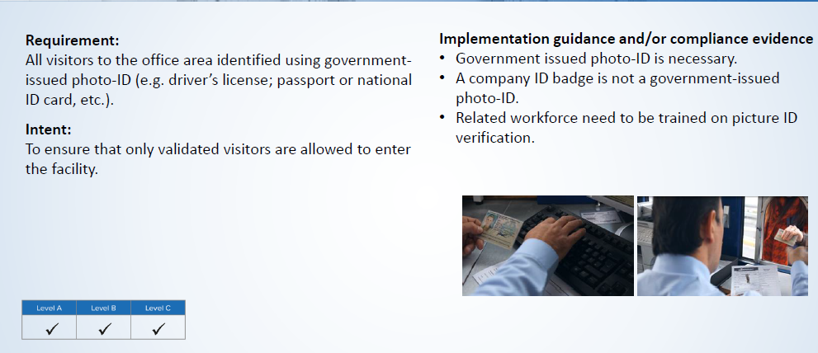
7. 3.4 Office Area Visitor Entry Point (s)

Slide 41
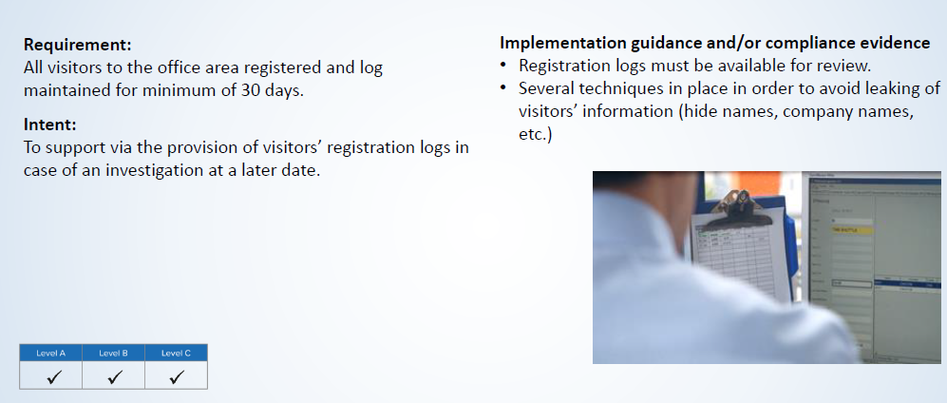
7. 3.5 Office Area Visitor Entry Point (s)

Slide 42
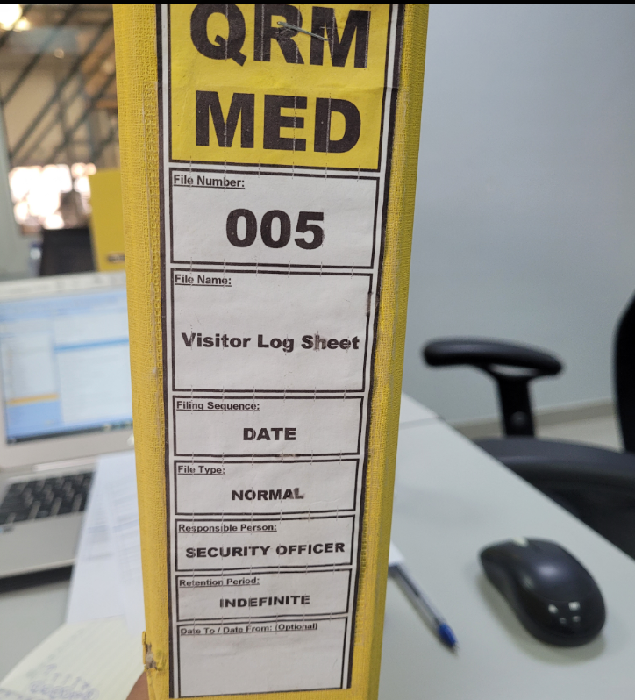
7. 3.5 Office Area Visitor Entry Points

Slide 43
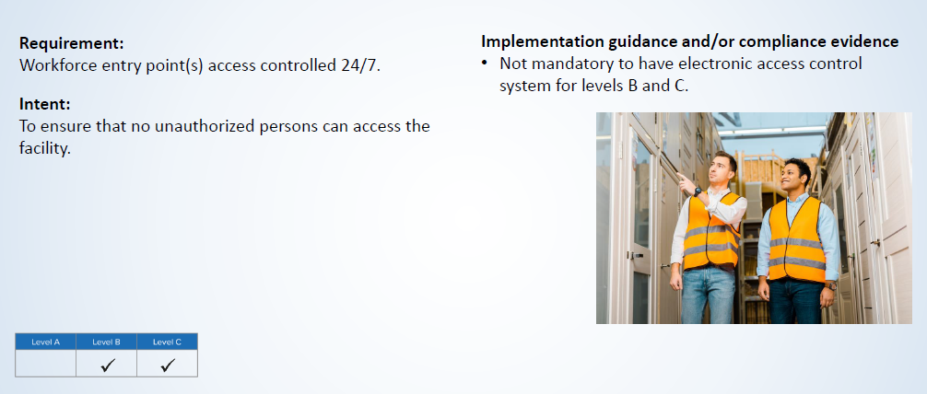
7. 3.8 Office Area Visitor Entry Points
90 days record required

Slide 44
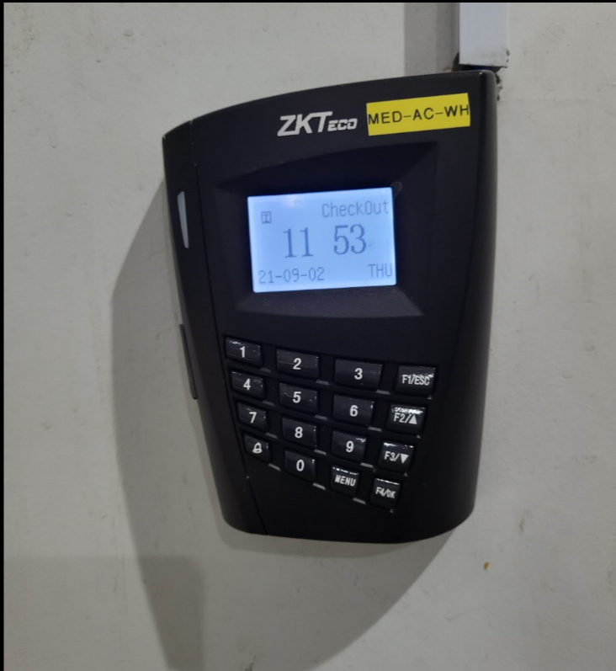
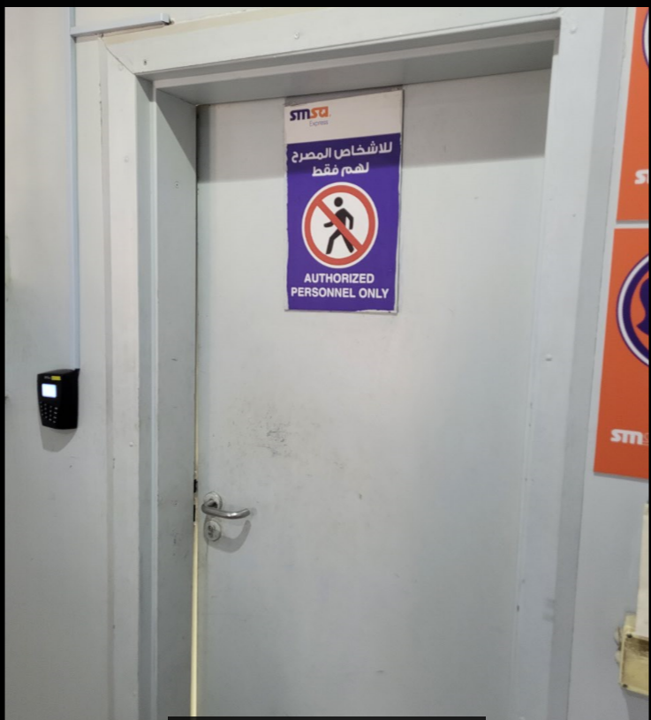
7. 3.8 Office Area Visitor Entry Points

Slide 45
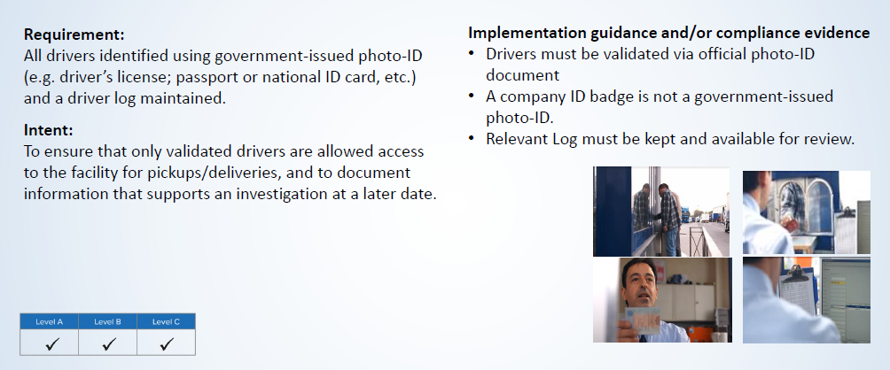
7. 3.15. Driver and Vehicle Identification

Slide 46
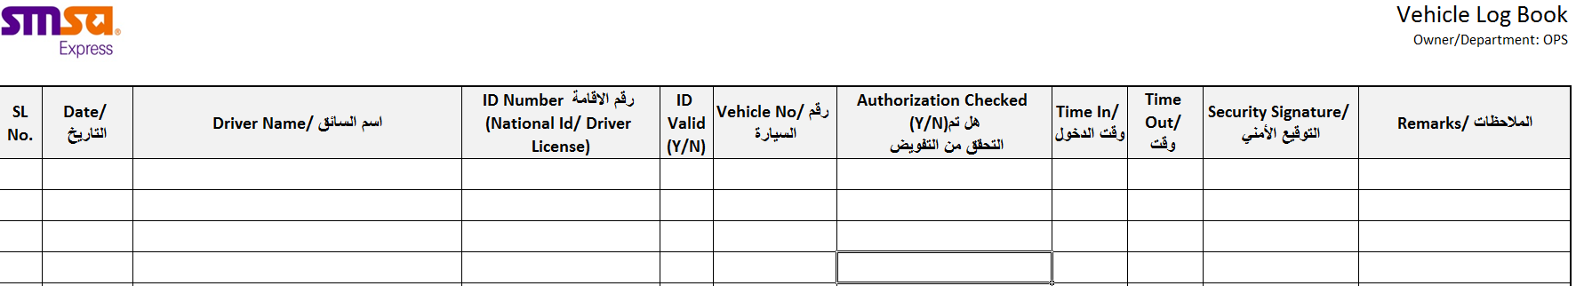
7. 3.15. Driver and Vehicle Identification
Doc# 5485

Slide 47
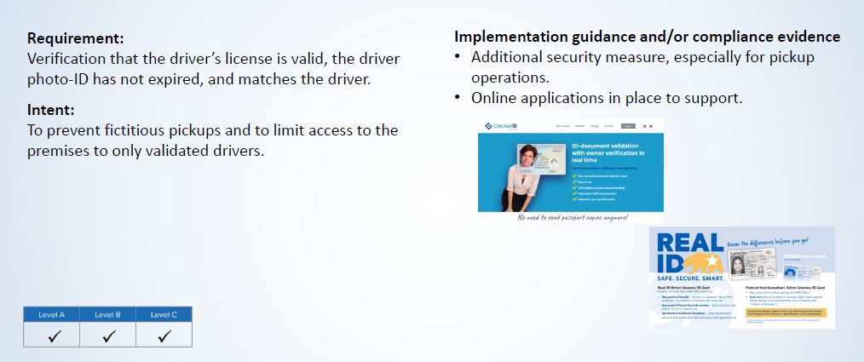
7. 3.16. Driver and Vehicle Identification

Slide 48
7.4 Inside Warehouse and Office

Slide 49
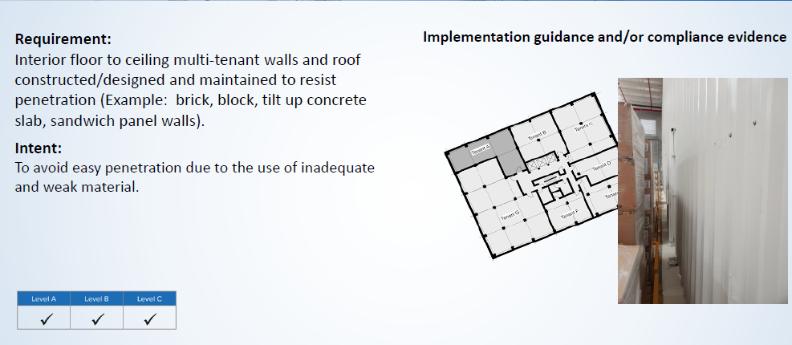
7. 4.1. Warehouse Area: Multi-Tenant walls

Slide 50
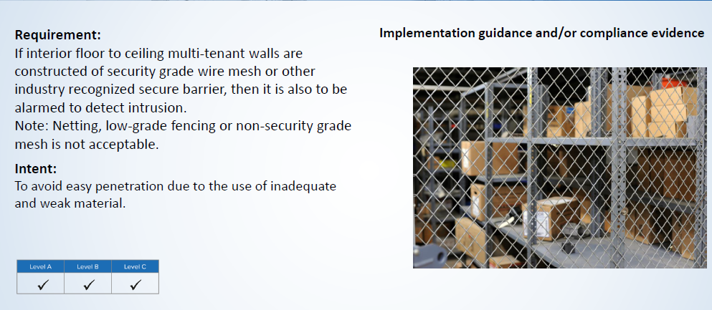
7. 4.2. Warehouse Area: Multi-Tenant walls

Slide 51
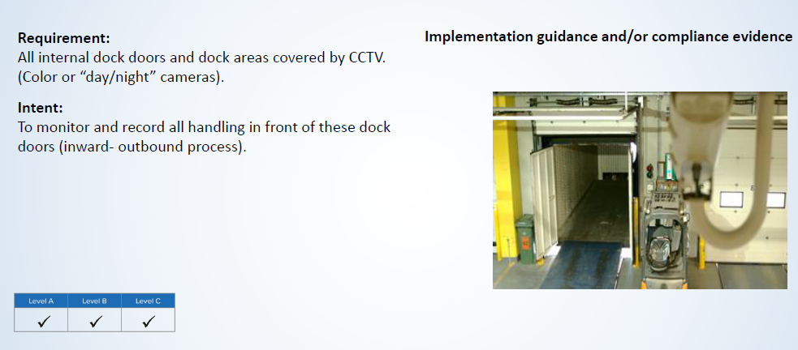
7. 4.4. Warehouse Area

Slide 52

7. 4.5. Warehouse Area

Slide 53

7. 4.10. Warehouse Area

Slide 54

7. 4.22 Trash bags

Slide 55

7. 4.23 No pre- loading or parking during non - operational

Slide 56

7. 4.27 7-points Inspection
Doc# 3142 – Security Seal Monitoring & Control

Slide 57


7. 4.27 7-points Inspection
Doc# 3096 & 3097

Slide 58

7. 4.28 Security Seals

Slide 59


7. 4.28 Security Seals

Slide 60

7. 4.29 Control of Security Seals
Doc# 3142 – Security Seal Monitoring & Control

Slide 61


7. 4.29 Control of Security Seals
Doc# 3143

Slide 62

7. 4.30 Control of Security Seals

Slide 63

7. 4.31 Compromised Security Seals
Doc# 3142 – Security Seal Monitoring & Control

Slide 64

7. 4.31 Compromised Security Seals
Doc# 298

Slide 65

7. 4.32 Loading/ Unloading Validation Process
GUIDE Process Map
Doc# 2029 – Incident Management Procedure

Slide 66



7. 4.32 Loading/ Unloading Validation Process

Slide 67

7. 4.33 Fraudulent Pick-Ups
Doc# 3133– IB/OB Pre-alert Procedure

Slide 68


7. 4.33 Fraudulent Pick-Ups

Slide 69
7. 5 Security Systems, Design, Monitoring and Responses

Slide 70

7. 5.1 Monitoring Post

Slide 71

7. 5.2 Monitoring Post
Doc# 3116 Security Manual

Slide 72

7. 5.3 Monitoring Post

Slide 73


7. 5.3 Monitoring Post

Slide 74

7. 5.4 Monitoring Post
60 Days System Record

Slide 75

7. 5.4 Monitoring Post
Doc# 2782 – Manual Record

Slide 76

7. 5.5 Monitoring Post
Doc# 3116 Security Manual

Slide 77

7. 5.6 Monitoring Post

Slide 78

7. 5.10 IDS –Intrusion Detection System
Doc# 3116 Security Manual

Slide 79


7. 5.10 IDS –Intrusion Detection System
Doc# 5484 – Area Access Register
Doc# 5488 – Security Systems Access Register

Slide 80

7. 5.10 IDS –Intrusion Detection System
Doc# 3137

Slide 81

7. 5.11 IDS –Intrusion Detection System

Slide 82


7. 5.11 IDS –Intrusion Detection System

Slide 83

7. 5.12 IDS –Intrusion Detection System
Doc# 3116 Security Manual

Slide 84


7. 5.12 IDS –Intrusion Detection System

Slide 85

7. 5.18 CCTV

Slide 86

7. 5.19 CCTV

Slide 87

7. 5.19 CCTV

Slide 88

7. 5.20 CCTV
Doc# 3116 Security Manual

Slide 89

7. 5.20 CCTV
Doc# 3102 Daily Security Checklist

Slide 90

7. 5.21 CCTV

Slide 91

7. 5.22 CCTV
Doc# 2940 CCTV Data Protection Policy

Slide 92

7. 5.23 CCTV

Slide 93

7. 5.23 CCTV
Doc# 2939

Slide 94
7. 6 Training and Procedures

Slide 95

7. 0.3 Management Commitment

Slide 96

7. 0.6 Management Commitment

Slide 97

7. 0.7 Management Commitment

Slide 98

7. 6.1 Escalation Procedures
Doc# 2029 – Incident Management Procedure

Slide 99


7. 6.1 Escalation Procedures
Doc# 3005

Slide 100

7. 6.3 Management Commitment

Slide 101

7. 6.3 Escalation Procedures

Slide 102

7. 6.2 Escalation Procedures
Doc# 3136

Slide 103

7. 0.2 Management Commitment

Slide 104

7. 6.3 Management Commitment

Slide 105

7. 0.5 Risk Assessment

Slide 106

7. 0.5 Risk Assessment

Slide 107

7. 6.5 Risk Assessment

Slide 108

7. 6.4 Training

Slide 109

7. 6.7 Information Control
Doc# 3138 – Access to Buyer Assets Procedure
Key Control and Area Access Control

Slide 110

7. 6.8 Information Control

Slide 111

7. 6.9 Information Control

Slide 112


7. 6.11 Information Control

Slide 113

7. 6.11 Maintenance Programs

Slide 114


7. 6.11 Maintenance Programs
Doc# 5488

Slide 115

7. 6.12 Maintenance Programs

Slide 116

7. 6.17 Contractors
Communication – handbook- Email

Slide 117

7. 6.16 Shipping and Receiving Records

Slide 118

7. 6.17 Shipping and Receiving Records

Slide 119

7. 6.18 Shipping and Receiving Records
Doc# 438 POD Policy

Slide 120

7. 6.19 Pre-alert Process

Slide 121
7. 7 Workforce Integrity

Slide 122

7. 7.1 Screening/Vetting/Background Checks
Doc# 43 Recruitment Policy

Slide 123

7. 7.2 Screening/Vetting/Background Checks

Slide 124

7. 7.3 Screening/Vetting/Background Checks

Slide 125

7. 7.4 Screening/Vetting/Background Checks

Slide 126

7. 7.5 Screening/Vetting/Background Checks
Doc# 1922 Resignation Policy

Slide 127

7. 7.5 Screening/Vetting/Background Checks
Doc# 1751

Slide 128

7. 7.6 Screening/Vetting/Background Checks

Slide 129

7. 7.7 Screening/Vetting/Background Checks
Doc# 3475 – Workforce checklist WI

Slide 130

7. 7.7 Screening/Vetting/Background Checks
Doc# 3476

Slide 131

7. 7.8 Screening/Vetting/Background Checks
Doc# 43 Recruitment Policy

Slide 132

7.2. Termination or Rehiring of Workforce

Slide 133


