Slide 1
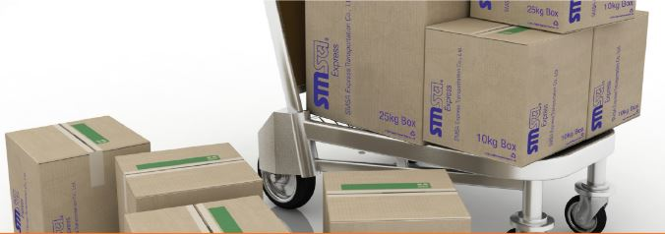
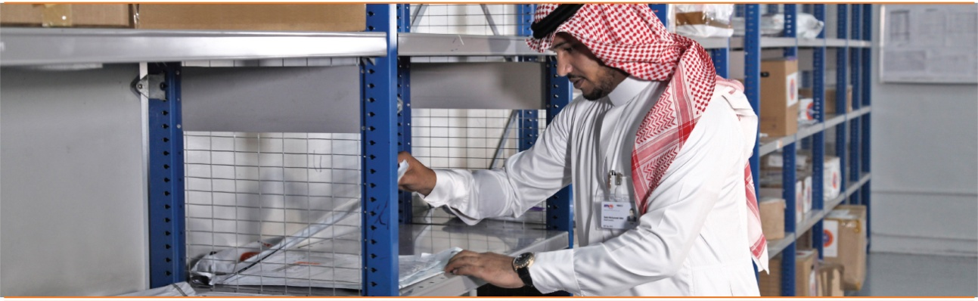



SMSA Packaging & Services

Slide 2

Learning Objectives – To Learn about:
SMSA Packaging & Customer Packaging
SMSA Envelope
SMSA Pak (Large & XL – HV1)
SMSA Bag (L - HV2 & XL - HV3)
SMSA 2 ,5, 10, 25, & 40 Kg Boxes
SMSA Unmarked 10 & 25 Kg Box
SMSA Honey & Olive Oil Boxes (Selected Regions)
SMSA Small, Medium & Large Boxes (SMSA Service Center)
SMSA Fresh Box
Customer Packaging
SMSA Domestic Services
SMSA Priority Overnight Documents & Parcels (SPOD/SPOP)
SMSA Freight Service (SFS)
SMSA 2, 5, 10, 25 & 40 kg boxes
SMSA Special Packaging (SSP)
SMSA Priority Overnight COD (SPO-COD)
SMSA Saudi Armed Forces Special Service (SAFSS)
SMSA Service Center to Service Center (STS)
SMSA Intra-City Domestic (ICD)
SMSA Fresh Box (10 kg)
SMSA Smart Ship
SMSA International Services
SMSA International Documents (SIDX)
SMSA International Non-Documents (SIND)
SMSA International Inbound Service (SIIS)
SMSA International Promo Boxes 2,5, 10, 25, 32 kg Boxes & Olive Oil SMSA Special Packaging
SMSA Economic Express Service (SEES)
SMSA International Parcel by Road (SIPBR)
SMSA Full Truck Load/ Less than Truck Load from/to UAE & GCC countries (FTL/LTL)
SMSA Freight Service
SMSA Store2Door

Slide 3
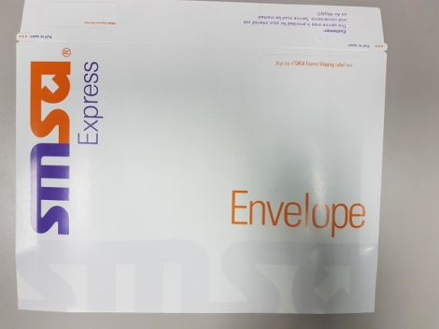
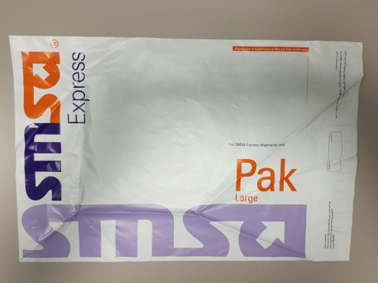
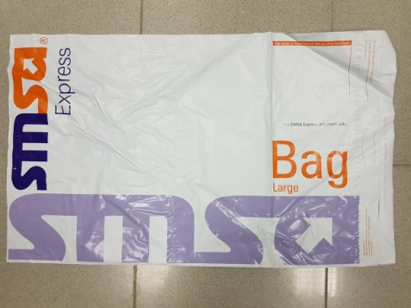
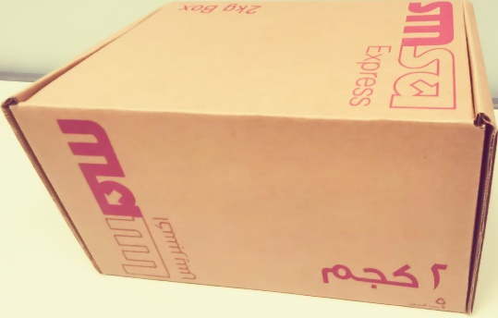

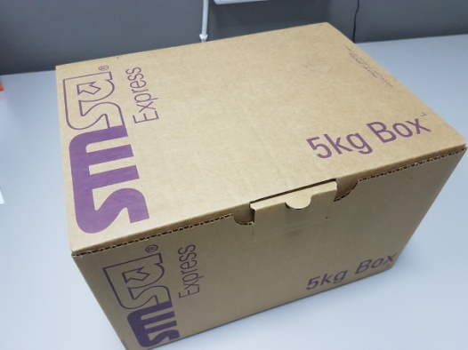
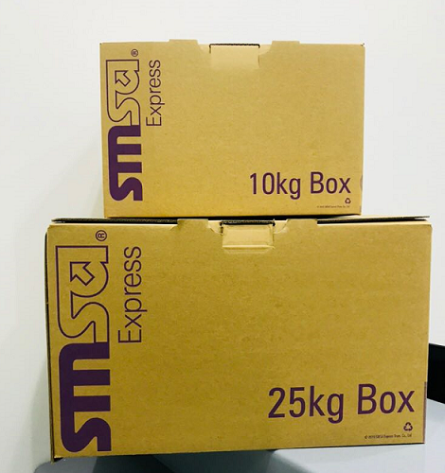
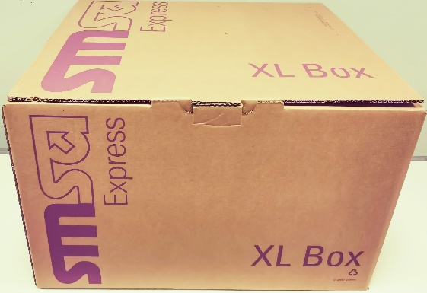
SMSA Packaging
SMSA Envelope
SMSA Pak (Large & Extra Large – HV1)
SMSA Bag (Large – HV2 & Extra
Large – HV3)
SMSA Box 2,5, 10, 25 & 40 kg Boxes
SMSA Unmarked 10 & 25 kg Boxes

Slide 4
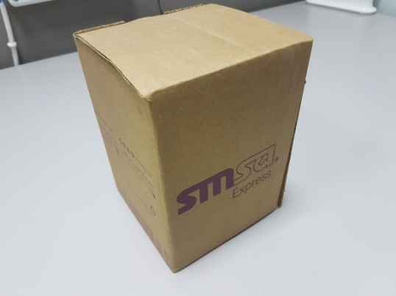
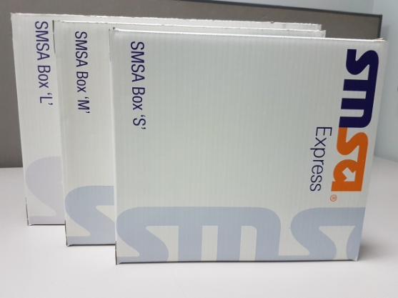
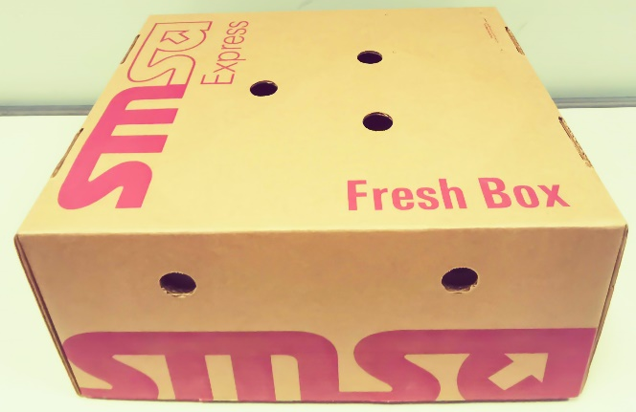

SMSA Packaging
SMSA Honey Box (Southern Region)
SMSA Olive Oil Box
(Northern Region)
SMSA Small, Medium & Large Boxes (SMSA Service Centers Only)
SMSA Fresh Box 10 kg
Customer Packaging

Slide 5

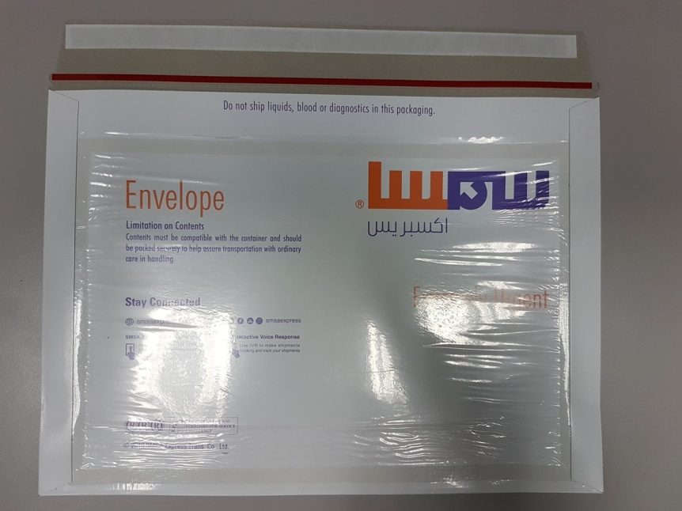
SMSA Envelope
Max Weight: 0.5 kg
Carriage Value: SAR 375
** May be higher upon declaration with Insurance Charges
MPS (Multiple Piece Shipment): Not Available

Slide 6
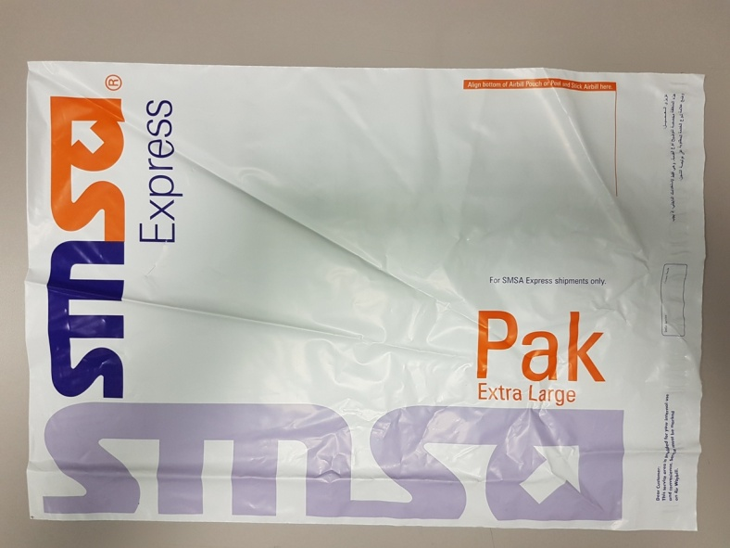
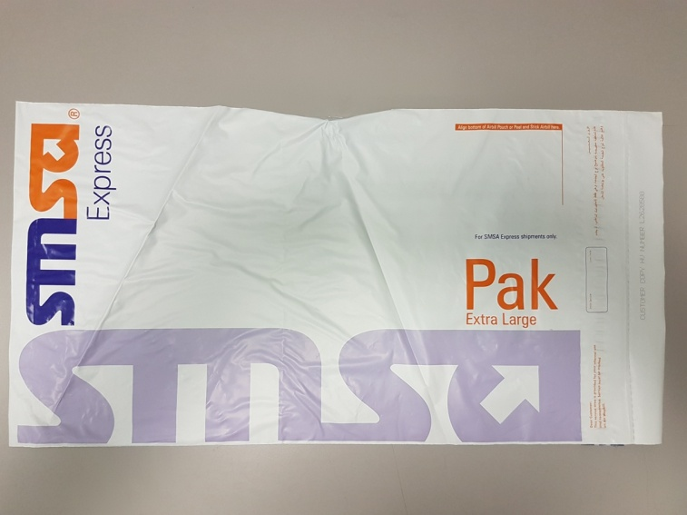
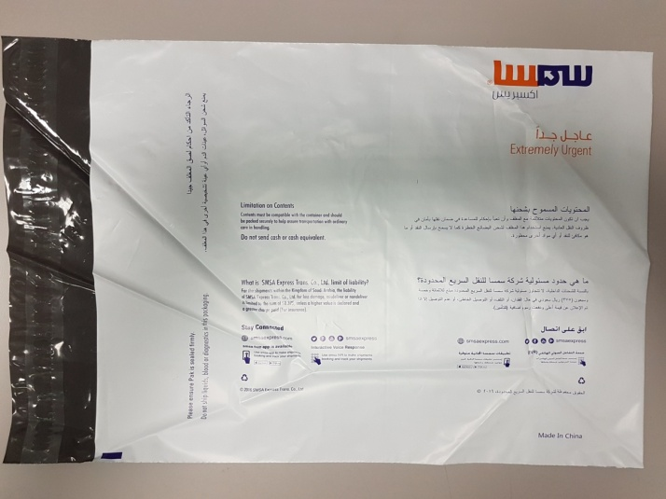
SMSA Pak
(Large, Extra Large, Extra Large - HV1)
Max Weight:
Large = 1 kg.
Extra Large (HV1) = 1 kg
Carriage Value: SAR 375
** May be higher upon declaration with Insurance Charges
MPS (Multiple Piece Shipment): Available

Slide 7
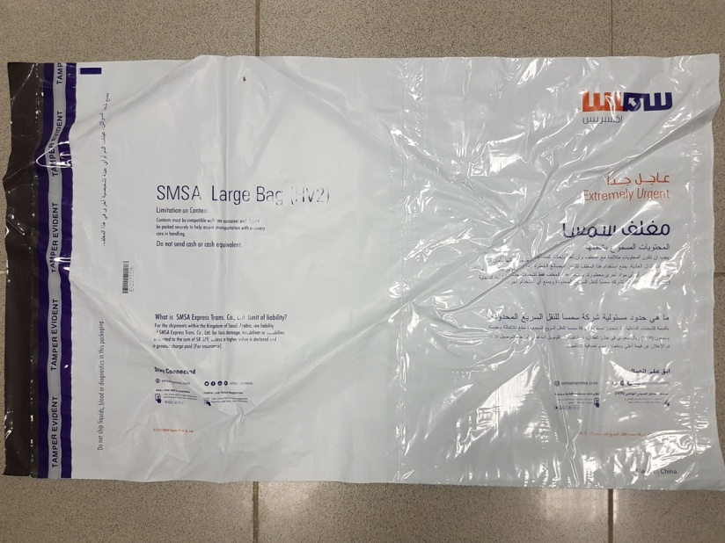

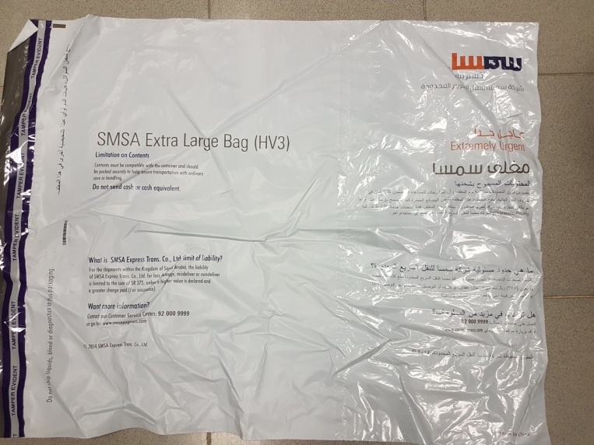
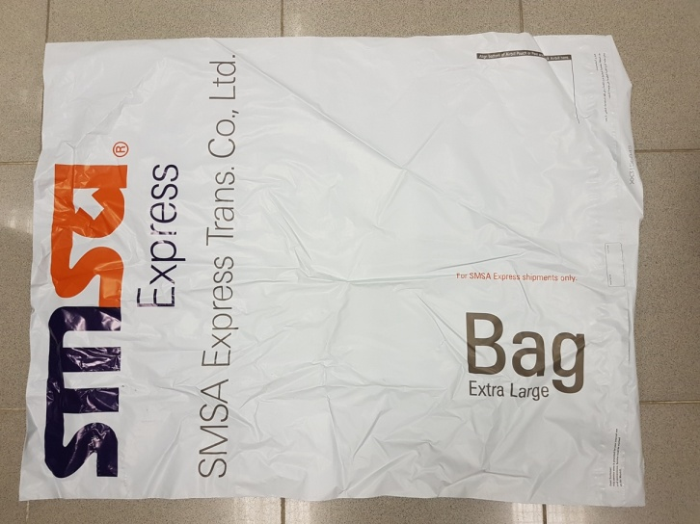
SMSA Bag
(Large – HV 2,
Extra Large – HV 3)
Max Weight:
Large (HV2) = 1 kg.
Extra Large (HV3) = 2.5 kgs
Carriage Value: SAR 375
** May be higher upon declaration with Insurance Charges
MPS (Multiple Piece Shipment): Available

Slide 8


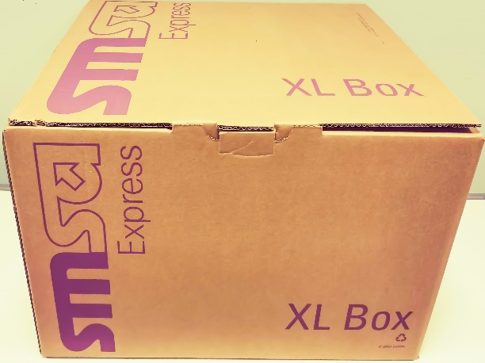
SMSA 2, 5, 10, 25, 40 Kg Boxes
(for International & Domestic Promo boxes)
Max Weight:
2 kg Box (Mini Box) = 2 kgs.
5 kg Box (SSB) = 5 kgs.
10 kg Box (SMB) = 10 kgs.
25 kg Box (SLB) = 25 kgs.
40 kg Box (SXLB) = 40 kgs.*
* 32 kgs. only Max for Int’l.
No Max Customs Value
Maximum Carriage Value Limited to: SAR 187,500
** May be lower or higher depending on country of destination – SRG w/ corresponding insurance charges
MPS (Multiple Piece Shipment): Not Available

Slide 9


SMSA Unmarked 10 & 25 Kg Boxes (Used for SPOP only)
Max Weight:
10 kg Box = up to 15 kgs.
25 kg Box= up to 30 kgs.
No Max Customs Value
Maximum Carriage Value Limited to: SAR 187,500
** with corresponding insurance charges
MPS (Multiple Piece Shipment): Available

Slide 10
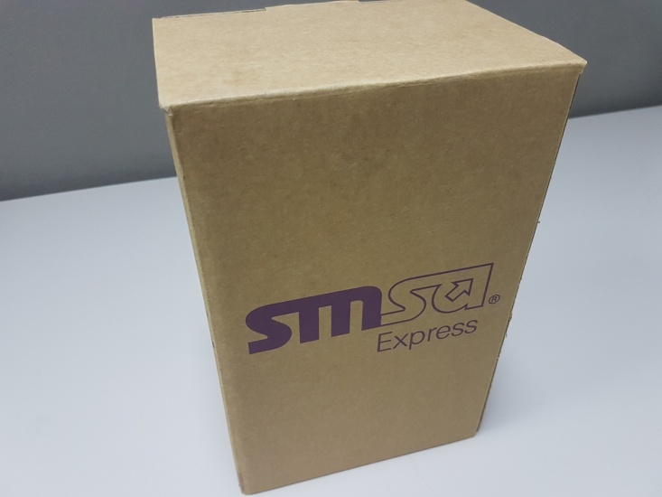

SMSA Honey Boxes (Southern Region)
& SMSA Olive Oil Boxes (Northern Region)
*** Domestic & SMSA Service Centers Only
Max Weight:
Small = 2 kgs.
Medium = 5 kgs.
Large = 10 kgs.
Carriage Value: SAR 375
** May be higher upon declaration with Insurance Charges
MPS (Multiple Piece Shipment): Available

Slide 11
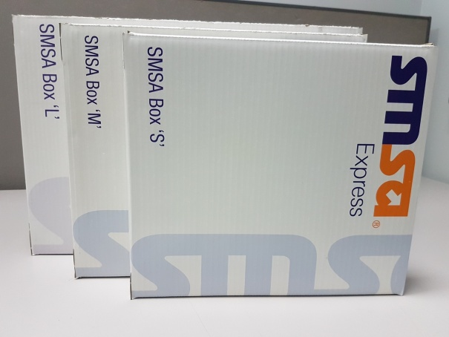
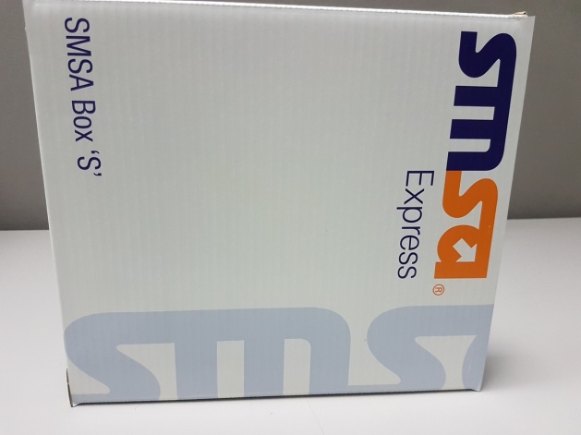
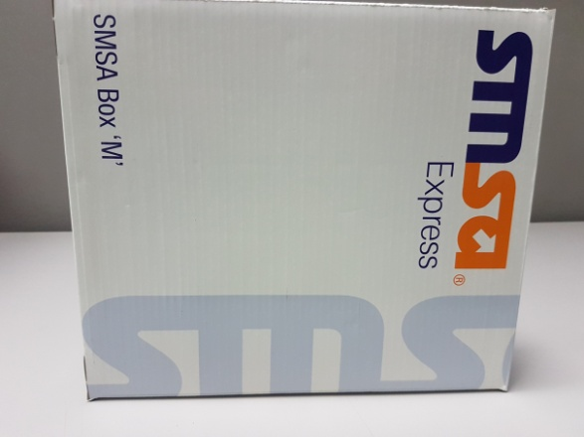
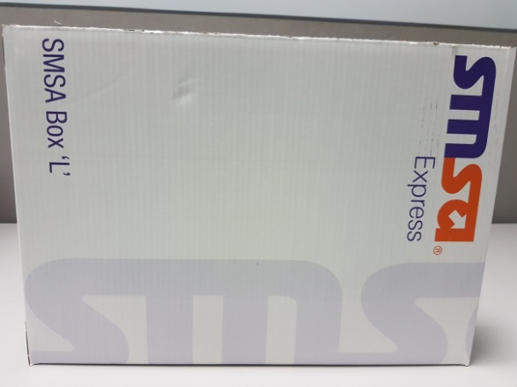
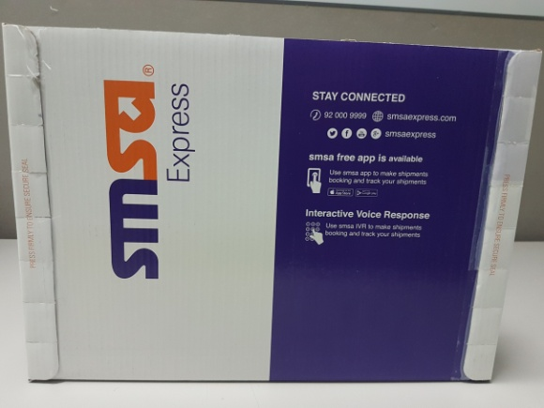
SMSA Small, Medium & Large Boxes
*** Domestic & SMSA Service Centers Only
Max Weight:
Small – 1.5 kgs.
Medium – 3 kgs.
Large – 5 kgs.
Carriage Value: SAR 375
** May be higher upon declaration with Insurance Charges
MPS (Multiple Piece Shipment): Available

Slide 12


SMSA Fresh Box
Max Weight: 10 kgs
Carriage Value: SAR 375
** May be higher upon declaration with Insurance Charges
MPS (Multiple Piece Shipment): Not Available

Slide 13
Customer Packaging (Non-Freight)
Max Weight = 32 kgs. (per piece)
Max Size = 280cm x 120cm x 130 cm (L, W, H)
Maximum Carriage Value Limited to: SAR 187,500
** May be lower or higher depending on country of destination - SRG
MPS (Multiple Piece Shipment): Available

Slide 14

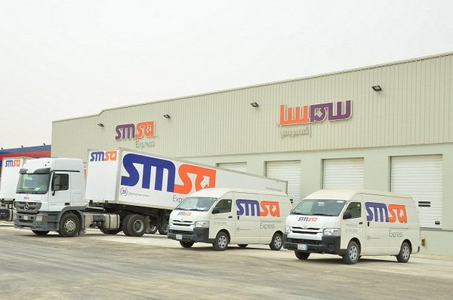
SMSA Express Service Categories
  ☑ Documents
  ☑ Parcels (Non-Documents)
  ☑ Freight (Heavy- Non-Documents)
  ☑ E-Commerce (Non-Documents)
  (details under development)
  ☑ Cold – Chain (Non-Documents)
  (details under development)

Slide 15
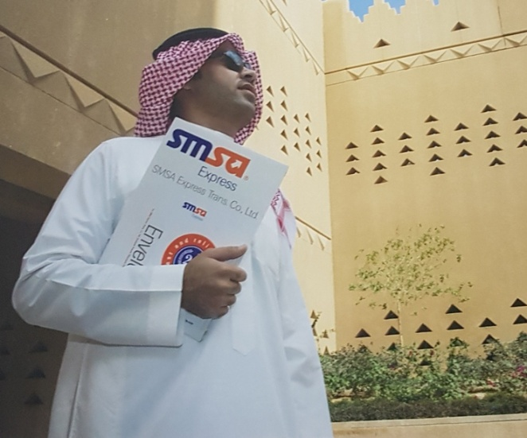


SMSA Domestic Services
SMSA Priority Overnight (SPO)
  Documents (SPOD)
  Parcels (SPOP)
  Cash on Delivery (SPO-COD)
SMSA Intra-City Domestic (ICD)
SMSA Fresh Box (10 kg)
SMSA 2, 5, 10, 25, & 40 kg Boxes
(Mini BOX, SSB, SMB, SLB, SXLB)
SMSA Freight Service – Loose (SFS)
SMSA Special Packaging (SSP)
SMSA SmartShip
SMSA Saudi Armed Forces Special Service (SAFSS)

Slide 16

SMSA Priority Overnight – Documents (SPOD)
This service is designed to meet business needs for time sensitive Documents to be delivered next business day to most of Saudi Arabia. Next Business-Day delivery by 10:30am
Weight Info: 0.5 kgs
Insurance: 2% of Declared Value for Customs
SMSA Packaging: SMSA Envelope or Customer’s Packaging (Envelope type)
Cities Served: SMSA Served Cities (Refer to Cities Served)
Commitment Time:
Major Cities: Next Business day by 10:30 a.m.
Remote Cities: see SPO Delivery Matrix

Slide 17

SMSA Priority Overnight – Parcels (SPOP)
For time sensitive Parcels to be delivered next business day to most of Saudi Arabia. Delivery by 10:30 A.M to main cities of Saudi Arabia; additional day to remote areas.
Weight Info: 0.1 – 15 kgs. (up to 32 kgs. Per piece)
Insurance: 2% of Declared Value for Customs
SMSA Packaging: SMSA Pak, SMSA (S,M, L) Box or Customer’s Packaging (Box type)
Cities Served: SMSA Served Cities (Refer to Cities Served)
Commitment Time:
Major Cities: Next Business day by 10:30 a.m.
Remote Cities: see SPO Delivery Matrix (+1 Business day)

Slide 18
SMSA Priority Overnight Documents & Parcels (SPOD / SPOP) Rates
Description Priority Overnight | Base Rate |  | Additional Rate
 | Weight | Net Rate (Including VAT) | Weight | Rate
SPOD (Documents) | 0.1 – 0.5 Kg | SAR 127.00 | Per 0.50 Kg | SAR 40.00
SPOP (Parcels) | 0.1 – 15 Kg | SAR 140.00 | Per 1.0 Kg | SAR 4.00
Dimensional Weight Applicable

Slide 19
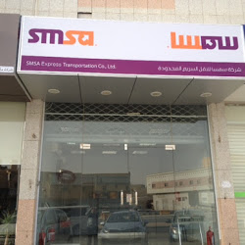

SMSA Priority Overnight Cash-On-Delivery (SPO-COD)
This service is designed to meet business needs for SPO Cash-On-Delivery needs for Documents and Non-Documents (Parcels) shipments to selected SMSA Service Centers in Saudi Arabia.
Weight Info: 15 kgs. Per piece
Insurance: 2% of Declared Value for Customs
SMSA Packaging: SMSA Envelope, SMSA Pak, Customer’s Own Packaging
Cities Served: SMSA Served Cities (Refer to Cities Served)
more than 250 SMSA Service Centers
Commitment Time:
Next Business Day Pickup at SSCs

Slide 20
SMSA Priority Overnight Cash-On-Delivery (SPO-COD) Rates
Description SMSA Priority Overnight | Base Rate |  | Additional Rate
 | Weight | Net Rate (Including VAT) | Weight | Rate
SPO-COD (Documents) | 0.1 – 0.5 Kg | SAR 161.00 | Per 0.50 Kg | SAR 10.00
SPO-COD (Parcels) | 0.1 – 15 Kg | SAR 161.00 | Per 1.0 Kg | SAR 10.00
Dimensional Weight Applicable

Slide 21

SMSA Intra-City Domestic (ICD)
** categorized as SPO within city by some
For time-definite, within the city delivery of Documents and Parcels to be delivered next business day before 10:30 a.m.
Weight Info: 0.1 - 2.5 kgs. (Docs) and 0.1 – 15.0 kgs (Non-Docs)
Insurance: 2% of Declared Value for Customs
SMSA Packaging: SMSA Envelope, SMSA Pak, SMSA Bag, SMSA S,M,L Boxes, Customer’s Packaging (Box)
Cities Served: RUH-RUH, JED-JED, DMM-DMM
Commitment Time:
Next Business Day before 10:30 a.m.
*** Cut-off time at 11 p.m. (or closing time of major RSCs)

Slide 22
SMSA Intra-City Domestic (ICD) Rates
Description | Net Rate (Including VAT) |  | Additional Rate
Intra-City Domestic | Weight | Rate | Weight | Rate
ICD (Documents) | 0.1 – 0.5 Kg | SAR 66.00 | Per 0.50 Kg | SAR 10.00
ICD (Parcels) | 0.1 – 15.0 Kg | SAR 66.00 | Per 1.00 Kg | SAR 4.00
Dimensional Weight Applicable

Slide 23
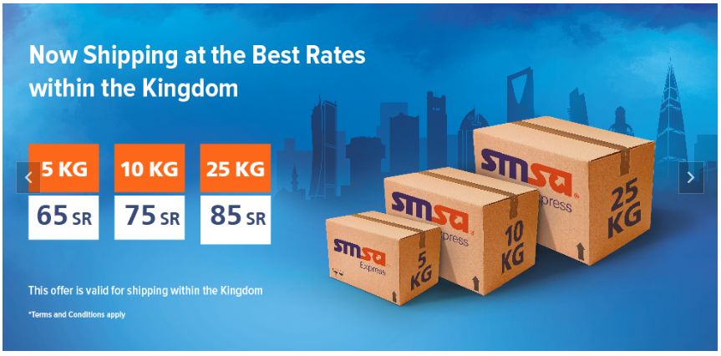
SMSA 2, 5, 10, 25 & 40 kgs. Promo Boxes
(Mini Box, SSB, SMB, SLB, SXLB)
This service is designed to meet business needs for time sensitive Non-Documents (Parcels) on a Promotional rate, to be delivered next business day to most of Saudi Arabia.
Weight Info: 2kg box – 2 kgs. ; 5kg box – 5 kgs. ;
10kg box – 10 kgs. ; 25kg box – 25 kgs. ; 40kg box – 40 kgs.
Insurance: 2% of Declared Value for Customs
SMSA Packaging: SMSA Mini Box (2kg) SMSA SSB (5kg),
SMB (10kg), SLB (25 kg) Boxes, SXLB (40 kg)
Cities Served: SMSA Served Cities (Refer to Cities Served)
Commitment Time:
Next Business Day before 12:00 p.m. (12 noon)

Slide 24
SMSA 2, 5, 10, 25, & 40 kg Promo Boxes (Mini Box, SSB, SMB, SLB, SXLB)
Description | Base Rate
SMSA Mini Box, Small, Medium, Large, Extra Large Promo Boxes | Weight | Net Rate (Including VAT) | Additional Rate
SMSA Mini Box (2 kgs) | 0.1 – 2.0 Kg | SAR 85.00 | Use the next weight range
SSB (5 kgs) | 0.1 – 5.0 Kg | SAR 105.00 | Use the next weight range
SMB (10 kgs) | 5.1 – 10.0 Kg | SAR 120.00 | Use the next weight range
SLB (25 kgs) | 10.1 – 25.0 Kg | SAR 150.00 | Use the next weight range
SXLB (40kgs) | 25.1 – 40.0 Kg | SAR 215.00 | *
Above 40 kgs., SPOP Rates and packaging (unmarked boxes) will be applied & Customer Packaging.

Slide 25

SMSA Fresh Box (10 kgs)
This is a new & special service introduced to meet business needs which comes with a special box limited to fruits, vegetables and other perishable products that do not require refrigeration for time sensitive Non-Documents (Parcels) on a Promotional rate, to be delivered next business day to SMSA Covered regions in Saudi Arabia. (please refer to matrix)
Weight Info: 10kg box – 10 kgs.
Insurance: 2% of Declared Value for Customs
SMSA Packaging: SMSA Fresh Box (10kg)
Cities Served: SMSA Served Cities (Refer to Cities Served)
Commitment Time:
Next Business Day

Slide 26
SMSA Fresh Box (10 kgs) Rates
Description | Base Rate |  | Additional Rate
 | Weight | Net Rate (Including VAT) | Weight | Rate
SMSA Fresh Box – Non Documents | 0.1 – 10 Kg | SAR 58.00 | Per 1.0 Kg | SAR 2.00
Comes with a special box limited to fruits, vegetables and other perishable products that do not require refrigeration. The service is designed for producers to customers not for producers to their sellers or stores throughout the kingdom

Slide 27

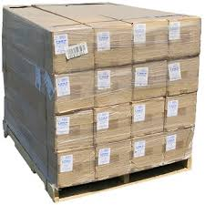
SMSA Freight Service (SFS – Loose)
This service is designed to meet business needs for deferred Non-Documents (Parcels) heavy-weight shipments to selected cities in Saudi Arabia.
Weight Info: No per piece and Maximum Total Weight Limits (max. weight limit depends on Origin City Station/Hub capabilities/infrastructure)
Insurance: 2% of Declared Value for Customs
SMSA Packaging: Customer’s Own Packaging
Cities Served: Selected Cities Only
Commitment Time:
2nd Business Day by 12:00 p.m. (12 noon)
Notes:
This service is designed to meet business needs for time sensitive Parcels to be delivered next business day to most of Saudi Arabia. Next-Business-Day delivery by 10:30 A.M. to main cities of Saudi Arabia; additional day to remote areas (Renaming SMSA Priority Overnight Non Documents)
Previous Details: SMSA Priority Overnight is our most popular time-definite mid morning service for documents and parcel.
Features Of SPO:
✓ Delivery Commitment : 10:30 to Metro Cities (RUH – JED – DHA)
✓ Service Days : 7 Days (Friday with Additional Charge and only in RUH- JED-DHA)
✓ Delivery Area : Current SMSA Served Cities & Towns.
✓ Cut-Off Time : 1800 Hours from Metro Cities.

Slide 28
SMSA Freight Service (SFS Served Cities)

Slide 29
SMSA Freight Service (SFS – Loose) Rates
Description | Base Rate |  | Additional Rate
Freight Service | Weight | Net Rate (Including VAT) | Weight | Rate
Loose | 0.1 – 40.0 Kg | SAR 140.00 | Per 1.00 Kg | SAR 2.00
Dimensional Weight Applicable

Slide 30
SMSA Service Center-to-Service Center (STS)
This service is designed to meet business needs for Service Center to Service Center pick up needs for Documents and Non-Documents (Parcels) shipments to selected SMSA Service Centers in Saudi Arabia.
Weight Info: 15.0 kgs
Insurance: 2% of Declared Value for Customs
SMSA Packaging: Customer’s Own Packaging
Cities Served: Selected SMSA Service Centers
Commitment Time:
SPO Commitment Time

Slide 31
SMSA Service Center-to-Service Center (STS) Rates
Description | Base Rate |  | Additional Rate
Services Center to Services Center (STS) | Weight | Net Rate (Including VAT) | Weight | Rate
STS (Documents/Non-Documents) | 0.1 – 15.0 Kg | SAR 75.00 | Per 1.00 Kg | SAR 2.00
In Limited Cities Only Dimensional Weight Applicable

Slide 32
SMSA Special Packaging (SSP)
This special service is designated for Honey and Olive Oil products coming from the Northern and Southern Region of Saudi Arabia.
Weight Info: 0.1 – 18.0 Kgs (Olive Oil)
Insurance: 2% of Declared Value for Customs
SMSA Packaging: SMSA Olive Oil & Honey Boxes
Cities Served: Northern (Olive Oil) and Southern Region (Honey) Cities Only

Slide 33
SMSA Special Packaging (SSP) Rates
Description | Base Rate |  | Additional Rate
SMSA Special Packaging (SSP) | Weight | Net Rate (Including VAT) | Weight | Rate
SSP Olive Oil Box (SOOS) * | 0.1 – 18.0 Kg | SAR 99.00 | Per 1.0 Kg | SAR 3.00
SSP Honey Box Small ** | 0.1 – 15.0 Kg | SAR 140.00 | Per 1.0 Kg | SAR 4.00
SSP Honey Box Medium ** | 0.1 – 18.0 Kg | SAR 140.00 | Per 1.0 Kg | SAR 4.00
* Available only NR. Free Olive Oil Boxes available only in selected SSCs of NR ** Available only in SR. Free Honey Boxes available only in selected SSCs of SR

Slide 34

SMSA Saudi Armed Forces Special Service (SAFSS)
This special service is designated for our SMSA Service Centers which support and enable Saudi Military troops serving in Southern border at the below mentioned 7 cities and their family members to send and receive shipments through our SSCs with lower transportation fees to be collected. This is Service Center-to-Service Center only. Docs & Non-Docs
Weight Info: No limit but fixed rated from 1-25 kgs
Insurance: 2% of Declared Value for Customs
SMSA Packaging: Envelope, Pak or Customer’s Packaging
Cities Served:
1. Najran (3 RSCs)
2. Jazan (3 RSCs)
3. Abu Arish (1 RSC)
4. Sabya (1 RSC)
5. Samtha (1 RSC)
6. Dharan Al Janoub (1 RSC)
7. Ad Dayer (1 RSC)

Slide 35
SMSA Saudi Armed Forces Special Service (SAFSS)
Sender: Anyone from any of our operating SSCs kingdom-wide*
* Recipient must be Saudi military or national guard employee. Sender must show a copy or image of the consignee's military ID for verifying and recording the number by the service center staff.
Consignee: Saudi military or national guard employee recipient in one of the cities mentioned below
1. Najran
2. Jazan
3. Abu Arish
4. Sabya
5. Samtha
6. Dharan al Janoub
7. Ad Dayer
*** Reminder not to obtain copy of the SAFS and Saudi ID but ensure to record the Saudi National ID number in the shipper’s from 7 authorized sending cities or Receiver’s from all cities other than these 7 cities.

Slide 36
SMSA Saudi Armed Forces Special Service (SAFSS)
Sender: Saudi military or national guard officer sending from any SSC enlisted below *
1. Najran RSC
2. Jazan RSC
3. Abu Arish RSC
4. Sabya RSC
5. Samtha RSC
6. Dharan al Janoub RSC
7. Ad Dayer RSC
Consignee:
Any recipient kingdom-wide
*** Reminder not to obtain copy of the SAFS and Saudi ID but ensure to record the Saudi National ID number in the shipper’s from 7 authorized sending cities or Receiver’s from all cities other than these 7 cities.

Slide 37
SMSA Saudi Armed Forces Special Service (SAFSS) Rates
SAFSS Rates | Net Rate (Including VAT) | Per Additional 1-kg
Documents & Non-Documents 1 – 25 kgs | 60 SAR | 2 SAR
Dim. Wt. Applicable

Slide 38
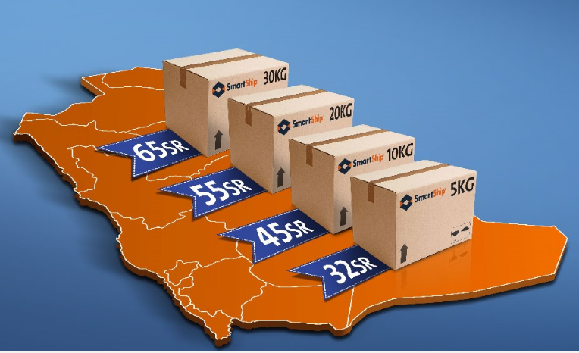
SMSA SmartShip
A Prepaid STS (Service Center-to-Service Center) Service within KSA.
This is a Web-based automated service for time sensitive Documents and Parcels to be delivered with the fastest possible transit time based on SMSA Service Center to Service Center service within
1- 2 business days (www.smartship.com)
Weight Info: categorized into less than 5kgs., 10 kgs., 20 kgs., 30 kgs.
Insurance: 2% of Declared Value for Customs
SMSA Packaging: Customer’s Own Packaging
Cities Served: SMSA Served Cities (Refer to Cities Served)
more than 250 Retail Service Centers
Commitment Time:
1 – 2 Business days pick up from RSC
** Purchase limit for AWBs is SAR 26,000

Slide 39
SMSA SmartShip Rates
Description | SmartShip Rates
SmartShip (Documents & Non-Documents) | 50 AWBs | Total | 100 AWBs | Total | 200 AWBs | Total
5 kgs | SAR 40 | SAR 2,000 | SAR 35 | SAR 3,500 | SAR 32 | SAR 6,400
10 kgs | SAR 55 | SAR 2,750 | SAR 50 | SAR 5,000 | SAR 45 | SAR 9,000
20 kgs | SAR 65 | SAR 3,250 | SAR 60 | SAR 6,000 | SAR 55 | SAR 11,000
30 kgs | SAR 75 | SAR 3,750 | SAR 70 | SAR 7,000 | SAR 65 | SAR 13,000

Slide 40
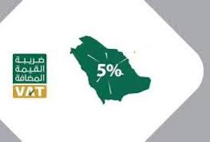

VAT (Value Added Tax)
Value added Tax (VAT) is a type of consumption tax that is placed on a product whenever value is added at a stage of production and at the point of retail sale.
VAT will apply to goods and services at the standard rate of fifteen percent (15%)
Applicable only on Domestic shipments – 15% of the amount collected towards transport charges and other charges like insurance
    Not applicable on International shipments transport charges both inbound and outbound. Applicable only on insurance charges collected.
    VAT will be collected on all inbound shipments coming into KSA by KSA Customs

Slide 41
VAT (Value Added Tax) Summary
  VAT on Value of inbound shipments
    VAT will be collected on all inbound shipments coming into Saudi by Saudi Customs.
    If the value of the shipment is above SAR 1,000, Custom duty and VAT will be applicable on the shipment, Saudi Customs will issue a Bayan for the shipment showing the custom duty amount and the VAT amount applicable. In such cases VAT will be calculated at 15% of (Declared value + Custom duty amount).
    If the value of the shipment is less than SAR 1,000, only VAT will be collected at 15% on the declared value of the shipment. Also note, individual Bayans will not be available for the VAT amount collected by Saudi Customs. Payment is done by clubbing all shipments less than SAR 1,000/- per inbound flight.

Slide 42
VAT (Value Added Tax) Service Center Job Aid
  1. If SSC has POS
This is applicable at 15% of the total amount of transportation charges plus insurance charges (if any) on domestic shipments ONLY.
Hence VAT amount will be automatically calculated after finalizing processing of the shipment. See the receipt from POS.

Slide 43
VAT (Value Added Tax) Service Center Job Aid
  2. If SSC don’t have POS - Manual AWB (Using TIN Stamp)
For Manual AWB Customer’s copy and Billing copy must have a stamp of VAT TIN number 300057426900003 stamped at the right top edge on the AWB. Transportation charges amount should be written in the transportation amount column
(1) Insurance amount to be written on coverage charges column
(2) VAT amount should be written on the other charges column
(3) Overlap other charges and write VAT instead. Total which will be Transportation charges + Insurance (if any) + VAT amount to be written on total charges column (4)

Slide 44
VAT (Value Added Tax) Service Center Job Aid
  2. If SSC don’t have POS - Manual AWB (No TIN Stamp)
In case TIN number stamp is misplaced or missing then TIN number 300057426900003 must be written manually at the top right edge on the AWB and follow all the manual AWB procedures in number 2.
NOTE: VAT amount needs to be rounded off examples: SAR 5.50 should be considered as SAR 6.00 and SAR 5.49 should be considered as SAR 5.00
If the customer is insuring for the shipment, then VAT amount of 15% will be (Transportation charges + Insurance charges)
VAT of 15% is applicable ONLY on domestic shipments.

Slide 45
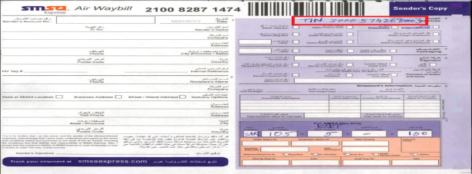
VAT (Value Added Tax) Service Center Job Aid

Slide 46
Hold At Location
SMSA offers HAL (Hold At Location) service at designated SMSA Service Centers, upon request of the customer.
Details:
Offered to customers at SMSA Service Center branches, or marked by customers in the AWB for pickup by the Operations Team.
HAL labels should be placed on the packages properly.
HAL Scans should be performed to indicate HAL selection.
HAL shipments not picked up within 15 days, are considered undeliverable and will undergo the RTS/RTO (Return to Shipper/Origin) procedure.
*** Refer to HAL Policy & RTS Policy in GUIDE for detailed procedures and
information.

Slide 47
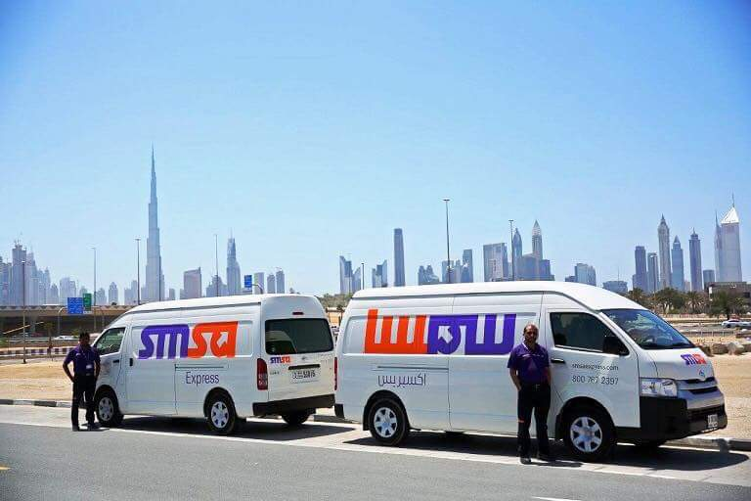

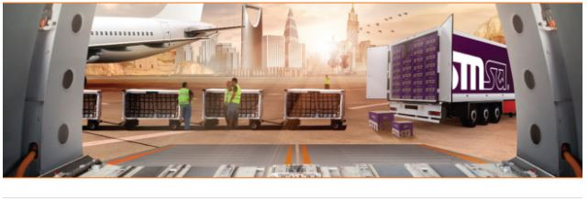
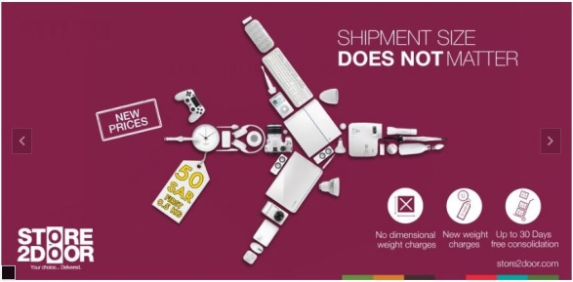
SMSA International Services
SMSA International Documents (SIDX)
SMSA International Non-Documents (SIND)
SMSA International Inbound Shipment (SIIS)
SMSA International Promo Boxes
  2, 5, 10, 25, & 32 kg Boxes (S2, S5, S10, S25, S32, Olive Oil Special Packaging)
SMSA Economic Express Service (EGY,BAH,UAE)
SMSA International Parcel by Road (SIPBR)
SMSA Full Truck Load / Less than Truck Load Service from/to UAE & GCC countries (FTL/LTL) - * except Qatar
SMSA Store2Door

Slide 48
SMSA International Documents (SIDX)
This International Service is for express delivery of Documents worldwide.
Weight Info: 0.5 kgs
Insurance: 2% of Declared Value for Customs
SMSA Packaging: SMSA Envelope, SMSA Pak, or Customer’s Packaging (Envelope type)
Countries Served: More than 230 Countries & Territories
Commitment Time:
GCC Countries – 1-2 business days
European Countries – 2 business days
Rest of the world – 2 – 3 business days

Slide 49

SMSA International Non-Documents (SIND)
This International Service is for express delivery of Non-Documents worldwide.
Weight Info: 32 kgs. (per piece)
Insurance: 2% of Declared Value for Customs
SMSA Packaging: Customer’s Own Packaging
Countries Served: More than 230 Countries & Territories
Commitment Time:
GCC Countries – 1-2 business days
European Countries – 2 business days
Rest of the world – 2 – 3 business days

Slide 50
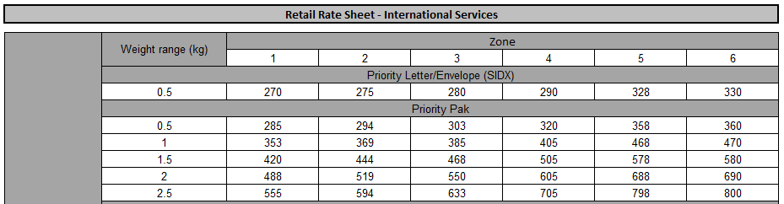
SMSA International Documents (SIDX)

Slide 51
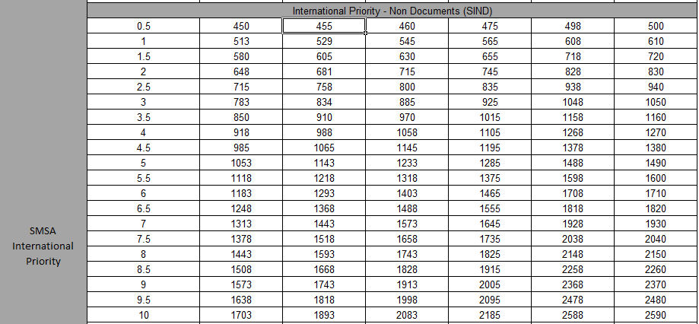
SMSA International Non-Documents (SIND) Rates

Slide 52
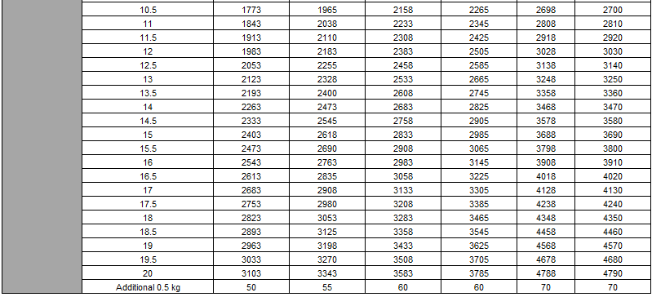
SMSA International Non-Documents (SIND) Rates

Slide 53
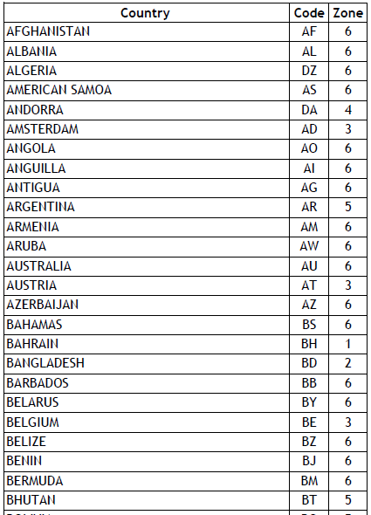
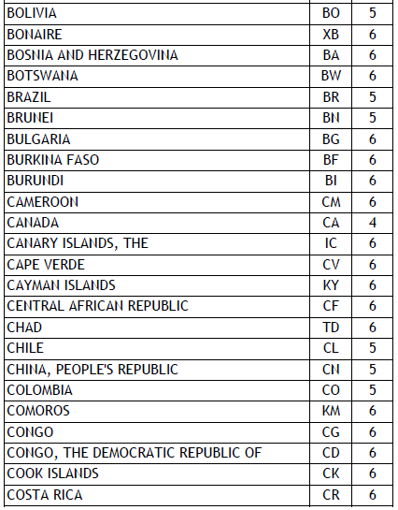
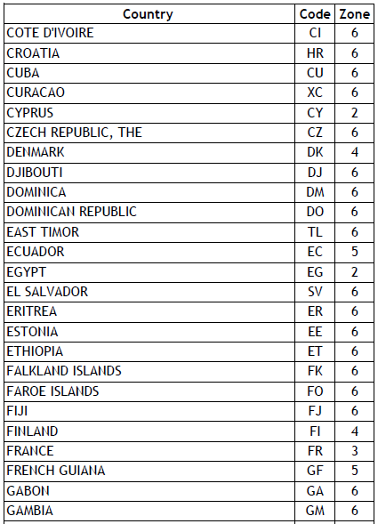
SMSA SIDX & SIND Zones

Slide 54
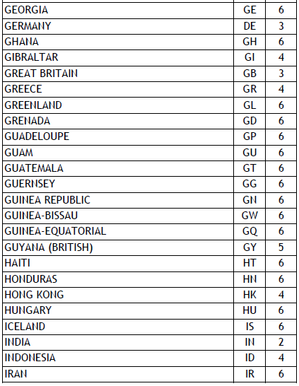
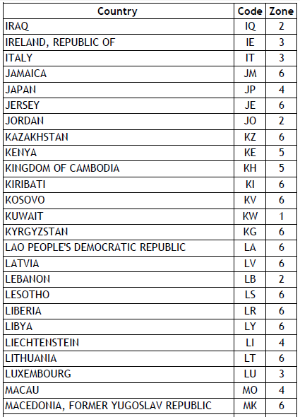
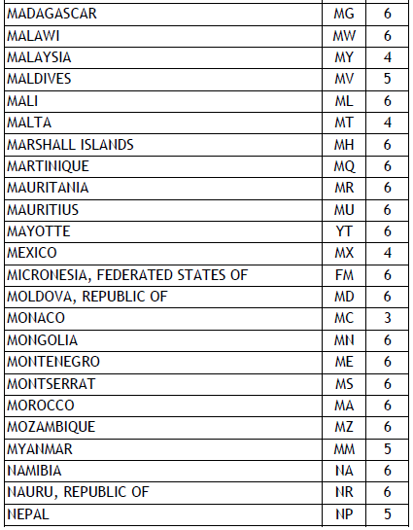
SMSA SIDX & SIND Zones

Slide 55
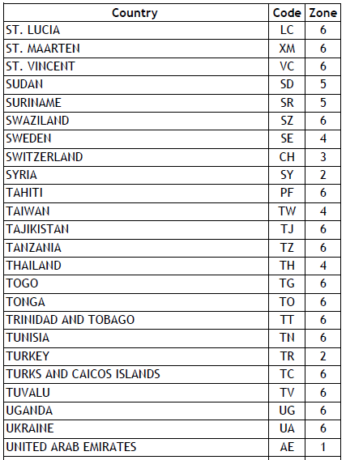
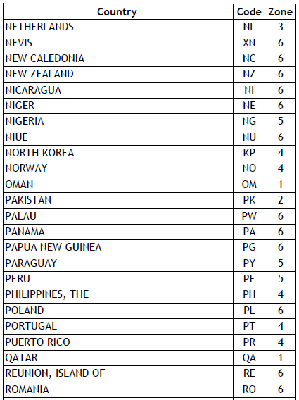
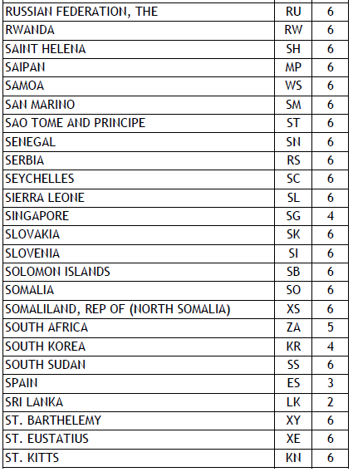
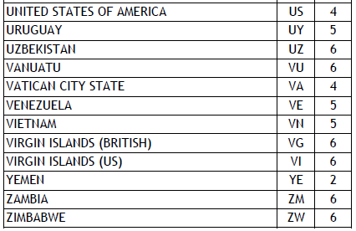
SMSA SIDX & SIND Zones

Slide 56

SMSA International Inbound (SIIS) - Documents
This International Service is for urgent import of Documents to KSA.
Weight Info: .5 kgs
Insurance: 2% of Declared Value for Customs
SMSA Packaging: SMSA Envelope, SMSA Pak,
or Customer’s Packaging (Envelope type)
Countries Served: More than 230 Countries & Territories
Commitment Time:
GCC Countries – 1-2 business days
European Countries – 2 – 3 business days
Rest of the world – 2 – 3 business days
*** Commitment time dependent on time of pickup from origin country

Slide 57

SMSA International Inbound (SIIS) – Non- Documents
This International Service is for urgent import of Non-Documents to KSA.
Weight Info: 68 kgs. (individual piece)
Insurance: 2% of Declared Value for Customs
SMSA Packaging: Customer’s Packaging (Box)
Countries Served: More than 230 Countries & Territories
Commitment Time:
GCC Countries – 1-2 business days
European Countries – 2 – 3 business days
Rest of the world – 2 – 3 business days
*** Commitment time dependent on time of pickup from origin country

Slide 58

SMSA International Inbound Service - Documents (SIIS) Rates

Slide 59

SMSA International Inbound Service Non-Documents (SIIS) Rates

Slide 60

SMSA International Inbound Service Zones

Slide 61

SMSA International Inbound Service Zones

Slide 62

SMSA International Promo Boxes 2, 5, 10, 25, & 32 kg Boxes (S02, S05, S10, S25, S32)
For time-sensitive Document & Non-Document shipments that fits in a SMSA Box, on a promotional rate using our SMSA 2, 5, 10, 25 & 32 kg Boxes.
Weight Info: up to 32 Kgs.
Insurance: 2% of Declared Value for Customs
SMSA Packaging: SMSA 2, 5, 10, 25, & 32 kg boxes.
Countries Served: More than 230 Countries & Territories
Commitment Time:
GCC Countries – 1-2 business days
European Countries – 2 – 3 business days
Rest of the world – 2 – 4 business days

Slide 63
SMSA Economic Express Service (SEES) –
* from KSA to Bahrain, Kuwait, Oman & UAE
For time-sensitive Document & Non-Document shipments that fits in a SMSA Box, on a promotional rate using our SMSA 5, 10 & 25 kg Boxes.
Weight Info: up to 32 Kgs.
Insurance: 2% of Declared Value for Customs
SMSA Packaging: SMSA 2, 5, 10, 25, & 32 kg boxes.
Countries Served: Bahrain, Kuwait, Oman & United Arab Emirates
Commitment Time:
BAH, KWT, OMN, UAE – 2-3 business days

Slide 64
SMSA International Promo Boxes 5, 10, 25, & 32 kg Boxes (S02, S05, S10, S25, S32) Rates

Slide 65
SMSA International Promo Boxes 2, 5, 10, 25, & 32 kg Boxes
(S02, S05, S10, S25, S32) Zones

Slide 66
SMSA International Promo Boxes 2, 5, 10, 25, & 32 kg Boxes
(S02, S05, S10, S25, S32) Zones

Slide 67

SMSA International Parcel by Road (SIPBR)
This International Parcel by Road is for deferred delivery of Document & Non-Document shipments via road network to selected GCC countries.
Weight Info: 18 kgs.
Insurance: 2% of Declared Value for Customs
SMSA Packaging: SMSA Olive Oil Box, Honey Box,
Customer’s Packaging (Box)
Countries Served: Bahrain, Kuwait, UAE
Commitment Time:
5-8 business days (dependent on Customs Clearance)

Slide 68
SMSA International Parcel by Road (SIPBR)

Slide 69

SMSA Full Truck Load / Less than Truck Load Service from/to UAE & GCC Countries(FTL/LTL)
This Freight Service is for deferred delivery of Non-Document shipments via road network to requested GCC countries (except Qatar).
Weight Info: no weight restrictions*
* primarily catering for Inbound from UAE.
Insurance: to be arranged by Shipper/Consignee
SMSA Packaging: Customer’s Packaging (Box)
Countries Served: GCC countries*** except Qatar
**primarily designed for Inbound from UAE.
*** Inbound/outbound from/to other countries –refer to Freight Dept.
Commitment Time:
5-8 business days (dependent on Customs Clearance)

Slide 70
SMSA Full Truck Load from/to UAE & GCC Countries*(FTL/LTL) Rates
Sl. No. | FTL Service (40ft. Closed Truck) | Currency: AED
1 | Trucking charges to Dammam | AED 6,800.00 Per truck
 | (Transit time approx. 5-6 working days)
 | Trucking charges to Riyadh | AED 7,850.00 Per truck
 | (Transit time approx. 6-7 working days)
 | Trucking charges to Jeddah | AED 9,250.00 Per truck
 | (Transit time approx. 7-8 working days)
2 | Export customs declaration, Gate pass, Documentation, Seal | AED 300.00 Per truck Per Set of Document
3 | Transit insurance & Chamber attestation | Not included
4 | All Official Charges like Customs Duty and Vat etc | At cost
* Inbound/Outbound from/to GCC countries (except Qatar) would have to be referred to Freight Dept.
** Rates shown in SAR

Slide 71

SMSA Less than Truck Load Service from/to UAE & GCC Countries* (LTL) Rates
* Inbound/Outbound from/to GCC countries (except Qatar) would have to be referred to Freight Dept.
** Rates shown in SAR

Slide 72



SMSA Freight Service
SMSA Freight is designed for heavy weight/deferred shipments* to and from other countries around the world. It provides the following services for personal effects:
Export packing & crating
Pick-up and domestic inland freight
Storage & warehousing
Air & ocean freight
Customs clearance
Door-to-Door service
* Refer all requests/inquiries to
Freight Dept.

Slide 73


SMSA Freight Service
Sea Cargo Service
  FCL (Full Container Load)
  LCL (Less-than-Container Load)
  Non-Containerized Cargo & Oversize Loads
  Ro-Ro (Roll-on/Roll-off)
  Port-to-Port
  Door to Port
  Door-to-Door
Air Cargo Services
  Door-to-Door
  Airport-to-Airport
  Door-to-Airport
Land Cargo Handling
  Door-to-Door
  Less-than Truck Load (LTL)
  Full Truck Load (FTL)
  Expedited Service
* Refer all requests/inquiries to
Freight Dept.

Slide 74



SMSA Store2Door
Sign up on Store2door.com, get a U.S. address, purchase on Online stores in the USA and ship to KSA.
Silver (Pickup in selected SSCs)
Items that arrive in your U.S. Address can be consolidated and shipped:
1 – Immediately
2 – Weekly shipping
3 – Bi-weekly shipping
4 – Monthly shipping
Notes:
This service is designed to meet business needs for time sensitive Parcels to be delivered next business day to most of Saudi Arabia. Next-Business-Day delivery by 10:30 A.M. to main cities of Saudi Arabia; additional day to remote areas (Renaming SMSA Priority Overnight Non Documents)
Previous Details: SMSA Priority Overnight is our most popular time-definite mid morning service for documents and parcel.
Features Of SPO:
✓ Delivery Commitment : 10:30 to Metro Cities (RUH – JED – DHA)
✓ Service Days : 7 Days (Friday with Additional Charge and only in RUH- JED-DHA)
✓ Delivery Area : Current SMSA Served Cities & Towns.
✓ Cut-Off Time : 1800 Hours from Metro Cities.

Slide 75

SMSA Store2Door Rates
 | Base Rate
Service | Weight | Rate | additional .5 kg
Store2Door | .5 Kgs | SAR 50 | SAR 30

Slide 76




Checking Status of Package via Online & SMSA App
Customers can check the status of their package & ship via Online (www.smsaexpress.com) or SMSA App (Downloadable via App Store for Apple Products & Play Store for Android Products)
Front Line staff (Couriers/SSEs/CSAs) should give a brief explanation of the status of the shipment depending on what was used (Online or App)
A more detailed status can be accessed via the CORE system.

Slide 77

Checking Status of Package - Online

Slide 78


Checking Status of Package - SMSA App

Slide 79




SMSA Air Waybill

Slide 80
By the End of this Training I will be able to learn about:
Definition of, and Rules in, completing a Manual Air Waybill
High Value / Items of Extraordinary Value, Non-Insurable Items, & High Value Shipment Handling
Importance of an Air Waybill
How to Fill a SMSA AWB (Manual & Electronic version)
Completion Responsibility (Manual & Electronic version)
SMSA Air Waybill Copy Distribution (Manual & Electronic version)
Customs and Carriage Values, & Dimensional Weight
Insurance & Indemnity Forms

Slide 81

Definition of Air Waybill
An Air Waybill is a contract Between the Shipper and SMSA.
Rules of the Air Waybill (Manual version):
Use Block / Capital Letters to Complete Air Waybill.
Press and WRITE HARD, So that all copies of the AWB is clear.
Check the FINAL PAGE of the AWB & ensure that all information is copied onto the last page.

Slide 82





Why the AWB is Important?
INCOMPLETE or INACCURATE AWB RESULTS in:
Loss of Revenue
Customs Delay
Late Delivery
Incorrect Billing
Dissatisfied Customer

Slide 83

Section 1 (Sender)
How to Fill a SMSA Air Waybill (Manual)
AWB Number
Sender Account
Date
Sender’s Name and ID No.
Company Name
Address
City (Province /State) Phone
Country
Postal Code
HV Tag #
Internal Reference
RU-1234
08/01/18
1234567890
Faisal Ahmad
The International Company
King Fahad St. Opposite to Kingdom Tower, 2nd Floor
0500000000
Riyadh
11526
Saudi Arabia
1596878
Notes:
BOLD Red Font, stands for mandatory.

Slide 84


Section 1 (Sender)
Customer Account is provided for Companies, Consists of City initial where the account is opened, followed by 4 digits E.g. (JE-1234). Always make sure that it is active (in POS or Siebel System)
Date should be in the form of (Month, Day, Year) e.g.. 1st of August 2018 will be (08/01/18)
High Value tag number is added when the AWB includes a HV value package.
Refer to the HV policy and HV Handling slides (succeeding slides).

Slide 85


Section 2 (Recipient)
Recipient Name
Phone
Company
Delivery Options:
    Hold At SMSA Location, Business Address, Street /Wasel Address
Address
Cell Phone
City
State/Province
Country
Postal Code
Sender’s Signature
+1 615-963-5000
John M. Smith
Tennessee State University
3500 John A Merritt Boulevard, Nashville, TN
+1 xxx xxx 0000
Tennessee
Memphis
37209
United States of America

Slide 86






Section 2 (Sender Signature)
Sender Signature
Not Acceptable Signatures
J.K

Slide 87






Section 3 (Services)
  Int’l. or Domestic Shipment
  SMSA Priority Document
  SMSA Freight (Palletized)
  SMSA Freight (Non-Palletized)
  SMSA Priority Parcel
  SMSA RTR (Service Center to Service Center)
  Friday Delivery
  SMSA 5 Kg Box
  SMSA 10Kg Box
  SMSA 25Kg Box
  Other (Services – SIDX, SIND, SIIS, etc.)

Slide 88




Section 4 (Packaging)
  SMSA Envelope
  SMSA Pack
  Other (Any other packaging – SMB, S10, Customer’s Packaging, etc.)

Slide 89







Section 5 (Payment Method)
Payment for Transport
  Payment Method
    Account Number
    Cash
    Credit Card
    Sender Account No.
    Recipient's/3rd Party Account Number
  Payments of duties and Taxes
    Third Party
    Recipient
    Sender’s Acct No.
    SMSA Account No.
RU-1234
Payment for Custom Duties & taxes
Always make sure the account is Active

Slide 90




Section 6 (Shipment’s Information)
  Total Packages
  Total Weight (Kgs)
  Dimensions (cm)
  Commodity Description
  Harmonized Code (HTC Code)
  Country of Manufacture
  Value for Customs
  Total Value for Customs
  Total Declared value for Carriage
3
3 Kgs
Hp 2014 DV4 Laptop New Not for resale
US
SAR 3,750
Canon Camera 40 Megapixel (Used)
China
SAR 750
Graduation Certificate
NCV / 1$ USD
SAR 4,500 or / NVD (if No insurance required)
SAR 4,500

Slide 91

Good Description for Items
From the description on the AWB and CI Customs will decide if this package can be cleared or will be held by customs
To be a good description you must be able to tell the following:
  What are the goods made of?
  What are the goods to be used for?
  How many are there of them?
  Are they for resale?

Slide 92



Dimensional Weight (How to Calculate)
Notes:
http://en.wikipedia.org/wiki/Dimensional_weight
Dimensional weight is a calculation of a theoretical weight of a package. This theoretical weight is the weight of the package at a minimum density chosen by the freight carrier. If the package is below this minimum density, then the actual weight is irrelevant as the freight carrier will charge for the volume of the package as if it were of the chosen density (what the package would weigh at the minimum density).

Slide 93
Describe the Following Items
2 Saudi Passports
2 sets of Ceramic Vases
Rolex Hand Watch
3 sets of full men Suits

Slide 94

Value for Customs
Represents the sale or True Market Value of the shipment content.
Is used by Customs Agents to determine the amount of duties and taxes to be paid.
Must be declared on all Non-Document Shipments.
May higher than SAR 375 , with corresponding insurance charges
(e.g. SMSA Envelope & Pak).
Has no limit unless determined by specific country or commodity. (as per SRG).

Slide 95




Carriage Value
Represents the amount of money the shipper expects SMSA to reimburse him for his Shipment if lost or Damage.
May be equal or lower than customs value. Is optional, but if not declared, SMSA will be responsible only for the amount covered by the automatic liability.
The amount of automatic liability is SAR 375 ($100 USD) per Shipment.
For Items of extraordinary value maximum amount is up to SAR 3,750 ($1,000 USD) with insurance or SAR 375 ($100 USD) with indemnity.
(Refer to the Extraordinary Items List)

Slide 96

Insurance Request Form
Carriage value should not be more than Custom value.
Insurance premium 2% for Shipments.
Calculated as :
Commercial value (Customs Value) of the commodity
X 2%= (Amount to be paid for insurance)
Example: (Value of item is SAR 500 x 2% = SAR 10)
Extraordinary items insurance maximum limit up to SAR 3,750 ($1000 USD) per shipment.
No Insurance / Indemnity is needed for Document shipment or any shipment whose Customs value is less than SAR 375 ($100 U USD) or equivalent.
Insurance manifest, Requisition form and AWB must be compiled and handed over to Finance immediately
Sender has to have Full Idea (be informed by SMSA Employee) about the insurance and take one copy of the form with him for reference.

Slide 97

Insurance Request Form
FRONT
BACK

Slide 98


Indemnity Agreement Form
Used when the customer/shipper is informed about choice to Insure Shipment, but does not want to avail of Insurance Request.
Customer must be informed to read the conditions in this form and ask for his/her understanding.

Slide 99

Section 7 (SMSA Use)
  Transportation Charges (if cash)
  Coverage Charges
  Other Charges
  Total Charges (if cash)
  Currency (if cash)
  Original Station ID
  Destination Station ID
  URSA Routing
  Handling Units
  Total Volume (cm)
  Attached Forms
  Shipment Received At:
    Reg Stop
    On-Call Stop
    Drop Box
    SMSA Service Center
    Station
  Pick Up Emp. No.
  Date:
  Audit Emp No.
  Date
SAR
1,015
90
925
RUH
BNA
US/BNA
CI
FCC form
1234
08/01/18

Slide 100

Sales Pre-Printed AWB (For Corporate Clients)

Slide 101

SMSA Automation Manager (SAM-Heavy) - AWB
Sender
Shipment Details
Recipient

Slide 102

SMSA Automation Manager (SAM-Light) - AWB
Sender
Shipment Details
Recipient

Slide 103
SMSA POS (Point of Sale – SMSA Service Centers Only) AWB
Sender
Shipment Details
Recipient

Slide 104
Domestic Items of Extraordinary Value/High Value
High Value & Extraordinary items can be insured up to a maximum of
SAR 3,750 ($ 1,000 USD)
For further details, refer to High Value & Extraordinary Items Document.

Slide 105

SSC High Value, Extraordinary, & Non-Insurable Items

Slide 106


SSC High Value, Extraordinary, & Non-Insurable Items

Slide 107

SSC High Value, Extraordinary, & Non-Insurable Items

Slide 108



SSC High Value, Extraordinary, & Non-Insurable Items

Slide 109
High Value Shipments Handling
Receiving High Value Shipment
Identification
Physical check / inspection in Customer’s presence
Insurance / Indemnity
Sealing – (Pre-printed bags or Pre-punched + tag) in presence of Shipper
Seal No. on AWB & Copy/Ref. to Shipper
High Value shipment label
High Value Manifest / +Cash manifest
Responsibility for safety and security of shipment until handed over

Slide 110
High Value Shipments Handling
Change of Hand – Handing Over
Briefing/ Debriefing.
Checking Seal Integrity
Reconcile – Manifest / AWB / Tag No. / Descriptions on PPWKs, check weight?
Discrepancy - Yes/No.
Discrepancy exists – Report to Line Manager & QRM
No Discrepancy –Sign on Manifest Received.

Slide 111
High Value Shipments Handling
 | Prohibition |  | Maximum | Security
 | Domestic | International | Insurance Allowed | Tag/ Bag
Ordinary Value Items | Allowed | Allowed | USD 50,000 | No
High Value Items | Allowed | Allowed | USD 50,000 | Yes
Extra-Ordinary Value Items | Allowed | Prohibited | USD 1,000 | Yes

Slide 112
High Value related Documents in GUIDE
Document Name
High Value Extraordinary Items List
High Value Hand-over Form
High Value Items List
High Value Shipment Handling
High Value Shipment Operating Procedure
High Value Shipment RSC Pick-up Process
RSC High Value Shipments - Receiving
High Value Shipments – Receiving
HV Shipment Corporate Customer - Courier Pickup
HV Shipment Delivery-Station Courier
HV Shipments Receiving Hub
RSC High Value Extraordinary Items List

Slide 113
AWB Responsibility – Completion
Customer
Sender Information
Recipients Information
Shipment Information
Service Information
Packaging Information
Delivery/Handling Instruction
Transportation Charges
Duties & Taxes
Sender’s Signature
Employee
Audit Air Waybill
Employee Number, Shipment Date and Time
Peel Off Package Tracking Numbers
Received at Information
Total Charges
Handling Units/ADDL. Documents
Dimensional Weight
Station ID/URSA Routing

Slide 114





AWB Copy Distribution
(Manual)
MANIFEST BILLING COPY
CASH MANIFEST COPY
ORIGIN STATION COPY
DESTINATION COPY
RECIPIENT COPY
AWB Distribution
SENDER COPY
*** For Automated AWB (SAM), there should at least be 4 copies of the A4 Printed Paper with the package.

Slide 115
Additional AWB Information
For SMSA Service Center, ensure that the Service Center Account Number/Branch Number (Cash Basis Only) be written if using the Manual AWB.
Keep the Manual AWB Flat on the Pouch with barcode facing up.
Place the Peel Off stickers (for Manual AWB) in a visible place on top or side of the box.
For Automated AWB, write manually the AWB number/s on the pack/box, as there are no Peel of Stickers.
Ensure proper computation and writing of Dimensional Weight (whenever applicable) in the AWB.
For MPS (Multiple Piece Shipment) boxes, write down/print AWB No/s. (child) with the Master Box.

Slide 116

Receipt Voucher

Slide 117
Who Gets Affected by Poor Auditing
Poor AWB
The Recipient
SMSA
Employee
The Shipper

Slide 118





Customs Paperwork

Slide 119
By the end of this training you will be able to understand:
What do we mean by Customs Authorities
Shipment Documentation Responsibilities
Customs Requirement for all destinations
Commercial & Pro Forma Invoice
Packing List
Certificate of Origin
Indemnity Letter
Shipper’s Declaration for Blood Sample
Exporting Blood Sample & Human Specimen
Material Safety Data Sheet (MSDS)
– for DG Shipments
Harmonized Code (HS / HTS Code)
Customs Requirement for the United States of America
U.S.A. Customs Paperwork
Personal Effects – U.S.A.
Gift Shipments – U.S.A.

Slide 120


Customs Authorities
What do we mean by customs authorities?
Customs officials in each country are responsible for protecting revenue & promoting lawful international trade & travel within their respective boundaries.
What are their main Functions?
Among their many responsibilities they collect Customs duties, taxes, fees and penalties due on imported, and some exported products. Customs also enforce provisions & laws of other government agencies. They monitor exports & imports to ensure that the correct licenses are present and ensure that no prohibited commodities are exported.
What are their basic requirements?
Commercial Invoice (CI) is the most basic of requirements, along with any country specific forms and statements.

Slide 121


Customs Authorities
Customs requirement responsibility
The Shipper
Origin Station
Hub & Destination
The Recipient / Consignee

Slide 122


Customs Requirements for all Destinations
A shipment travelling from one country to another is subject to two different customs regulations: export from the origin country & import to the destination country. In addition to the AWB, the primary document required by all Customs around the world is the Commercial Invoice.
Additional paperwork may be required by export or import Customs based on the shipment & its origin/s. That is why it is imperative to check the Commodity Information (Documents & Non-Documents) in the SRG.
How many different types of invoice exist?
Commercial Invoice (CI)
Pro-Forma Invoice (PRO)

Slide 123

Commercial Invoice (CI)
What is a Commercial Invoice?
A Commercial Invoice is the primary document required by most customs authorities for clearance of shipments crossing international borders. The CI is a legal document and is subject to international law.
Penalties and/or fines may be assessed by destination Customs and the shipment may be rejected if the Shipper does not complete the CI correctly. It is recommended that the CI be completed on the Shipper’s letterhead.

Slide 124


Commercial Invoice (CI)

Slide 125


Commercial Invoice form used in SMSA
*** This is an Excel File which can be completed in a computer or printed and filled manually.

Slide 126
Completing the Commercial Invoice form used in SMSA
Sender Information
Faisal Ahmad
John M. Smith
Consignee Information
The International Company
Tennessee State University
King Fahad St. Opposite to
Kingdom Tower, 2nd Floor
3500 John A Merritt Boulevard,
Nashville, TN
Shipment date, weight, pieces.
Riyadh
Memphis, Tennessee
Sender Reference No. & Country of Manufacture
Saudi Arabia
United States of America
0500000000
+1 615-963-5000
08/01/18
3 Kgs
3
& USA

Slide 127

Completing the Commercial Invoice form used in SMSA
Commodity Description
(Quantity, Unit, Unit Value,)
1
Hp 2014 DV4 Laptop New Not for resale
1
Pc.
SAR
3,750
Canon Camera 40 Megapixel (Used)
2
1
Pc.
SAR
750
Itemized Value of Items, Currency & Total Value of Shipment
3
Graduation Certificate
1
Pc.
SAR
NCV
4,500

Slide 128
Completing the Commercial Invoice form used in SMSA
Sender’s Signature & Date

Slide 129

Pro Forma Invoice
What is a Pro-Forma Invoice?
The Pro-Forma invoice is an importer’s statement of value or the price paid in the form of an invoice for the purpose of Customs control.

Slide 130


Pro Forma Invoice

Slide 131


Packing List
What is a Packing List?
A Customs officials use this to check the cargo. A Packing List must be included with an MPS shipment if required information is not listed on the CI (Commercial Invoice). This is completed by the Sender/Shipper.
Information in a Packing List:
Itemized list of materials for each package
Type of Packaging (Box, Crate, Etc.)
Weight(s) and Measurement(s)
Package Markings, Sender’s and Buyer’s References
Information must not contradict AWB and CI

Slide 132


Certificate of Origin (COO)
What is a Certificate of Origin?
The Certificate of Origin is used when required by the destination country. It must not contradict the information on the Commercial Invoice or AWB. Check the current SRG for country & commodity requirements. This must be completed by the Shipper and must be notarized by the Chamber of Commerce.
Items that often require a Certificate of Origin are:
Clothing
Footwear
Headwear
Foodstuffs

Slide 133


Certificate of Origin (COO)

Slide 134


Indemnity Letter
Indemnity Letter
This letter is required from the Shipper whenever the International shipment is destined to the following Countries:
Iran
Syria
North Korea
Sudan
Crimea
Russia
Libya
Cuba

Slide 135



Shipper’s Declaration for Blood Samples
Shipper’s Declaration for Blood Samples
This Declaration Letter is required from the Shipper whenever the International shipment being sent is a Blood Sample.

Slide 136
Exporting Blood Sample and Human Specimen
Blood Samples and Human Specimen shipments thru SMSA Network need Customs approval first before sending the physical shipment.
Customers must provide Customs Permit & Online Authorization
Hospitals/Labs & Licensed Medical Entities
Hospitals / labs and licensed medical entities need to obtain export approval from Customs HQ (Restricted Goods department)
Shipper should have his Legal “Affair Officer” contact Customs HQ in RUH to apply for one year bulk approval export permit and indicate required point of exit – JED, RUH etc.
The permit can be requested for six months or one year to export Blood, urine etc. samples for test and analysis
All shipments require a final export declaration which SMSA can process
Exporter needs to register an Electronic Authorization letter (EAL) customs and register/ approve SMSA as an authorized broker for their shipments

Slide 137


Exporting Blood Sample and Human Specimen
Individual Doctors
Individual Doctors needs to apply for SFDA non objection to export approval letter
Approval is issued on a shipment by shipment basis
All shipments require a final export declaration which SMSA can process
Exporter needs to register an Authorization letter customs and register approve SMSA as an authorized broker for their shipments
For the Electronic Authorization, shipper in Saudi needs to issue the E Al for point of exit Export:

Slide 138


Material Safety Data Sheet (MSDS)
Material Safety Data Sheet (MSDS)
This is a document that contains information on potential hazards (health, fire, reactivity, environment, etc.) and how to work with the chemical product.
This is a required document whenever sending Dangerous Goods (DG) shipments.

Slide 139


Harmonized Code
What is a Harmonized Code or HTS Code?
The Harmonized Commodity Description and Coding System, or the Harmonized System is the Internationally standardized system of names and numbers to classify traded products.
The Harmonized System Clarification (HS Code) is a 6-digit standard for globally traded products. This is used when referencing the classification of products outside of the U.S.A.
The Harmonized Tariff Schedule Code (HTS-US) Code, is a 10-digit import classification system for the U.S.A. This is used when commodities are being traded to and from the U.S.A.
*** HS Codes are provided by the shipper.

Slide 140

Customs Requirement for U.S.A.
Documentation normally required is:
AWB (Air Waybill)
Invoice(s) – Commercial or Pro Forma
Importer’s Tax ID number, if known.
Various commodities require specific documents and/or information for clearance purposes.

Slide 141
Importer Identification Numbers
U.S. Customs regulations specify that each person, business, government agency or other organization mush have an Importer Identification Number. These numbers are used to identify persons and organizations to meet various U.S. Tax requirements. There are 2 types of Importer Identification Numbers:
Employer Identification Number
Social Security Number
If an importer has not been assigned an Importer Identification Number, US customs will assign an importer number.

Slide 142


U.S. Customs Paperwork
Food and Drugs Administration (FDA) Prior Notice
The FDA Prior Notice (PN) is used for all food (foodstuff, medicines, eyeglasses, contact lenses, etc.) shipments, that is completed online by the shipper, especially if the total value for customs is over $200 USD.
Not required for:
Personal shipments (Home made food to individual) with Customs Value of less than $200 USD sent as a gift.

Slide 143


U.S. Customs Paperwork
Federal Communication Commission (FCC) Form 740
The FCC Form is used for all non-US origin commodities imported into the US categorizes as “radio frequency devices or sub-assemblies” and over $200 USD.
Supply this form with all shipments of this nature & must be used for EACH piece regardless of quantity.
The FCC Form is not required if 3 or fewer radio frequency devices are being imported for personal use and not for resale.

Slide 144

U.S. Customs Paperwork
Federal Communication Commission (FCC) Form 740
The following is a general list of radio frequency devices:
Disc drive units
Storage units for data processing machines
Printer units for data processing machines
Parts of keyboard units, storage units, disc drives & printer units
Cartridge type radio player combinations
All other radio-tape & phonograph-tape player combinations
Digital Electronic weighing machine
Industrial robots
Automatic typewriters
** Not required for gifts & personal usage less than 3 devices
Microwave ovens
Calculating machines for multiplying & dividing
Electric adding machines
Cash registers
Electrostatic copying machines
Photocopying machines
Video games & parts
Pacemakers
Telephone apparatus, instruments & parts

Slide 145


U.S. Customs Paperwork
Personal Effects – New & Used
The Customs Form 3299 (CF 3299) is used when sending Personal Effects items to the U.S., whether it is New or Used.
All documents must indicate “Personal Use not for Resale”
Duty-free under $200 USD. Generic description needed*
Dutiable from $200.01 USD. Detailed description needed
If valued over $2000 USD, SSN is also required.
No other forms needed such as textile declaration, footwear form, FCC 740 etc
* CF 3299 is not required if value of the shipment is less than $200 USD.

Slide 146


U.S. Customs Paperwork
Unsolicited Gifts
All gifts under $100 USD per person can be sent to the U.S. and will enter duty-free if the CI and AWB states “Unsolicited gifts”. If the gift is for more than 1 person, each person’s name should be indicated
Not allowed as Gifts:
Drugs & Narcotics
Alcohol, Tobacco & firearms
Items subject to TSCA restraints (pens, chemicals sec.)
Fish & Wildlife restricted or regulated articles.

Slide 147


Proper Packaging

Slide 148

Objective:
Know the importance of proper packaging
Identify who will be responsible for packing the shipment properly.
Distinguish if the shipments packaging is sufficient for shipping
Advise the customers of how to properly packed their shipment.

Slide 149


Why do we need proper packaging?
To protect the shipment from damages.
To secure the profit of the company.
To secure the safety of the personnel who is handling the shipment.
Protect the Shipper, consignee and SMSA reputation.

Slide 150


Who is responsible for packaging?
SHIPPER
Who is responsible in accepting the shipment?
COURIER
You ( SMSA Employee)

Slide 151


Packaging Basics
Scenario
Corrective Action
Shipment with Strings and Ropes
Strings must be removed from the shipment and re-taped with our approved tape
  Note: strings may get entangled in our conveyors and cause problems in our network and might as well damage the shipment.

Slide 152


Packaging Basics
Specifics:
Features/ Restrictions
Tape
  Shipment tape with cellophane tapes, masking tape and water activated tapes
Kindly advise the customer not to use these tapes and educate them that these type of binding will not survive the transit.
Show them the approved tape that has a good adhesive and sturdy enough to with stand the handling of the network.

Slide 153

Proper Application of Tape
The H-taping method helps to secure all the points of the box to be sealed.
H-Taping Method

Slide 154

Packaging Basics
Specifics:
Features/ Action item
If the shipper uses a re-used cartons, boxes or containers.
Advise the shipper to remove all the markings and make sure that all flaps of the box are intact.
If you see any dents, holes, tears, torn flaps, oil and water stains please advise the sender to replace the box or container.

Slide 155
Packaging Basics
Specifics:
Features/ Action item
If you see or hear that the shipment is moving or rattling inside the box or container.
You should inspect the shipment prior to acceptance.
Make sure that:
  No spaces inside the box
  All spaces must be filled with loose fills or reinforcements.
  There is no damage such as dents and holes on the package.

Slide 156



Packaging Basics
Specifics:
Features/ Action item
If you receive small items in large quantity
Inspect the shipment and ask what is the item
Ensure that the items is placed inside a bag or burlap.
Over pack it inside a sturdy box with no spaces and do not allow the items to move.

Slide 157


Packaging Basics
Specifics:
Features/ Action item
If the sender wants to send brief case, luggage, garments and re-usable cases.
Make sure that the packaging is secured and items are properly declared
Do not put adhesive tapes and labels on the package. It may damage the appearance of the shipment
Use a tie on tag (if available) for AWB and invoices.

Slide 158



Packaging Basics
Specifics:
Features/ Action item
Fragile shipments and glass shipments
Glass products and fragile items must be wrapped separately and cushioned properly.
Make sure that a Fragile sticker and orientation stickers is at the shipment

Slide 159





Overpacking of Fragile Items
Note: Glass and Fragile items are not valid for SMSA claim

Slide 160
Proper Application of Tapes
Any Damaged shipment is a…….
As a Courier or a front liner you must be prepared to refuse any shipment that is not properly packed.
Any shipment that is not properly packed may lead to damage shipment.
If you refuse the shipment for improper packaging , explain the following:
  What is unacceptable about the packaging.
  How the customer can repack the shipment.
FREE SHIPMENT

Slide 161


