Slide 1


RISK MANAGEMENT
AWARENESS TRAINING
quality.qrm@smsaexpress.com

Slide 2
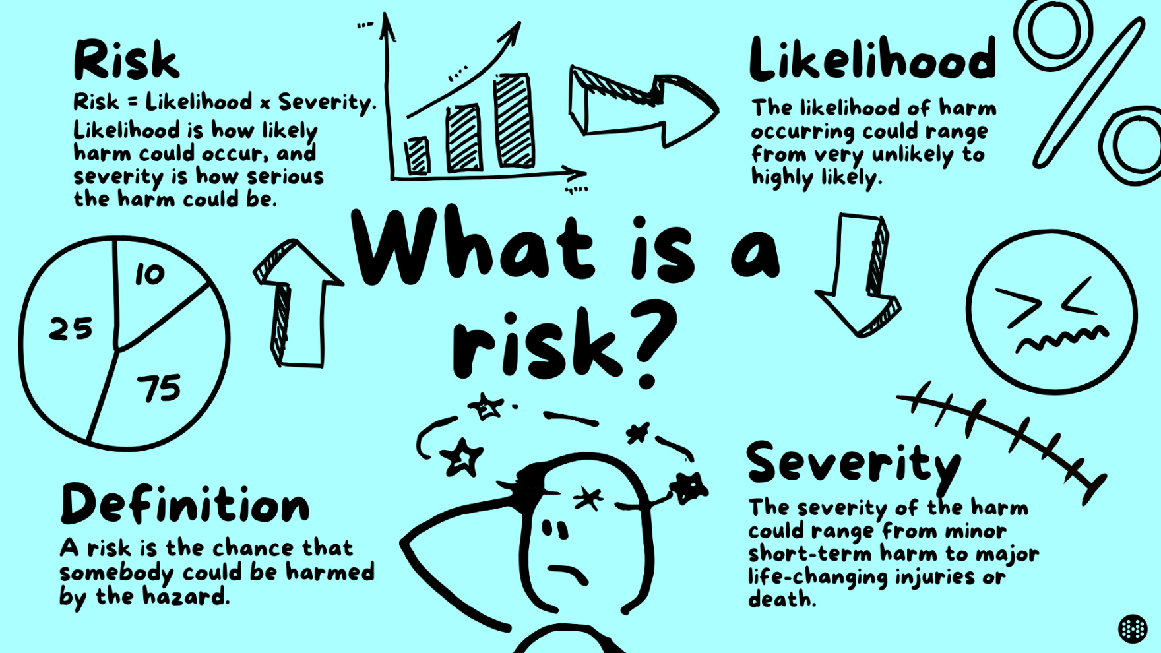
WHAT IS RISK?
Risk = Something that might go wrong and affect our objectives.
Explanation: “If something can happen and cause a problem, delay, loss, injury, or complaint — that is a risk.”
3 Examples:
Shipment lost during transfer
System outage stops tracking
Staff injury in warehouse

Slide 3
WHY RISK MANAGEMENT MATTERS?
Risk management protects people, customers, money, and reputation.
Explanation: “When we manage risks early, problems don’t become disasters.”
3 Examples:
Preventing accidents saves lives
Preventing fines saves money
Preventing complaints protects brand
EARLY RISK
IDENTIFICATION
PROJECT
SUCCESS
MITIGATION &
RESPONSE
STRATEGIES

Slide 4
RISK IS EVERYONE’S RESPONSIBILITY
IMAGE
RISK
Risk exists in every department.
Explanation: “If your work affects others, you create or control risk.”
3 Examples:
HR delay → staff shortage
Finance error → billing dispute
IT downtime → CS overload
OPERATIONAL
RISK
IT & DATA
SECURITY RISK
RISK
MANAGEMENT
SOCIAL &
HR RISK
JUDICIAL
RISK
FINANCIAL
RISK

Slide 5

WHO DOES WHAT IN RISK MANAGEMENT?
Role | Responsibility
Staff | Identify & report risk
Supervisor | Control low risks
Department Head | Own department risks
QRM | Framework, guidance, challenge
Management | Approve high risk
Board/EXCO | Review top risks
Golden Line:
Everyone sees risk. Management owns risk.
Notes:
Discuss:
Right now, people know what risk is, but not who does what.

Slide 6
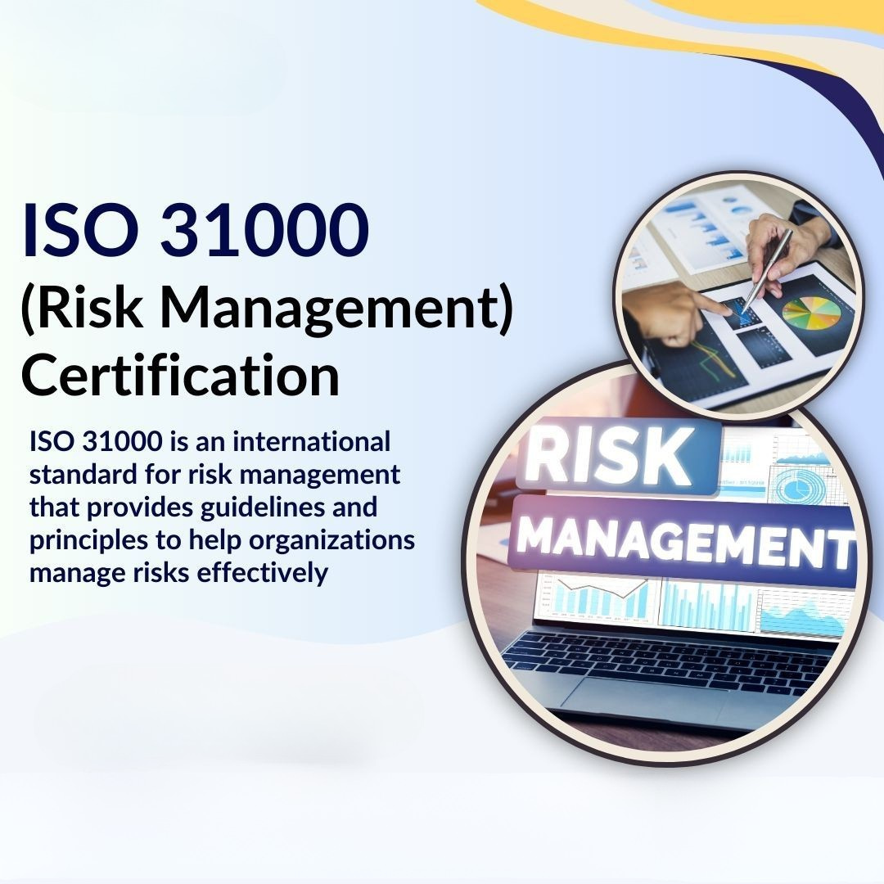
ISO 31000 (SIMPLE VERSION)
ISO 31000 = global best practice for managing risk.
Explanation: “It tells companies how to manage risk properly and consistently.”
3 Examples:
Leadership sets risk direction
Risks are documented
Controls are reviewed regularly

Slide 7
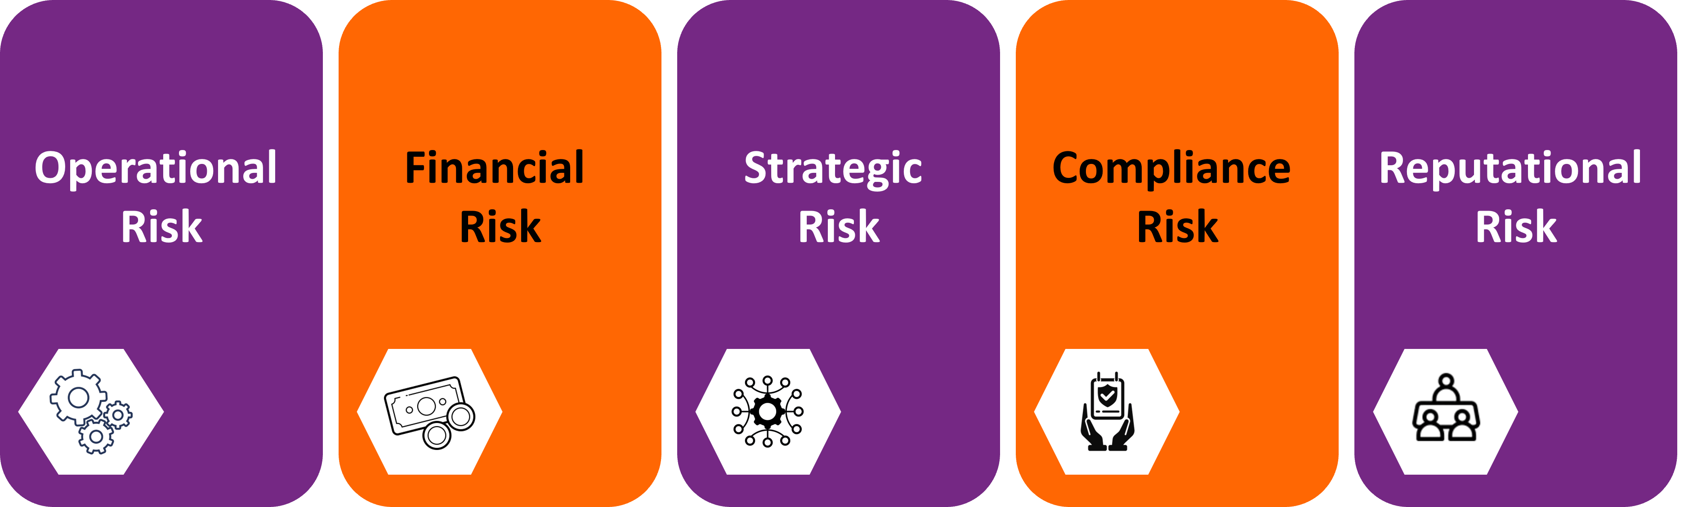
RISK CATEGORIES
Main risk types across the company -
Explanation: “These categories help us organize risks.”
3 Examples:
Operational – lost shipment
Financial – fraud or wrong invoice
Compliance – law or policy breach

Slide 8

DEPARTMENT RISK EXAMPLES
Each department has unique risks.
Explanation: “No department is risk-free.”
3 Examples:
CS – wrong information to customer
Fleet – vehicle accident
Procurement – bad vendor selection

Slide 9
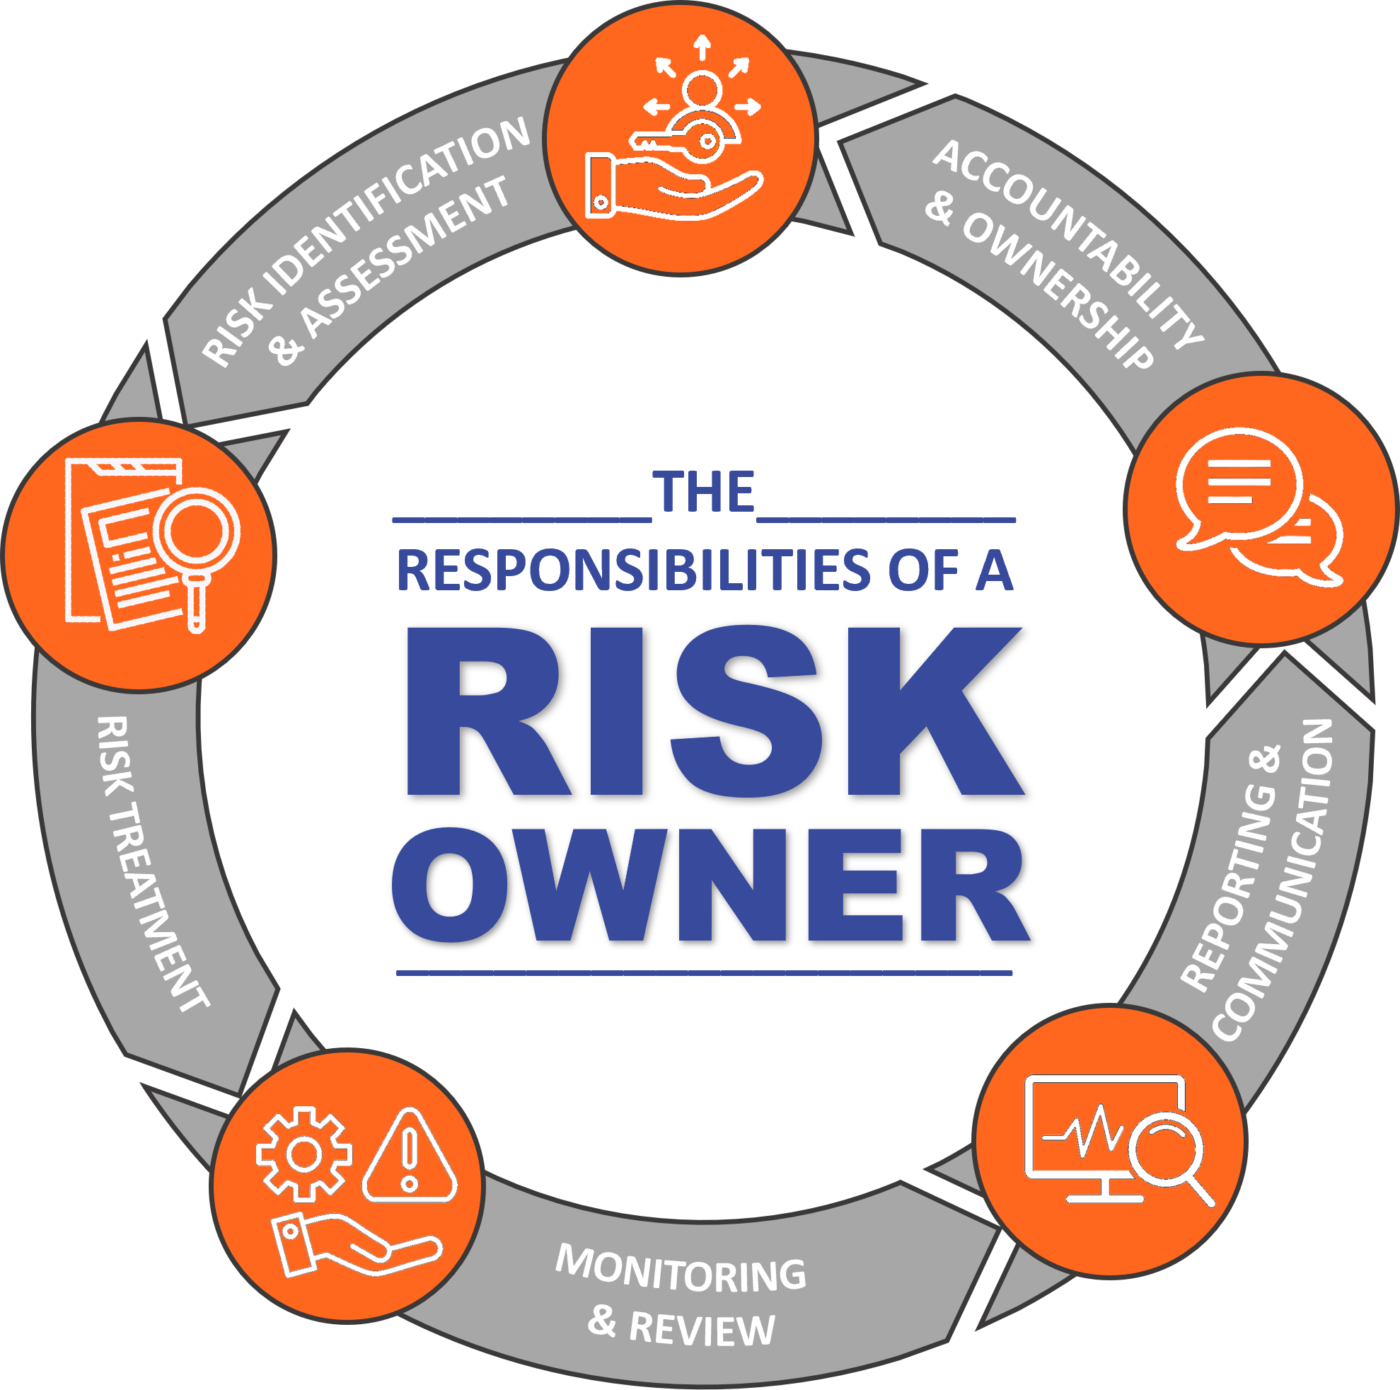
RISK OWNERSHIP
The department closest to the risk owns it.
Explanation: “You can’t pass risk to someone else if it starts in your work.”
3 Examples:
IT owns system risks
HR owns manpower risks
Ops owns delivery risks

Slide 10
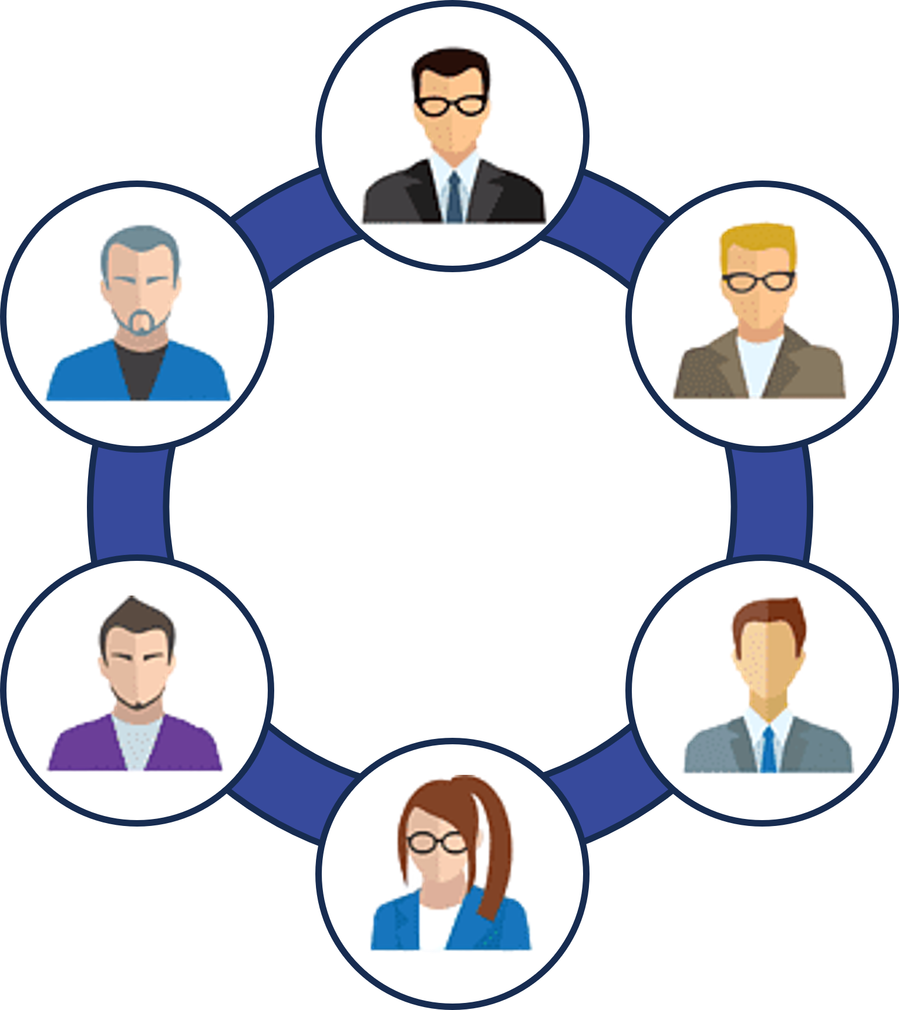
WHO CAN ACCEPT RISK?
Role | Responsibility
Staff | Identify & report risk
Supervisor | Control low risks
Department Head | Own department risks
QRM | Framework, guidance, challenge
Management | Approve high risk
Board/EXCO | Review top risks
Golden Line:
This prevents “silent acceptance”.

Slide 11

RISK IDENTIFICATION
Ask: What could go wrong?
Explanation: “If you can imagine the failure, it is a risk.”
3 Examples:
Missed scan
Wrong address
Untrained staff

Slide 12







WHERE DO RISK COME FROM?
Incidents & Near Misses
Change
(new system, vendor, process)
Customer Complaints
RISKS
Legal & Regulatory
Updates
Audit Findings
Management Review
KPI & *KRI Trends
*Key Risk Indicators

Slide 13
RISK ASSESSMENT
Risk = Likelihood × Impact
Explanation: “How often it happens + how bad it is.”
3 Examples:
Rare + small = low risk
Frequent + medium = medium risk
Frequent + severe = high risk
* A separate 5X5 Risk Matrix is available for EHS and ISMS which has a different criteria.
Notes:
Idiot Rule:
Green = manage in department
Amber = inform manager
Red = escalate to QRM & Management

Slide 14
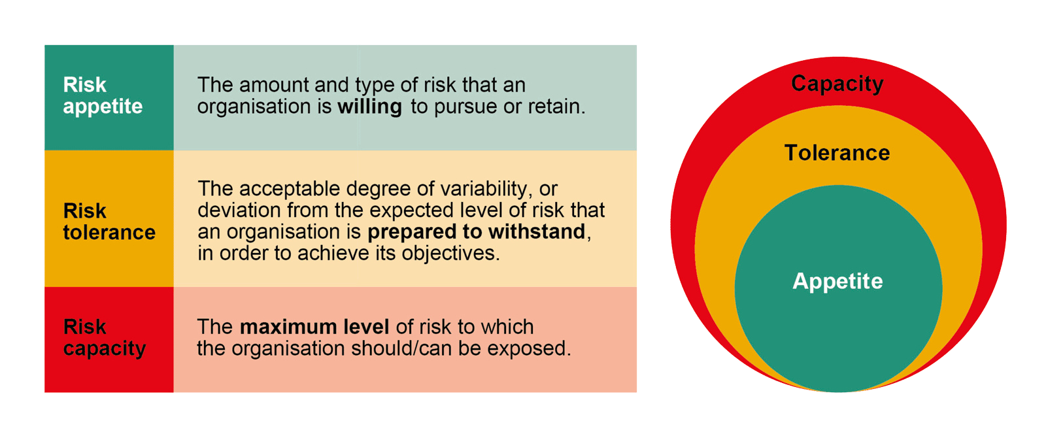
RISK APPETITE (CRITICAL)
Risk appetite = how much risk we accept.
3 Examples:
Zero tolerance for safety risk
Low tolerance for legal risk
Medium tolerance for operational delay
Explanation: “Some risk is OK. Some is never OK.”

Slide 15
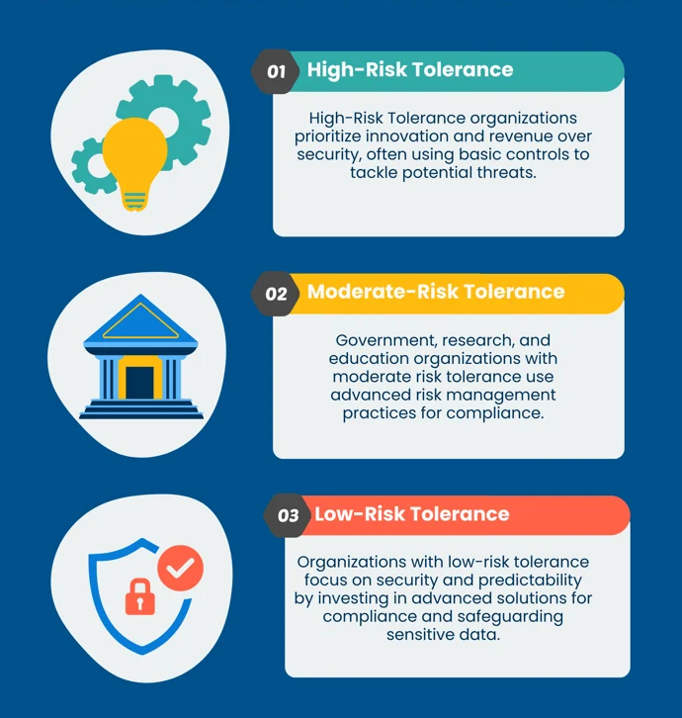
RISK TOLERANCE LEVELS
Low / Moderate / High risk levels.
Explanation: “Higher risk = higher management involvement.”
3 Examples:
Low – handled by supervisor
Moderate – department head
High – executive escalation

Slide 16
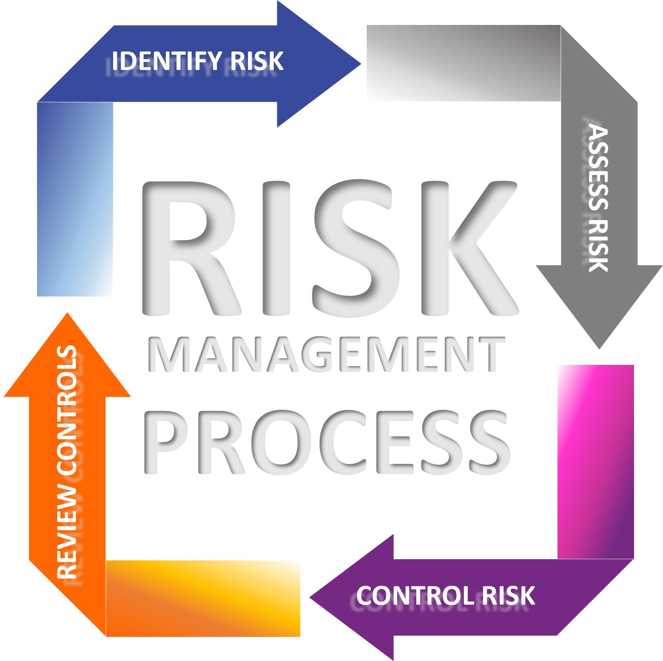
RISK CONTROLS
How we treat risks.
3 Examples:
Training staff
SOPs and checklists
Insurance coverage
Explanation: “We don’t ignore risk — we control it.”

Slide 17

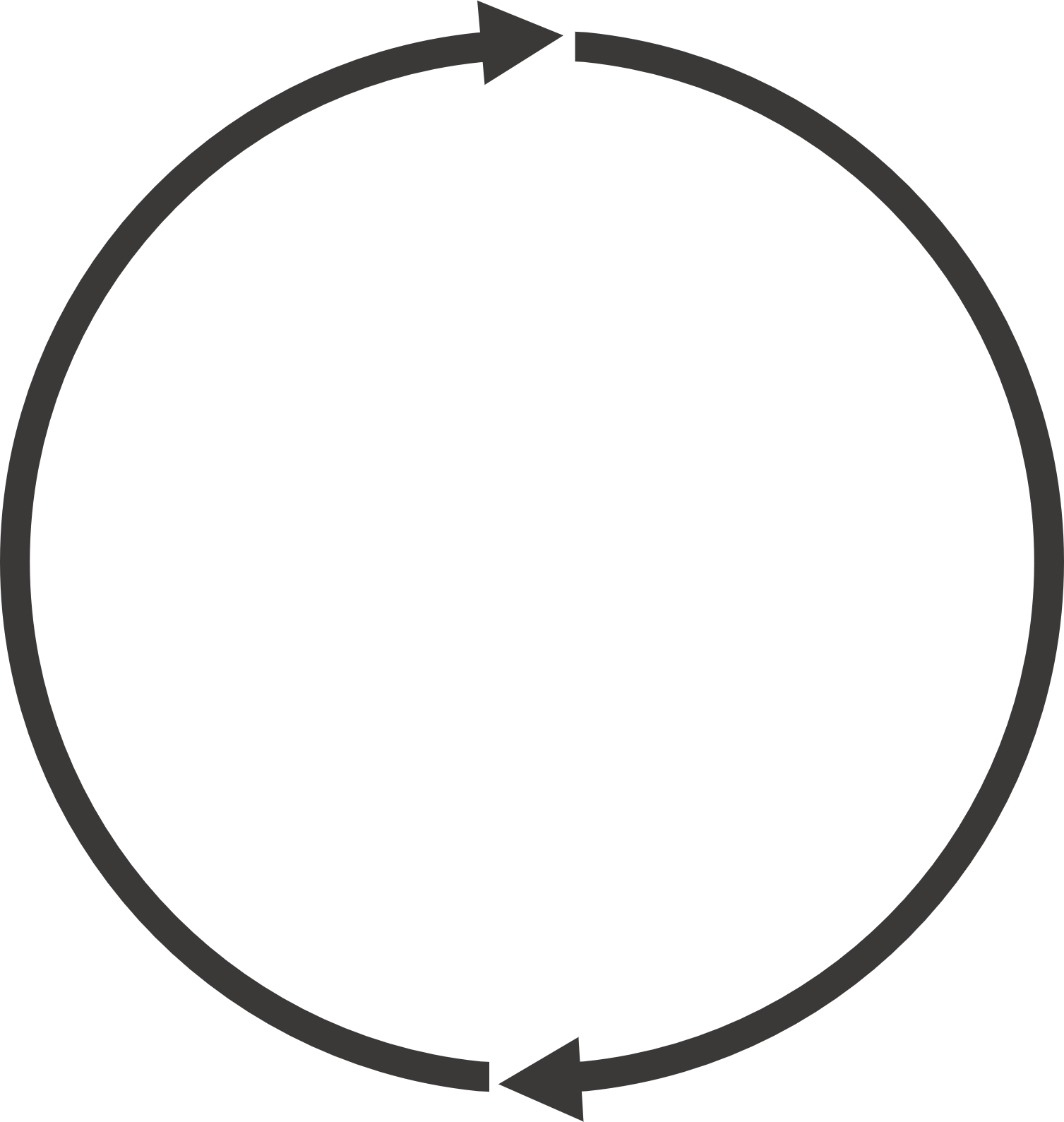

4 WAYS TO TREAT RISK
RISK
RISK
RISK
RISK
Rule:
Any “Accept” decision for medium/high risk must be approved by management.
ACCEPT
AVOID
REDUCE
TRANSFER
Hope it doesn’t happen
Cancel the source of the risk
Decrease probability or impact
Move risk to someone else
Method | Simple Meaning | Example
Avoid | Stop doing it | Ban unsafe shortcut
Reduce | Add control | Training, SOP
Transfer | Move financial impact | Insurance
Accept | Keep it with approval | Low-value delay
Notes:
Discuss:
The four treatment options:
Avoid – Stop the activity
Reduce – Add controls
Transfer – Insurance / contract
Accept – With approval

Slide 18
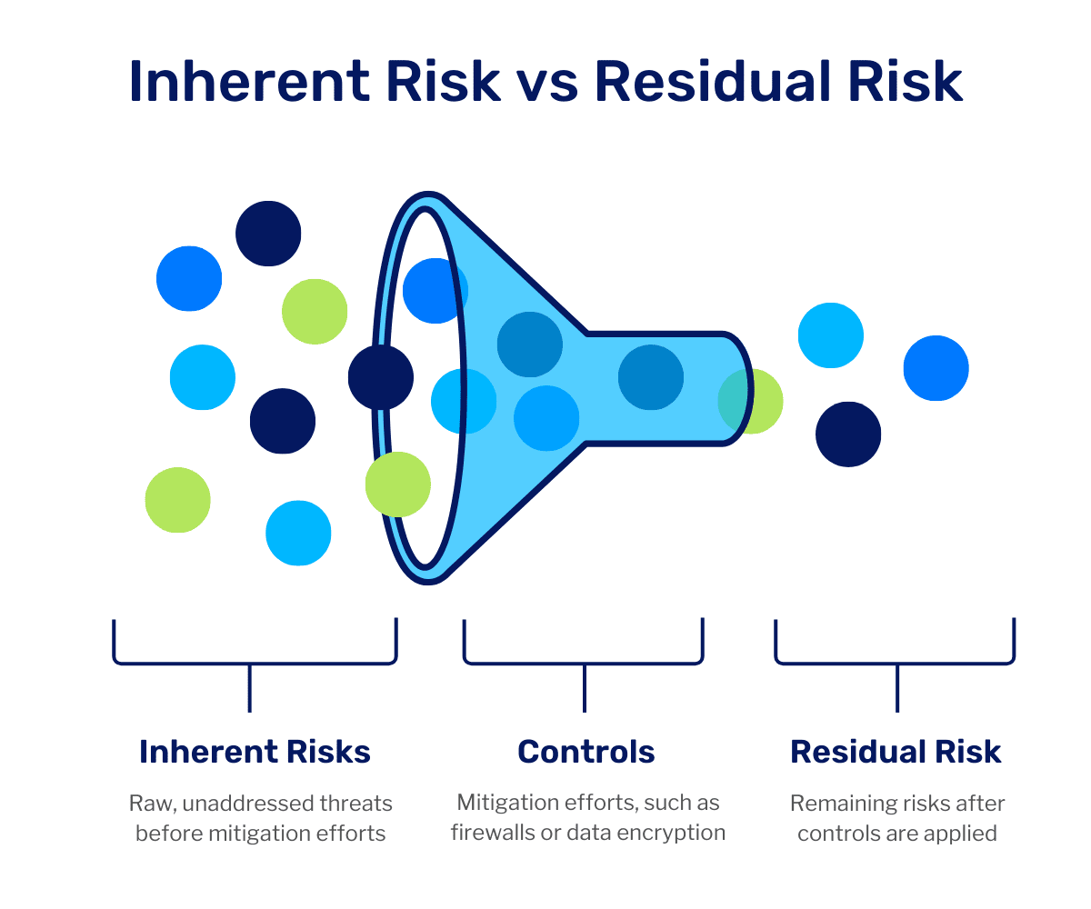
RESIDUAL RISK
Inherent Risk =
before controls
Residual Risk =
after controls
Rule:
If residual risk is still high → escalate. This is critical for audit defense.

Slide 19
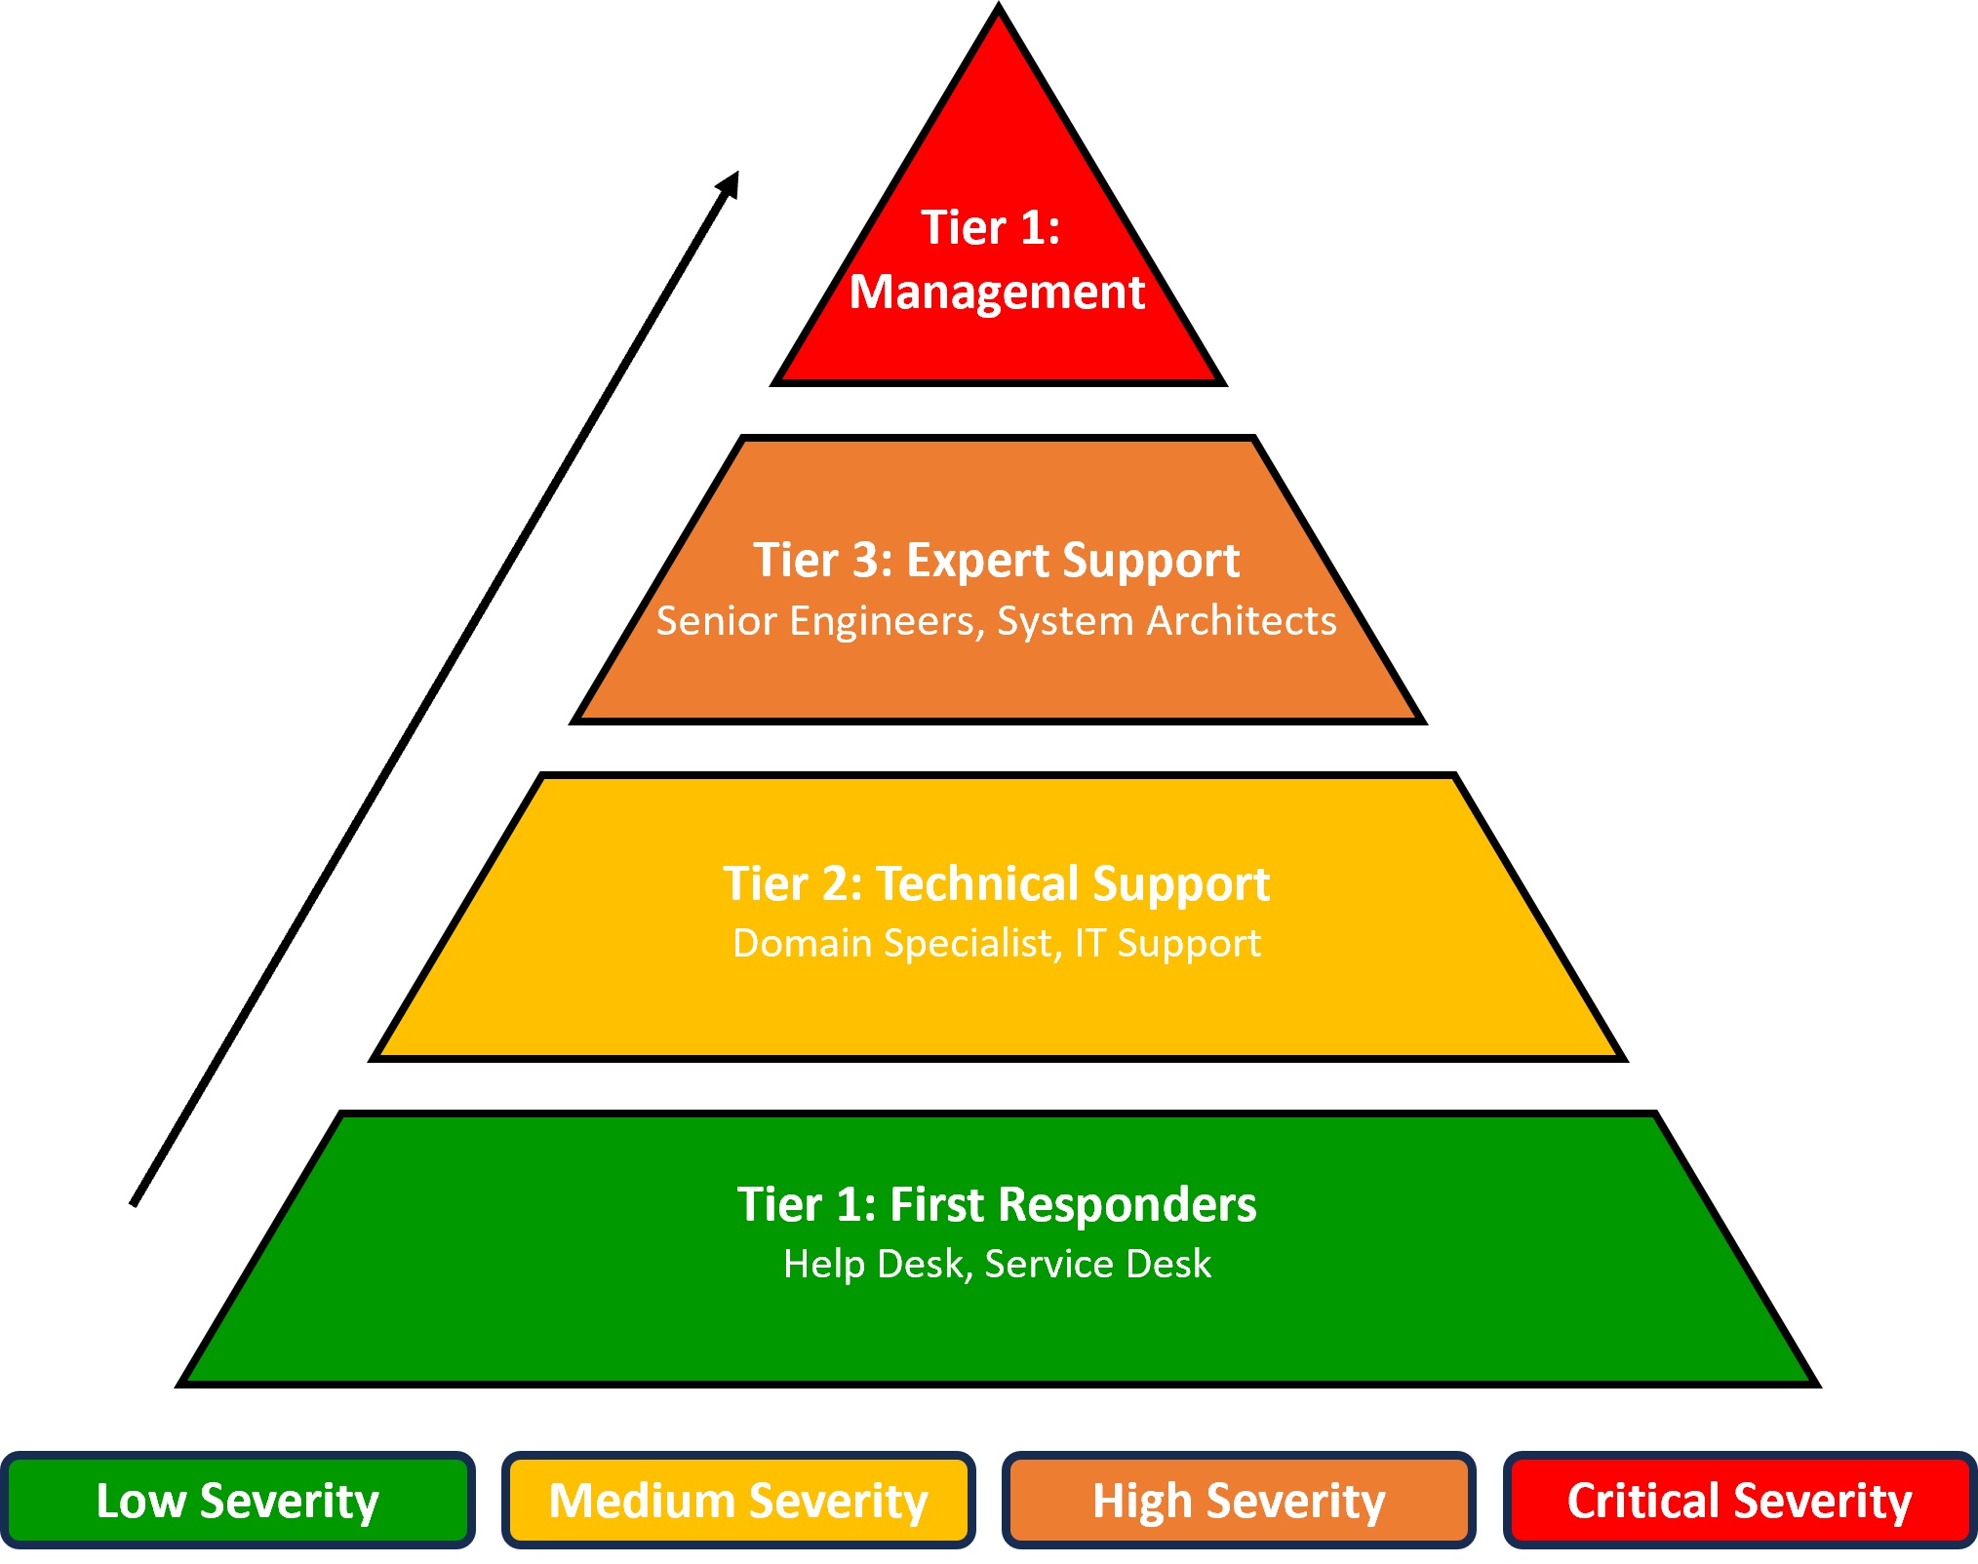
ESCALATION RULES
When to escalate risk.
Explanation: “If it can hurt people, money, or reputation — escalate.”
3 Examples:
Injury incident
Legal notice
Data breach

Slide 20


THIRD-PARTY & VENDOR RISK
Outsourced risk is still our risk.
Explanation: “You can’t outsource responsibility.”
3 Examples:
Courier partner mistake
IT vendor failure
Security contractor negligence
3P
V

Slide 21
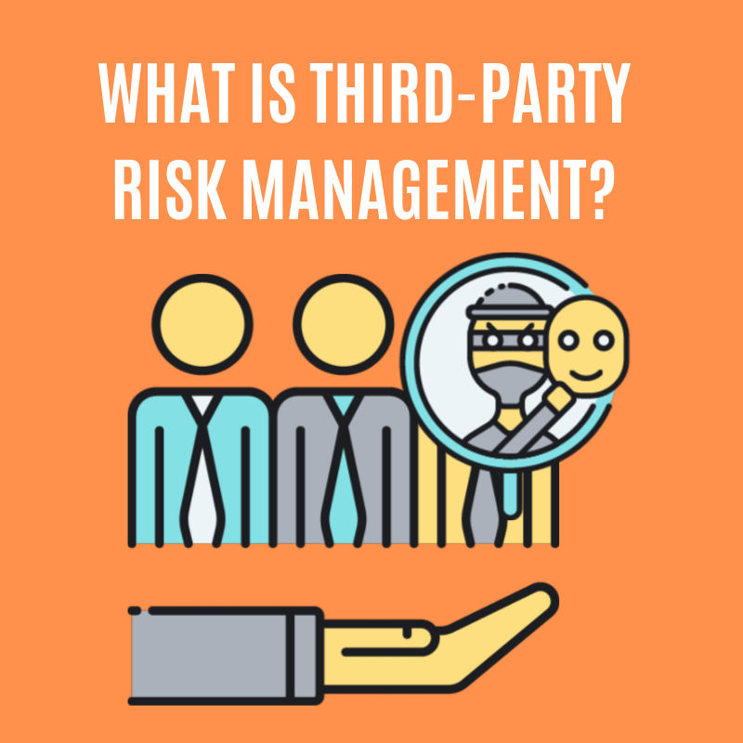
WHAT IS THIRD-PARTY RISK?
Third-party risk is any risk created by companies or people working for us but not employed by SMSA.
Examples:
Outsourced employee loses a shipment
Security contractor allows theft
IT vendor causes system outage
Outsource line haul driver causes an accident
“If someone works for us but is not on SMSA payroll, their mistakes are still our responsibility.”

Slide 22

WHY THIRD-PARTY RISK IS CRITICAL?
Outsourced work does not outsource responsibility.
Examples:
Customer complaint → SMSA
Legal notice → SMSA
Regulator fine → SMSA
“Customers, regulators, and courts do not blame the vendor – they blame SMSA.”
Notes:
Golden Line:
You can outsource work. You cannot outsource risk.

Slide 23




COMMON THIRD-PARTY RISK TYPES
Outsourced work does not outsource responsibility.
Area | Risk Example
Operations | Shipment theft by handler
Safety | Accident by contracted driver
Compliance | Unlicensed security staff
IT | Data breach by vendor
Finance | Fraud by service provider
“Customers, regulators, and courts do not blame the vendor – they blame SMSA.”

Slide 24

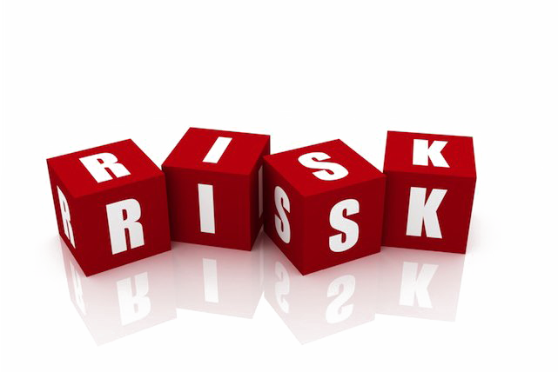
HOW WE CONTROL THIRD-PARTY RISK
Controls include:
Pre-qualification & due diligence
Contract clauses (SLA, penalties, compliance)
Training & induction
Access control (systems, sites)
Performance KPIs
Audits of vendors
Incident escalation to QRM
Third-Party
Rule:
If a vendor touches customers, data, money, or safety – they must be controlled.

Slide 25
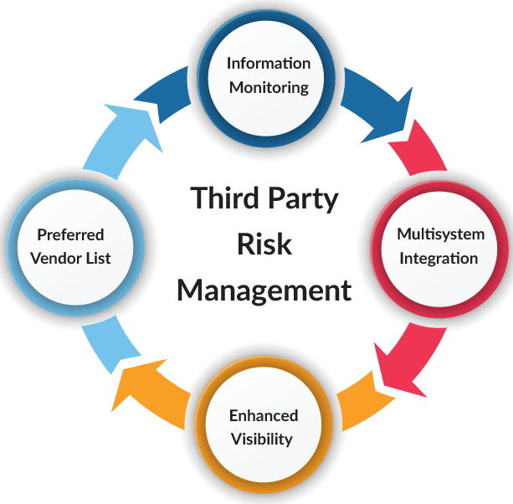
THIRD-PARTY RISKS IN THE RISK REGISTER
Third-party risks must be recorded like internal risks.
Examples:
“Outsourced employee theft risk – Hub A”
“Security contractor access control failure”
“IT vendor system downtime risk”
Rule:
Owner = SMSA department, not the vendor
Reviewed in management review
Updated after incidents or audits

Slide 26

CASE STUDY
(Based on real SMSA investigation – QRM Ref #5320)
What Happened A courier stopped to deliver a package and left the vehicle running with the keys inside. An unknown person entered the vehicle and drove it away.
67 shipments were inside
Vehicle was later recovered
Only 15 low-value documents remained
52 high-value shipments were stolen
Root Cause
Vehicle not secured
Keys left in ignition
Courier walked away from the vehicle
Basic security rule not followed

Slide 27
CASE STUDY
Risk Breakdown
Element | Description
Risk Source | Daily delivery operation
Risk Type | Operational / Security / Financial
Likelihood | Possible
Impact | Severe (financial loss, customer impact, reputation)
Inherent Risk | High
Control Missing | “Engine off – Keys out – Lock vehicle”
Residual Risk | Still High until controls enforced

Slide 28
CASE STUDY
Risk Treatment Applied
Reduce: Reinforce vehicle security procedure
Reduce: Training & toolbox talks for all couriers
Control: Management supervision
Escalate: QRM investigation & disciplinary action
Lessons
One small shortcut created a major business loss
Risk existed before the theft
The incident was preventable
Daily behavior is risk management
Golden Rule
“If a risk can be prevented by a simple action, failure to act becomes negligence.”

Slide 29
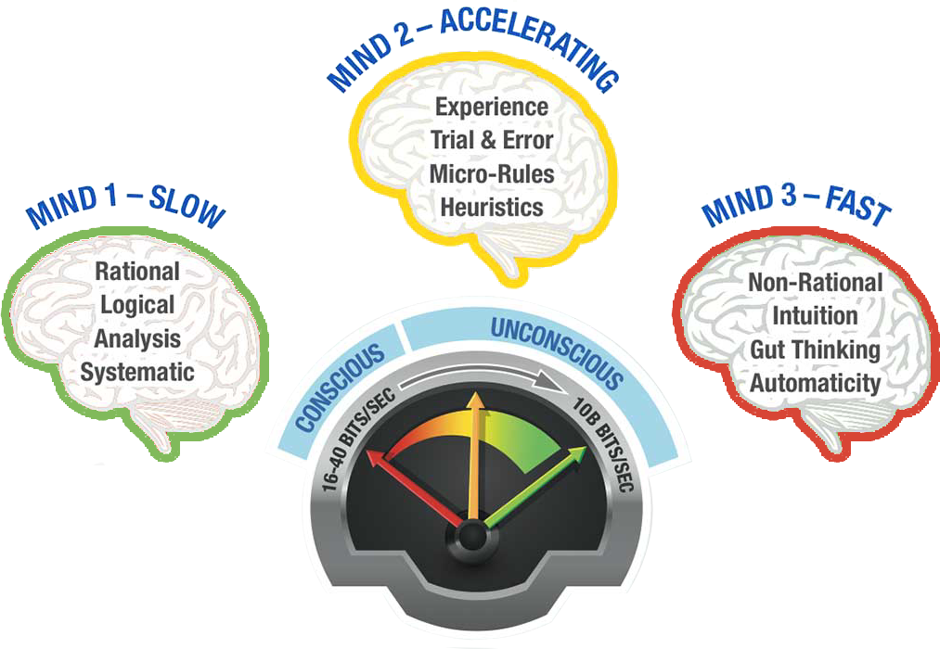
RISK IN DAILY DECISIONS
Risk exists in shortcuts and exceptions.
Explanation: “Fast decisions without thinking create risk.”
3 Examples:
Skipping scan
Manual override
Unauthorized approval

Slide 30
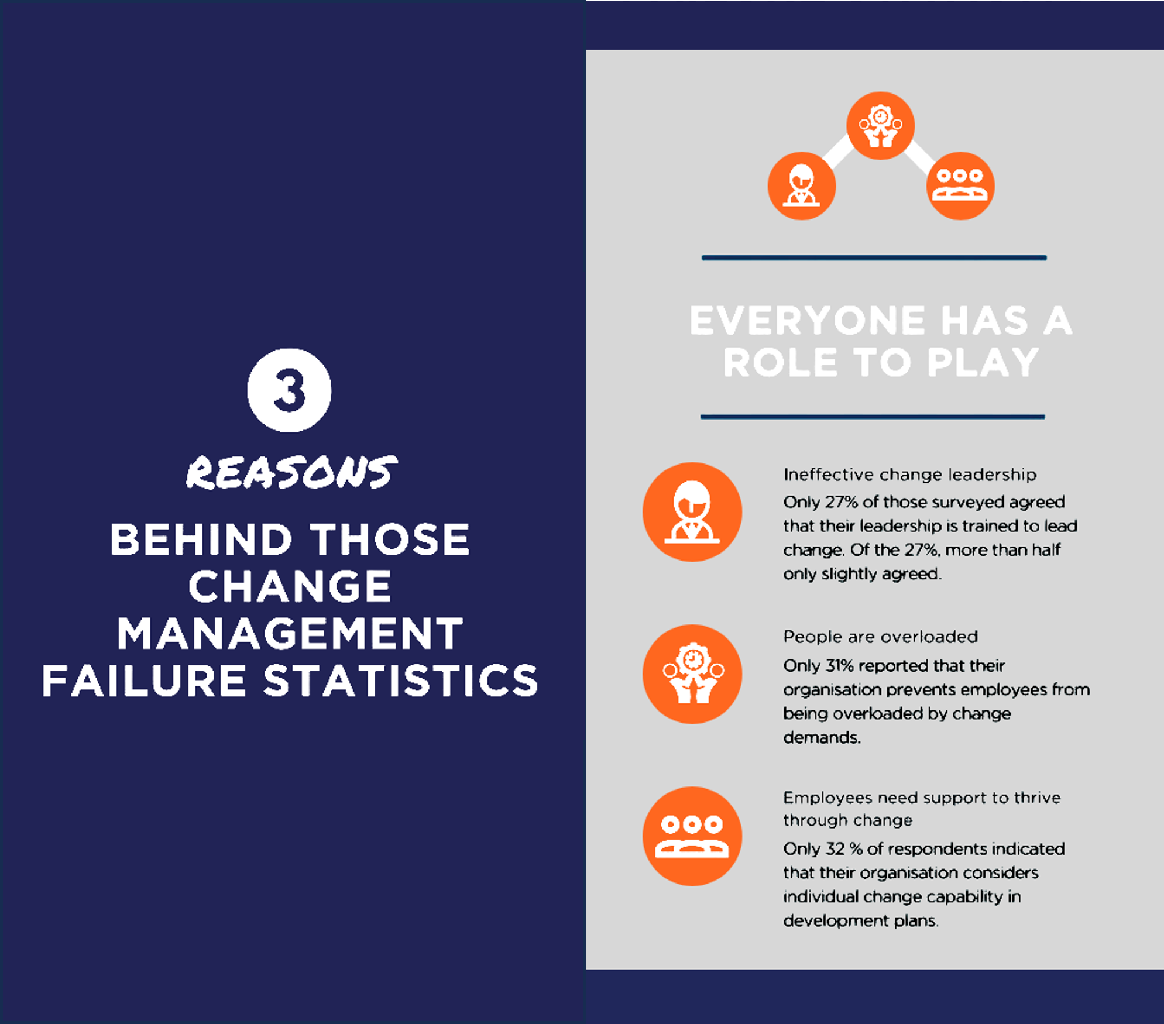
CHANGE MANAGEMENT RISK
Change creates new risks.
Explanation: “Most failures happen during change.”
3 Examples:
New system launch
New vendor onboarding
New process rollout
Management of Change (MOC) Policy – GUIDE Doc. No. 6312
MOC Form – GUIDE Doc. No. 6313

Slide 31
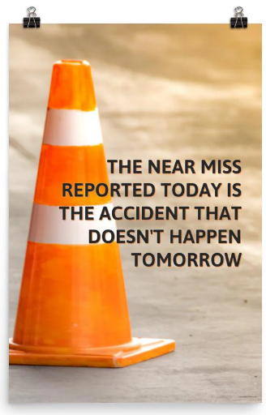
INCIDENT & NEAR MISS REPORTING
Report issues early.
Explanation: “Near misses are gifts — they prevent accidents.”
3 Examples:
Almost accident
Almost wrong delivery
Almost data leak

Slide 32
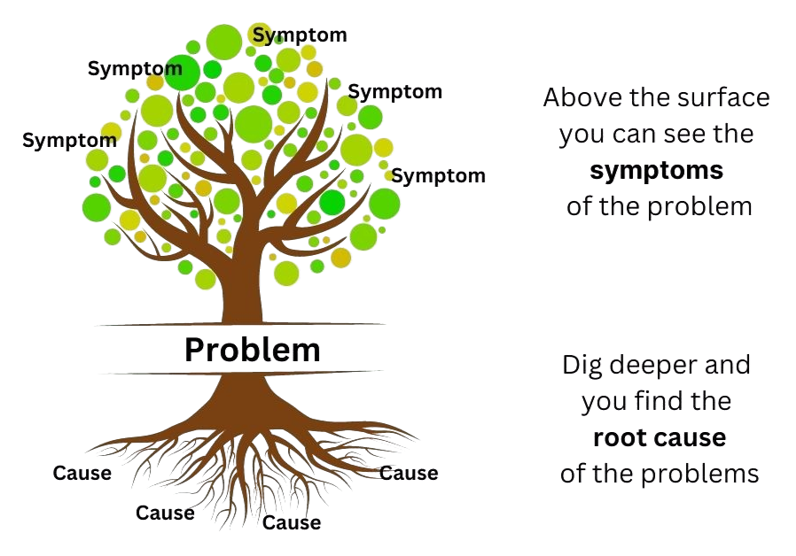
ROOT CAUSE ANALYSIS (RCA)
Fix the cause, not the symptom.
Explanation: “If the same issue repeats,
the cause wasn’t fixed.”
3 Examples:
Repeated shipment loss
Frequent billing errors
Recurrent system downtime

Slide 33
KEY RISK INDICATORS (KRIs)
Better Resources Allocation
Early warning signs.
Explanation: “Key Risk Indicators warn us before failure happens.”
3 Examples:
Rising complaints
Increase in near misses
System slowdowns
Main Purposes of KRIs
Improve Regulatory Compliance
Develop a Risk-Aware Culture

Slide 34
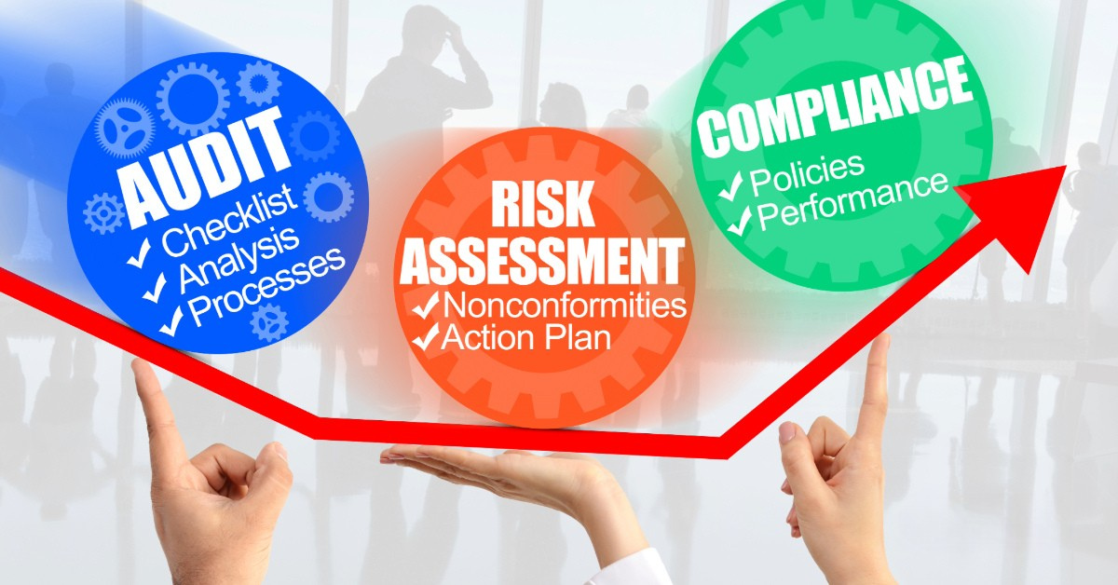
RISK VS COMPLIANCE VS AUDIT
Different but connected.
Explanation: “Risk comes first. Audit checks later.”
3 Examples:
Risk = what can fail
Compliance = rule followed
Audit = evidence check

Slide 35

WHEN DOES RISK BECOME AN NC?
Situation | Result
Risk exists but controlled | Risk entry
Control missing or failed | Observation
Requirement violated | NC
Repeated failure | Major NC
Major NC
Non-Conformity
Observation
Risk
Rule:
Risk = future problem NC = rule already broken
Notes:
Discuss:
When a risk becomes an NC
The difference between “risk” and “nonconformity”

Slide 36

RISK REGISTER
Official list of company risks.
Explanation: “This proves we manage risk properly.”
3 Examples:
Safety risk register
IT risk register
Compliance risk register

Slide 37

RISK REGISTER – LIVING DOCUMENT
Owner: Department Head
Reviewed: Monthly / Quarterly
Updated When:
Incident happens
Audit finding issued
Process changes
KPI trend worsens
Rule: A risk register that is not updated is a false document.
Notes:
Discuss:
Who updates it
How often
What triggers change

Slide 38
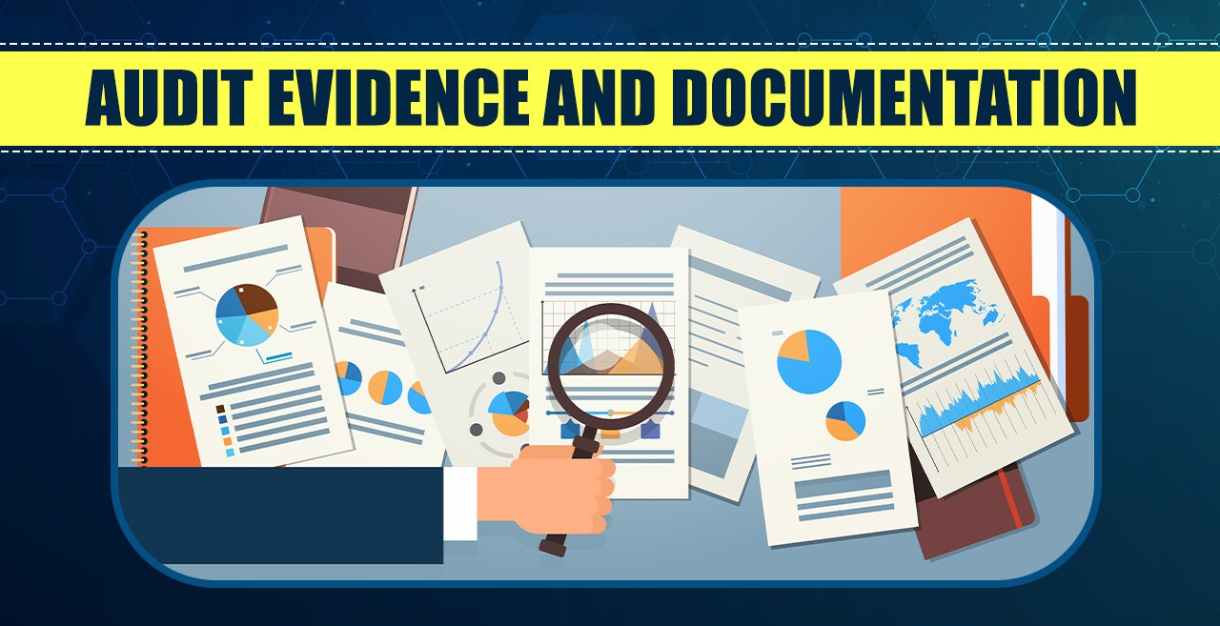
DOCUMENTATION & EVIDENCE
If it’s not written, it didn’t happen.
Explanation: “Auditors trust evidence, not memory.”
3 Examples:
Training records
Incident reports
Approval emails

Slide 39

SMSA RISK DOCUMENTS
Risk Management Policy - doc. no. 2662
Department Risk Registers - doc. no. 2831
Methods of Risk Identification - doc. no. 2770
Risk Ranking Criteria- doc. no. 2801
Determination Evaluation & Control of Risk Procedure - doc. no. 2608
Risk Register
Determination Evaluation &
Control of Risk Procedure
Risk Ranking Criteria
Methods of Risk Identification
Risk Management Policy
Golden Line:
“If a risk is not written, it does not exist for auditors.”
Notes:
Discuss:
What documents exist
Where risks are recorded
What policies control risk

Slide 40
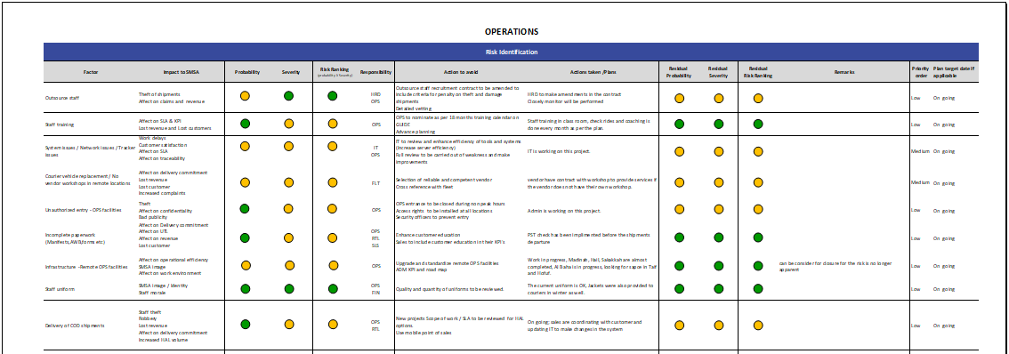
SMSA RISK DOCUMENTS
Department Risk Register
GUIDE Doc. No. 2831
Notes:
Discuss:
What documents exist
Where risks are recorded
What policies control risk

Slide 41


TRAINING & COMPETENCE RISK
Untrained staff = high risk
Explanation: “People can’t follow rules they don’t understand.”
3 Examples:
New hire without induction
Driver without refresher training
System user without access training

Slide 42

ETHICS & SPEAK-UP CULTURE
Speak up without fear.
Explanation: “Silence increases risk.”
3 Examples:
Reporting unsafe acts
Reporting misconduct
Reporting system weaknesses
tellus@smsaexpress.com

Slide 43
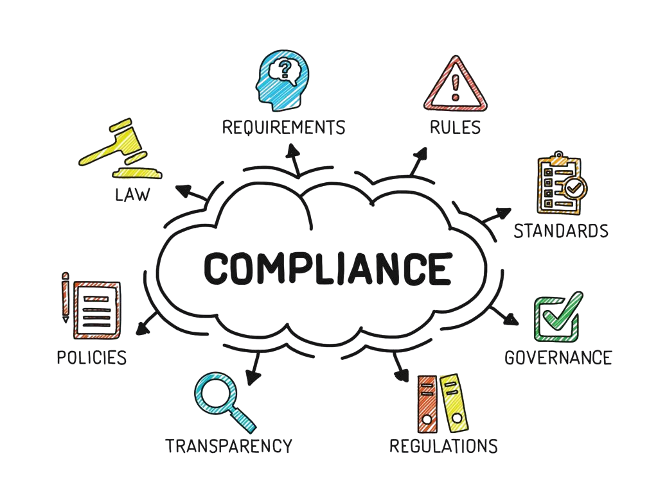
REGULATORY COMPLIANCE LINK
Risk controls keep us legal.
Explanation: “Good risk management prevents legal trouble.”
3 Examples:
Labor law compliance
Transport regulations
Data protection

Slide 44






EXTERNAL RISK DRIVERS
Transport compliance
Labor Law – HR & Payroll
Civil Defense – Safety
Municipal/ Environmental
Bodies
Data Protection – IT
Every regulator is a risk source if ignored.
Notes:
Discuss:
Who regulates us
Why this creates risk

Slide 45
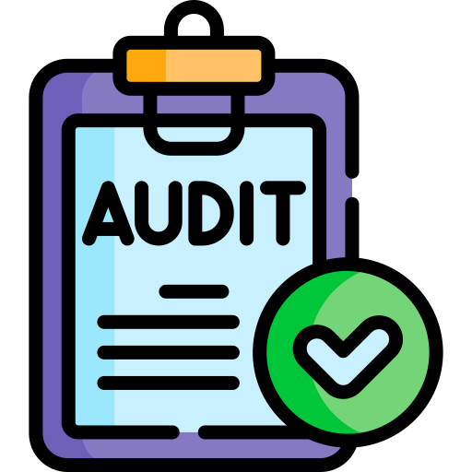
AUDITING RISK MANAGEMENT
Auditors check:
Are risks identified?
Are they assessed correctly?
Are controls in place?
Are actions tracked?
Are risks reviewed by management?
Notes:
Auditors don’t ask “Do you have risk?” They ask “Show me how you control it.”
Discuss:
That risks themselves are audited
What auditors check

Slide 46

GOVERNANCE & MANAGEMENT REVIEW
Leadership oversight is mandatory.
Explanation: “Management must review top risks regularly.”
3 Examples:
Executive committee review
Key Performance Indicators & Key Risk Indicators monitoring
Action tracking

Slide 47

RISK REVIEW CYCLE
Department risk review
– Monthly
Top risks – Quarterly
Enterprise risks
– Management Review
After any major incident
or change
Rule:
Risk not reviewed = risk ignored

Slide 48







CONSEQUENCES OF POOR
RISK MANAGEMENT
Ignoring risk has real impact.
Explanation: “This is not theory — it affects jobs and lives.”
3 Examples:
Injury or death
Heavy fines
Reputation damage
Unhappy
Clients
Reputational
Damage
Poor User
Adoption
Impacts of
Poor Risk
Management
Project
Failure
Unrealized
Benefits
Overspent
Budgets
Late-running
Projects

Slide 49
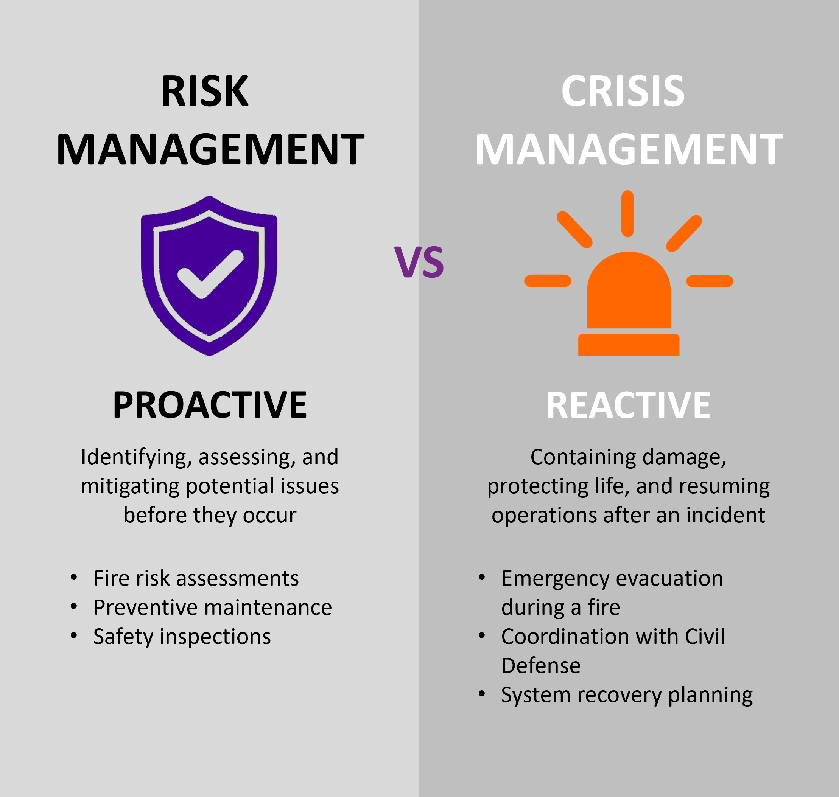
RISK VS CRISIS
Risk = what might go wrong
Incident = what did go wrong
Crisis = what stops the business
Examples:
System outage
Warehouse fire
Regulatory shutdown
This links SMSA’s Risk Management to adaptability (resilience).

Slide 50
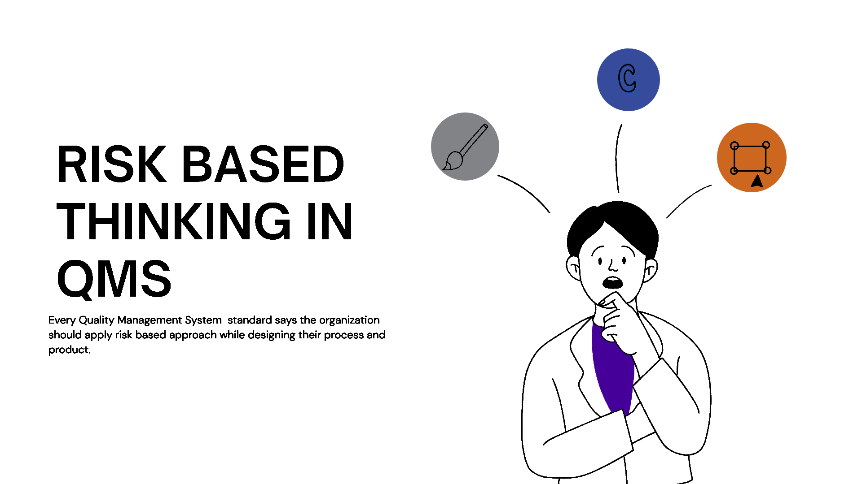
ISO INTEGRATION
Risk supports all ISO systems.
Explanation: “Risk management is the backbone of ISO.”
3 Examples:
ISO 9001 – quality risk
ISO 45001 – safety risk
ISO 27001 – information risk

Slide 51
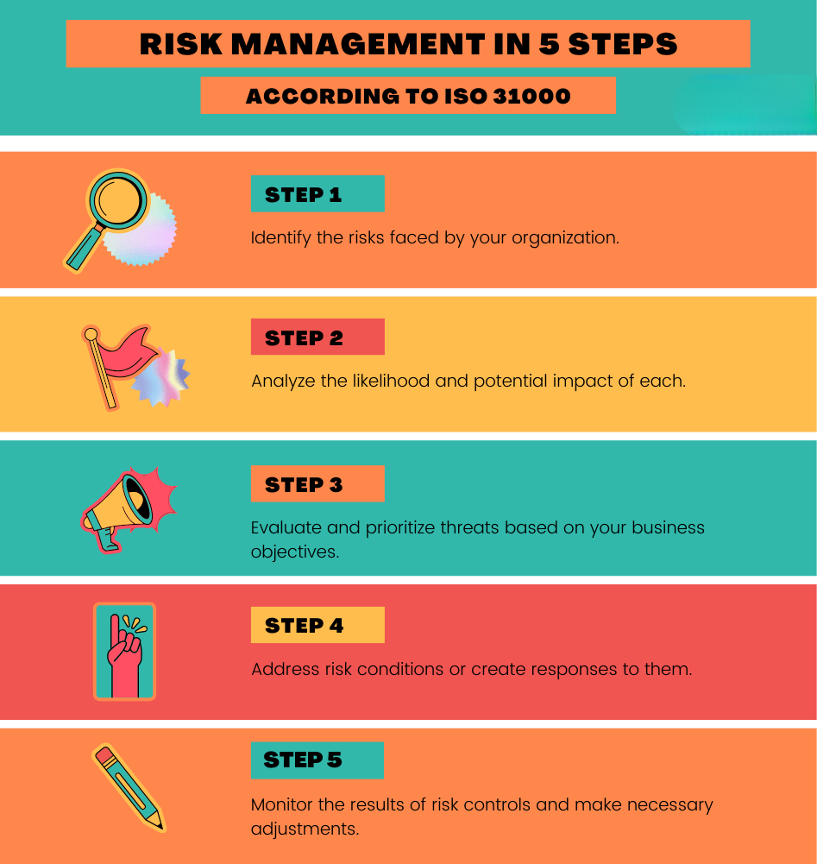
GOLDEN RULES
Five rules to remember.
Explanation: “These rules make risk management work.”
3 Examples:
Report early
Document everything
No blame culture

Slide 52
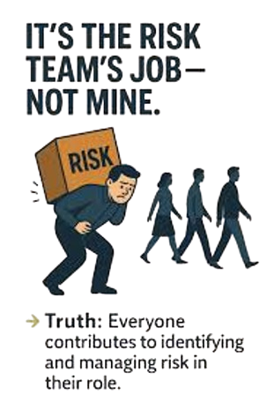
FINAL TAKEAWAYS
Risk management is everyone’s job.
Explanation: “If everyone manages risk, SMSA succeeds.”
3 Examples:
Safer workplace
Better service
Stronger company

Slide 53
SUMMARY
Examples where risks comes from –
People (Human Risk)
Why this exists: People make decisions, handle money, touch shipments, drive vehicles, and operate systems. Every human action can introduce error, fraud, or harm.
Typical risks:
Theft of shipments, COD, fuel, assets
Negligence (mis-sorting, wrong delivery, missed scans)
Misconduct (bribery, gifts, data misuse)
Lack of training / competence
Fatigue, stress, shortcuts
Insider threat (intentional harm)
What it becomes: Lost shipments, financial loss, lawsuits, reputational damage, regulatory action.
2. Process (How Work Is Done)
Why this exists: Every operation is a chain of steps. If a step is weak, unclear, or skipped, control disappears.
Typical risks:
Missing handover points
No segregation of duties
Manual steps without verification
Inconsistent procedures across stations
No escalation timelines
Informal “workarounds”
What it becomes: Untraceable losses, SLA breaches, audit failures, systemic leakage.
3. Technology & Systems
Why this exists: Operations depend on systems for tracking, billing, security, and evidence.
Typical risks:
System downtime
Data corruption or loss
Weak access controls
Manual operations outside the system
Inaccurate or delayed scans
Cyber incidents
What it becomes: Blind operations, disputes, billing errors, regulatory breaches, loss of trust.
4. Physical Assets & Infrastructure
Why this exists: Logistics is a physical business: warehouses, vehicles, cages, belts, scanners.
Typical risks:
Broken CCTV
Poor lighting
Weak fencing
Unsecured yards
Damaged MHE
Fire, flood, power failure
What it becomes: Theft, accidents, shutdowns, insurance claims, regulatory penalties.
5. Shipments & Cargo
Why this exists: Cargo is the core asset. It moves across hands, locations, and time.
Typical risks:
High-value shipments
Dangerous goods
Mis-declared contents
Poor packaging
Mixed consignments
Transit gaps
What it becomes: Loss, injury, customs penalties, legal exposure, customer escalation.

Slide 54
SUMMARY
Examples where risks comes from –
6. Financial Flow
Why this exists: Money moves through COD, billing, claims, vendor payments, payroll.
Typical risks:
COD misuse
Fraudulent refunds
Revenue leakage
Unreconciled accounts
Vendor overbilling
Weak approval limits
What it becomes: Direct financial loss, audit findings, legal exposure, reputational damage.
7. Customers & Contracts
Why this exists: Every SLA and contract creates obligation and liability.
Typical risks:
Overpromised service
Unclear liability clauses
Inconsistent service delivery
Poor complaint handling
Breach of SLA timelines
What it becomes: Penalties, claims, termination, blacklisting, regulatory escalation.
8. Third Parties & Vendors
Why this exists: The business relies on drivers, security, airlines, agents, warehouses, IT vendors.
Typical risks:
Poor vetting
Weak contracts
No audits
Misaligned controls
Shadow operations
What it becomes: Shared liability, compliance gaps, uncontrolled exposure.
9. Legal & Regulatory
Environment
Why this exists: Logistics is regulated by transport, customs, labor, data, safety authorities.
Typical risks:
Expired licenses
Non-compliant operations
Labor law breaches
Data protection violations
Customs violations
What it becomes: Fines, shutdowns, criminal exposure, loss of right to operate.
10. Environment & External Events
Why this exists: The company operates in the real world.
Typical risks:
Weather disruption
Road closures
Political events
Pandemics
Supply chain collapse
What it becomes: Service failure, cost spikes, business interruption.

