Slide 1


1
Information Security Management System Awareness
ISO 27001:2022
Information Security Management System Awareness
“Copyrights: All rights are reserved, no part of this presentation can be reproduced or copied by any means except with written permission from SMSA.“

Slide 2


Contents
Table of Contents
Course Objectives, Definitions
01
Course Objectives, Definitions
Information Security Management Principles
02
Information Security Management Principles
Information Security Management Benefits
03
Information Security Management Benefits
Structure & Requirements of ISMS Standard
04
Structure & Requirements of ISMS Standard
Controls
05
Controls
“Copyrights: All rights are reserved, no part of this presentation can be reproduced or copied by any means except with written permission from SMSA.“

Slide 3

Course Objectives
This course will help the participants
Understand ISO 27001:2022 requirements and SMSA’s Information Security Management System (ISMS)
Identify and treat security risks using ISO 27002 guidelines.
Know the scope of IT security at SMSA, covering both internal
and external factors.
“Copyrights: All rights are reserved, no part of this presentation can be reproduced or copied by any means except with written permission from SMSA.“

Slide 4

Cybersecurity refers to protecting systems
What is Cybersecurity?
The application of technology, techniques, and controls to defend systems, networks, programs, devices and data against cyberattacks is known as cybersecurity
Its objectives are to lower the number of incidents of cyberattacks and safeguard against the unauthorized exploitation of technology, networks and systems, meant to create chaos and panic.
“Copyrights: All rights are reserved, no part of this presentation can be reproduced or copied by any means except with written permission from SMSA.“

Slide 5


Why Information Security Management System?
5
ONLY
35%
of small businesses
have cybersecurity component within their business
ISO 27001, Information Security Management System (ISMS) provides a systematic approach that will help SMSA to protect the confidentiality, integrity and availability (CIA) of our sensitive information.
It provides a framework to assess and manage security risks, establish security objectives, and implement appropriate security controls.
For implementing controls ISO 27002 has also been referred to.
Over 2200
Cyberattacks happen each day resulting in 1 cyberattack every 39 seconds
Businesses affected by
cyberattacks as of 2022 is at
73%
Resulting in significant losses
“Copyrights: All rights are reserved, no part of this presentation can be reproduced or copied by any means except with written permission from SMSA“
“Copyrights: All rights are reserved, no part of this presentation can be reproduced or copied by any means except with written permission from SMSA.“

Slide 6
The Difference in Understanding?
6
INFORMATION SECURITY
CYBERSECURITY
Protects information in all forms
Protects digital systems from cyber threats
Digital data, paper records, verbal information and physical files
People, process, technology and suppliers
Focus: Confidentiality, Integrity and Availability (CIA)
Systems, networks, applications, devices and digital data
Focus: hacking, malware, phishing and ransomware
Unauthorized access and digital attacks
Broader scope
Focused digital part
Simple difference: Cybersecurity is part of Information Security, but Information Security is bigger than Cybersecurity.
This presentation refers to ISMS / Information Security ISO 27001, not only cybersecurity.
“Copyrights: All rights are reserved, no part of this presentation can be reproduced or copied by any means except with written permission from SMSA“
“Copyrights: All rights are reserved, no part of this presentation can be reproduced or copied by any means except with written permission from SMSA.“

Slide 7

Benefits of ISMS
7
01
05
Protects SMSA data from loss, theft, or misuse. - Ensures confidentiality
Enhances company reputation by demonstrating a commitment to security
02
06
Builds customer trust by securing sensitive information
Improves operational efficiency by managing risks
03
07
Prevents cyberattacks and data breaches
Reduces financial losses from security incidents
04
08
Ensures compliance with legal and regulatory requirements
Supports business continuity by minimizing disruptions from security threats
“Copyrights: All rights are reserved, no part of this presentation can be reproduced or copied by any means except with written permission from SMSA“
“Copyrights: All rights are reserved, no part of this presentation can be reproduced or copied by any means except with written permission from SMSA.“

Slide 8

ISMS Main Components
ISMS Main Components
Roles & Responsibilities
•Who does what? Everyone has a part to play in security!
•Why it matters: Clear roles make sure no security tasks are missed. (JD)
Example: IT staff handle system security, while warehouse staff ensure packages are secured.
Policies & Procedures
•Rules to follow: These are the security “do’s and don’ts.” (Documented policies and WI)
•Why it matters: Helps everyone know what to do to protect info.
Example: SMSA staff are required to use
strong passwords and change them every
90 days.
Monitoring & Auditing
•Check it’s working: Regular reviews to ensure the system is effective.
•Why it matters: Find and fix weaknesses before bad stuff happens.
Example: SMSA conducts quarterly security audits to review access logs and identify potential breaches.
03
04
02
Risk Management
•Spot the risks: Identify what can go wrong with our data.
•Handle the risks: Decide how to protect it (controls).
Example: SMSA evaluates the risk of a hacker accessing customer data and implements firewalls to block unauthorized access.
Incident Response
•Be ready: Have a plan for when something goes wrong.
•Why it matters: Quickly respond to security threats and minimize damage.
Example: SMSA has a response plan in place for cyberattacks, like immediately disabling compromised accounts.
01
05
“Copyrights: All rights are reserved, no part of this presentation can be reproduced or copied by any means except with written permission from SMSA.“

Slide 9
ISMS Main Components
1
2
ISO 27001, Information Security Management System (ISMS) provides a systematic approach that helps organizations protect the confidentiality, integrity, and availability (CIA) of their sensitive information. It provides a framework to assess and manage security risks, establish security objectives, and implement appropriate security controls. For implementing controls ISO 27002 has also been referred to.
Risk
Assessment & Management
Security Controls
3
Continuous Improvement (Plan-Do-Check-Act)
  Implement the Plan-Do-Check-Act (PDCA) cycle for continuous ISMS improvement.
  Regularly review and update processes to stay ahead of threats and ensure compliance
Compliance & Documentation
“Copyrights: All rights are reserved, no part of this presentation can be reproduced or copied by any means except with written permission from SMSA.“

Slide 10
Information Security Do’s & Dont’s
Helps protect SMSA’s data, systems and reputation.
SMSA’s security is everyone’s responsibility.
Report all information security incidents to IT:
DOs
DON’Ts
01
Keep your passwords confidential. Never write down or share your passwords with anyone
01
Don’t install unauthorized software. Avoid downloading or using apps that haven’t been approved by IT
Be aware of bystanders when printing, faxing, or discussing sensitive info. Always check who’s around before sharing confidential information and do not leave any printouts in the printer.
Don’t leave Wi-Fi or Bluetooth on when not in use. Turn off Wi-Fi and Bluetooth on your devices when not needed, especially in public places.
02
02
Always lock your computer screen when stepping away, even for a minute. Use company VPN when accessing SMSA applications outside the office network
Don’t click on unknown links. Always verify the source before clicking on any link sent via email or message.
03
03
04
Pay attention to phishing scams. Be cautious of suspicious emails or messages asking for personal information.
04
Don’t enter personal or confidential data on suspicious websites. Check for "https" or a lock icon before entering sensitive information online.
05
Beware of unsolicited messages or emails. If it looks too good to be true, it probably is. Don't trust unknown senders.
05
Don’t visit insecure websites. Avoid websites that don’t have proper security certificates, as they could be harmful.
“Copyrights: All rights are reserved, no part of this presentation can be reproduced or copied by any means except with written permission from SMSA.“

Slide 11


Key ISMS Principles (CIA Triad)
Confidentiality
Availability
Integrity
“Copyrights: All rights are reserved, no part of this presentation can be reproduced or copied by any means except with written permission from SMSA.“

Slide 12
Principles of ISMS: Confidentiality
It includes data security, granting access to permitted individuals while preventing unauthorized parties from discovering anything about its contents
Confidentiality helps in preventing unauthorized disclosure of information
It ensures that vital information does not reach the wrong set of people
01
02
03
“Copyrights: All rights are reserved, no part of this presentation can be reproduced or copied by any means except with written permission from SMSA.“

Slide 13

Tools for Accomplishing the Goal of Confidentiality
There are many tools to ensure confidentiality. These are
Encryption
Access Control
Authorization
Authentication
Physical Security
“Copyrights: All rights are reserved, no part of this presentation can be reproduced or copied by any means except with written permission from SMSA.“

Slide 14
Principle of ISMS:
Integrity
01
02
Integrity is an approach for ensuring that data is authentic, accurate, and guarded against unauthorized user manipulation
Integrity also ensures non-repudiation, which means that data is created and handled to ensure that nobody can question its authenticity and accuracy
“Copyrights: All rights are reserved, no part of this presentation can be reproduced or copied by any means except with written permission from SMSA.“
Notes:
Non-repudiation is a concept in information security that ensures that someone cannot deny the authenticity of their actions or the validity of a message they sent. It provides proof of the origin, integrity, and ownership of data, making it clear who was responsible for a specific action.
Here are the key points:
Proof of Action: Non-repudiation means that a person cannot claim they didn’t perform an action, like sending a message or signing a document. For example, if you send an email, non-repudiation ensures that you can't later deny that you sent it.
Methods Used:
Digital Signatures: Like a handwritten signature, a digital signature is a unique code attached to a digital message. It verifies that the message was indeed sent by the person and hasn't been altered.
Audit Trails: Logs that track actions taken in a system can provide evidence of who did what and when, further supporting non-repudiation.
Importance: Non-repudiation is crucial in legal and financial transactions, contracts, and communication, as it helps build trust and accountability. For instance, in online banking, non-repudiation ensures that transactions are traceable and that customers can't deny having made them.
In summary, non-repudiation helps ensure that actions and communications can be verified, preventing parties from denying their involvement or the authenticity of their messages.

Slide 15

Tools for Accomplishing the Goal of Integrity
The tools that can be employed to ensure integrity are:
Backups
Checksums
Codes for
Data Correction
“Copyrights: All rights are reserved, no part of this presentation can be reproduced or copied by any means except with written permission from SMSA.“
Notes:
A checksum is a value calculated from a data set to verify its integrity. It acts like a fingerprint for the data, allowing you to check whether the data has been altered during transmission or storage. Here's how it works:
Calculation: A checksum is generated by applying a specific algorithm to a data set (such as a file or packet). This algorithm produces a short, fixed-length string of characters or numbers that represents the data.
Transmission: When data is sent over a network or saved, the checksum is transmitted or stored alongside it.
Verification: Upon receiving the data, the receiver can recalculate the checksum using the same algorithm. If the recalculated checksum matches the original one, it indicates that the data is intact. If it doesn’t match, it suggests that the data may have been corrupted or tampered with.
Checksums are commonly used in networking (e.g., in TCP/IP packets), file storage (e.g., to verify downloads), and error detection in data transmission.
Data Correction Codes
Data correction codes are like safety nets for information. They help make sure that when data is sent or stored, it remains accurate and can be fixed if it gets messed up. Here’s how they work, along with some everyday examples:
Purpose:
Just like checking your work for mistakes before handing it in, these codes help catch and fix errors in data.
How They Work:
When data (like a message or a file) is prepared to be sent or saved, extra bits of information are added to it. These extra bits help check if everything is correct later on.
Examples:
Hamming Code: Imagine you’re sending a message to a friend, but some letters might get mixed up. Hamming code helps find and fix a single wrong letter in your message. For example, if you sent "CAT" but it arrived as "COT," Hamming code would help fix it back to "CAT."
Reed-Solomon Code: This is like having a backup copy of a recipe you wrote on a piece of paper. If some of the ingredients get smudged and are hard to read, this code helps recover what was lost. For instance, if you wrote a shopping list and some items were unclear, Reed-Solomon can help figure out what you originally intended to write.
Convolutional Codes: Think of a radio broadcast. Sometimes the signal can get fuzzy. Convolutional codes help fix the sound so that you can still hear the music clearly, even if there are some interruptions.
BCH Codes: Imagine you're organizing a family photo album, and some photos got damaged. BCH codes can help restore those photos so that you can still remember those moments, even if some details are missing.
In summary, data correction codes help ensure that the information we send, like messages, recipes, or music, stays accurate and can be corrected if errors happen. They’re an essential part of making sure our data is reliable!

Slide 16
The capability of individuals with authorization to view and modify information efficiently and promptly is known as availability
It guarantees that only authorized individuals have consistent access to sensitive data
Principle of ISMS: Availability
“Copyrights: All rights are reserved, no part of this presentation can be reproduced or copied by any means except with written permission from SMSA.“

Slide 17
Tools for Accomplishing the Goal of Availability
The principle of availability in information security can be accomplished using the following tools
Physical Protection
Computational Redundancy
“Copyrights: All rights are reserved, no part of this presentation can be reproduced or copied by any means except with written permission from SMSA.“
Notes:
Computational redundancy refers to the practice of duplicating critical components or processes in a computer system to increase reliability and fault tolerance. It ensures that if one component fails, another can take over, preventing system failure. This concept can be applied in various contexts, including:
1. Hardware Redundancy: Using multiple hardware components, such as dual power supplies, RAID storage, or backup processors.
2. Software Redundancy: Implementing multiple algorithms or processes that can perform the same task, allowing the system to switch to a backup if the primary fails.
3. Data Redundancy: Storing the same data in multiple locations to protect against data loss.
Computational redundancy helps maintain system performance and reliability, especially in critical applications like aerospace, telecommunications, and healthcare.

Slide 18

Components of Information Security
Information security includes the protection of SMSA data as well as the data we obtain from clients, consumers or vendors.
01
Most businesses will have to follow one or more information security standards.
SMSA will follow ISO 27001:2022.
02
Auditors will audit the data collection, storage and transfer practices.
They will check the security measures to guarantee that data is necessarily encrypted and is shielded from a breach.
03
“Copyrights: All rights are reserved, no part of this presentation can be reproduced or copied by any means except with written permission from SMSA.“

Slide 19
Common Types of Cyberattacks
A cyber-attack is an attempt by an individual or a group to gain unauthorized access to a computer system or network to steal, expose or destroy private data.
Social Engineering
Denial Of Service Attacks (DoS)
Man In The Middle
(MITM) Attacks
Simple word -manipulation. Social engineering attackers aim to take advantage of human nature in order to access private information. E.g. Phishing, Malware etc.
Hacker or cybercriminals direct overwhelming traffic to a server or a system exhausting all the resources. As a result, the system shuts down, and legitimate users cannot access the system or network.
Attacker joins the two-party conversation without their notice to steal information from your conversation.(via insecure public WIFI's or a compromised router)
Phishing
Malware
Zero Day Exploit
Phishing attacks use emails that mimic legitimate organisation’s to trick you into providing sensitive information (passwords or credit card numbers)
Malicious software is created to identify vulnerabilities in the system or network and target them to breach the system or network. Malware disrupts, destroys, and alters the network of the victim e.g.: Virus, Ransomware, Trojan
Attackers target and exploit the weakness disclosed for a system before a patch is designed. They can breach into the system to steal data or make changes..
“Copyrights: All rights are reserved, no part of this presentation can be reproduced or copied by any means except with written permission from SMSA“
Notes:
Influence of AI - This suggests that hackers are using generative AI tools like ChatGPT to construct targeted attacks at scale. This will likely make it more difficult to spot red flags in phishing emails. For example, if a lot of your writing is online, attackers can feed examples of it into an AI system. The AI can then produce convincing emails written in your style.

Slide 20
Structure Of ISMS Standard
Clause 4. Context Of the Organisation
No Exclusions permitted when
Claiming conformity to this standard.
Clause 5. Leadership
Similar to Quality
Management
System
Clause 10. Improvement
Clause 6. Planning
Clause 9. Performance Evaluation
Clause 7. Support
Clause 8. Operations
7 Effective Clauses
“Copyrights: All rights are reserved, no part of this presentation can be reproduced or copied by any means except with written permission from SMSA“

Slide 21

Clause 4 Context of Organisation
Clause 4.1
01
Internal Factors
Culture Values Performance Knowledge
02
External Factors Political Economic Social/ Cultural Technological Legal
Environmental/ Geographical
Levels
Local/ Regional National International
03
GUIDE doc. no. 2746 – Internal & External Factors affecting SMSA
“Copyrights: All rights are reserved, no part of this presentation can be reproduced or copied by any means except with written permission from SMSA“

Slide 22

Clause 4.2 Understanding the needs &
expectations of interested parties
Regulatory Compliance: SMSA must meet all legal and regulatory requirements for data protection and security, ensuring we stay compliant. We assess compliance based on regulatory assessment document (Doc# 2776)
Why It Matters:
Knowing what’s expected helps SMSA design a better security management system and avoid penalties or breaches.
Service Level Agreements (SLA):
SLAs with third parties must also include information security terms to ensure our partners also protect data.
It’s about identifying and understanding the needs of all interested parties (like customers, regulators, and suppliers) related to information security. Needs & Expectations GUIDE doc. no. 2740

Slide 23
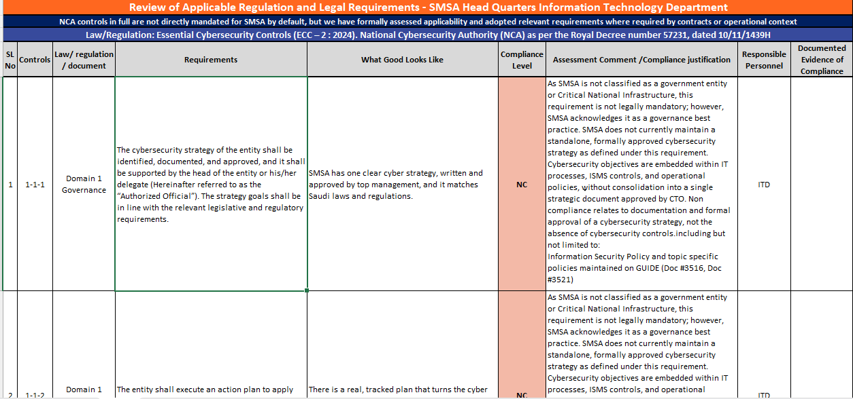
Regulatory Compliance Assessment
(Doc # 2776)

Slide 24

Clause 4.3 Scope of ISMS
List of processes and services
List of departments & other organizational units
List of physical locations
GUIDE doc. no. 3541 – Scope of ISMS in SMSA
Exclusions from the scope (Not the standard)
Interfaces and dependencies influencing the scope
“Copyrights: All rights are reserved, no part of this presentation can be reproduced or copied by any means except with written permission from SMSA“
Notes:
if employees of two different departments share the same office and all software and data, then it would be very difficult to include one of those departments in the ISMS scope and not the other.
Defining the ISMS scope if the server is in the cloud
Servers implemented in cloud environments are an extra challenge in the ISMS implementation. Common cloud service models adopted in the market, in order of increasing complexity, are:
Infrastructure as a Service (IaaS): offers only basic computing infrastructure (e.g., physical and virtual machines, location, network, backup, etc.)
Platform as a Service (PaaS): offers, beyond computing infrastructure, a development environment for application developers (e.g., operating systems, programming-language execution environment, databases, etc.)
Software as a Service (SaaS): offers to final users access to application software and databases (e.g., email, file sharing, social networks, ERPs, etc.)

Slide 25
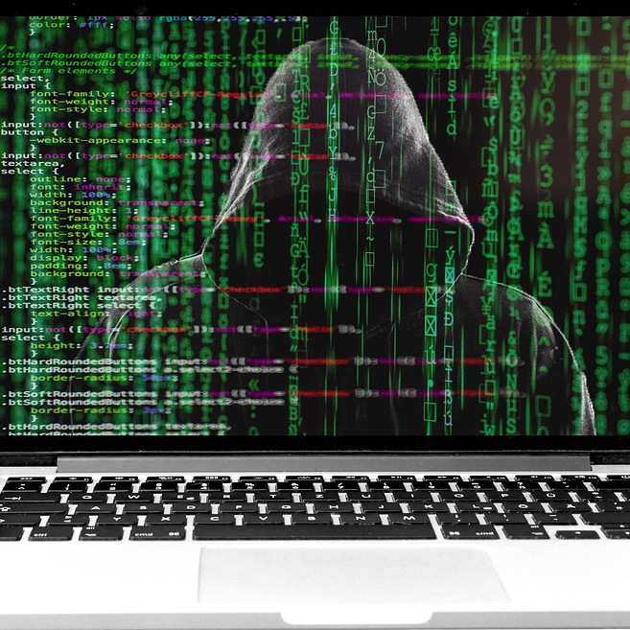
Clause 5.1 Leadership
Top Management
Takes accountability for the effectiveness of the Information Security Management System
Ensures ISMS policy and security objectives are compatible with SMSA strategy and up-to-date
Ensures business processes are integrated to Information Security Management System
Ensures that resources needed are available
“Copyrights: All rights are reserved, no part of this presentation can be reproduced or copied by any means except with written permission from SMSA“

Slide 26


What is an Information Security Policy?
A set of guidelines for using IT assets is known as an Information Security Policy (ISP)
SMSA has developed an information security policy to guarantee that staff members and other users follow security standards and processes
01
02
According to security regulations, only authorized individuals are supposed to have access to sensitive systems and information
03
“Copyrights: All rights are reserved, no part of this presentation can be reproduced or copied by any means except with written permission from SMSA.“

Slide 27

Clause 5.2 ISMS Policy
GUIDE doc. no. 3533
SMSA’s commitment to satisfy ISMS requirements
Must be reviewed at regular intervals
Must be communicated and available to relevant interested parties
Maintained as documented information
“Copyrights: All rights are reserved, no part of this presentation can be reproduced or copied by any means except with written permission from SMSA“

Slide 28

Clause 5.3 Org Roles & Responsibilities
All process maps will have the responsible person to do the job function
Delegation of Authority
Organizational structure up to date
“Copyrights: All rights are reserved, no part of this presentation can be reproduced or copied by any means except with written permission from SMSA“

Slide 29

Clause 6.1.1 & 6.1.2 Risk & Opportunity Assessment
  Methods of Risk Identification (GUIDE doc. no. 2770)
  Includes techniques such as SWOT (Strengths, Weaknesses, Opportunities and Threats) analysis
  Methods of Opportunity Identification (GUIDE doc. 2769)
  Risk Ranking Criteria (GUIDE doc. no. 2801)
  Reviewed annually
  Residual Risk
Risk Mitigation Strategies
Five ways of mitigating risk
Fix the risk immediately
Risk can be set as a KPI for a department
Risk can be set as a strategy
Transfer the risk to a third party
Accept the risk due to cost vs risk
RISK = Severity x Probability
“Copyrights: All rights are reserved, no part of this presentation can be reproduced or copied by any means except with written permission from SMSA“

Slide 30
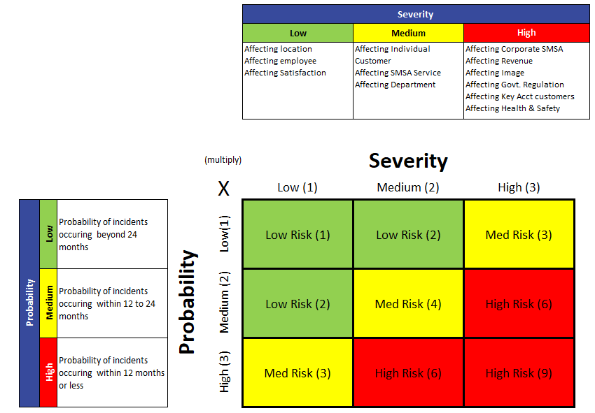
Clause 6.1.1 & 6.1.2 Risk & Opportunity Assessment
GUIDE doc. no. 2801 - Risk Ranking Criteria
“Copyrights: All rights are reserved, no part of this presentation can be reproduced or copied by any means except with written permission from SMSA“

Slide 31


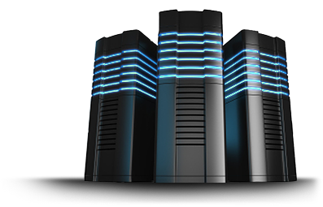
Clause 6.1.3 Information Security Risk Treatment
Focus on employees who are a critical part of the information security equation.
Pre-employment screening, Contracts/ NDA, remote working
Staff awareness and training
Reporting incidents, DVD.
Focus on basic business technology
Malware protection, network security and segregation
Backups, Logging and monitoring, capacity management, web filtering
Development and coding practices, testing.
Annex A within the ISO 27001 standard outlines four primary control themes aimed at mitigating risks and conducting risk treatment, encompassing a total of 93 subcategorized controls across these four themes. ISO 27002 provides guidance on implementing these controls.
Organizational
Controls
(37)
Physical Control
(14)
Focus on the policies, procedures, responsibilities and other organisational-level measures
management and the people responsible for operating the ISMS day to day, Audits
Threat intelligence monitoring & business continuity
Identity, asset and access control
Focus on the physical environment of the ISMS
Clear desks and screens
Secure cabling
Equipment maintenance
People Control
(8)
Technological
Controls
(34)
It is not mandatory to implement all 93 controls listed under Annex A. We select the controls that apply to SMSA based on the risks identified
Notes:
SOA next.

Slide 32




Clause 6.1.3 Information Security Risk Treatment
Statement of Applicability (SoA) in ISO 27001 is one of the most important documents. It lists all Annex A controls applicable to SMSA. This is required to be maintained as documented information (GUIDE doc.no.3559)
Has justifications for the inclusion or exclusion of controls and their implementation status
The SoA will be a key focus during certification and surveillance audits, accessible to all via GUIDE. Review is done at regular intervals
ISO 27001 Standard
Annex A
ISO 27002 Standard
“Copyrights: All rights are reserved, no part of this presentation can be reproduced or copied by any means except with written permission from SMSA“

Slide 33

What is Annex A?
A list of control objectives and guidelines to help protect SMSA’s data. Controls are chosen based on risks and business needs. Annex A provides guidelines, not strict rules.
Management's Role: Management selects and approves controls, ensuring enough budget and resources for implementation and maintenance.
Risk Assessment: We assess risks, then pick Annex A controls to avoid, mitigate, or accept those risks.
Implementation: To understand these guidelines, we refer to ISO 27002 for detailed control implementation. All steps are documented in the ISMS SOA.
Staff Awareness: Everyone must know relevant controls and how they affect their role. Clear communication is key.
Example: Risk “Data Protection” in SMSA
SMSA uses encryption to protect customer data and access controls to limit who can see sensitive information.
“Copyrights: All rights are reserved, no part of this presentation can be reproduced or copied by any means except with written permission from SMSA“

Slide 34
Screen Shot of Statement of Applicability (SoA)
(GUIDE doc.no.3559)
“Copyrights: All rights are reserved, no part of this presentation can be reproduced or copied by any means except with written permission from SMSA.“

Slide 35
Clause 6.2 ISMS Objectives & Planning
ISMS objectives/ KPI’s are goals used to improve the quality and effectiveness of SMSA’s ISMS. They play a crucial role in devising strategies to fulfil ISMS requirements and meet customer satisfaction.
(SMART)
Consistent with Information Security Policy
Available as
documented Information
Measurable
Establish at : Levels + Functions + Processes
Monitored
Take into account applicable processes, risk treatment results and regulatory requirements
Updated regularly
“Copyrights: All rights are reserved, no part of this presentation can be reproduced or copied by any means except with written permission from SMSA“

Slide 36

Clause 7.1 Resources
Adequate People (Manpower Formulae Doc# 2764)
Adequate Space
Ticket can be open by sending email to
IT-helpdesk@smsaexpress.com
Required Equipment
Properly maintained locations
Maintenance

Slide 37

Clause 7.2 & 7.3 Competence & Awareness
Training Calendar (Internal courses)
Basic, Intermediate & Advanced courses
External Courses
Coaching front line staff
Competency job description
Measurement of KPIs
Appraisals
Knowledge Assessment
ISO 27001 Awareness Course available to all via SMSA E-learning
“Copyrights: All rights are reserved, no part of this presentation can be reproduced or copied by any means except with written permission from SMSA“

Slide 38

Clause 7.4 Communication
Internal & External Communications
  Message Centre
  Newsletter
  SMSA Website
  SMSA Video on TV screens
  GUIDE changes communicated through Champions
  Regional Meeting & Department Meetings
Documented in Minutes of Meeting, with RACI
All meetings documented in the minutes of meetings using RACI
GUIDE doc. nos.
2727 – Gaps Template
2790 – Project Plan Template
2771 – Minutes of Meeting Template
“Copyrights: All rights are reserved, no part of this presentation can be reproduced or copied by any means except with written permission from SMSA“

Slide 39


Clause 7.5 Documented Information
Clause 7.5.1 & 7.5.2
Annual Review of all documents & processes
Regular Password change
Control of Documents
Observe confidentiality
All documents must be on GUIDE
Must always use forms from GUIDE,
and not to be saved on desktops
Version controlled
Approved by Department Head
Acknowledged by the End-user
GUIDE doc. nos.
2604 – Control of Documents
2601 – Confidentiality Policy
2733 – GUIDE System Access Rights
3516 – Access Control Policy
“Copyrights: All rights are reserved, no part of this presentation can be reproduced or copied by any means except with written permission from SMSA“

Slide 40

Clause 7.5 Documented Information
Clause 7.5.3
All CONFIDENTIAL documents
must be kept in locked cabinets
 |  | QRM
 |  | CR
 |  | File Number:
 |  | 007
 |  | File Name:
 |  | ENVIRONMENTAL HEALTH & SAFETY
 |  | Filing Sequence:
 |  | NUMERIC
 |  | File Type:
 |  | CONFIDENTIAL
 |  | Responsible Person:
 |  | QRM
 |  | Retention Period:
 |  | INDEFINITE
 |  | Date To / Date From: (Optional)
Control of Records
Labeling
Storage / Archiving
Retrieval
Retention
Disposal
Classification
Confidential
Restricted
Public
GUIDE doc. nos.
2604 – Control of Records
2690 – Box File Template
2721 – File Archive Register
“Copyrights: All rights are reserved, no part of this presentation can be reproduced or copied by any means except with written permission from SMSA“

Slide 41


Clause 8 Operation
Clause 8.1, 8.2 & 8.3
Implement documented processes and controls and maintain evidence e.g. Forms, system logs etc.
Manage changes in planned manner - identify any effects the change may have on the systems. Actions in place to help lessen any impacts.
(IT Change Request Form Doc#5650)
Perform the risk assessment (Defined in 6.1.2)
Implement the risk treatment plan (Defined in 6.1.3)
List of ISMS procedures and forms – GUIDE Doc# 3553
“Copyrights: All rights are reserved, no part of this presentation can be reproduced or copied by any means except with written permission from SMSA“

Slide 42
Clause 8.2 & 8.3 Risk Assessment & Treatment
Identify :Assets, systems, suppliers
  Asset based risk assessment method, supported by event based risk identification where required.
Assess: Threat + vulnerability
Risk Life Cycle ISMS
Review: Quarterly / changes / incidents
Analyse: Likelihood × impact
Approve: Acceptance authority
Treat: Avoid / reduce / transfer / accept
  Separate from corporate / enterprise IT risk. Developed using ISO/IEC 27005 and aligned to ISO 27001 Clause 6.1.2 and 6.1.3.
ISMS Risk Mngt Policy – GUIDE Doc# 6343
Reassess: Residual risk
“Copyrights: All rights are reserved, no part of this presentation can be reproduced or copied by any means except with written permission from SMSA“

Slide 43
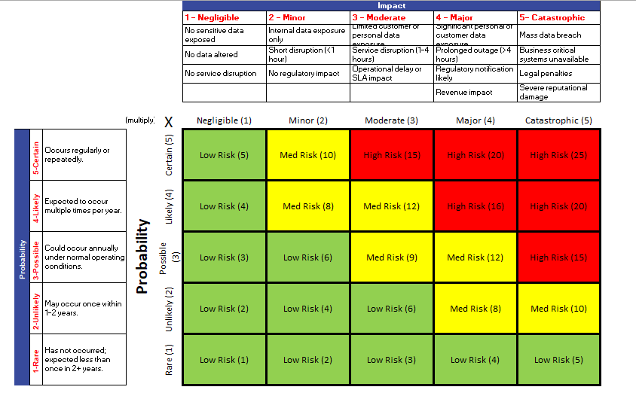
Clause 8.2 & 8.3 Risk Assessment & Treatment
GUIDE doc. no. 6344 – ISMS 5x5 Risk Ranking Criteria
“Copyrights: All rights are reserved, no part of this presentation can be reproduced or copied by any means except with written permission from SMSA“

Slide 44
Information Security Incident Management 27001:2022 Annex A 5.24 – 5.28
1
2
3
Report
Any approved channel
Assess
Event or incident
Log
Incident Register or IT ticket
4
5
6
Classify
Low / medium / high
Respond
Contain, recover, evidence
GUIDE doc. no. 3528 – ISMS Incident Management
Close
Root cause, CAPA, approval
Information Security Event
Information Security Incident
An observable activity, alert or report that may indicate a security issue and requires assessment, but is not yet confirmed.
A confirmed event that compromises, or has high risk of compromising, confidentiality, integrity or availability and requires formal response.

Slide 45
Information Security Incident Management 27001:2022 Annex A 5.24 – 5.28
Low
Medium
High
Suspicions or odd behavior. Not verified. No clear emergency response required.
Likely risk or exploitation not proven yet. Examples: unencrypted lost laptop, exploitable vulnerability, malware risk.
Active exploitation or serious impact. Examples: ransomware, active breach, compromised admin account, DDoS.
Normally within
3–5 working days
Normally within
2–3 working days
Immediate L3 escalation
24h closure where possible
Handling levels
L1 — Service Desk / IT Support
L2 — IT Security / System / Network teams
L3 — CTO / IT Managers / QRM / Legal
Receive report, log, classify and route.
Investigate, contain, recover, preserve evidence.
High severity, major decisions, governance and independence.

Slide 46

Clause 9.1 Monitoring, Measurement, Analysis & Evaluation
In SMSA, we monitor and measure information security processes and controls through various means
KPI (Key Performance Indicator)
SOA Assessment
Risk assessment and treatment plans
IT Service Level
IT Incidents (IT Ticketing System)
Customer Complaints
Customer Satisfaction Survey
Vendor Evaluations
Coaching
Employee Opinion Survey
Previous Audits
HR Figures
QRM maintains a database
to monitor and evaluate
the results
“Copyrights: All rights are reserved, no part of this presentation can be reproduced or copied by any means except with written permission from SMSA“
of this presentation can be reproduced or copied by any means except with written permission from SMSA“

Slide 47
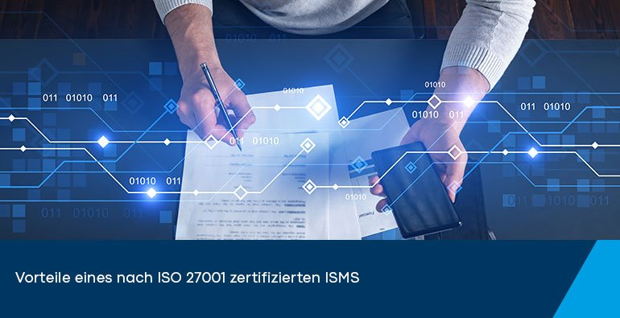
Clause 9.2 Internal Audit
Held as per annual plan – Checks include:
ITD processes & SLA’s
ITD risk & security controls
Documentation & system logs
Vendor management, evaluations & results
Evaluation of the collected evidence (KPI’s, records etc.)
Requirements of the standard
Scope of Applicability
Legal requirements assessment
Previous findings
Audit Checklist is available on GUIDE under Doc# 2744
“Copyrights: All rights are reserved, no part of this presentation can be reproduced or copied by any means except with written permission from SMSA“

Slide 48
Clause 9.3 Management Review
Held every last Thursday of the month
Attended by Senior Management Team with MD
Actions points updated regularly
“Copyrights: All rights are reserved, no part of this presentation can be reproduced or copied by any means except with written permission from SMSA“
“Copyrights: All rights are reserved, no part of this presentation can be reproduced or copied by any means except with written permission from SMSA“

Slide 49

Clause 10 Improvement
Clause 10.1 & 10.2
Non Conformity is issued when non compliance is observed against regulatory requirements, ISO standards & SMSA policies and procedures
NC issued via QRM- CAPA system
(nc.smsaexpress.com)
CA- Action taken to eliminate the causes of non-conformities or other undesirable situations.
PA- Action taken to prevent further reoccurrence of such non-conformities.
Once NC is issued the following applies:
Department has to fill the Corrective and Preventive action on the CAPA System within 7 business days
Department has 30 days to resolve the NC
Auditor will verify the CAPA and either close the NC or keep the NC open
The auditor wants to see continual improvement. Department should learn from previous audit findings, gaps, and measurements evaluation analysis
“Copyrights: All rights are reserved, no part of this presentation can be reproduced or copied by any means except with written permission from SMSA“
“Copyrights: All rights are reserved, no part of this presentation can be reproduced or copied by any means except with written permission from SMSA“

Slide 50


Definitions
PII – Personal Identifiable Information:
PII is any information that can identify a person.
Examples: names, phone numbers, and ID numbers.
Protecting PII prevents identity theft and legal issues.
Information Security Management System (ISMS):
A system to protect company data from loss, theft, or unauthorized access.
Example: As part of 27001, SMSA controls who can access sensitive information.
It builds trust, prevents breaches, and ensures legal compliance.
Asset:
An asset is anything valuable to the company, like data, equipment, or people.
Examples: customer data, servers, employee skills etc.
Protecting assets ensures smooth operations and reduces risks.
Encryption:
Is the process of scrambling data so only authorized people can read it.
Example: SMSA encrypts customer data during online transactions.
It protects sensitive information and prevents data breaches.
“Copyrights: All rights are reserved, no part of this presentation can be reproduced or copied by any means except with written permission from SMSA.“

Slide 51
Definitions
Information Security Event:
Is any occurrence that might affect the security of company data.
Example: A failed login attempt or unusual network activity.
Monitoring these events helps prevent security breaches and protect data.
Risk treatment:
Is the process of managing risks to reduce their impact.
Example: SMSA installs firewalls to protect against cyberattacks.
It helps minimize potential damage and ensure business continuity.
Vulnerability:
Is a weakness in a system that can be exploited.
Example: An outdated software that hackers can use to access SMSA’s data.
Fixing vulnerabilities helps prevent security breaches and protects company assets.
Attack:
Is a deliberate attempt to damage or steal company data. Example: A hacker trying to break into SMSA's systems.
Attacks can lead to data breaches, so they must be detected and stopped quickly.
“Copyrights: All rights are reserved, no part of this presentation can be reproduced or copied by any means except with written permission from SMSA.“

Slide 52
Definitions
Threat:
Is anything that could harm company data or systems.
Example: A virus or hacker targeting SMSA’s network.
Identifying threats helps protect against potential security breaches.
Control:
Is a measure taken to reduce or eliminate risks.
Example: SMSA uses two-factor authentication to secure access to systems.
Controls help protect data and prevent security breaches.
Information security incident:
Is an event that compromises the security of data.
Example: A data breach where unauthorized users access SMSA's customer information.
Handling incidents quickly helps minimize damage and protect company assets.
Risk:
Is the chance that a threat will exploit a vulnerability and cause harm. Example: The risk of a hacker accessing SMSA’s data through weak passwords.
Managing risks helps prevent security breaches and protect assets.
“Copyrights: All rights are reserved, no part of this presentation can be reproduced or copied by any means except with written permission from SMSA.“

Slide 53

ISMS Requirements
Security
Policies
Human
Resource
Security
Organization of
Information
Security
Information
Security Incident
Management
Asset
Management
Maintain &
Improve
Security &
Policy
Objectives
Information
Security
Aspects Of BCM
Access
Management
Management
Responsibility
Competence
Awareness Trng.
ISMS
System
Acquisition,
Development &
Maintenance
Monitor&
Review
ISMS
Requirement
Documentation
Risk
Assessment
& Controls
Communication
Security
Interested
Parties
Interested
Parties
Implement
Risk
Treatment
Plan
Physical &
Environmental
Security
Compliance
360° Overview
Supplier
Relationship
Operations
Security
Cryptography
“Copyrights: All rights are reserved, no part of this presentation can be reproduced or copied by any means except with written permission from SMSA“
“Copyrights: All rights are reserved, no part of this presentation can be reproduced or copied by any means except with written permission from SMSA“

Slide 54
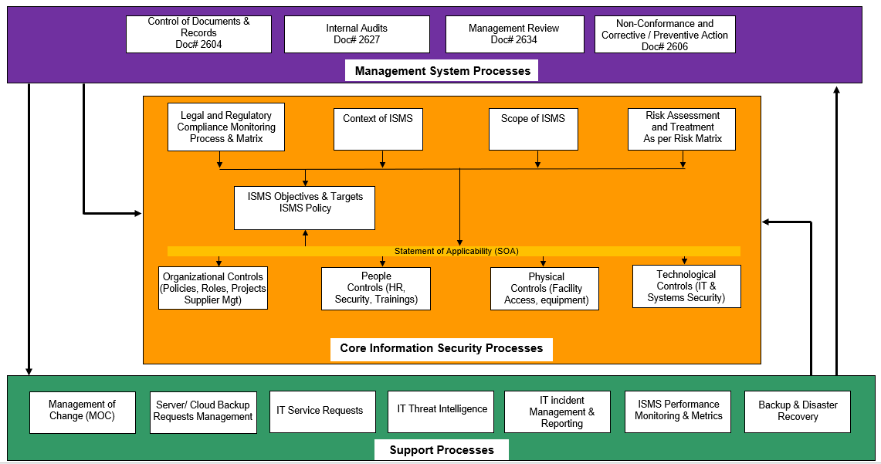
ISMS Process Interactions

Slide 55
ISMS Requirements
These policies and procedures, when implemented together with the ones mentioned in above slides, form a strong and unified information security management system in SMSA
1. Organization of Information Security: Defines roles and responsibilities to protect company data.
2. Human Resource Security: Ensures employees are trained and screened for security risks.
3. Asset Management: Keeps track of company assets (data, devices) to ensure they are protected.
4. Access Control: Limits who can access sensitive information and systems.
5. Physical and Environmental Security: Protects buildings and hardware from unauthorized access or damage.
6. Operations Security: Ensures SMSA’s operations are secure through processes and monitoring.
7. Communications Security: Protects data while it is being transmitted (emails, messages).
8. System Acquisition, Development & Maintenance: Ensures new systems are built and maintained with security in mind.
9. Supplier Relationships: Makes sure third-party suppliers follow SMSA’s security standards.
10. Information Security Incident Management: Procedures for dealing with security incidents (like data breaches).
11. Business Continuity: Plans to keep SMSA running smoothly during disruptions or attacks.
12. Compliance: Ensures we follow all laws and regulations related to information security.
13. IT Data Masking Policy: Hides sensitive data so it can’t be easily accessed or misused.
14. Vulnerability & Patch Management Policy: Identifies system weaknesses and applies patches to fix them.
15. Threat Intelligence: Keeps track of security threats to stay ahead of potential attacks.
16. Use of Cloud Service: Ensures cloud services used by SMSA follow secure practices.
17. Configuration Management: Controls changes to IT systems to ensure security and reliability.
“Copyrights: All rights are reserved, no part of this presentation can be reproduced or copied by any means except with written permission from SMSA.“

Slide 56

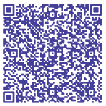

Thank You
Address:
Sulaymaniyah, Prince Abdulaziz Ibn Masa'ad Ibn Jalawi St, Dhabab, Riyadh.
Contact Number:
+966 56 731 2568
+966 11 463 3999 EXT:8906
Email Address:
maltamush@smsaexpress.com

